Slide 1
Limits of Modularity and Optimized Greedy Algorithms
Network Science section 9.4.3 and Asymptotic resolution bounds of generalized modularity
and multi-scale community detection
Stephen Trempel

Slide 2
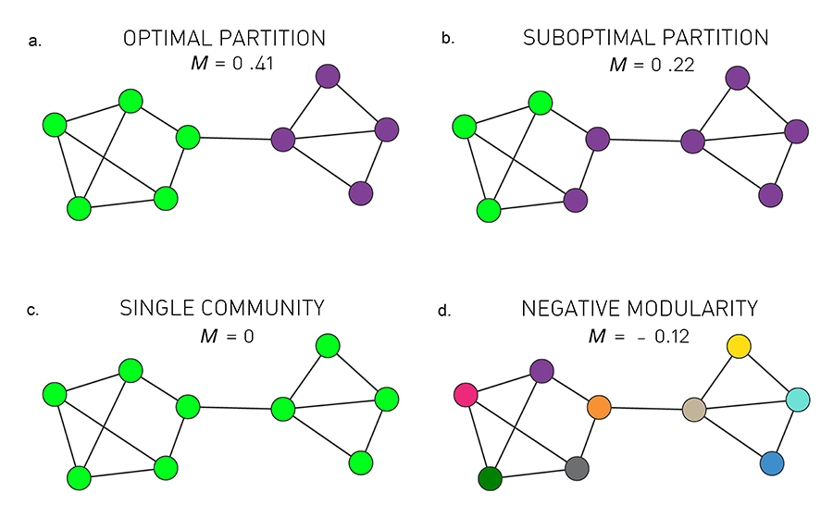
Community Detection
Create partitions that best represent the community structure
Unknown number of partitions
No mathematical definition
[1]

Slide 3
Modularity
Measures a set of partitions
Higher modularity implies better set of partitions
[1]

Slide 4

Modularity
L_{c}: Number of links
k_{c}: Sum of degrees
Range: [-½ to 1]
Brute force infeasible
[1,2]

Slide 5
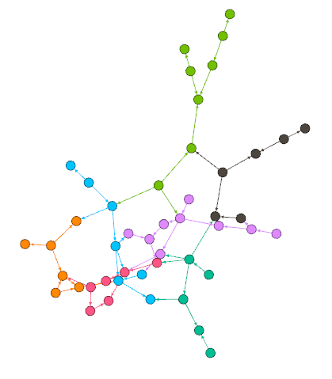
Greedy Algorithm
Initialize with N communities
Until # communities == 1
Combine clusters for maximum modularity
Store best so far
Return best
Efficient: O[(L + N)N]
Resolution Limit!
  Large communities split
  Small communities merged
[1]

Slide 6
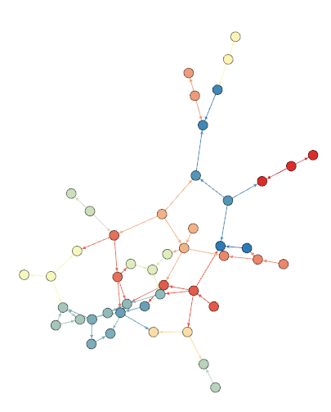

Resolution Parameter
Big 𝛾
𝛾
Big 𝛾 → small communities
Small 𝛾 → big communities
Small 𝛾
W_{rs}: Inter community density
W_{tt}: Density of t
[3]

Slide 7

Plateau Problem
We want this →
But what if →
[3]

Slide 8
Plateau Problem
Min W_{tt}
Max W_{rs}
[3]

Slide 9
Plateau Problem
Max W_{rs}
Min W_{tt}
[3]

Slide 10


Multi-scale Community Detection Algorithm
Initialize with N communities
Run greedy with small 𝛾
Repeat with larger 𝛾 for each community
Stop when a “good” community is found
When to stop?
[3]
Notes:
* H0 is a random graph with 1 partition *
* H1 found by maxing generalized modularity *

Slide 11
Multi-scale Community Detection Algorithm
Max W_{rs}
Min W_{tt}
[3]

Slide 12
Multi-scale Community Detection Algorithm
𝛾
[3]

Slide 13
Multi-scale Community Detection Algorithm
𝛾
[3]

Slide 14
Multi-scale Community Detection Algorithm
𝛾
[3]

Slide 15
Multi-scale Community Detection Algorithm
[3]

Slide 16
Questions?

Slide 17
Sources
[1] Barabási, A. (2015), Network Science, Cambridge University Press
[2] Wikipedia. Modularity (networks). https://en.wikipedia.org/wiki/Modularity_(networks)
[3] Xiaoyan Lu, Brendan Cross, Boleslaw K. Szymanski. Asymptotic resolution bounds of generalized modularity and multi-scale community detection. https://arxiv.org/pdf/1902.04243.pdf

