Slide 1
Giant Component and 3.D
Component Sizes
Felix(Zonghong) Yu, CSE&ISYE 2022
11/29/2021

Slide 2
Overview
Definition for Giant Component
Introduce Topics and Questions
Analysis and Solutions for Giant Component
Definition for Giant Component for 3D Component Sizes
Analysis and Solutions for 3D Component Sizes
Relevant Concepts
Conclusion
References

Slide 3
Giant component
Proposed by Solomonoff and Rapoport and by Erdős and Rényi, for the emergence of giant component at 〈k〉= 1
A connected component of a given random graph that contains a finite fraction of the entire graph's vertices
Prominent feature of the Erdős–Rényi model (ER) of random graphs
Be utilized in interdependent networks

Slide 4
Problems
How many components do we expect for a given size?
What is their size distribution?

Slide 5
Analysis and Solution
Let us denote with u = 1 - NG/N
  The fraction of nodes that are not in the giant component, whose size we take to be NG.
  If node i is part of the GC, it must link to another node j, which must also be part of the GC.
  If i is not part of the GC:
    There is no link between i and j (probability for this is 1- p).
    There is a link between i and j, but j is not part of the GC (probability for this is pu).
Therefore, the total probability that i is not part of the GC via node j is 1 - p + pu.
As there are other N-1 nodes, u = (1-p+pu)^(N-1)

Slide 6
Analysis and Solution
By using this: u = (1-p+pu)^(N-1) and taking the logarithm of both sides, we obtain:
Taking an exponential of both sides leads to u = exp[- 〈k〉(1 - u)]. If we denote with S the fraction of nodes in the giant component
  S = 1 – e^(-kS)
This equation provides the size of the giant component S in function of k.

Slide 7
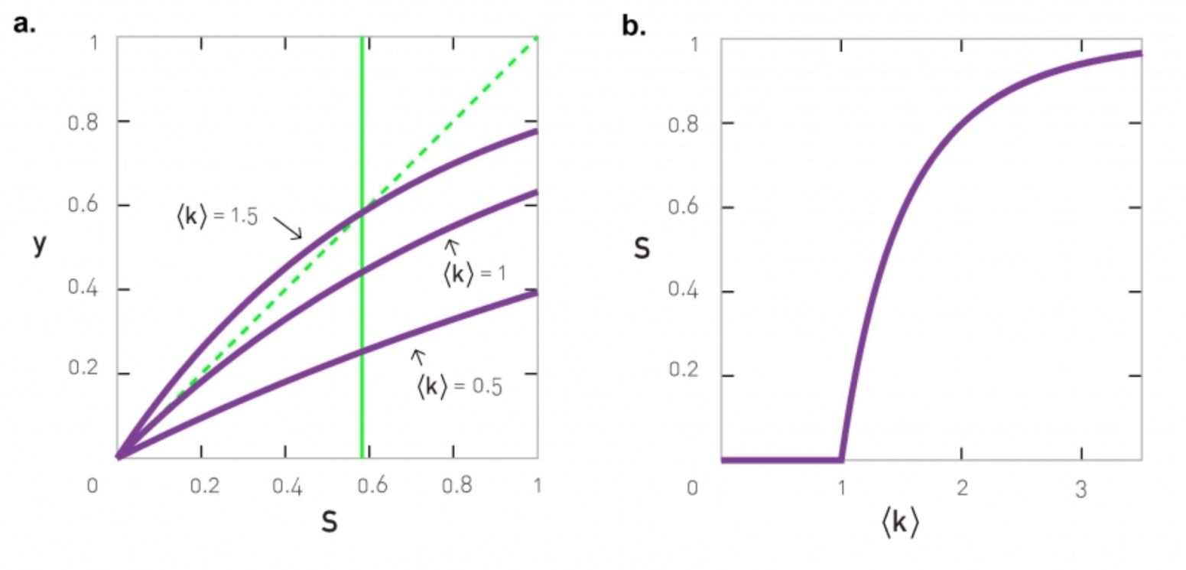
S = 1 – e^(-kS)
It does not have a closed solution
To have a nonzero solution, the obtained curve must intersect with the dotted diagonal
For small 〈k〉 the two curves intersect each other only at S = 0
To determine the value of 〈k〉, take a derivative of S = 1 – e^(-kS)
  dS/dS = d(1 – e^(-kS))/dS
  => 1 = ke^(-kS)
  Set S = 0, we would get k = 1
Therefore, we obtain that the phase transition point is at k = 1

Slide 8

3.D Component sizes
Component Size Distribution
  By calculating the probability that a randomly chosen node belongs to a component of size s in a random network
  Getting two contributions: a slowly decreasing power law term and a rapidly decreasing exponential term
Average Component Size
  Follows the equation
  Diverges when the average degree approaches the critical point

Slide 9
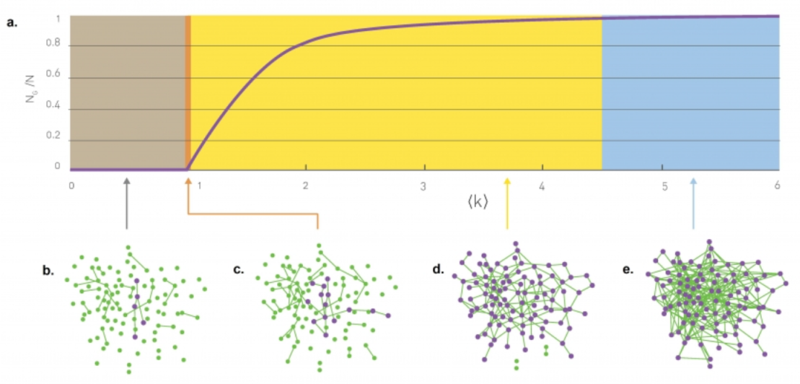

3.D Component sizes
For a random network, the probability that a randomly chosen node belongs to a component of size s
By replacing k^S – 1 with exp[(S-1)In<k>] and using Stirling-formula: s! = squareroot(2πs)(s/e)^s
  Get Ps = s^(-3/2) * e^-{(k-1)s+(s-1)In(k)}
  Two contributions:
    Slowly decreasing power law term s^(-3/2)
    Rapidyl decreasing exponential term -
    e^-{(k-1)s+(s-1)In(k)}
  When at the critical point k =1, no exponential term:
    Ps = s^(-3/2)

Slide 10
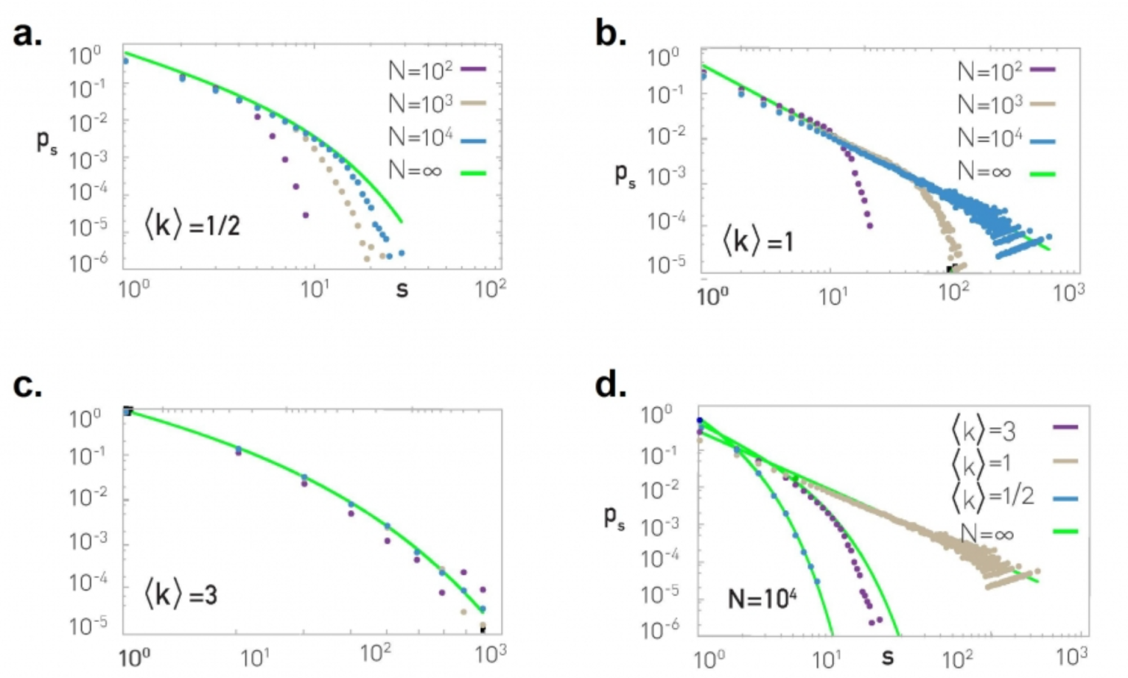
Slowly decreasing power law term s^(-3/2) with different k

Slide 11
Component Size Distribution
Denote as Ps in a random network
  Through the graphs, Ps converges for large N to the prediction
  When N = 10^4, Ps has an exponential form for k != 1
  When at critical point k = 1, follows power law:
    Ps = s^(-3/2)
  The green lines are Ps = s^(-3/2) * e^-{(k-1)s+(s-1)In(k)}

Slide 12

Average Component Size
The equation for average component size excluding the GC:
  When k < 1, we lack GC, meaning NG = 0:
    S = 1/(1-k), diverges when average degree approaches k = 1
    Size of the clusters increases when approaching the critical point
To determine the average component size for k > 1
  Calculate the size of GC
  Predicts the size of component to which a randomly node belongs
    S’ = 2/(2-k+kNg/G)

Slide 13
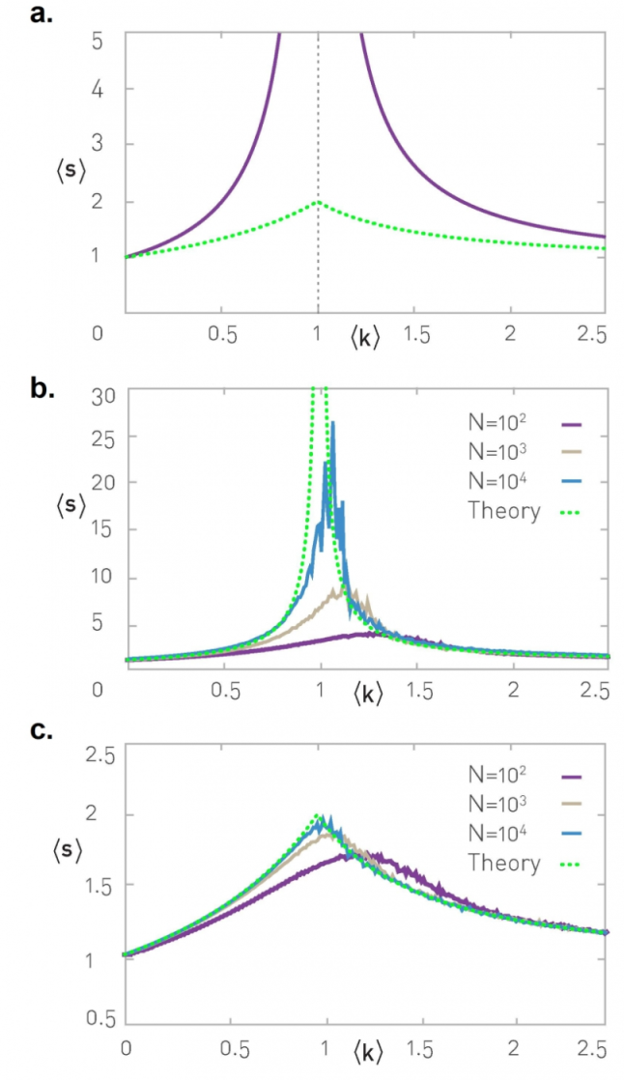
S’ = 2/(2-k+kNg/G)
The average size s of a component is the purple line
Green curve shows the overall average size as the equation
The larger N becomes, the more closely the numerical data follows the equation
The measure is biased as each component of size s will be counted s times
Diverges at the critical point for s.

Slide 14
Relevant Topics in Research
Reinforced nodes
  Extra sources that can support the finite components in which they belong.
Graphs with arbitrary degree distributions
Criteria for giant component existence in directed and undirected configuration graphs
Percolation theory
  Describes the behavior of a network when nodes or links are added
Scale free networks

Slide 15
Graphs with arbitrary degree distributions
Recent work on the structure of social networks and the internet has focused attention on graphs with distributions of vertex degree
  Significantly different from the Poisson degree distributions
  Develop in detail the theory of random graphs with arbitrary degree distributions.
  Simple undirected, unipartite graphs, and the properties of directed and bipartite graphs.
  Derive exact expressions for the position of the phase transition at which a giant component first forms, the mean component size, the size of the giant component
Apply the theory to some real-world graphs, including the world-wide web and collaboration graphs of scientists
  Demonstrating that in some cases random graphs with appropriate distributions of vertex degree predict with surprising accuracy the behavior of the real world, while in others there is a measurable discrepancy between theory and reality.

Slide 16
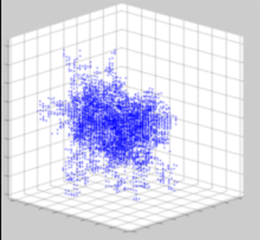
Percolation theory
The simplest not exactly solved model displaying a phase transition.
The percolation threshold is the concentration (occupation probability) p at which an infinite cluster appears for the first time in an infinite lattice
Two events A1 and A2 are independent ⇔ P(A1 ∩ A2) = P(A1)P(A2).
A cluster is a group of nearest neighboring occupied sites.

Slide 17
Current Research Conclusion
Network science is adopted to solve practical and research challenges related to understanding the nature of online interactive platforms
The largest connected component, so-called a giant component (GC), to better understand how the representative network has established.
  Apply dynamic network analysis to investigate how the GC has evolved over time
  Identify a particular pattern towards emerging a GC
Dynamic complex networks also involve of utilizing GC and 3D component sizes
  Recent research proves that power grids have the characteristics of complex networks, such as “small-world” and “scale-free.”

Slide 18
Reference
Barabási Albert-László and Pósfai Márton, Network science. Cambridge, United Kingdom: Cambridge University Press, 2017.
En.wikipedia.org. 2021. Giant component - Wikipedia. [online] Available at: <https://en.wikipedia.org/wiki/Giant_component#Reinforced_nodes> [Accessed 31 October 2021].
Xisong Dong, ... Jiachen Hou, in Service Science, “Management, and Engineering”, 2012
Rinaldi SM, Peerenboom JP, Kelly TK (2001) Identifying, understanding, and analyzing critical infrastructure interdependencies. IEEE Control Syst Mag N Y 21(6):11–25
Little RG (2002) Controlling cascading failure: Understanding the vulnerabilities of interconnected infrastructures. J Urban Tech 9(1):109–123.
Bashan A, Bartsch RP, Kantelhardt JW, Havlin S, Ivanov PCh (2012) Network physiology reveals relations between network topology and physiological function. Nat Commun 3:702.
Gao J, Buldyrev SV, Stanley HE, Havlin S (2012) Networks formed from interdependent networks. Nat Phys 8(1):40–48.
Onnela J-P, et al. (2007) Structure and tie strengths in mobile communication networks. Proc Natl Acad Sci USA 104(18):7332–7336.
Coniglio A (1982) Cluster structure near the percolation threshold. J Phys A Math Gen 15(12):3829–3844.
Cohen R, Erez K, Ben-Avraham D, Havlin S (2000) Resilience of the internet to random breakdowns. Phys Rev Lett 85(21):4626–4628.
Bollobás B (2001) Random Graphs: 1985 (Academic, London).
Albert R, Barabási A-L (2002) Statistical mechanics of complex networks. Rev Mod Phys 74(1):47–97.
Gao J, et al. (2011) Robustness of a network of networks. Phys Rev Lett 107(19):195701.

Slide 19
Thank you!

