Slide 1

Transferable Learning of Continuous Tie Strengths from Behavior
James Flamino

Slide 2
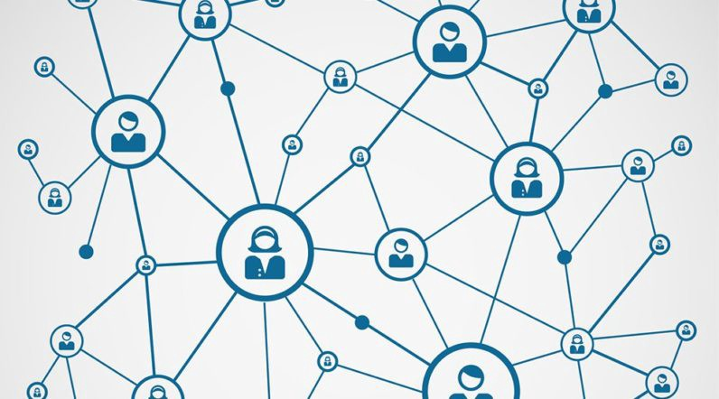
What is a tie strength?
Tie strength is a quantification of a “relationship” in a social network
  High value = close relationship (e.g. significant other)
  Low value = distant relationship (e.g. acquaintance)
Tie strength can be represented in several ways
  Discrete range
  Symbolic
  Continuous

Slide 3
Understanding tie strength
Interaction Frequency
Affection
Time Invested
Time (Enduring History)
Intimacy
Emotional Intensity
Reciprocal Services
Overlap of Friend Networks
Shared Attributes
Notes:
Expand on the fact that tie strength description is nebulous, and telecommunication data is often not used, but we found a way that it can be very useful in understanding relationships consistently.

Slide 4


Predicting tie strength
Frequency of communication
Duration of history
Overlap of friend groups
$$Σ$$
Tie Strength
$$ML$$
Number of mutual pictures liked
Co-occurrence of keywords
Frequency of comments on pics
Co-occurrence of status updates
Notes:
Where tie strength is usually either a binary “close” or “not close”, or a sliding range of closeness as asked by a survey

Slide 5
Shortcomings and solutions
Shortcomings:
  Previous works focus on single snapshots of time
  Previous works depend on ad hoc and platform-specific attributes to predict tie strength
Solutions:
  Design a pipeline that can predict tie strength continuously
  Have that pipeline only depend on general attributes and input
Number of mutual pictures liked
Co-occurrence of keywords
Frequency of comments on pics
Co-occurrence of status updates

Slide 6


The data
NetSense/NetHealth
NetSense
  Study on Notre Dame college students
  Fall 2011 to Spring 2013
  196 participants
  Continuous communication records (call and text)
  Surveys at the beginning of every semester
NetHealth
  Study on Notre Dame college students
  Fall 2015 to Spring 2019
  594 participants
  Continuous communication records (call and text)
  Surveys at the beginning of every semester

Slide 7





Calculating tie strength
User: 30072
Survey
We calculate tie strength using the NetSense and NetHealth ego network surveys
Surveys ask participants (egos) to list up to 20 individuals (listed alters) with whom they communicate
Surveys then ask for information on each listed alter relating to:
  Closeness
  Relationship type
  Duration of history
  Etc…
1)
2)
3)
.
.
.
20)
Note: anyone with whom an ego has communicated with over the course of the data is considered an alter. Any alter that is specifically listed in an ego network survey is considered a listed alter
Time
Notes:
NetSense and NetHealth both provide demographic and ego network surveys at the beginning of each semester

Slide 8
Calculating tie strength
Initially, survey orderings are arbitrary
Using seminal works, we weight and sort listed alters for each ego network survey
This is done using a pairwise, comparative tournament
  Listed alters with higher values of closeness, duration, frequency of communication, and similarity are sorted near the top
No assumptions are made about attribute weighting, no attributes are platform-specific
We use these weighted surveys as the ground truth
Survey
Survey
1)
2)
3)
.
.
.
20)
1)
2)
3)
.
.
.
20)
Weighted

Slide 9
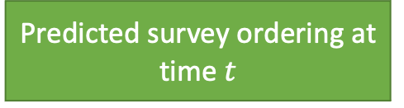
Calculating tie strength
Call Detail Record
Timestamp, target, source, type
100, A, B, 0
101, B, A, 1
102, C, A, 0
…
Given weighted surveys at extended intervals, train a model to reconstruct the ground truth surveys using only arbitrary communication data (calls and text, CDR format)
This model will generate a score between each ego and alter
When ordered by magnitude, these scores mark the ranking of the alter in the ego’s weighted survey
Therefore, this score is the alter’s predicted tie strength to the ego
The higher the tie strength, the closer the ego and alter
Feed input
Model
Generate scores
Predicted survey ordering at time $t$
Notes:
CDR = Call Detail Record

Slide 10
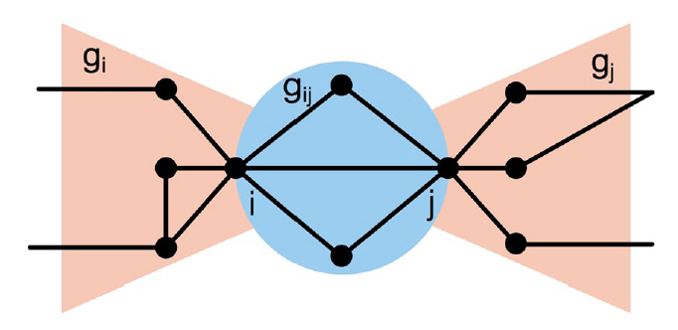
Predictive models
We introduce three classes of models responsible for predicting tie strengths provided CDR data:
  Baseline
  Time series
  Machine learning
The baseline class includes models built around single attributes that have been found, in past works, to be indicative of tie strengths:
  Bow Tie overlap
  Duration
  Recency
  Frequency
  Volume
Additionally, a random baseline model is added to establish the lower bounds of prediction
Figure ref: H. Mattie, K. Engø-Monsen, R. Ling, and J.P. Onnela, “Understanding tie strength in social networks using a local bow tie framework," Sci. Rep., vol. 8, no. 1, pp. 1-9, Jun. 2018.
Notes:
All these models simply use the aggregate score of their single attribute for each ego-alter dyad to represent their tie strength. We then order this score for each alter for a given ego to assemble the predicted survey for that ego.

Slide 11
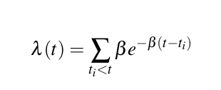
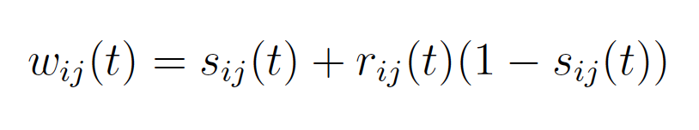
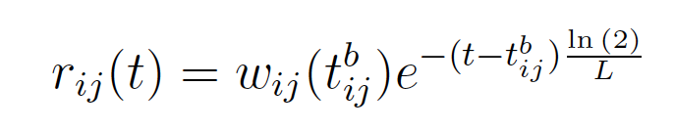
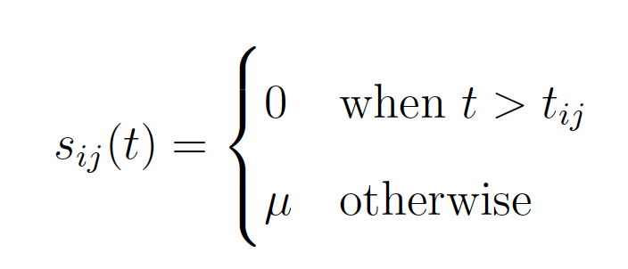
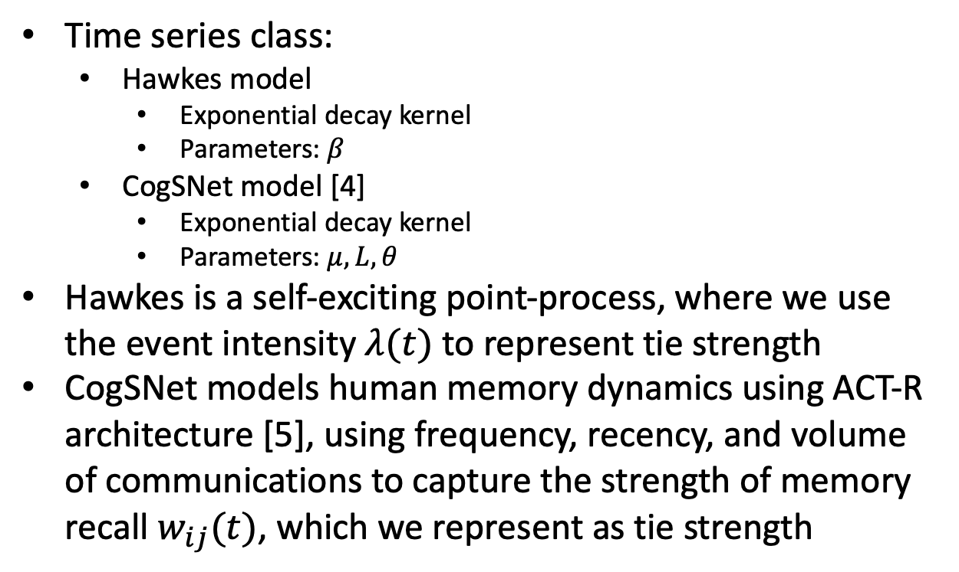
Time series class
Time series class:
  Hawkes model
    Exponential decay kernel
    Parameters: $β$
  CogSNet model [4]
    Exponential decay kernel
    Parameters: $μ, L, θ$
Hawkes is a self-exciting point-process, where we use the event intensity $λ(t)$ to represent tie strength
CogSNet models human memory dynamics using ACT-R architecture [5], using frequency, recency, and volume of communications to capture the strength of memory recall $w_{ij}(t)$, which we represent as tie strength
[4] R. Michalski, B. K. Szymanski, P. Kazienko, C. Lebiere, O. Lizardo, and M. Kulisiewicz, “Social networks through the prism of cognition,” Complexity, vol. 2021, Jan. 2021.
[5] J. R. Anderson, D. Bothell, C. Lebiere, and M. Matessa, “An integrated theory of list memory,” J. Mem. Lang., vol. 38, no. 4, pp. 341-380, May. 1998.
Notes:
Parameters are tuned using Optuna

Slide 12
Ego A’s Alters
Machine learning class
Ego A
Given an ego and their alters…
Machine learning models operate on a pairwise comparison methodology, iteratively comparing all pairs of alters using their respective communication histories with the ego (see figure)
Given a pair of histories, the ML model makes a simple binary decision: 1 if the former alter will be ranked higher in the weighted survey, or 0 if the latter will be
Since the ML models compare pairs of histories, we represent tie strength as the Borda score:
  For a win in a pair comparison, an alter is award +1 points
  For a draw, they are awarded 0 points
  For a loss, they are awarded -1 points
Assemble pairwise comparisons of alters
Compare histories inside ML model and predict winners
Purple wins!
Purple wins!
Yellow wins!
1)
2)
3)
Borda score: 2
Tally winners and order by Borda score magnitude for predicted survey
Borda score: 0
Borda score: -2

Slide 13
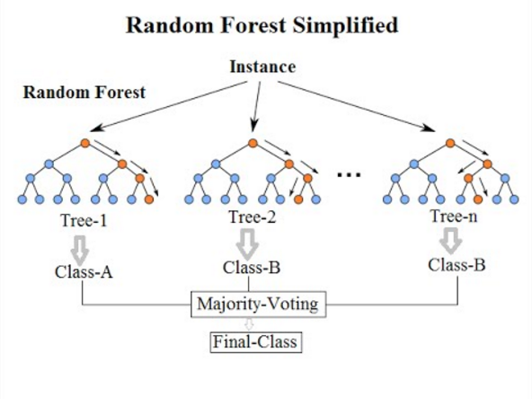
Machine learning class
4-Channel LSTM
Fully Connected
Fully Connected
Sigmoid
Model types:
  LSTM
    Input communication history pairs as stacked time series to determine which of the two individuals will be higher ranked
  Ensemble
    Same process, but using Random Forest model, integrating an ensemble of attributes that are extracted from the communication histories (instead of using entire time series)
    Attributes:
      Frequency
      Recency
      Duration
      Volume
Output: 1 dim
Figure ref: https://en.wikipedia.org/wiki/Random_forest

Slide 14
Validating predictive models
To compare our predictive models for a given dataset, we take all available egos and split them into a 3-fold validation process, where one fold contains egos used for testing, and the other two folds (combined) contain egos used for training
  To prevent models from training on future data (before the time of the current testing surveys), the test fold is staggered by one semester
  Once all test surveys have been predicted for a semester, both the training and testing egos are advanced by one semester
Upon completion of predicting all available testing surveys, the fold score is calculated using Ranked Bias Overlap (RBO)
  For every predicted test survey belong to a test ego, the RBO score is found, and the weighted average is then found of every RBO score, where the weight is determined by the size of the predicted surveys
  This weighted average is then averaged over all test egos to find the fold score

Slide 15
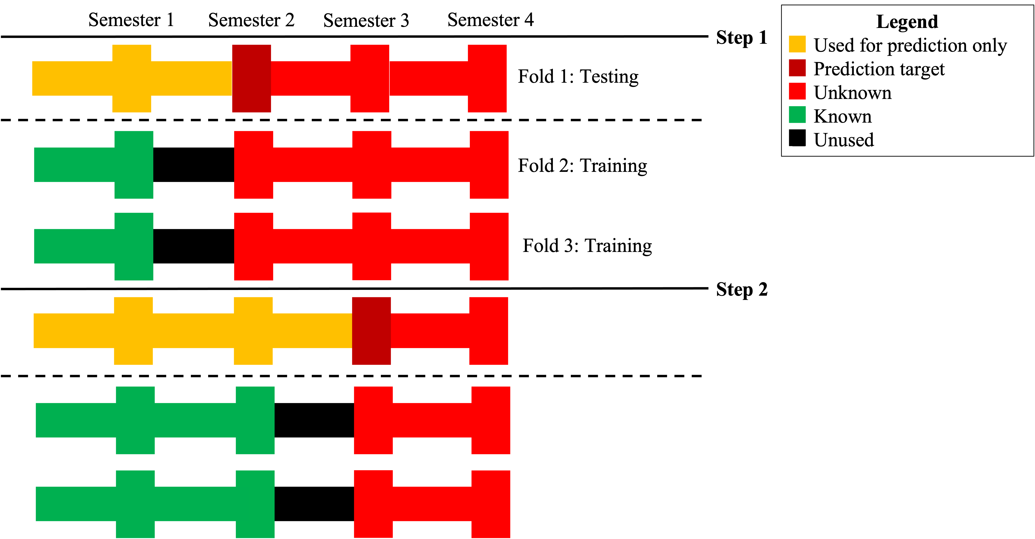
Validating predictive models

Slide 16
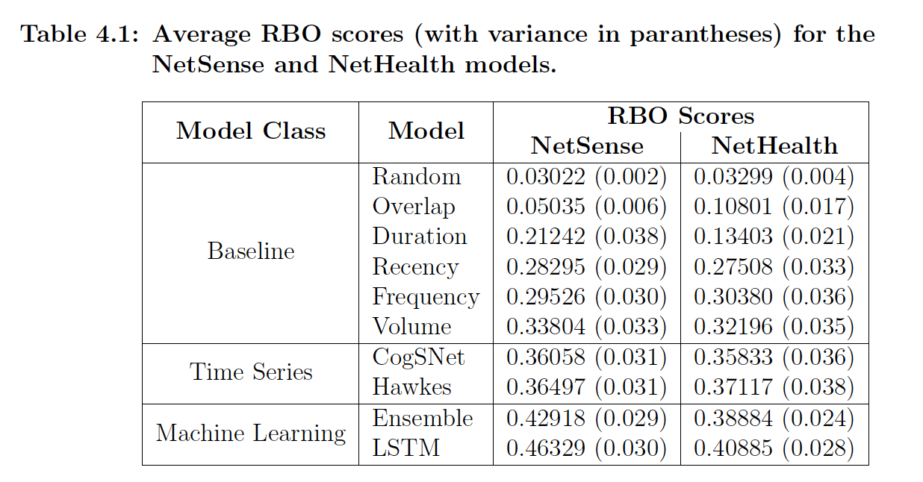
Results

Slide 17
Cross-domain predictions
How well can the time series class and ML class of models carry over behavior learned from one dataset to another?
We split all the NetHealth egos into three subsets to control for study size, then pair all NetSense egos with each subset
To test how well NetSense carries over to NetHealth, we train the models on the entirety of the NetSense dataset, then test these models once on each of the three NetHealth subsets
To test vice versa, we train the models once on one NetHealth subset then test on the entirety of the NetSense dataset, repeating this process for each subset
Since the two datasets are set in entirely different periods of time, we can simply perform 3-fold validation without any time staggering, averaging the final results across all three subset variations for both training-testing directions

Slide 18
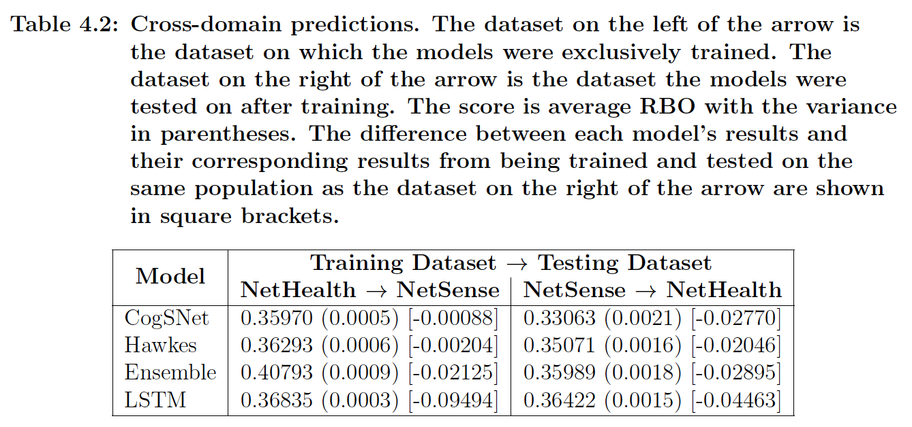
Cross-domain predictions
Notes:
While there is some loss of accuracy, these models are able to carry over predictions fairly well, still beating out the baseline models for the respective datasets. The Ensemble performs the best overall, indicating some power in the generalizability of its features implemented within a machine learning framework

Slide 19
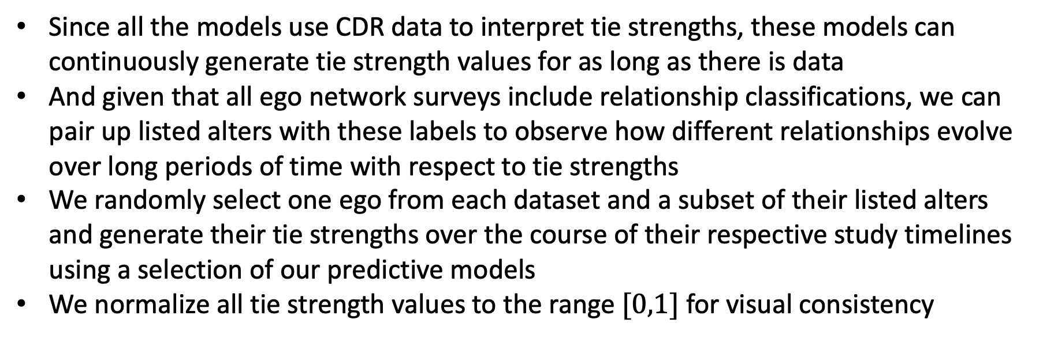
Analyzing continue tie strengths
Since all the models use CDR data to interpret tie strengths, these models can continuously generate tie strength values for as long as there is data
And given that all ego network surveys include relationship classifications, we can pair up listed alters with these labels to observe how different relationships evolve over long periods of time with respect to tie strengths
We randomly select one ego from each dataset and a subset of their listed alters and generate their tie strengths over the course of their respective study timelines using a selection of our predictive models
We normalize all tie strength values to the range $[0,1]$ for visual consistency

Slide 20
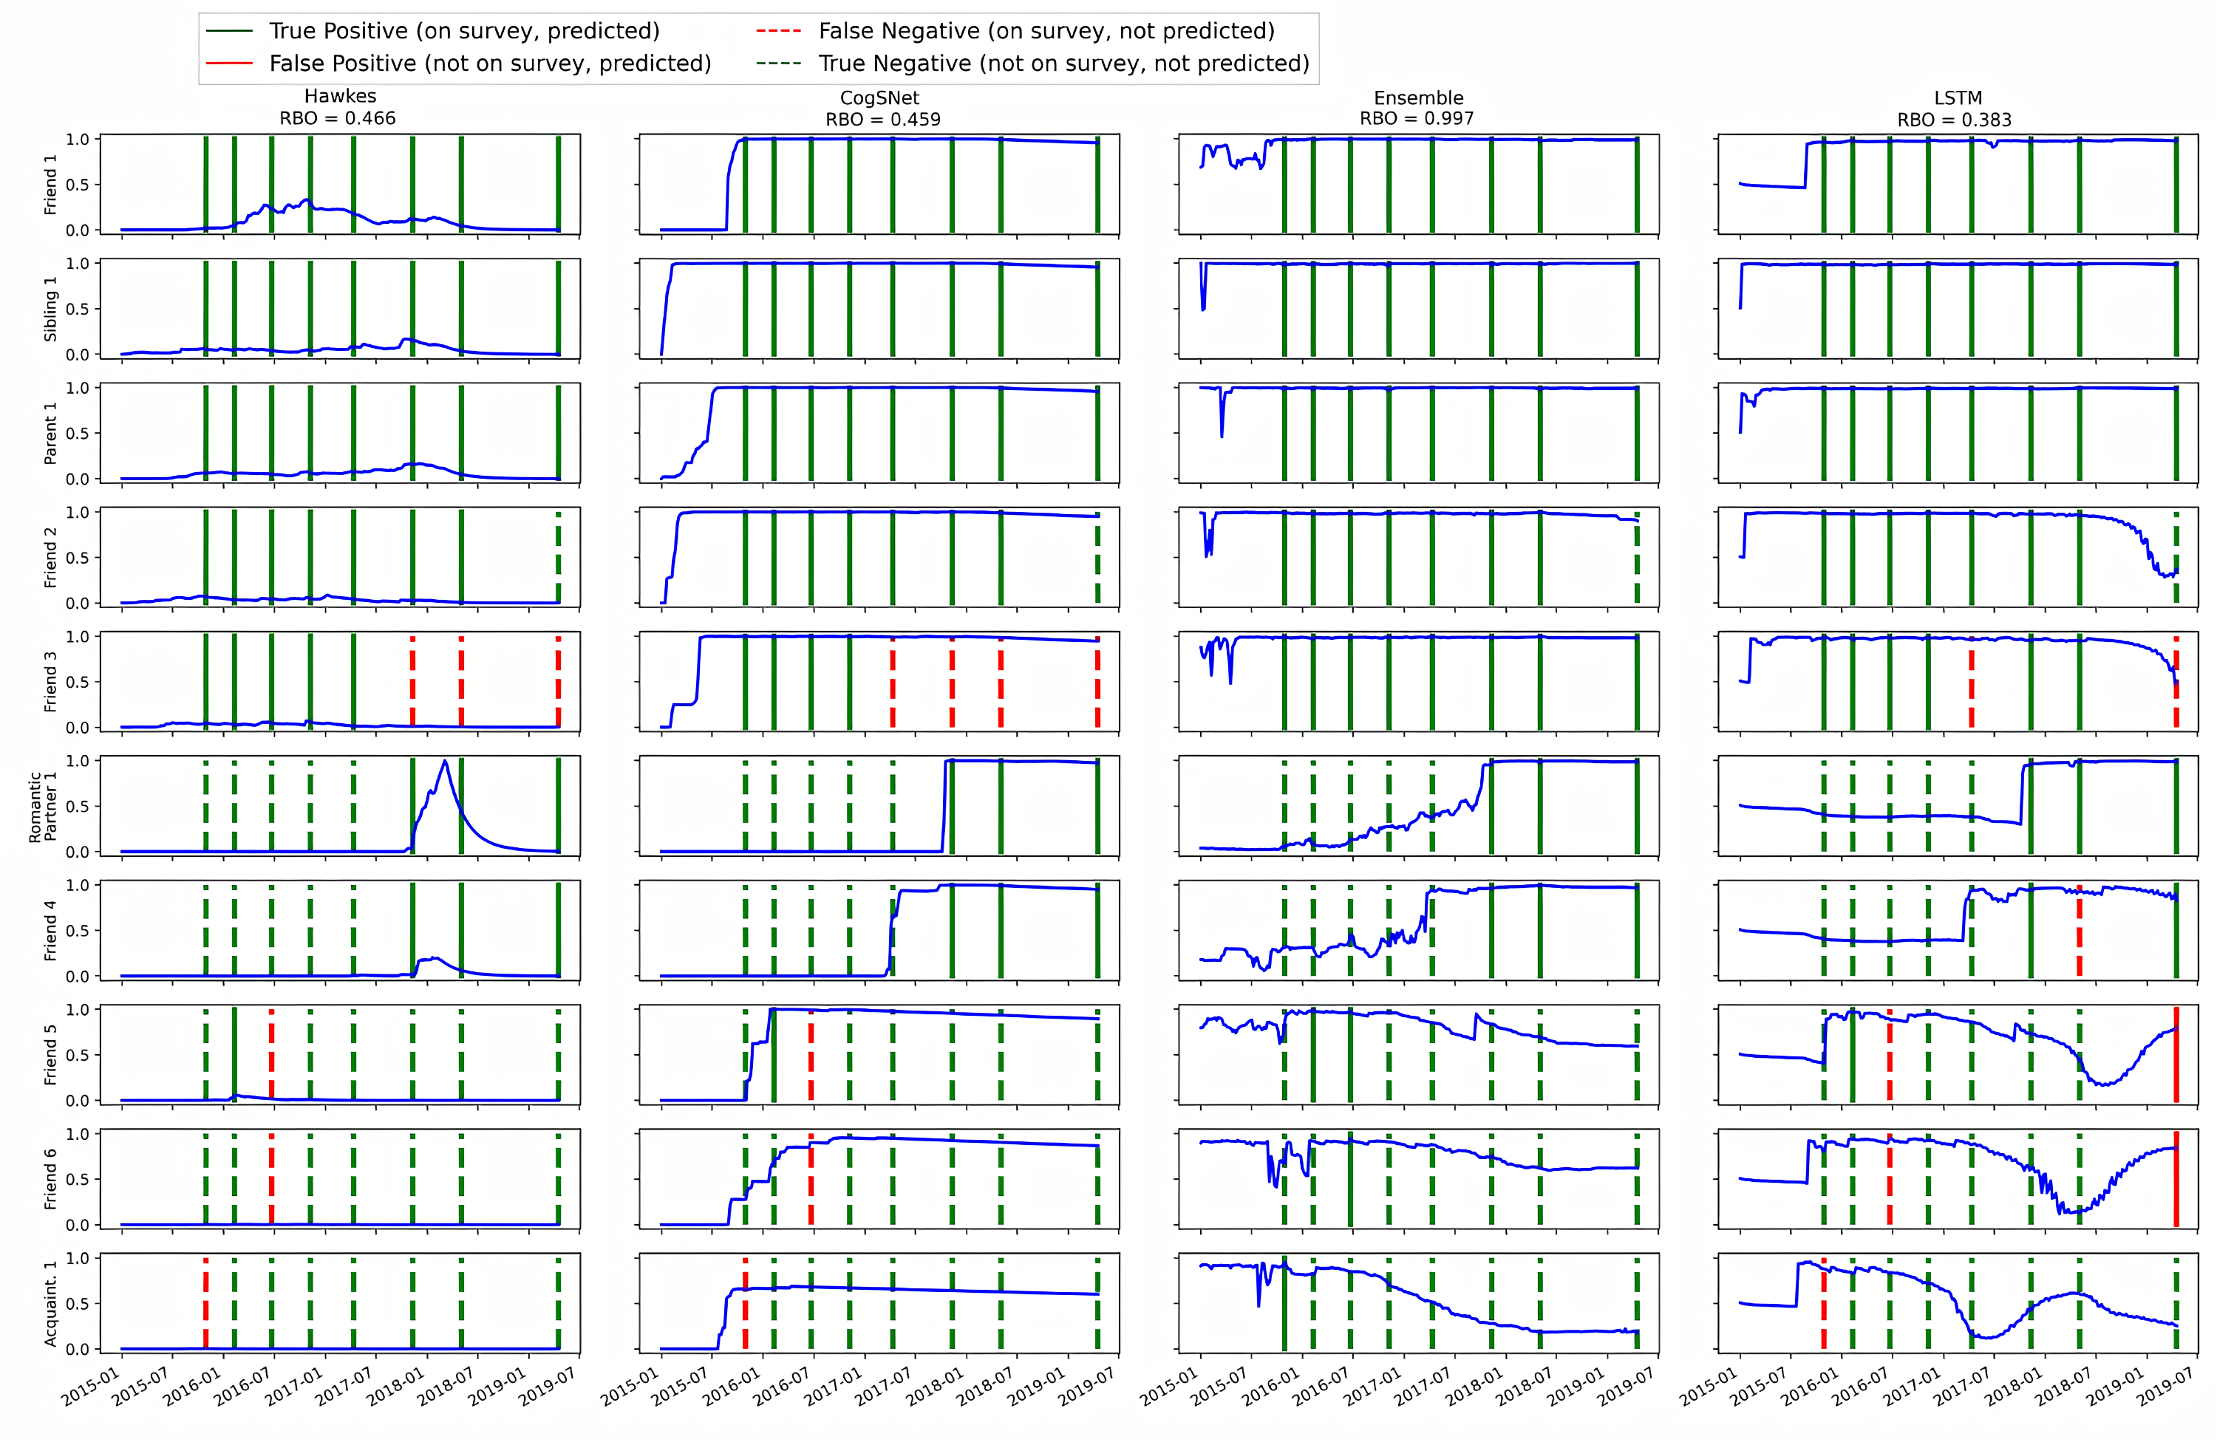
For NetHealth
Notes:
Note the obvious transition of significant others. But also note the trace of decay of acquaintance 1 that is only detectable using ML models. Also note how stable familial ties tend to be.
Figure caption: Generated tie strengths for a randomly selected NetHealth participant using the top four ranking prediction models (Hawkes, CogSNet, Ensemble, and LSTM). The x-axis marks the timestamp, and the y-axis marks the strength of the ties. The colored vertical bars indicate the occurrence of a survey, denoting if the models correctly (or incorrectly) classified the ranking of the considered individual.

Slide 21
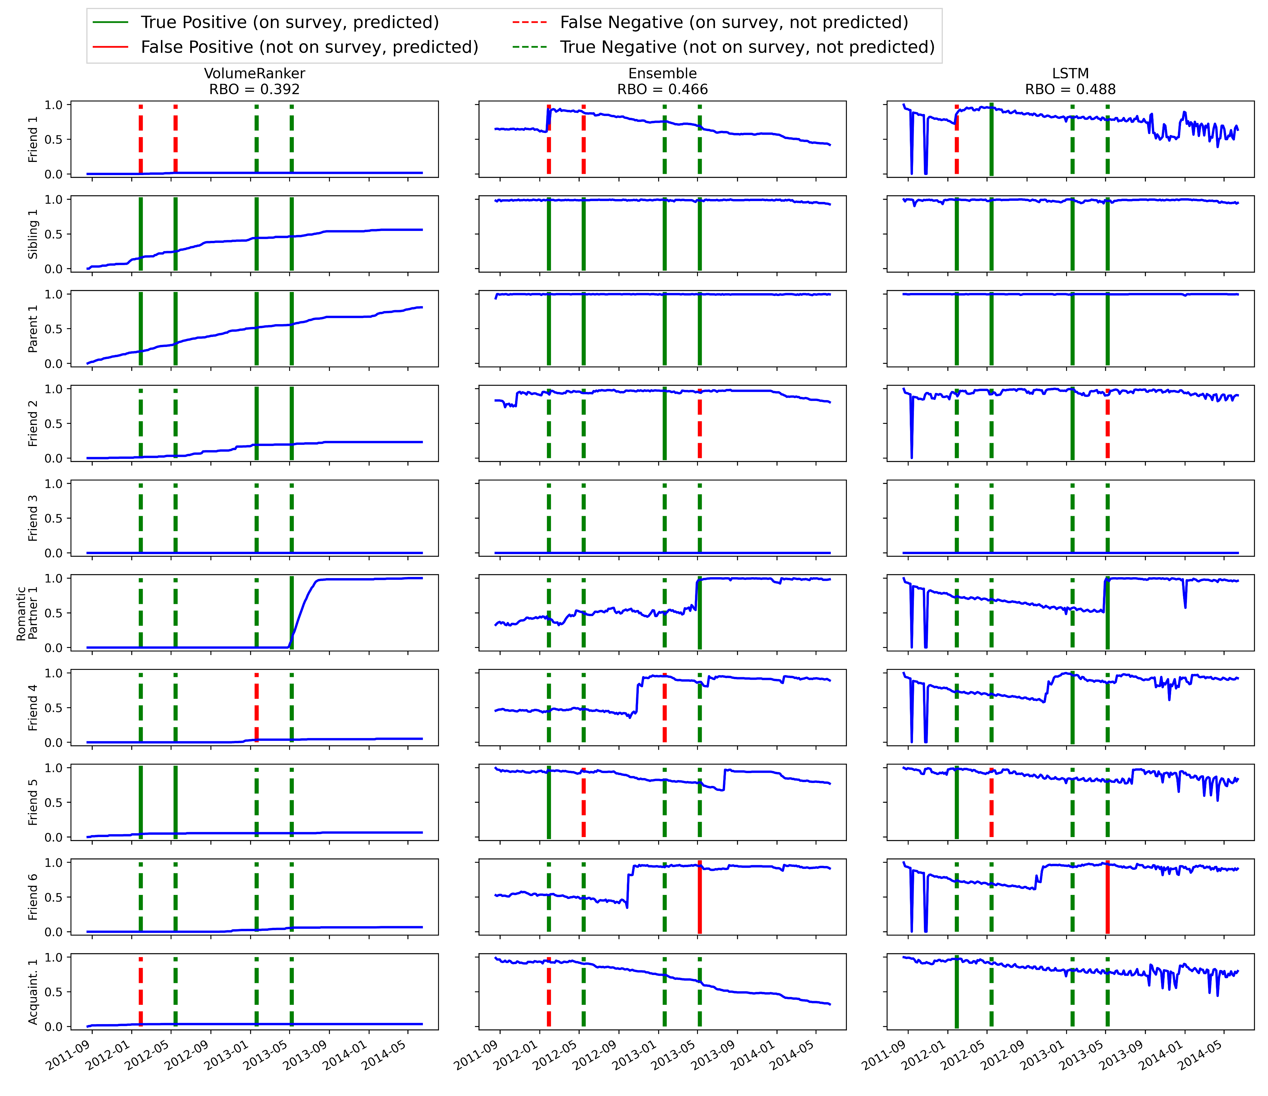
For NetSense
Notes:
Similar trends to NetHealth. But note how the ML models pick up a significant shift in friendship in Friend 4 that the volume model does not pick up on. Also note the tie strength stability of friend 2 despite the generally low communication volume.
Figure caption: Generated tie strength for a randomly selected NetSense participant using the the Volume, Ensemble, and LSTM models. The x-axis marks the timestamp, and the y-axis marks the strength of the tie. The colored vertical bars indicate the occurrence of a survey, denoting if the models correctly (or incorrectly) classified the ranking of the considered individual. All tie strengths are normalized between $0$ and $1$ for comparison.

Slide 22
Analyzing relationship dynamics
Using the LSTM model, we project the tie strength values of all listed alter-ego pairs over the entirety of the NetSense and NetHealth datasets
We subsequently identify these evolving dyads by their relationship classifications
We then analyze:
  The average tie strength (edge weight) of these classifications over time
  The distribution of transition differences of these classifications
    We find the timestamp of the point of greatest change for a given dyad,
    We then take the average tie strength value of this dyad before and after this transition
    We then take the difference of these two values to find how great, overall, was the tie strength change upon this transition
    We group these values by their classification and then distribute them

Slide 23
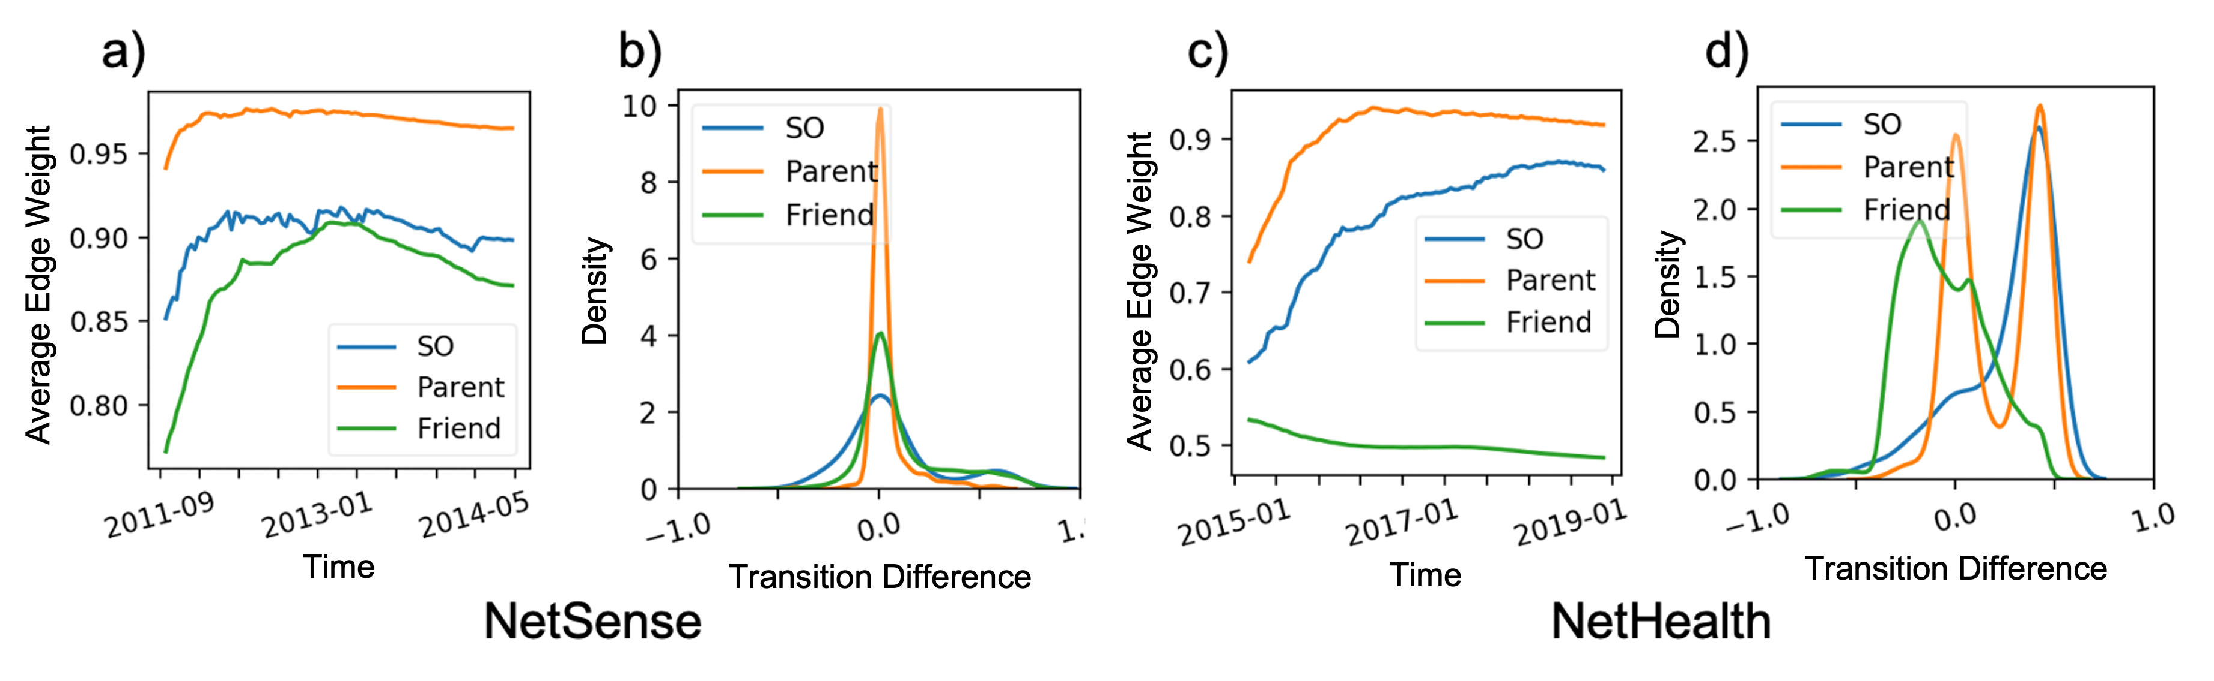
Analyzing relationship dynamics

Slide 24
Conclusions
Our pipeline introduces a novel approach to predicting tie strength
Time series and ML models can accurately predict surveys over long periods of time without stimulus
The predictive process itself requires no platform-specific attributes, just general communication data and sparse tie strength ground truth
Time series and ML models can accurately predict across domains, showing transferability of behavior is extractable using our pipeline
Analysis findings:
  Continuous tie strength trends:
    Unless experiencing a perturbative event, tie strength will eventually establish a stable state
    Perturbative events are easily traceable for anyone using signal generation
  Relationship dynamics:
    Familial relationships are often the most stable, undergoing little change
    Friend relationships are usually the most unstable
    Significant others are generally stable, but will often experience the greatest transitions
Notes:
Here, stimulus means training data taken from the pool of testing egos that have already been predicted, or using CDR data that comes from testing egos

Slide 25
Questions?
Notes:
Make sure to thank your advisor, family, friends, and funders (including DARPA, ARL, ARO).

