Slide 1
Universal resilience patterns in complex networks
Jianxi Gao, Baruch Barzel & Albert-László Barabási
Presentation by : Kushal R. Bhandari

Slide 2
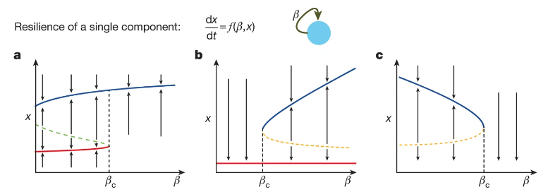
Background
What is resilience?
- the ability to withstand required capability in the face of adversity
Traditional approach for treatment of resilience is based on one-dimensional (1D) nonlinear dynamic equation

Slide 3
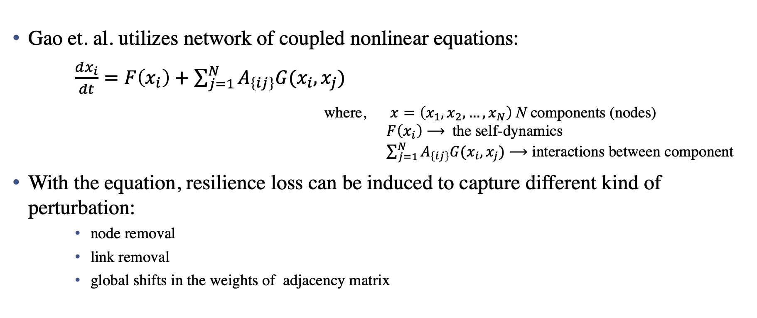
Introduction
Gao et. al. utilizes network of coupled nonlinear equations:
$\frac{dx_{i}}{dt}=F\left(x_{i}\right)+\sum_{j=1}^{N}{A_{\left\{ij\right\}}G(x_{i},x_{j})}$
where, $x=\left(x_{1}, x_{2}, …, x_{N}\right)$ N components (nodes)
$F\left(x_{i}\right)$ $⟶$ the self-dynamics
$\sum_{j=1}^{N}{A_{\left\{ij\right\}}G(x_{i},x_{j})⟶}$ interactions between component
With the equation, resilience loss can be induced to capture different kind of perturbation:
    node removal
    link removal
    global shifts in the weights of adjacency matrix

Slide 4
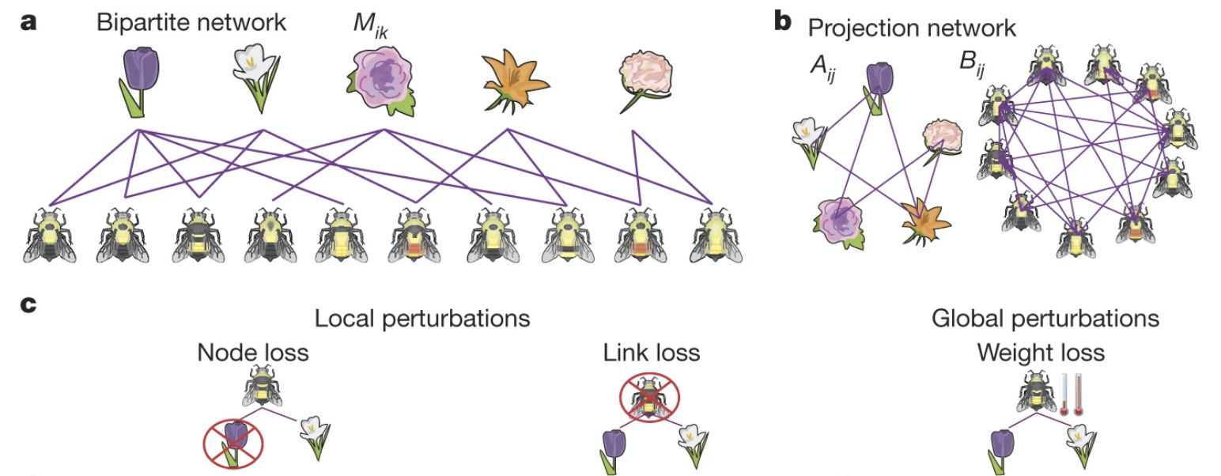
Ecological Network
the mutualistic interactions among species in seven ecological systems
  Coral Reefs, Rain forest, Montane forest and grassland, Andean scrub, Caatinga (semi-arid vegetation), Agricultural area, Primary montane (tropical rainforest)
  fourteen different networks, Net1 - Net14, with sizes ranging from N = 10 to N = 1, 429 nodes
  tested its resilience under three realistic perturbations

Slide 5
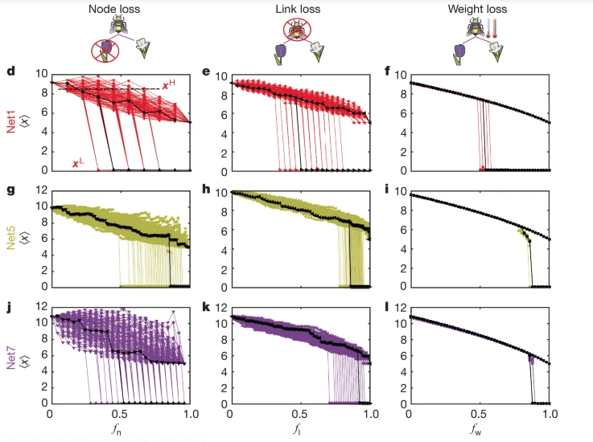
Ecological Network

Slide 6
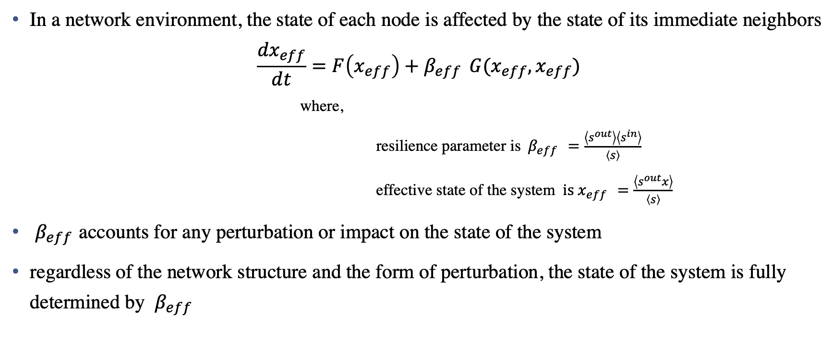
Universal Resilience pattern of a complex system
In a network environment, the state of each node is affected by the state of its immediate neighbors
$\frac{{dx}_{eff}}{dt}=F\left(x_{eff}\right)+β_{eff } G(x_{eff},x_{eff})$
    where,
    resilience parameter is$β_{eff }=\frac{\left\langle s^{out}\right\rangle \left\langle s^{in}\right\rangle }{\left\langle s\right\rangle }$
    effective state of the system $is x_{eff }=\frac{\left\langle s^{out}x\right\rangle }{\left\langle s\right\rangle }$
$β_{eff }$accounts for any perturbation or impact on the state of the system
regardless of the network structure and the form of perturbation, the state of the system is fully determined by $β_{eff }$

Slide 7
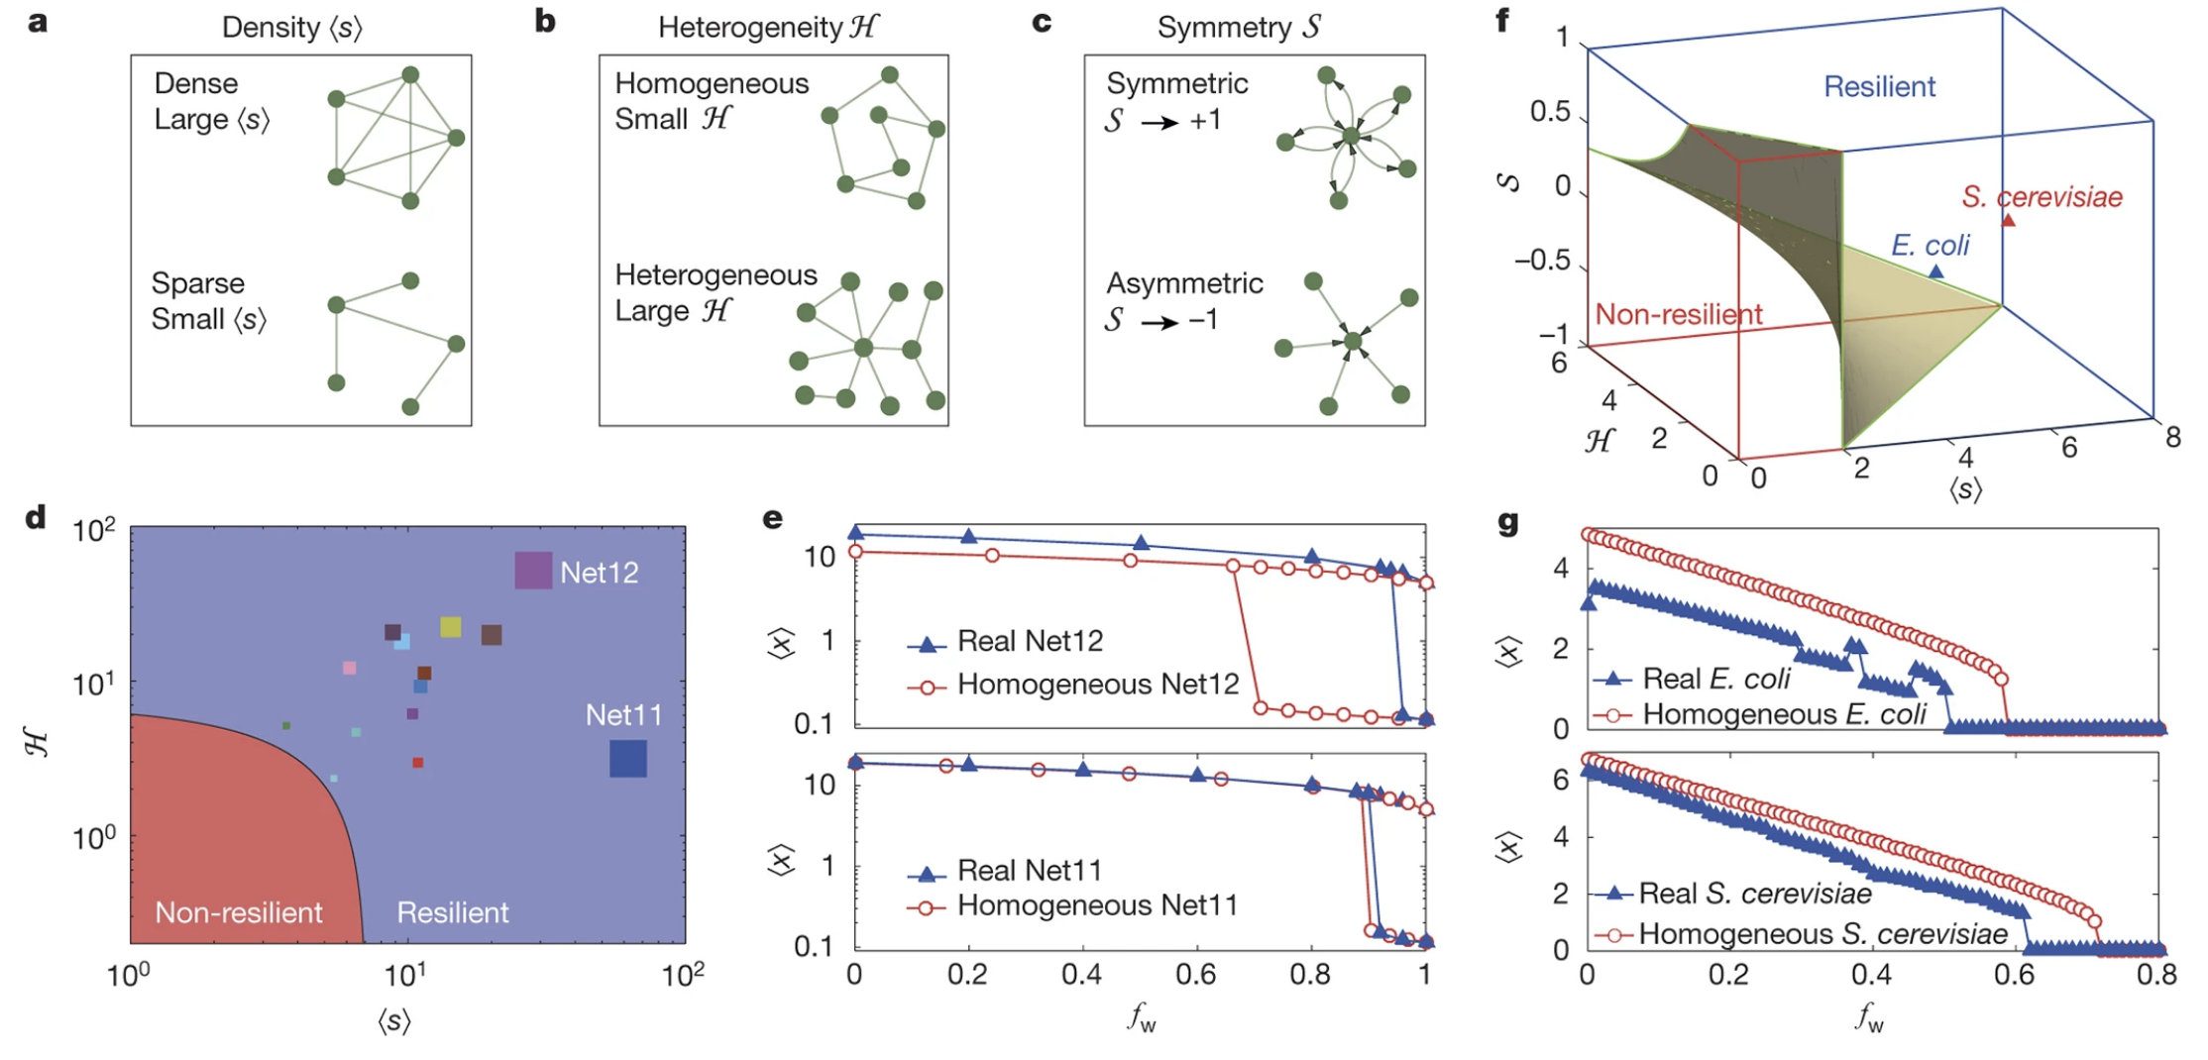
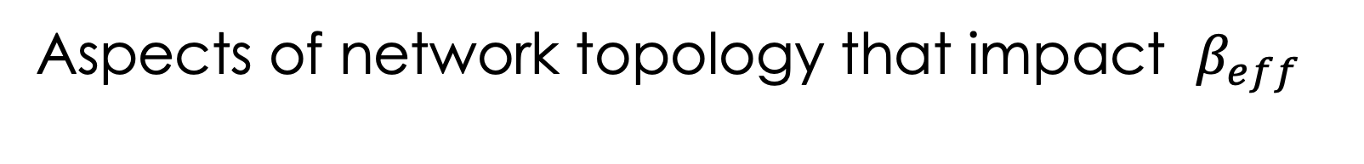
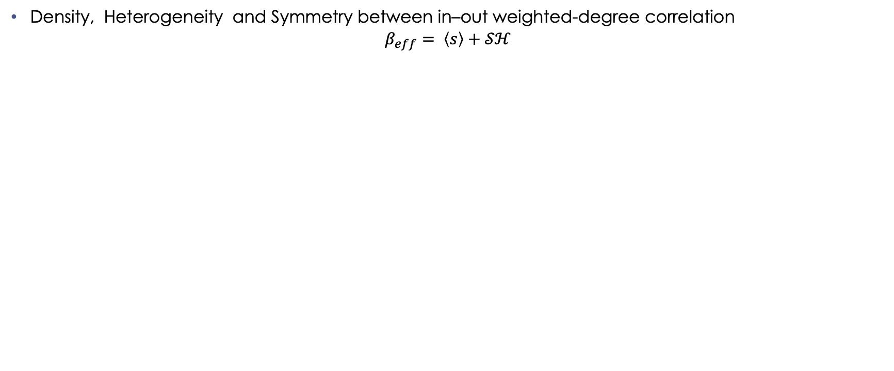
Aspects of network topology that impact $β_{eff }$
Density, Heterogeneity and Symmetry between in–out weighted-degree correlation
$$β_{eff}= \left\langle s\right\rangle +𝒮ℋ$$

Slide 8
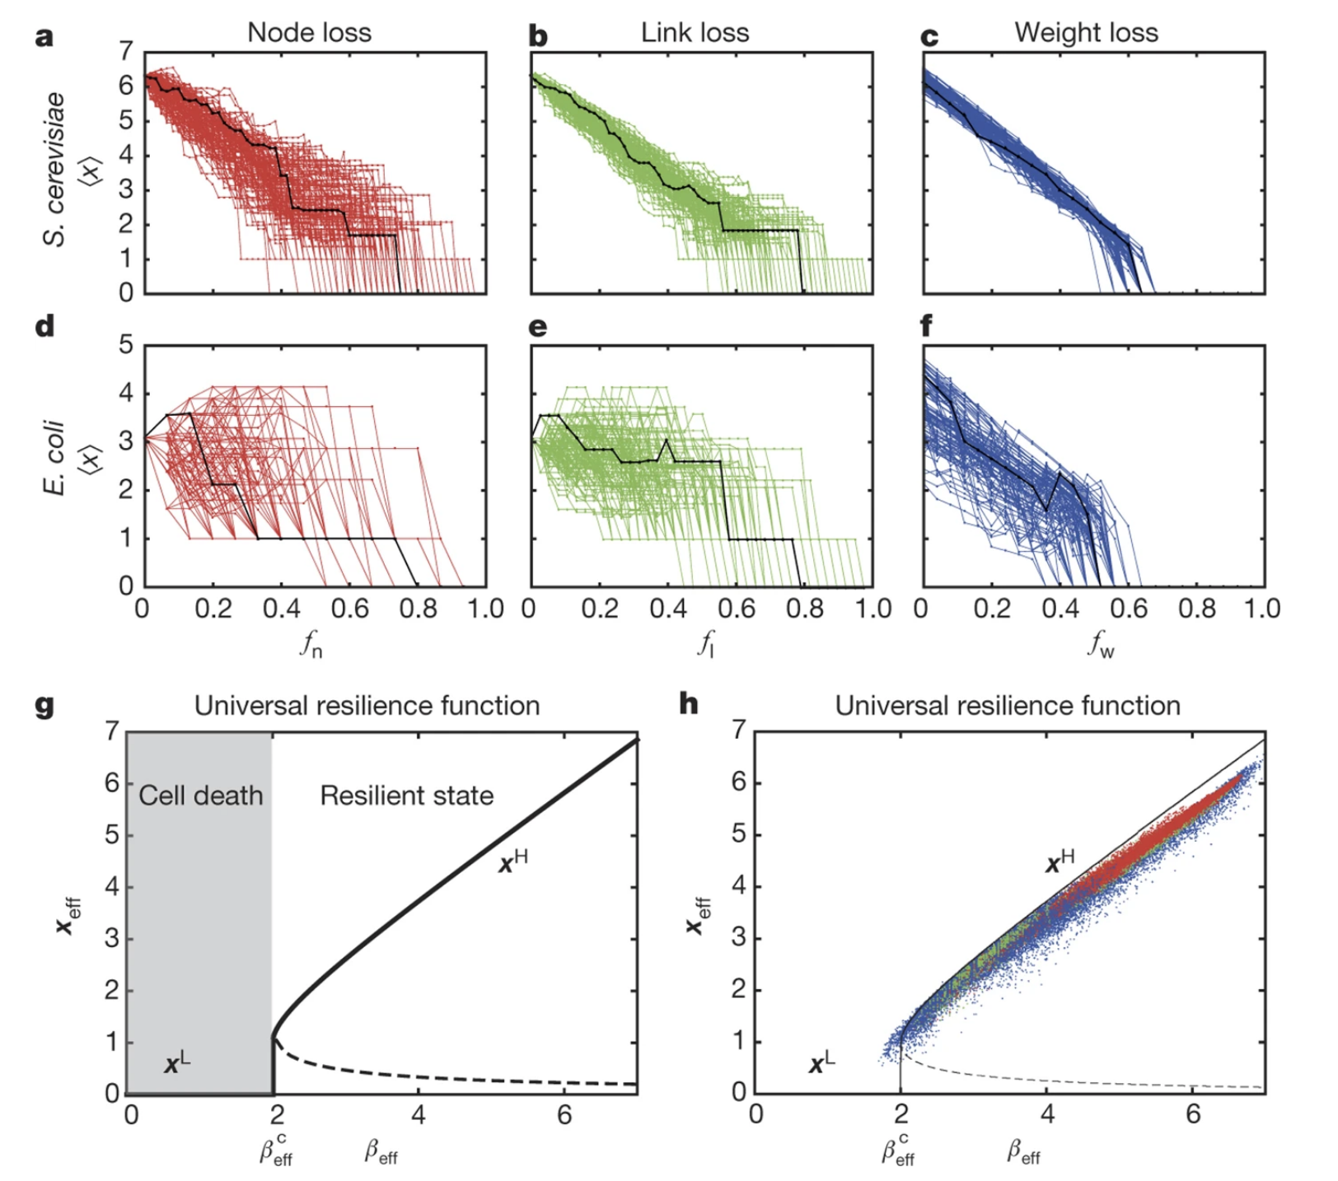
Gene regulatory networks
regulatory interactions in yeast and in E. coli
  the yeast regulatory network with N = 4, 441 nodes and L = 12, 873 directed links
  the E. coli network with N = 1, 550 and L = 3, 244

Slide 9
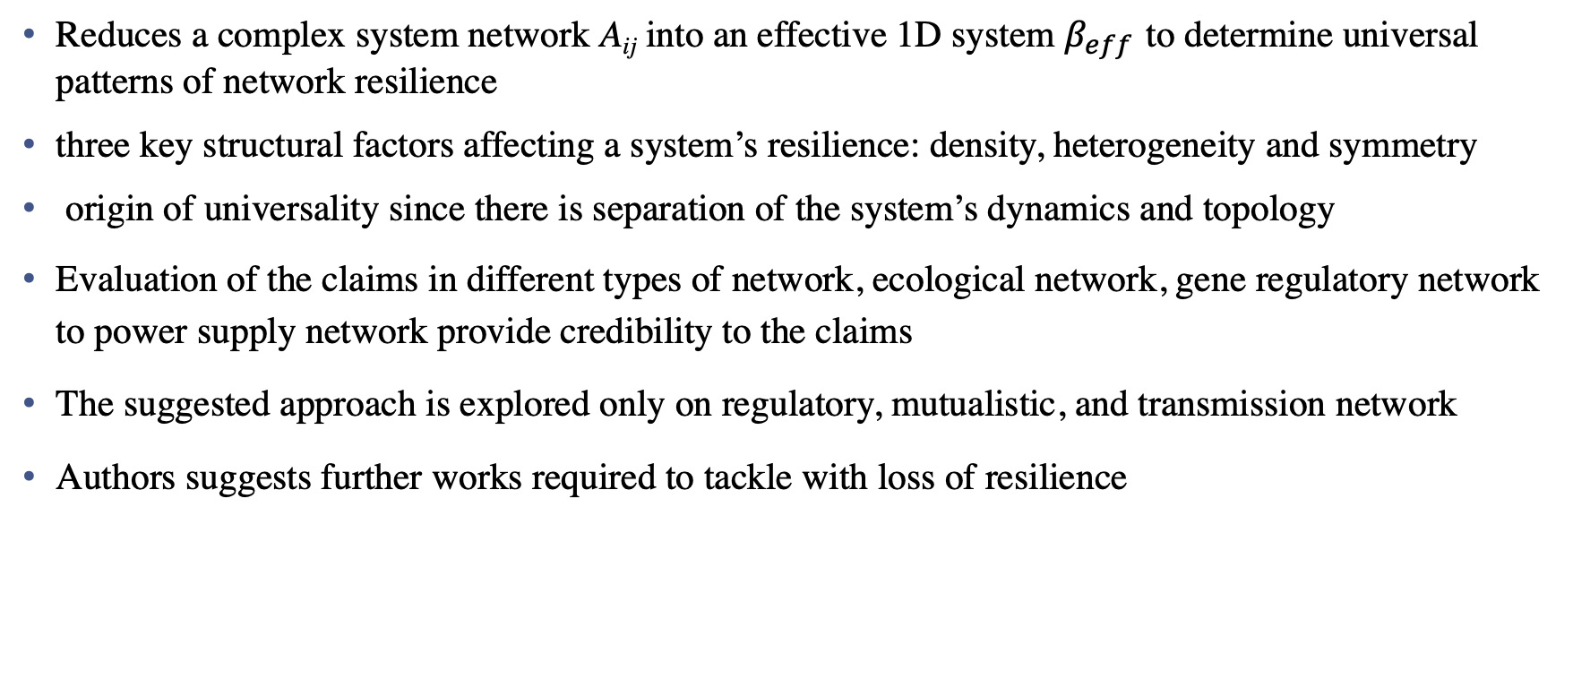
Conclusion
Reduces a complex system network A_{ij} into an effective 1D system $β_{eff }$to determine universal patterns of network resilience
three key structural factors affecting a system’s resilience: density, heterogeneity and symmetry
origin of universality since there is separation of the system’s dynamics and topology
Evaluation of the claims in different types of network, ecological network, gene regulatory network to power supply network provide credibility to the claims
The suggested approach is explored only on regulatory, mutualistic, and transmission network
Authors suggests further works required to tackle with loss of resilience

Slide 10
Related Works
Universal resilience patterns in labor markets
  Esteban Moro, Morgan R. Frank, Alex Pentland, Alex Rutherford, Manuel Cebrian & Iyad Rahwan
Inferring Degrees from Incomplete Networks and Nonlinear Dynamics
  Chunheng Jiang, Jianxi Gao, Malik Magdon-Ismail
From data to complex network control of airline flight delays
  Xiang Niu, Chunheng Jiang, Jianxi Gao, Gyorgy Korniss & Boleslaw K. Szymanski

Slide 11
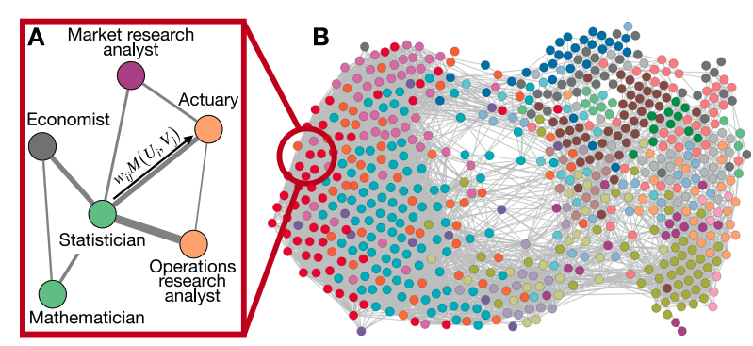
Universal resilience patterns in labor markets
analyze labor market resilience compared to the unemployment experienced
Predict impact of labor disruption in coming future due to automation
Data: O*NET database from the US Bureau of Labor Statistics (BLS)

Slide 12
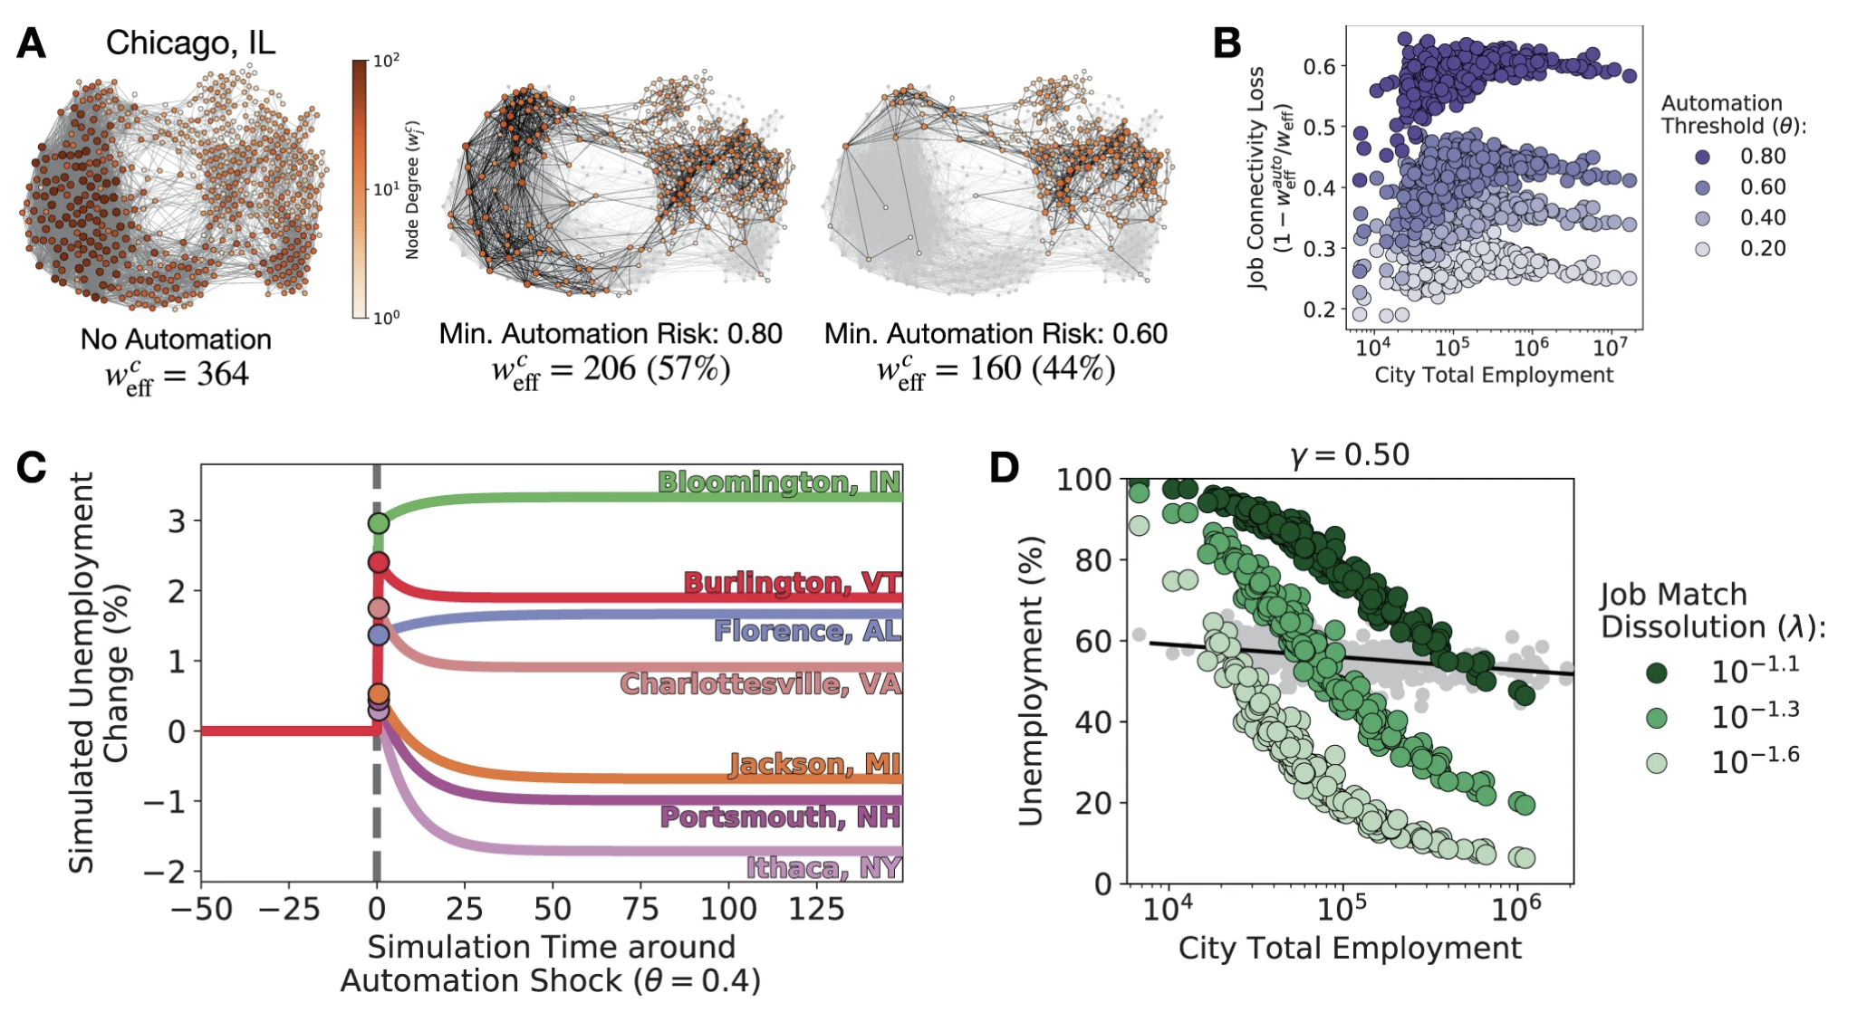
Result:
the topology of skill inter - dependencies relates to job polarization,
job connectivity predict labor responses to Great Recession
the latter labor markets cannot accommodate the initial automation shock.

Slide 13
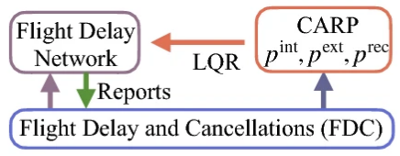
From data to complex network control of airline flight delays
Mitigating delay propagation in airport networks
Convert flight delay problem into a network and solve via network science and control theory
Data: Flight Delays and Cancellations (FDC): over five million fight records of 13 US passenger airlines
Utilize dynamics of the system, and its linearization and then apply the Linear Quadratic Regulator (LQR) to find optimal control
successfully control the fights of all 13 US domestic passenger airlines with a minimum cost
  Either finding the consequences of not controlling the delay or renting a plane to control delay

Slide 14
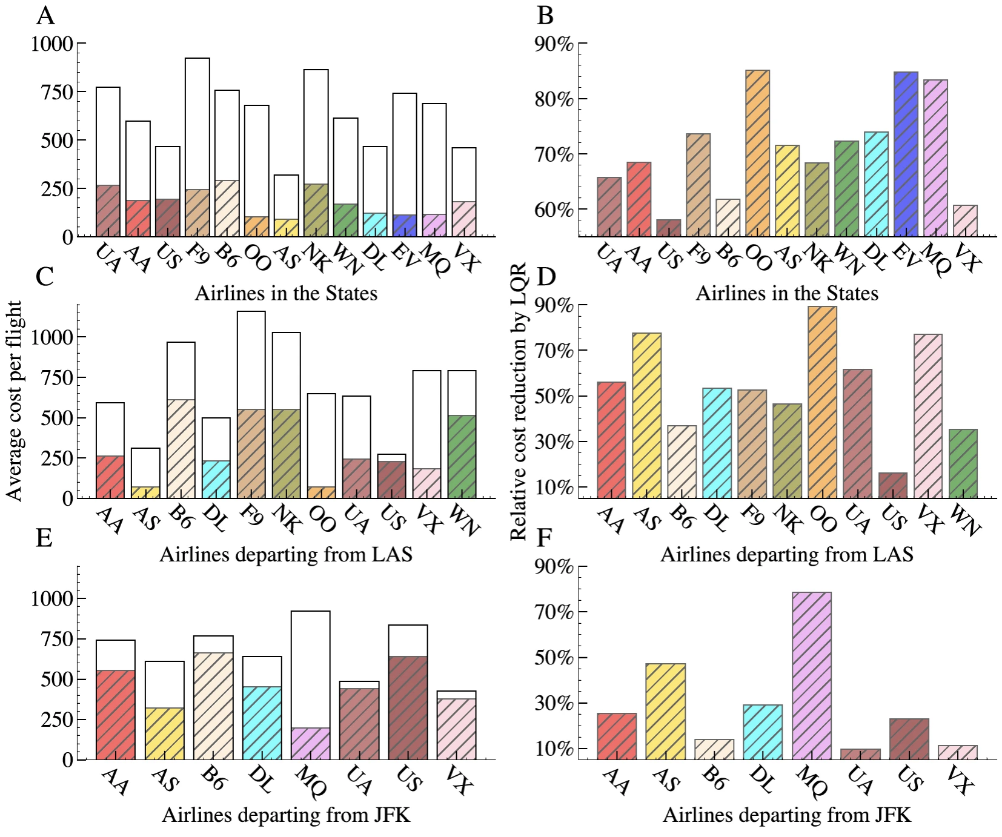
Results
Optimal control for the real airline flight delay networks
Reduction in delay cost by the optimal control LQR on airlines in the United States and airlines departing from two airports LAS and JFK.

Slide 15
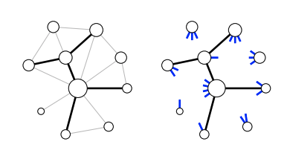
Inferring Degrees from Incomplete Networks and Nonlinear Dynamics
Inferring missing degrees accurately from an incomplete network
Utilize mean-field theory with universal resilience to learn vertex degrees
Algorithms introduced
  ZeroTopo: estimate degree from zero known topology
  TopoPlus: estimates degree from partially observed topology
  Round: optimization of TopoPlus

Slide 16
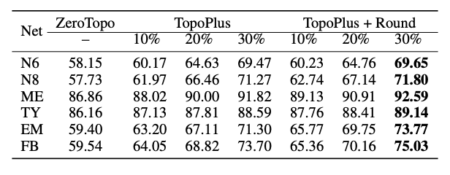
Inferring Degrees from Incomplete Networks and Nonlinear Dynamics
Data: Ecological, Gene Regulatory, and Epidemic
All three algorithm provide favorable result to infer degree nodes
Method of Sampling of the subgraph (uniform sampling or random walk sampling) does not affect the result of the prediction
the proposed algorithm perform significantly better than the baselines

Slide 17
Thank you!
Any Question?

