Slide 1
Section 9.6: Testing Communities
Sahith Bhamidipati

Slide 2
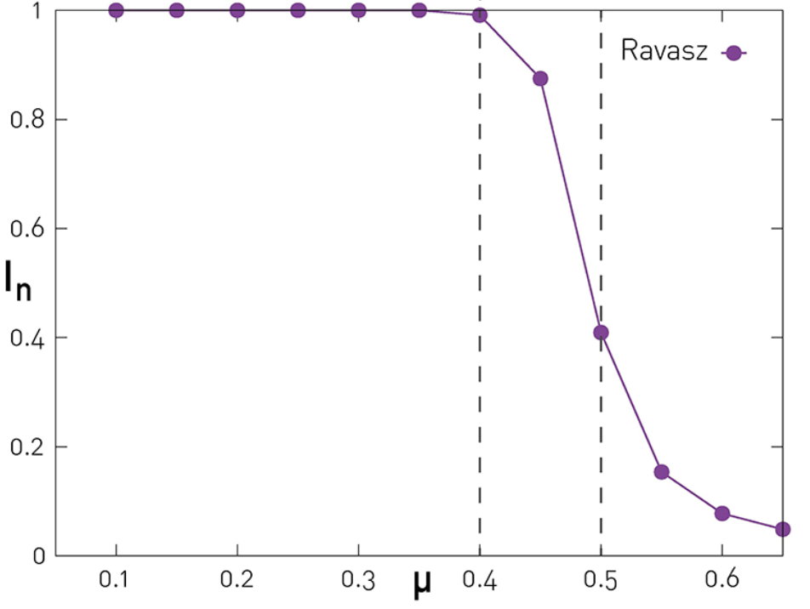

Testing with Benchmarks
Benchmarks – networks with predefined community structure
Benchmarks test accuracy of community detection algorithms
Two main benchmarks used: Girvan-Newman (GN) and Lancichinetti-Fortunato-Radicchi (LFR)
Complexity of benchmarks depends on control parameter: μ = $\frac{k_{ext}}{k_{ext}+k_{int}}$
Performance of Ravasz detection algorithm on GN benchmark for varying μ

Slide 3
Benchmark Graphs
Girvan-Newman (GN) Benchmark
  N = 128 nodes split into n_{c} = 4 communities of size N_{c} = 32 nodes
  Parameters: p_{int}, p_{ext} (determines control parameter μ)
Lancichinetti-Fortunato-Radicchi (LFR) Benchmark
  N isolated nodes split into communities of size N_{c} following power law distribution
  Each node assigned degree k following power law distribution
  Degree split into internal degree = (1 - μ)k and external degree = μ*k
  All nodes start homeless, each assigned random community until none are homeless
  Parameters: community distribution exponent (𝜁), degree distribution exponent (y), average degree k, control parameter μ

Slide 4
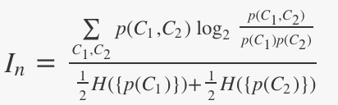

Measuring Accuracy
p(C): probability that random node belongs to community C in partition
p(C₁, C₂): probability that random node belongs to community C₁ in one partition and community C₂ in second partition of same network
I_{n} is max value when partitions are equivalent
Shannon entropy
Normalized mutual information equation

Slide 5
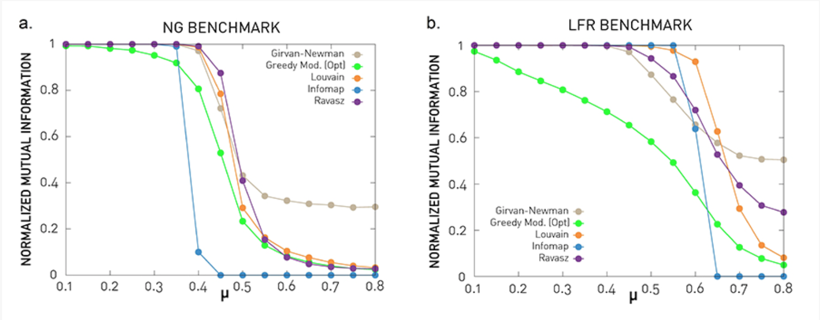
Benchmark Graph Comparison
GN Benchmark
LFR Benchmark
Communities of equal size
Nodes have same expected degree
Small network size
Doesn’t work with clique percolation, link clustering
Distributed community size
Distributed node degrees
Doesn’t work with clique percolation, link clustering
NMI of various community detection algorithms on GN
NMI of various community detection algorithms on LFR

Slide 6
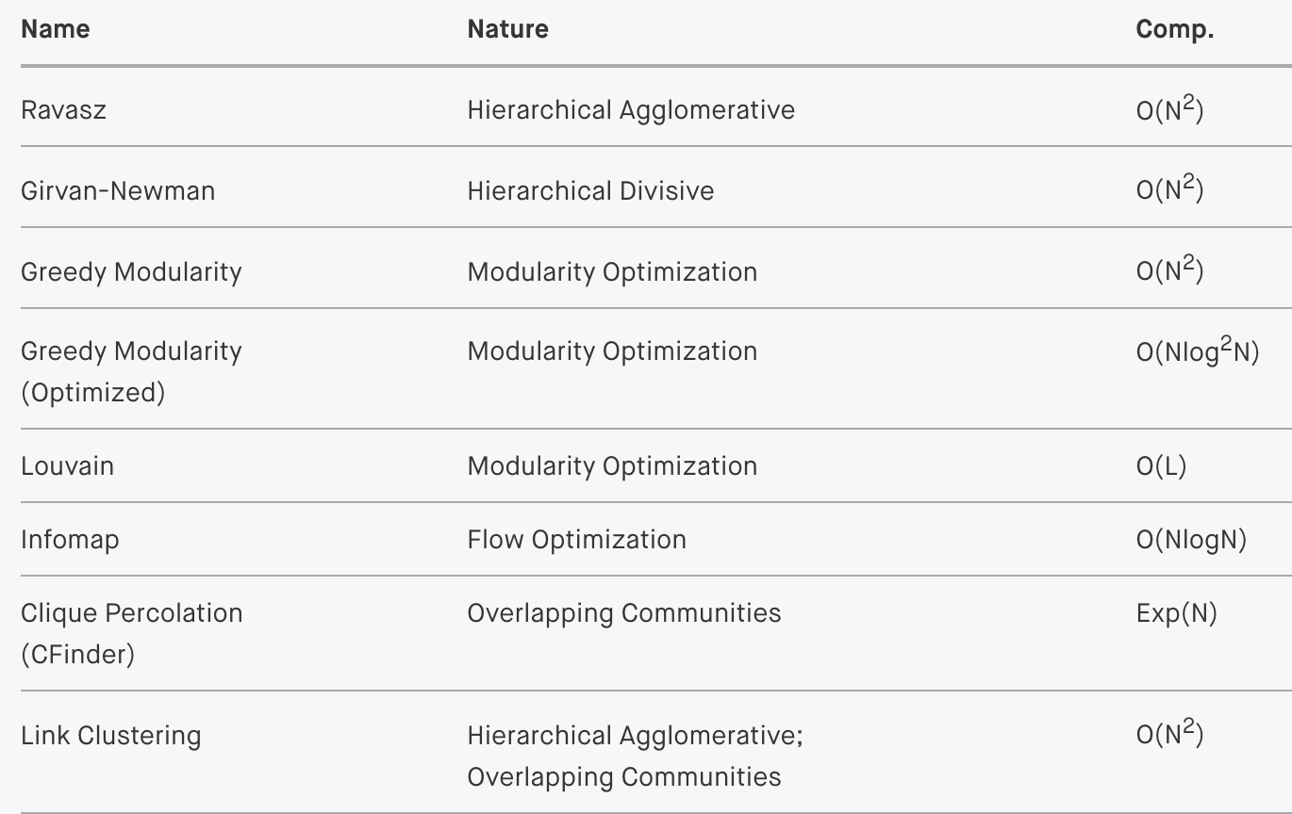
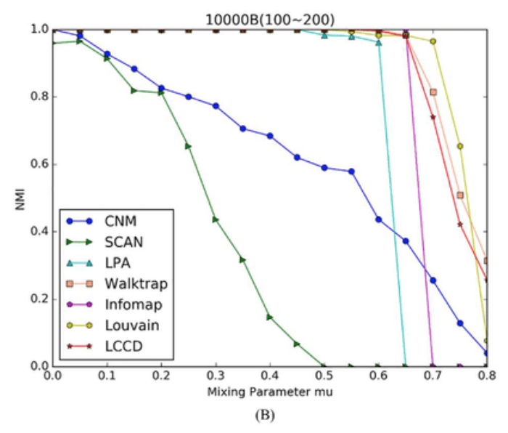
Community Detection Algorithm Comparison
Runtime
Accuracy
Various community detection algorithm nature and computational complexity
NMI of various community detection algorithms on LFR

Slide 7
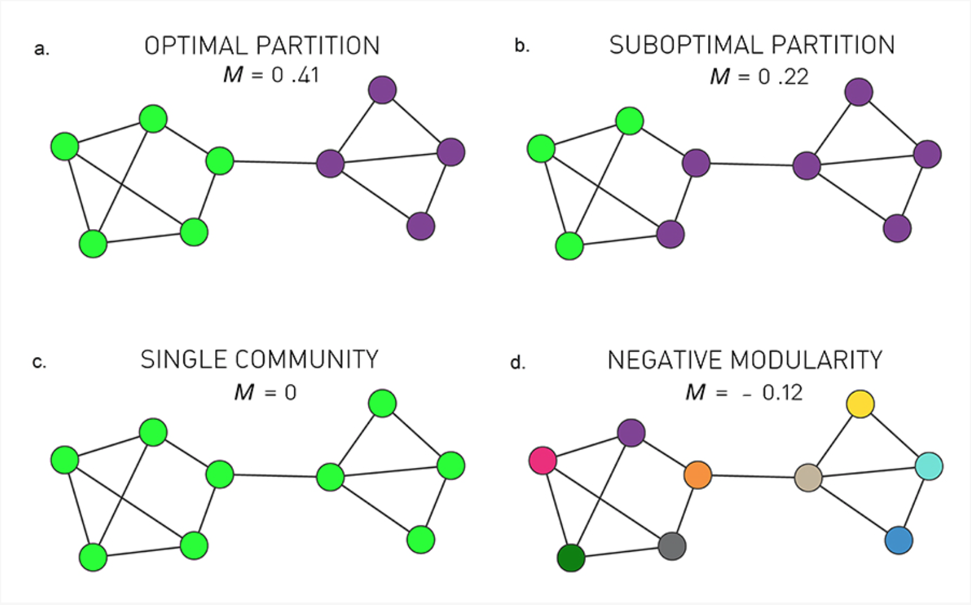
Modularity Optimization
Modularity – denseness within community and sparseness externally
Maximize modularity within communities, then create new networks until global maximum
Popular community detection algorithm
  Easy to use
  Efficient
Trouble with small networks/communities
Louvain especially popular
  Simple and fast
  Inefficient with storage
Modularity of network with different community partitions

Slide 8
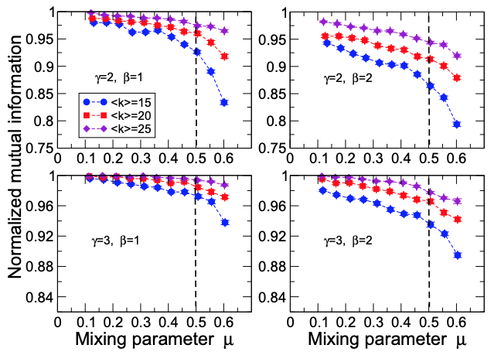
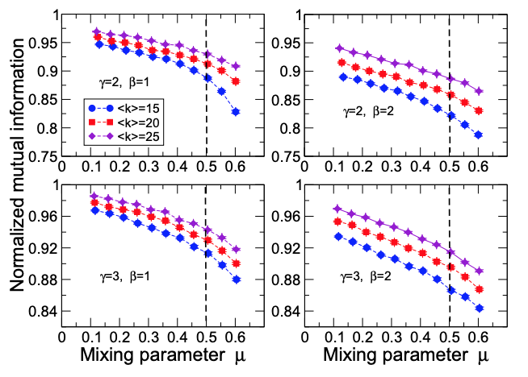
Benchmark Parameter Comparison
Modularity optimization run on LFR with varying parameters

Slide 9
Bibliography
Barabási, Albert-László. Network Science. Cambridge University Press, 2016.
Blondel, Vincent. Louvain Method for Community Detection. Mar. 2011, https://perso.uclouvain.be/vincent.blondel/research/louvain.html.
Jayawickrama, Thamindu Dilshan. “Community Detection Algorithms. Many of You Are Familiar with Networks… | by Thamindu Dilshan Jayawickrama | Towards Data Science.” Medium, Towards Data Science, 29 Jan. 2021, https://towardsdatascience.com/community-detection-algorithms-9bd8951e7dae.
Lancichinetti, Andrea, et al. “Benchmark Graphs for Testing Community Detection Algorithms.” Physical Review E, no. 4, American Physical Society (APS), Oct. 2008. Crossref, doi:10.1103/physreve.78.046110.
Wang, Xiaofeng, et al. “Locating Structural Centers: A Density-Based Clustering Method for Community Detection.” PLOS ONE, edited by Yong Liu, no. 1, Public Library of Science (PLoS), Jan. 2017, p. e0169355. Crossref, doi:10.1371/journal.pone.0169355.

Slide 10
Questions?

