Slide 1



Failures, Dynamics, Evolution and Control of the Global Risk Network
Boleslaw Szymanski
Xin Lin, Xiang Niu, Noemi Derzsy, Alaa Moussawi,
Jianxi Gao, and Gyorgy Korniss
NeST Center & SCNARC
Department of Computer Science
Department of Physics, Applied Physics and Astronomy
Rensselaer Polytechnic Institute, Troy, NY
*email: szymab@rpi.edu
Notes:
Good (afternoon).
In this talk we will discuss Long-term Failure Prediction based on Alternating Renewal Process Model of Global Risk Network.

Slide 2
Outline
Background information
Model details and dynamics
Limits of parameter recovery
Evolution of the WEF model over years
Control of the global risk network
Conclusion

Slide 3
Definitions
Global risks are defined each year by the World Economic Forum (WEF) which defines Global Risk Networks for its meeting in Davos since 2000. We are building models of this networks starting with the 2013 Global Risk Network* but using data from all networks.
Each WEF report identifies 30-50 global risks that are classified into five broad categories of economic, environmental, geopolitical, societal and technological risks.
The report contains also an assessment of the risks potential impact, interconnectedness and likelihood of materialization in the next 10 years prepared by over a thousand industrial, governmental, and academic experts.
*World Economic Forum Global Risks Report (2013)
http://www.weforum.org/reports/global-risks-2013-eighth=edition
Notes:
The WEF identifies 50 global risks that can be categorized as either economic, environmental, geopolitical, societal or technological risks. The metric for these risks is generated by expert opinions in their respective fields. They assess the likelihood of materialization of these risks, influence of risk materialization on other risks, and the potential impact that materialization of each risk has on the global economy. The objective of our research is to better understand the network properties in order to decouple harmful risks, and mitigate materialization probabilities. Analysis has moved from risk identification to thinking through risk interconnections and the potentially cascading effects that result.

Slide 4
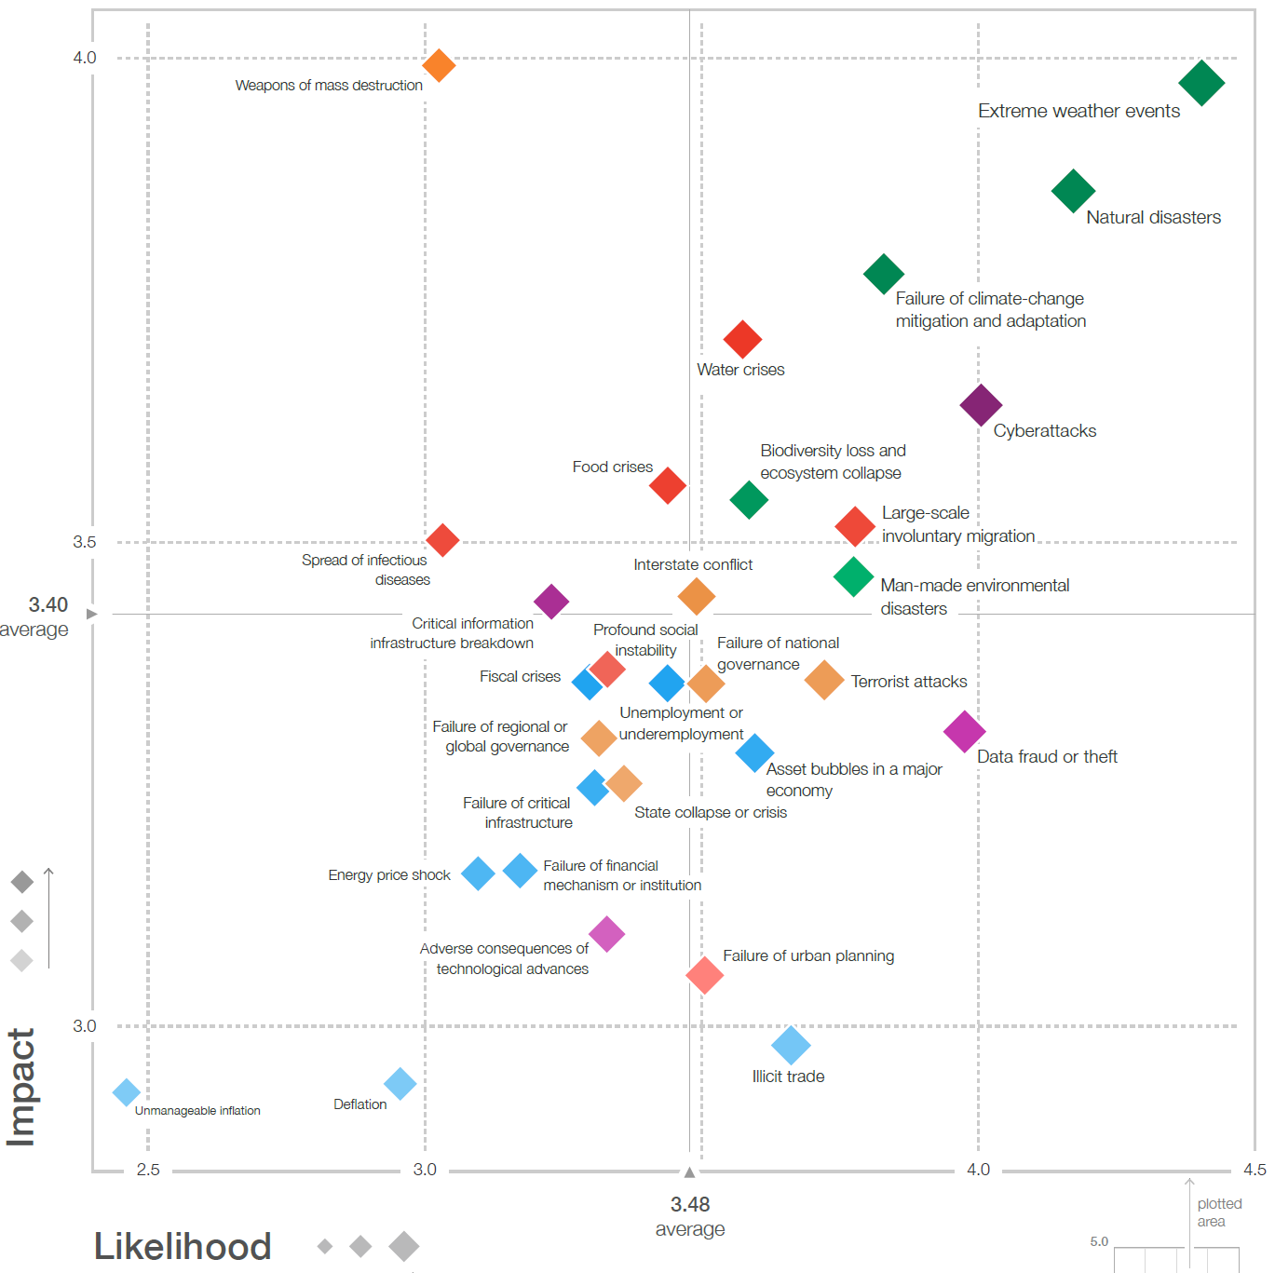
An Example of 2018 Report Data*
Distribution of likelihood and impact for 30 global risks grouped into five categories indicated by the color of risk node by GRR18*
* http://www3.weforum.org/docs/WEF_GRR18_Report.pdf
Notes:
We study the interconnectedness of the risks, and how this affects their evolution. This has important consequences for the global economy. Here we see an example of the economic losses due to natural catastrophes in 2011.

Slide 5
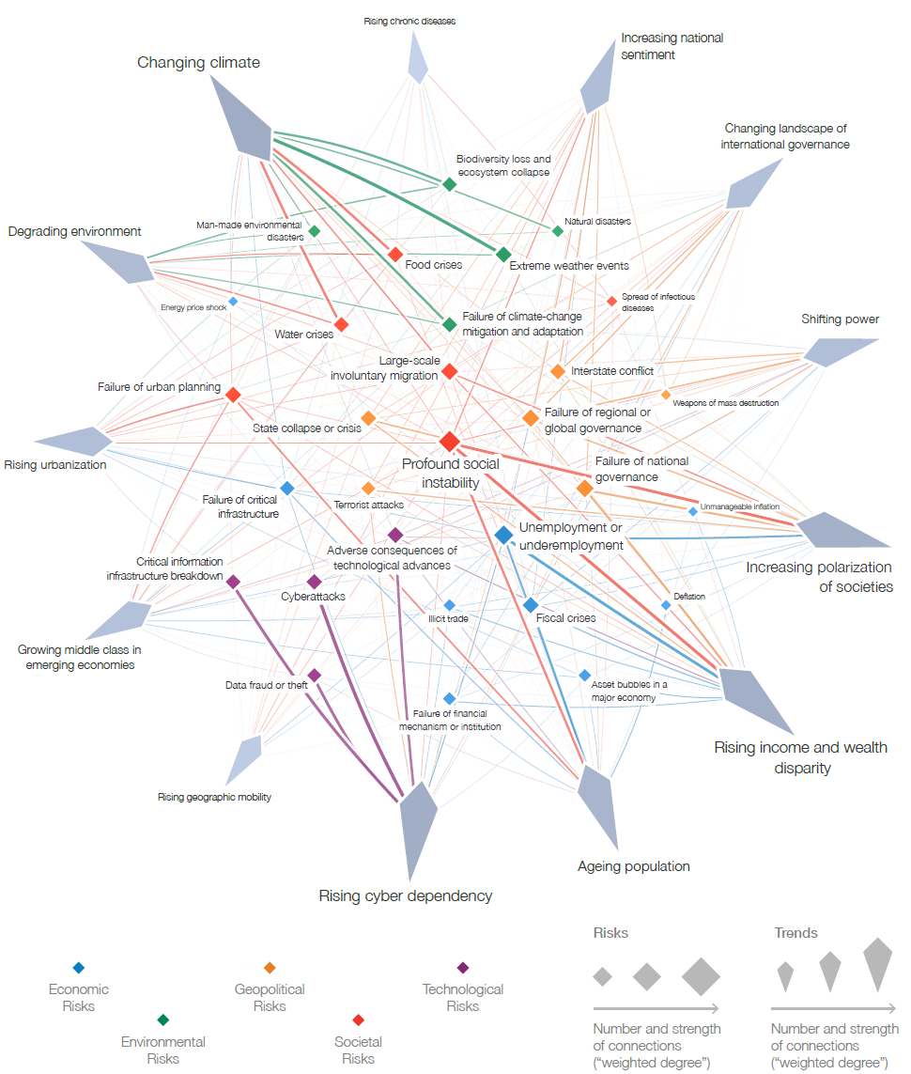
An Example of 2018 Report Data*
2018 Interconnections
of Global Risks reported
In GRR18*
* http://www3.weforum.org/docs/WEF_GRR18_Report.pdf
Notes:
We study the interconnectedness of the risks, and how this affects their evolution. This has important consequences for the global economy. Here we see an example of the economic losses due to natural catastrophes in 2011.

Slide 6
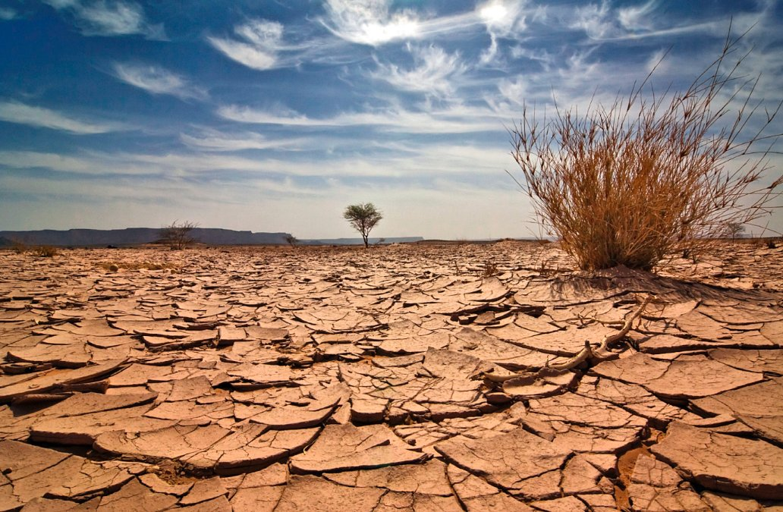


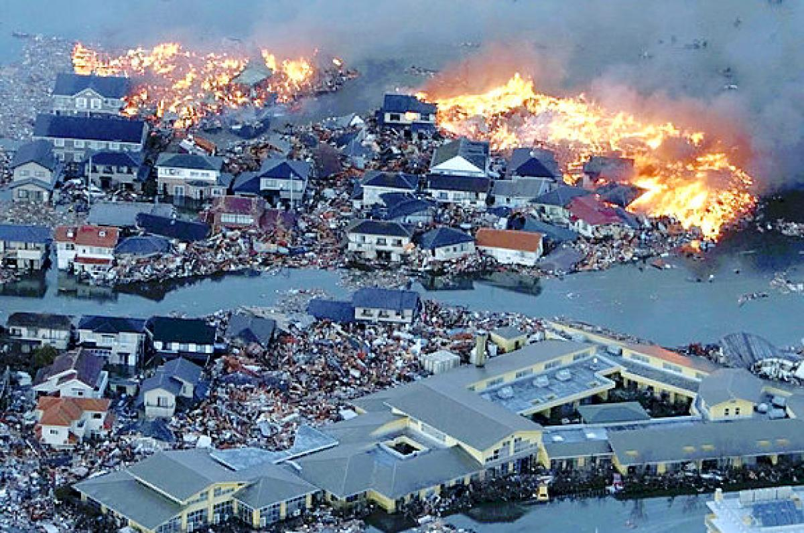

Global Risks
Notes:
Some examples of global risks are cyber attacks, persistent extreme weather, diffusion of weapons of mass destructions, terrorism, or water supply crises, basically anything that can have an effect on the global scale.

Slide 7
Dynamics of Global Risk Failures
Each risk is a node in the global risk network and is assigned likelihood of failure in the next 10 years and the failure economical impact by the 20-25 experts in this risk*.
The risk network is a Stochastic Block Model (SBM) graph** with the average node connectivity 20.6 and undirected weighted edges representing risks influence of nodes on each other.
The optimal model can measure how decreasing the strength
of some critical network nodes and edges can decrease probability of future failures.
*World Economic Forum (2013) http://www3.weforum.org/tools/rrn/wef_grr/20130108/server/getrisks.json
**R. Holland, K. Laskey & S. Leinhardt, Stochastic blockmodels: first steps. Soc. Networks 5:109–137 (1983)
Notes:
We generate a Stochastic Block Model to represent the interconnectivity of the risks which we represent as nodes of the graph. Each node is given a likelihood of failure. Edge weights in the graph represent probabilities of external influence. We use this graphical representation to generate a model that can address the behavior over a 13 year time span. The objective is to understand how the interconnectivity of risks generates the observed results, and how varying risk probabilities can reduce failures in the system.

Slide 8
Visualization of Inter-group Connectivity
Node’s color indicate its total connectivity
Node’s size indicates its internal likelihood of activation
The number of inter-group links indicates the strength of connectivity between a pair of groups
Notes:
Here we have a visual representation of the graph being modeled, and you can explicitly see the 5 groups previously mentioned as clusters. Groups 1 (economic risks), 2 (environmental risks), and 3 (geopolitical risks) are the best connected, so risks from these groups dominate the list of most persistent nodes. The remaining two groups: 4 (societal risks) and 5 (technological risks), have fewer connections to other groups.

Slide 9
Alternating Renewal Processes*: Discrete Model
Each risk at time t is either at state 1 (materialized also called active) or state 0 (not materialized also called inactive) but can transition to a new state in the next time instance by one of the three processes.
Process 1. For a risk i, given that it is in state 0, its internal materialization is a latent Poisson process with intensity λ_{i}^{int} .
Process 2. Given that the risk i is in state 1, its recovery from this state is an observable Poisson process with intensity λ_{i}^{rec}.
Process 3. Given that risk i is in state 0, and risk j connected to it in state 1, the materialization of risk i due to the external influence of risk j is a latent Poisson process with intensity λ_{i}^{ext} (which is independent of j).
Only cumulative effect of Processes 1 and 2 is observable.
** D.R. Cox & H.HD. Miller, The Theory Of Stochastic Processes (Methuen, 1965)
Notes:
We model the global risks with an alternating renewal process, where we identify each risk as either active or inactive. We assign three parameters to each risk. These parameters represent the intensity of internal activation of risk(which we call internal materialization), intensity of activating another risk (external influence), and intensity of recovery from a formerly materialized risk. The only immediately observable parameter is the intensity of recovery (lambda rec). Internal and external intensities are not observable because when a risk materializes, you can’t tell whether it has materialized from internal or external conditions, but you can observe the combined effect.

Slide 10
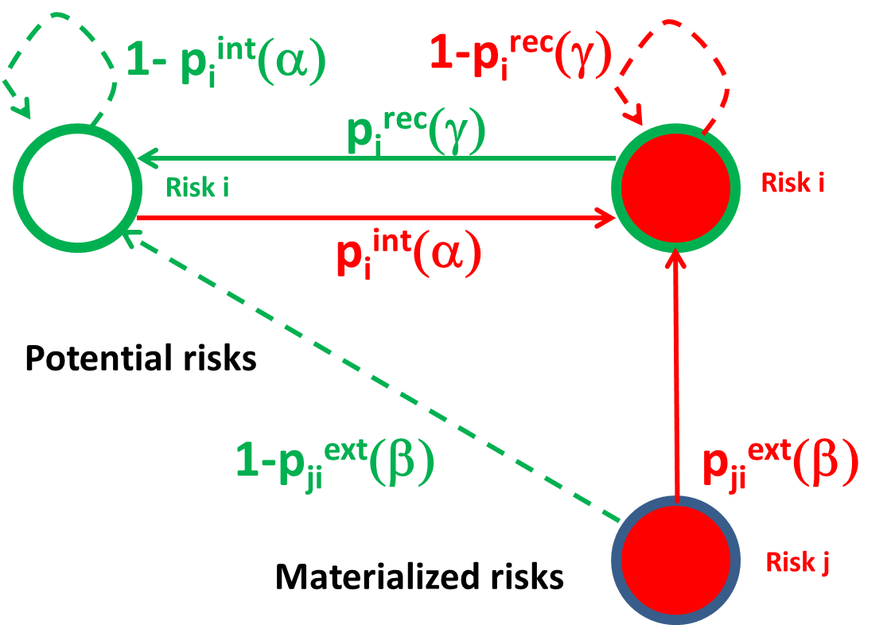
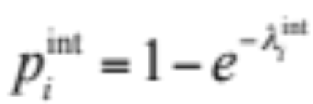
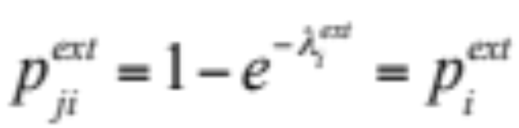
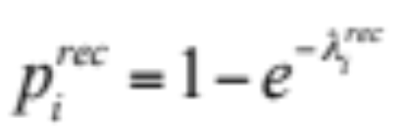
Model Dynamics
The dynamics is Markovian
and progresses by assuming
that at each time step t:
A risk i that was inactive at time t - 1
materializes internally with probability
A risk j active at time t - 1 causes a connected risk i inactive at
time t - 1 to materialize with probability
A risk i that was active at time t – 1 recovers from its
active risk with probability
Notes:
We model risk materialization as a Markovian process with probabilities for internal and external risk materialization, as well as a recovery probability. The solid lines represent a change of state, while dotted lines represent no change in state. Every probability is calculated once per time step, from time t-1, to time t. Starting at the top left inactive node we see that the probability that it’s risk is internally materialized is simply P_int. The probability that the node stays in the same state of no risk materialization is 1-P_int. Next we look at the node on the top right who’s risk has been materialized. With probability P_rec this node can recover, or with probability 1-P_rec this node can remain in the same state. Finally we can turn our focus to a third node J and it’s external influence on a non-activated node I. With probability P_ext node J can materialize the risk in node I (the solid line going straight up), and conversely with probability 1-P_ext node J will have no effect on node I, and node I will remain in an inactive state.

Slide 11
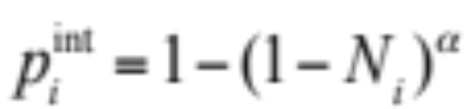
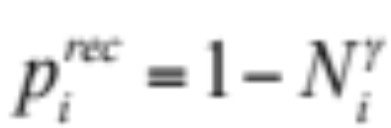
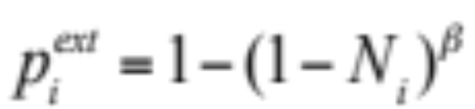
Model Parameters
Normalizing the likelihood values, L_{i}, given in the range [1, 5] to their natural range of [0, 1], we obtain:
N_{I} = (L_{i}-1)/4
This normalized likelihood values N_{i} are in direct proportion to the expert assessment L_{i} and for our purposes captures the node’s vulnerability to a failure.
Probability of internally triggering inactive risk is:
Probability of active risk recovering to inactive state is:
Probability of triggering externally inactive risk i by active risk j is:
Notes:
Now we take the expert assessments of the various risks which were generated on a 1-5 scale, normalize them, and use them to generate probabilities for materialization and recovery, as prescribed. We tweak the parameters alpha, beta, and gamma to generate the maximum likelihood of the probabilities that we observe from our previous modeling. (b is adjacency matrix)

Slide 12
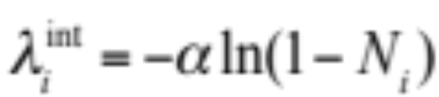
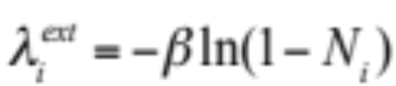
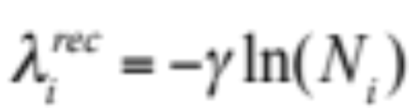
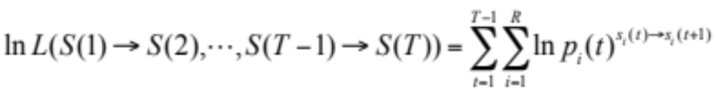
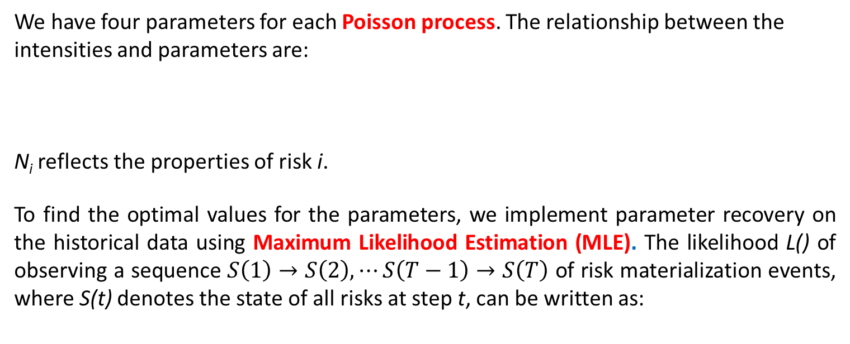
Parameter Recovery Formulation
We have four parameters for each Poisson process. The relationship between the intensities and parameters are:
N_{i} reflects the properties of risk i.
To find the optimal values for the parameters, we implement parameter recovery on the historical data using Maximum Likelihood Estimation (MLE). The likelihood L() of observing a sequence $S\left(1\right)→S\left(2\right),⋯S\left(T−1\right)→S\left(T\right)$ of risk materialization events, where S(t) denotes the state of all risks at step t, can be written as:
where T is total size of historical data, R is the number of risks, s_{i}(t) is the state of risk i at step t, and${p_{i}(t)}^{s_{i}(t)→s_{i}(t+1)}$ denotes the probability of transition for risk i at step t.
The optimal values for parameters are those that maximize the likelihood of observing the historical data with the assumed distribution.

Slide 13
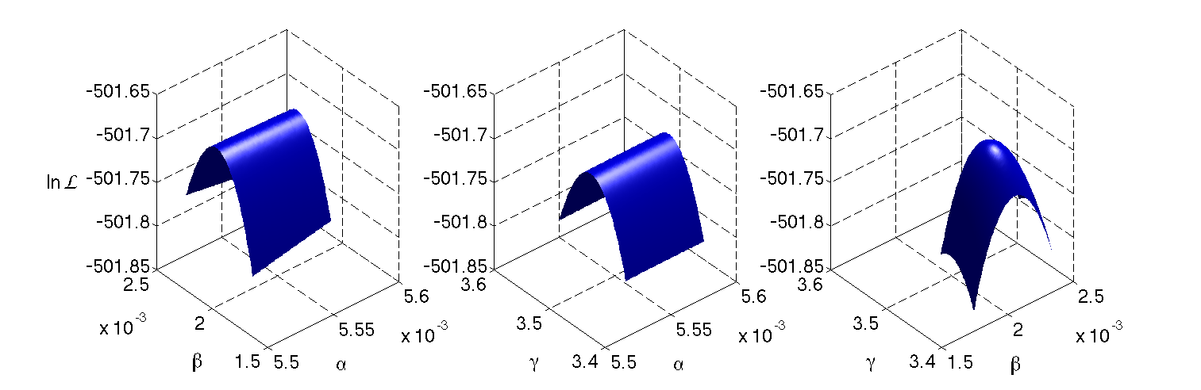
MLE* Values of Parameters
By scanning different combinations of 𝛼, 𝛽 and γ over their respective acceptable ranges, and by computing the resulting log-likelihoods, we find with the desired precision the values of 𝛼, 𝛽 and γ that maximize the likelihood of observing the data.
The likelihood function is itself smooth with a unique maximum that guarantees that the found parameter values are indeed globally optimal for the model considered.
α=0.364≈4/11, β=0.14≈1/7, γ=427
* Y. Pawitan, In All Likelihood: Statistical Modelling And Inference Using Likelihood (Clarendon, 2001)

Slide 14
14
Historical Data of Global Risks
We collected data on the materialization of each risk over the period 2000 – 2017.
The source of data is news, magazine, academic articles and websites.
There are 50 * 13 * 12 = 7800 data points for finding system parameters for 2013.
Global Governance Failure (19) | Events | Influence | Period | Reference
 | Crisis in Syria | Global and serious | 2011.05 --- 2012.12 | http://en.wikipedia.org/wiki/Syrian_Civil_War http://www.usaid.gov/crisis/syria http://www.cbsnews.com/feature/syria-crisis/ http://www.bbc.com/news/world-middle-east-17258397
 | Crisis in Libya | Global and serious | 2011.02 --- 2012.12 | http://en.wikipedia.org/wiki/Libyan_Civil_War http://www.nytimes.com/2013/10/11/opinion/libyas-security-crisis.html?gwh=3863288CE0B70560093F7E40D0254D5D&gwt=pay http://www.bbc.com/news/world-middle-east-12480844
The optimal values of model parameters α, β, γ based on collected data
Year | Nodes | Edges | Avg. Degree | Edge Prob. | Avg. CC. | Diameter | α | β | γ
2013 | 50 | 515 | 20.60 | 0.42 | 0.61 | 3 | 0.364 | 0.140 | 427
2017 | 30 | 275 | 18.33 | 0.63 | 0.74 | 2 | 0.634 | 0.364 | 300

Slide 15
15
Contagion Potentials Versus Internal Vulnerability
Five risks with the highest contagion potential in 2013 were:
8 -- Severe income disparity
25 – Global government failure
1 – Chronic fiscal imbalances
27 – Pervasive entrenched corruption
12 -- Failure of climate change adaptation
Network visualization showing the contagion potentials (indicated by color) and the internal failure probabilities (indicated by size) with the optimal parameters.
Notes:
Here we see a visualization of the results. We display the contagion potentials through the color of the nodes. We highlight the 5 risks with the greatest contagion potential. They are “Severe income disparity”, “Global government failure”, “Chronic fiscal imbalances”, “Pervasive entrenched corruption”, and “Failure of climate change adaptation”. We display the internal failure probabilities as the size of each node.

Slide 16
16
Asymptotic (Steady State) Risk-Persistence for 2013
Notes:
Here we have the persistence of all risks. The persistence is the fraction of time-steps during which the risks were active. Again we see that “Severe income disparity” tops the list. (Asymptotic because we only consider the steady state. Did not include measurement of the initial transient 200 steps of simulation).

Slide 17
17
Conclusions Based on the Network Model
For 2013 data, we rank order the persistence of various risks during the lifetime of a cascade. Strikingly, risk 8 - “Severe income disparity” - was active for about 80% of the lifetime of a cascade on average, while in comparison, the second most persistently active risk - “Chronic fiscal imbalances” - was active for about 33% of the lifetime of a cascade on average.
Decreasing the internal failure and external influence probabilities of global risks both contribute to the stability of the global economy, with reduction of internal failure probabilities contributing more effectively.
Notes:
There are stark quantitative differences between the rank ordered persistence during cascades, and the general persistence of the system, yet qualitatively they are very similar, with the top 14 risks of both being the same (with one exception). Our finding suggest that reducing internal failure probabilities (as opposed to isolating influence of different risks) is more effective in stabilizing the global economy.

Slide 18
Measuring Quality of Predictions
In the global risk network, we recover latent (hidden) and explicit parameters of the model from historical data and predict future activation of global risks, including cascades of such risk activations.
The question arises how reliable such parameter recovery is and how the recovery precision depends on the complexity of the model and the length of its historical data.
Here, this model is applied to fire propagation in an artificial city with modular blocks that can be assembled into a complex system.
We simulate the fires in such cities of varying size, over varying periods of times and use the Maximum Likelihood Estimation to recover the parameters and compare them with the values assigned to them in simulations.
* X. Lin, A. Moussawi, G. Korniss, J.Z. Bakdash, and B.K. Szymanski, Limits of Risk Predictability
In a Cascading Alternating Renewal Process Model, Scientific Reports 7:6699, (2017)

Slide 19
Model Details
In the firehouse model, three types of houses are defined: small, medium and large.
For each house, the quality of its building material and size of its lot are proportional to its size (type).
Each house fire worthiness properties, such as resistance to fires, ability to spread fire, etc. are determined by its type and the housing density in its neighborhood.
Large houses have a low probability of catching fire and a high ability to recover from burning, while medium and small houses have increasingly lower characteristics.
Each house has an influencing circle with a fixed radius, in which all the neighbors inside the circle are at risk of being catching fire from this house.
We can expand the city by adding blocks horizontally and vertically.

Slide 20
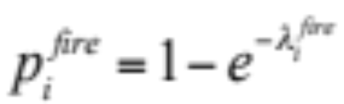

Model Dynamics - Probabilities
At time t, a house is in one of three states: susceptible (0), on-fire (1), recovery(-1)
The dynamics progresses at each time step t > 0 as follows:
House i susceptible at time t–1 catches fire internally at time t with probability:
House i that was susceptible at time t–1 catches fire externally from on-fire neighbor j at time t with probability:
House i on-fire at time t–1 is extinguished and enter the recovery state at time t with probability:
4. House i in-recovery at time t–1 becomes susceptible at time t with probability:

Slide 21
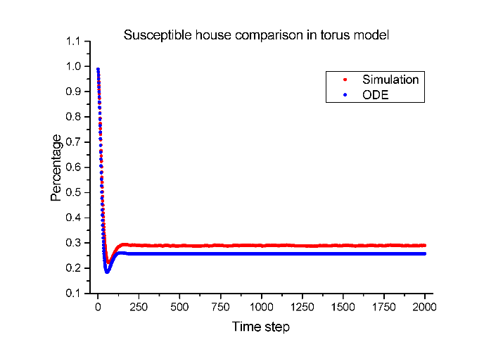
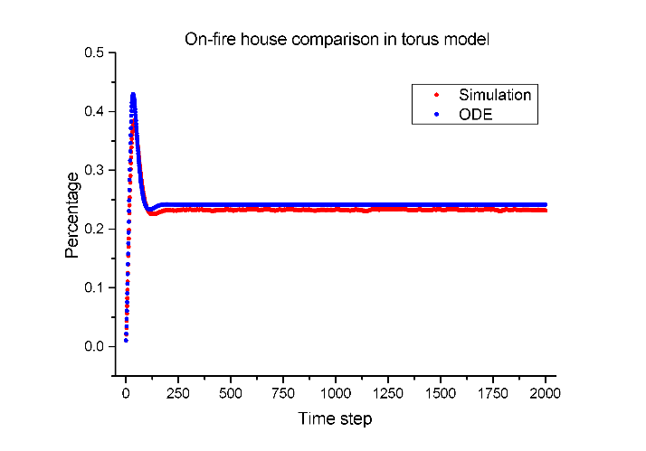
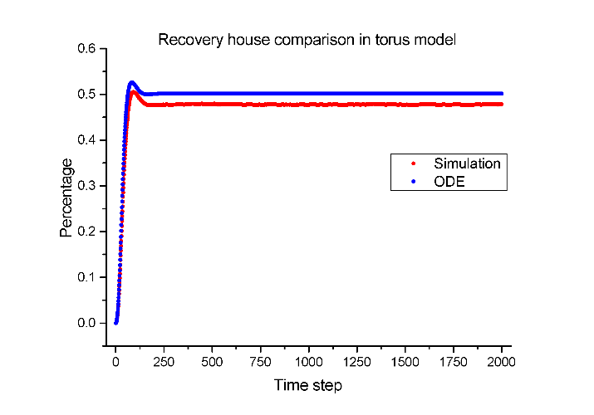
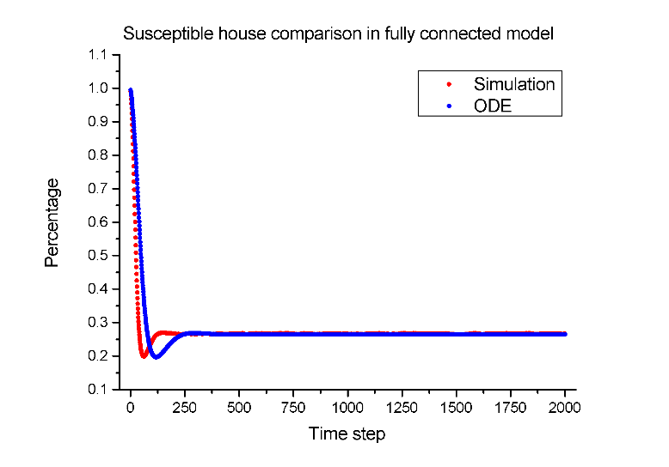
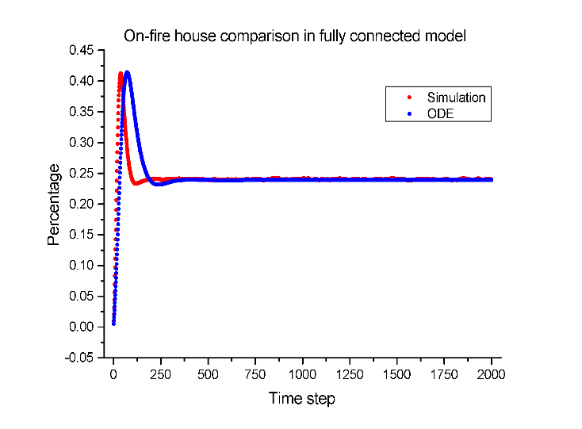
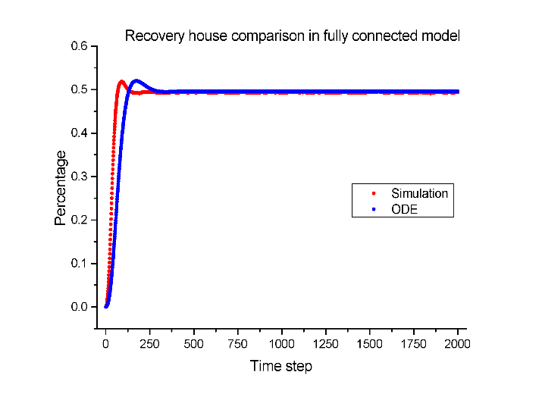
Model Comparison – Discrete vs. ODE
Three state comparisons in torus model
s(t)
f(t)
r(t)
Three state comparisons in fully connected model
s(t)
f(t)
r(t)
The higher the model connectivity, the better the match between discrete and ODE results.

Slide 22
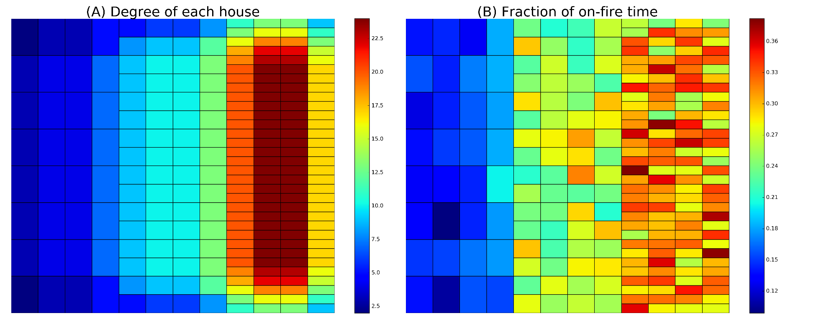
Fraction of On-fire Time in Simulation
Time steps of simulation: 10,000
Counts at how many time steps each house is on fire
Averaged 20 independent realizations

Slide 23
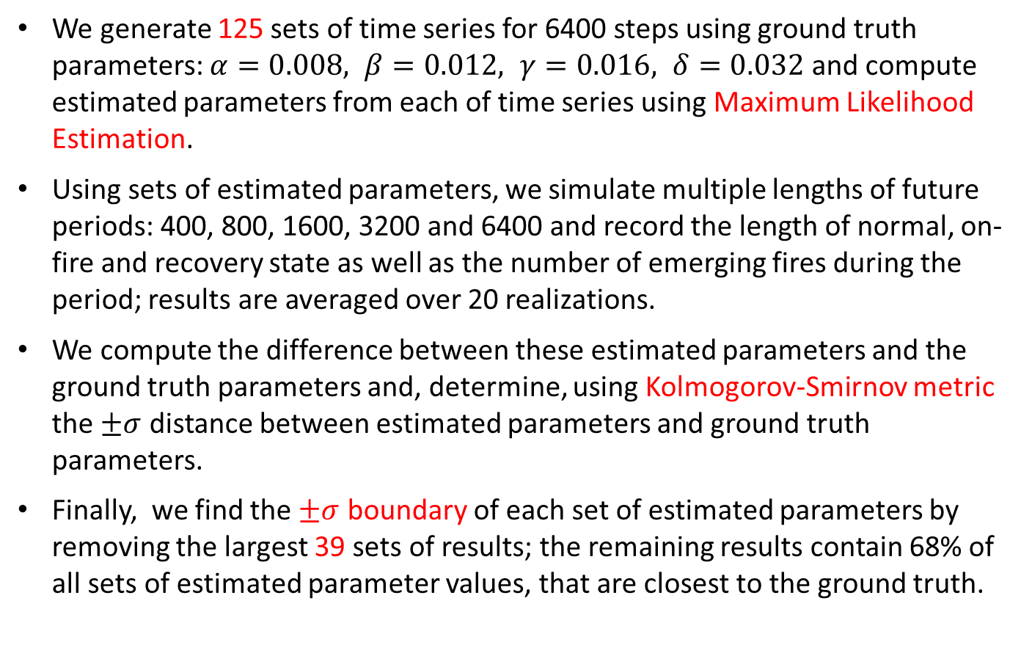
Measuring Performance of Estimated Parameters
We generate 125 sets of time series for 6400 steps using ground truth parameters: $α=0.008, β=0.012, γ=0.016, δ=0.032$ and compute estimated parameters from each of time series using Maximum Likelihood Estimation.
Using sets of estimated parameters, we simulate multiple lengths of future periods: 400, 800, 1600, 3200 and 6400 and record the length of normal, on-fire and recovery state as well as the number of emerging fires during the period; results are averaged over 20 realizations.
We compute the difference between these estimated parameters and the ground truth parameters and, determine, using Kolmogorov-Smirnov metric the $±σ$ distance between estimated parameters and ground truth parameters.
Finally, we find the $±σ$ boundary of each set of estimated parameters by removing the largest 39 sets of results; the remaining results contain 68% of all sets of estimated parameter values, that are closest to the ground truth.

Slide 24
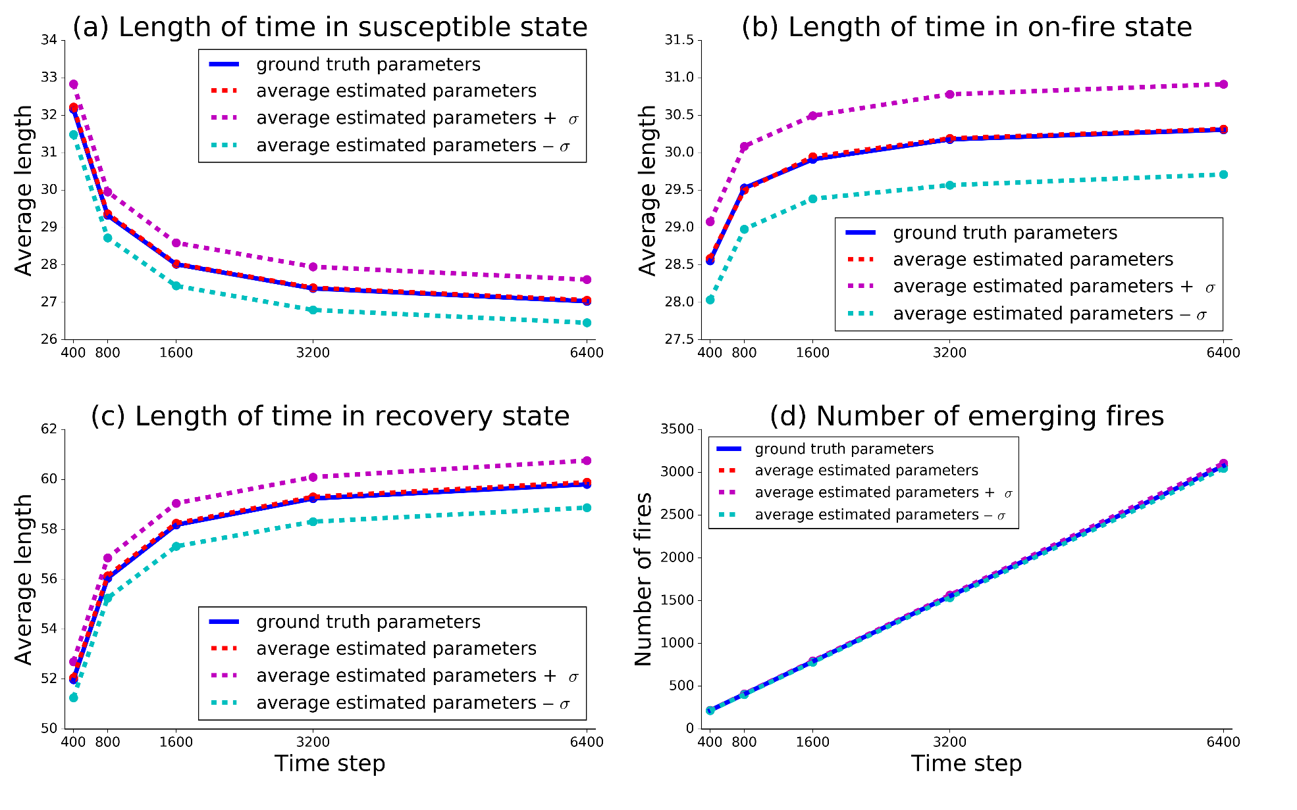
Performance of Estimated Parameters

Slide 25
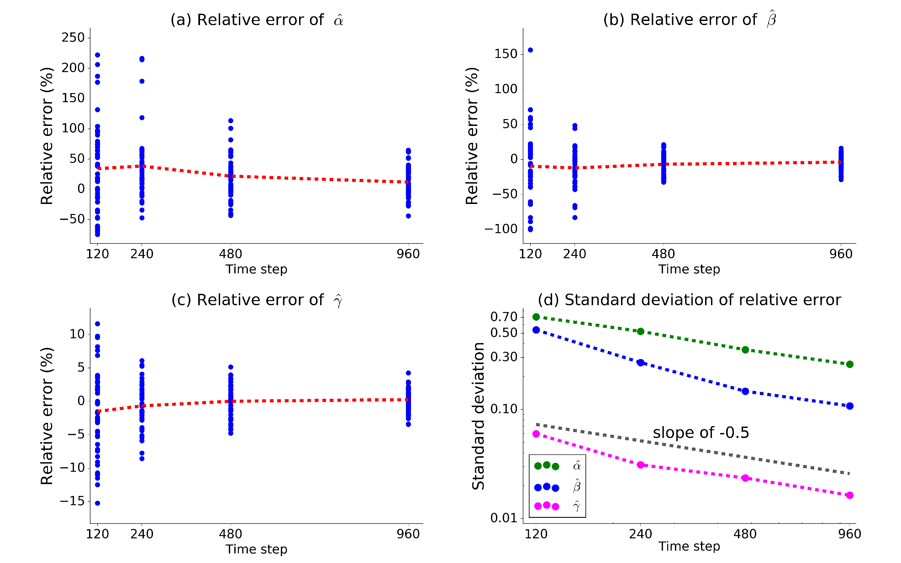
Parameter Recovery in Global Risk Network
Ground truth parameters: $α=0.364, β=0.140, γ=$ 427
For each case, there are 50 realizations.

Slide 26
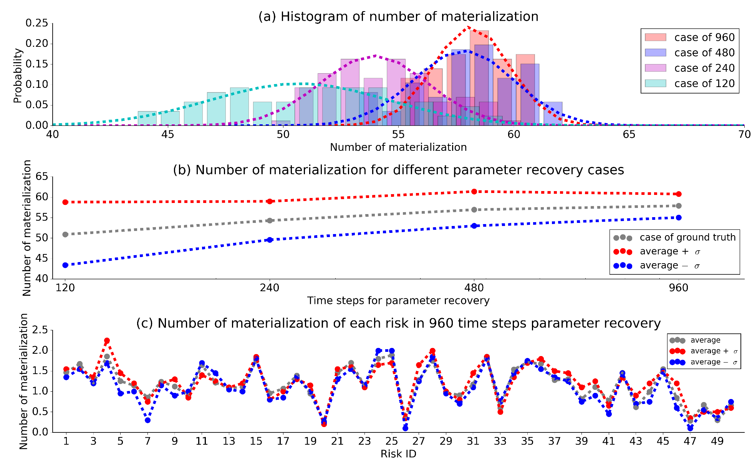
Parameter Recovery in Global Risk Network
125 sets of estimated parameters.
Number of realizations is 20 in each scenario.

Slide 27
Conclusions and Future Plan
Conclusions
Studying the prediction limit of an interconnected network of risks using Alternative Renewal Process, we find that:
Simulations of discrete and continuous (ODE) risk models match each other with precision improving with the increasing model connectivity.
The parameter recovery performance improves and its error decreases when the volume of training data grows.
The relative error reduces asymptotically to zero with unlimited growth of training data.
Future Plans
Implementing parameter recovery for more complex models
Measuring the prediction accuracy using statistical metrics
Studying applications combining human expert assessment with the stochastic computer predictions based on MLE recovered parameters for regional models.

Slide 28
Questions?

