Slide 1
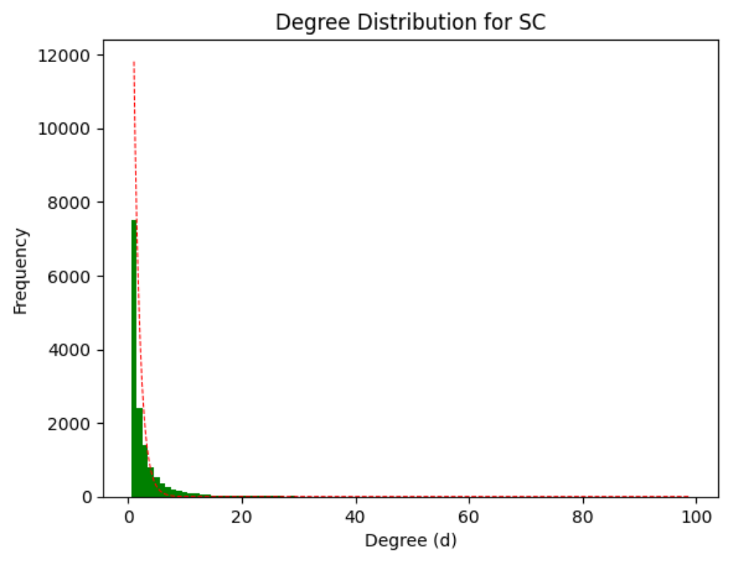
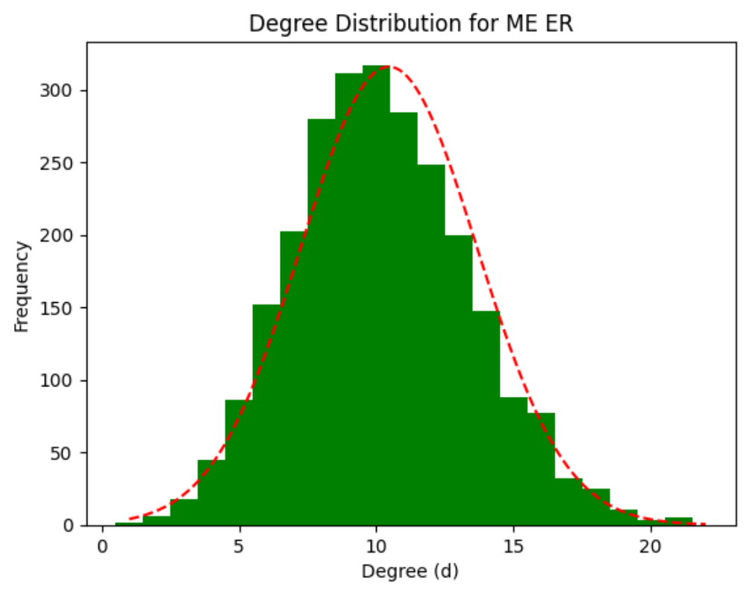
What to avoid
This plot begs for log log scale This plot is perfectly happy with linear scale

Slide 2
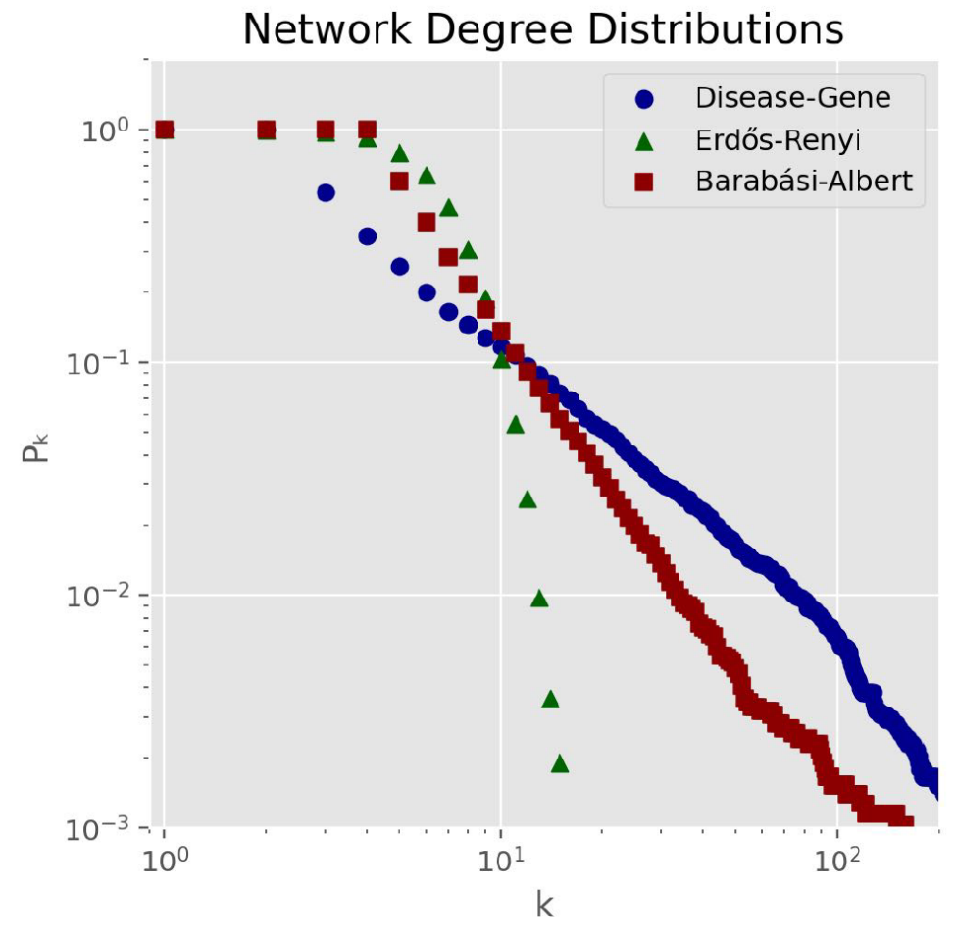
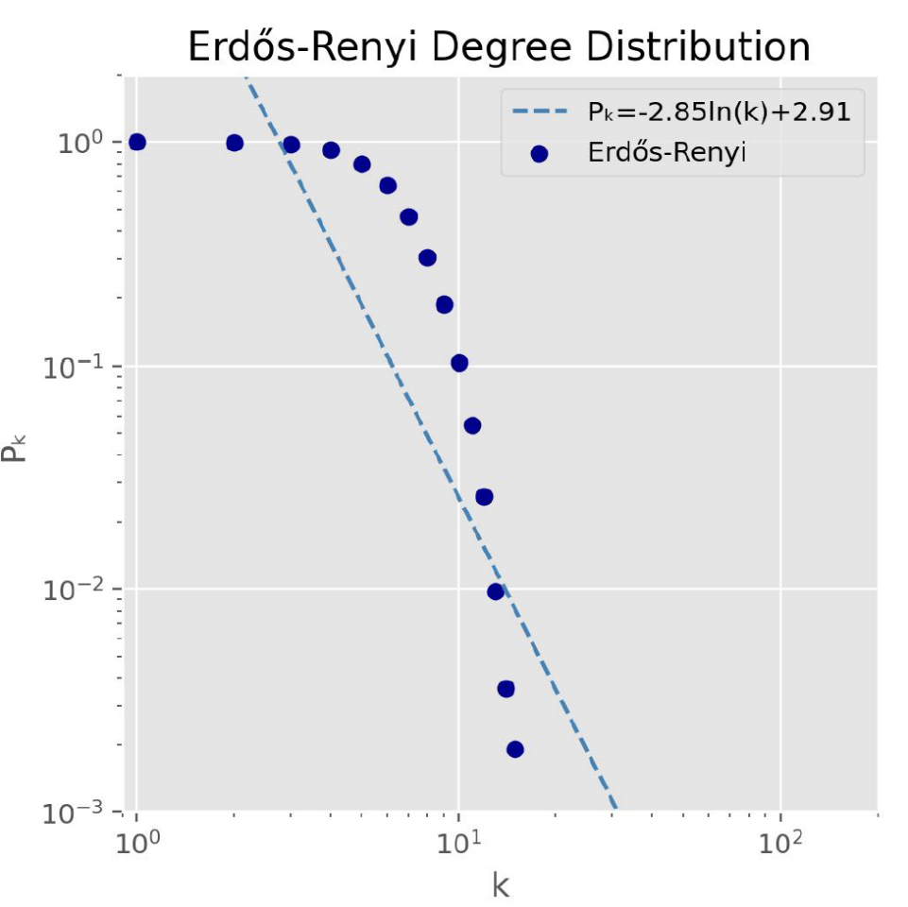
Comparison of degree distribution of
Disease Gene Network with Random Network
Christopher Maria

Slide 3
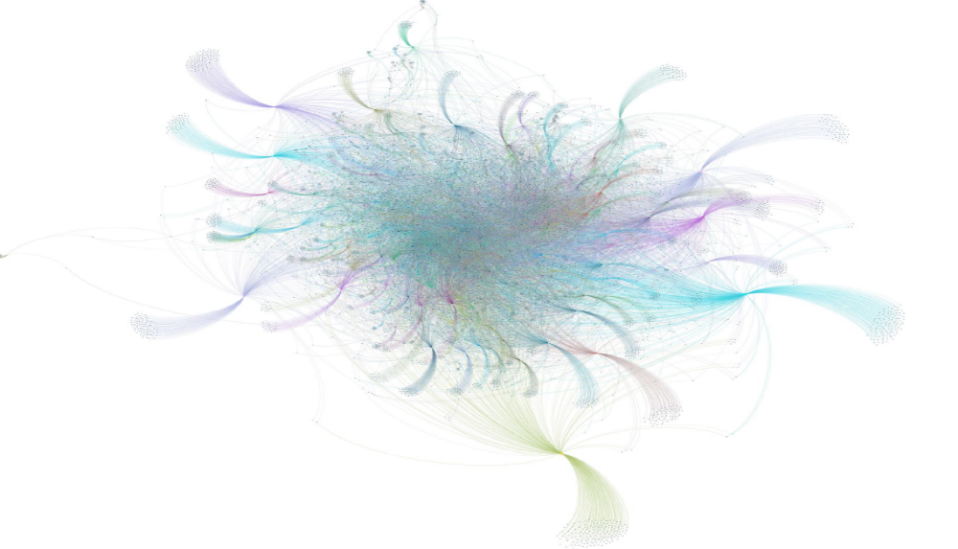
Visualization of Disease Gene Network
Christopher Maria

Slide 4
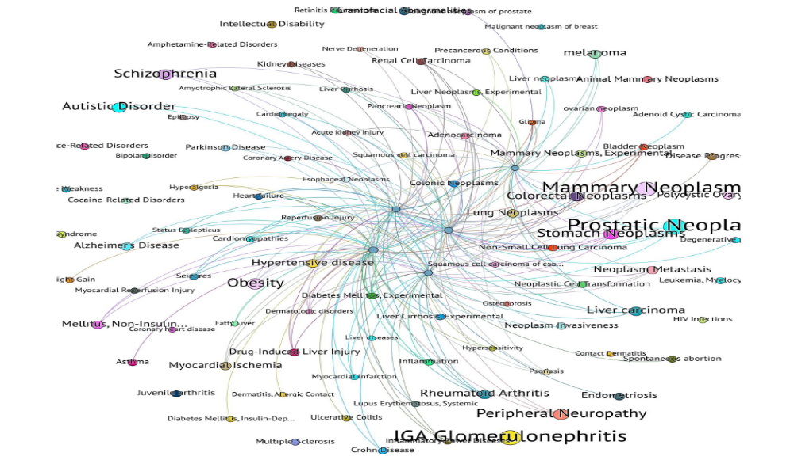
100 nodes by degree showing highly connected center
Christopher Maria

Slide 5
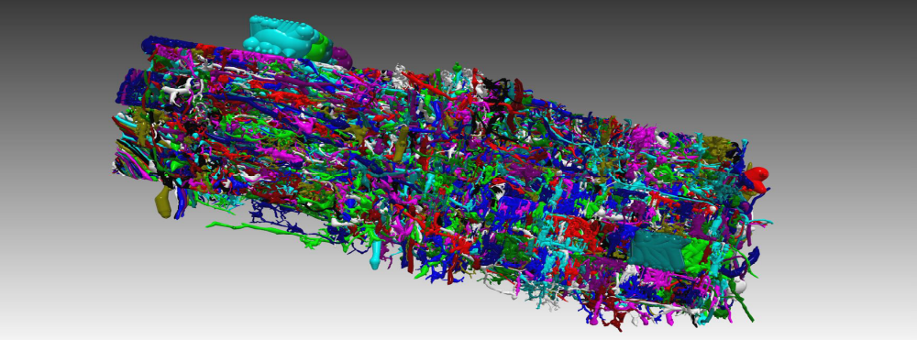
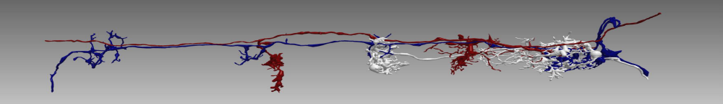
Individually colored neurons and high-degree neuron group
Christopher Maria: Drosophila Medula Neural Connectome

Slide 6
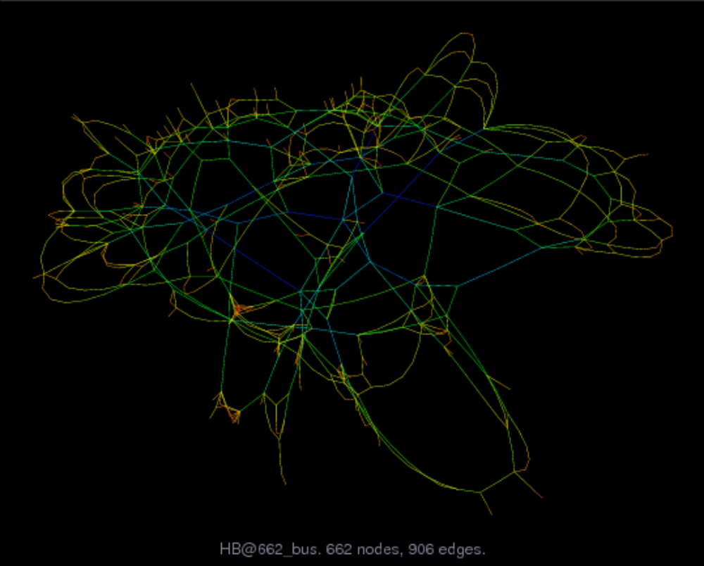
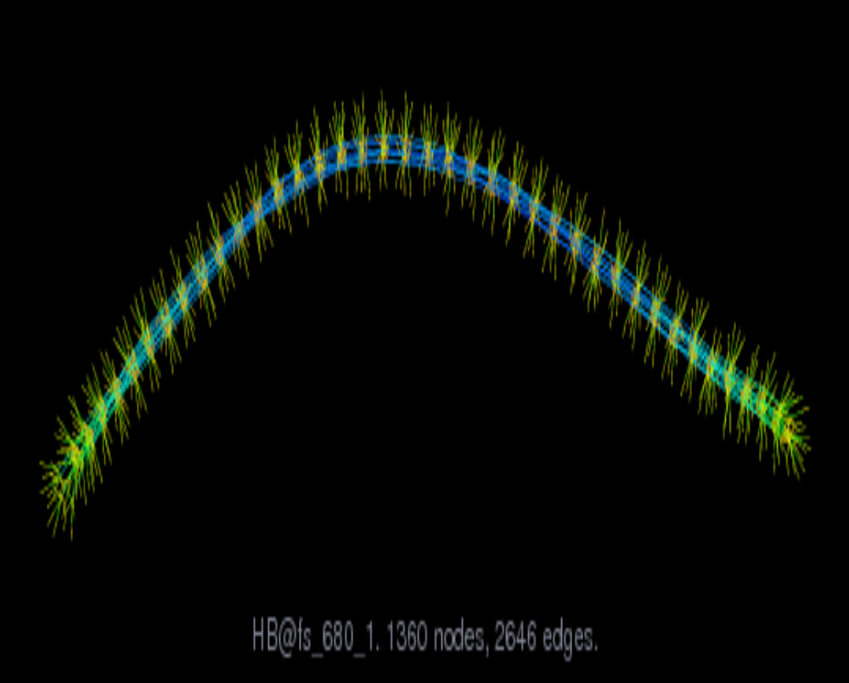
Individually colored neurons and high-degree neuron group
Convergence Matrix visualization for PDE 2D/3D solution
662 Bus Power System visualization spatial embedding
Emelia Blankenship

Slide 7
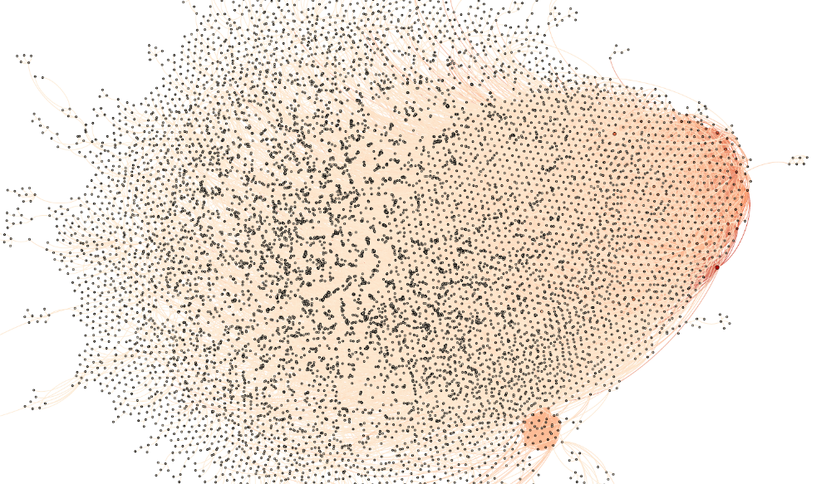
Visualization of twin cities, each node represents a city, and an edge a twin relationship between nodes.
Sen Francis: A snapshot of the center distribution of the network.

Slide 8
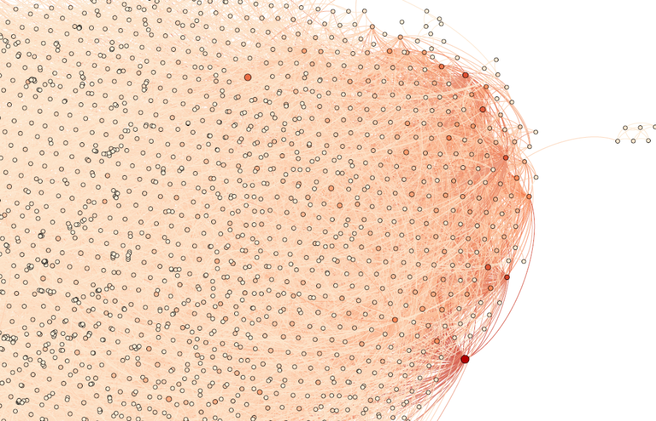
Visualization of twin cities, each node represents a city, and an edge a twin relationship between nodes.
Sen Francis:
A zoomed in
snapshot of the network.

Slide 9
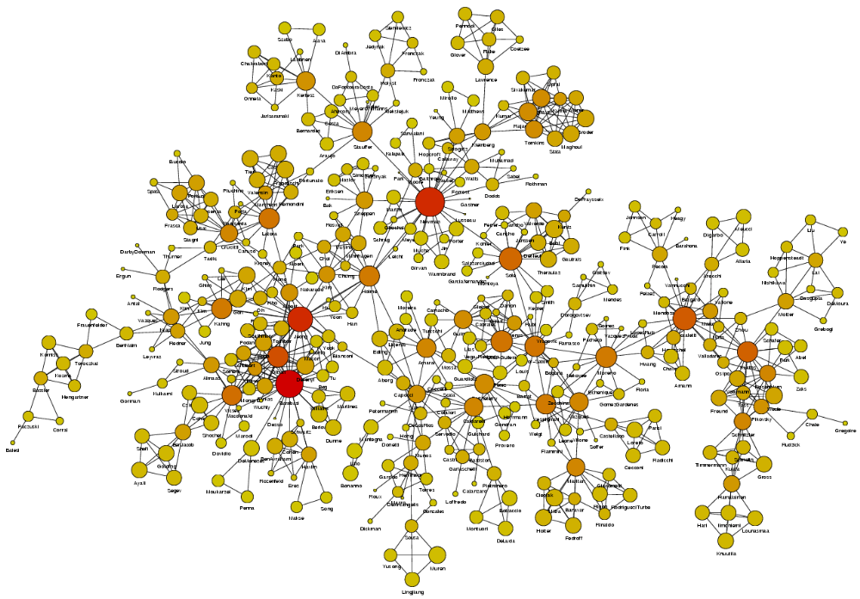
NetScience Collaboration Network
Maria Khodak

Slide 10
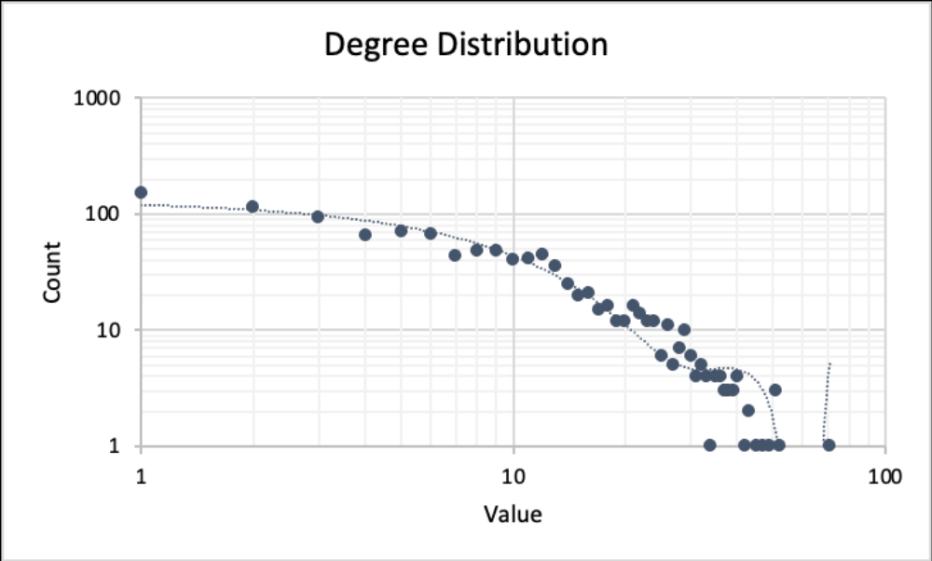
University Emails – Degree distribution in log log scale
Lisa Knuckey

Slide 11
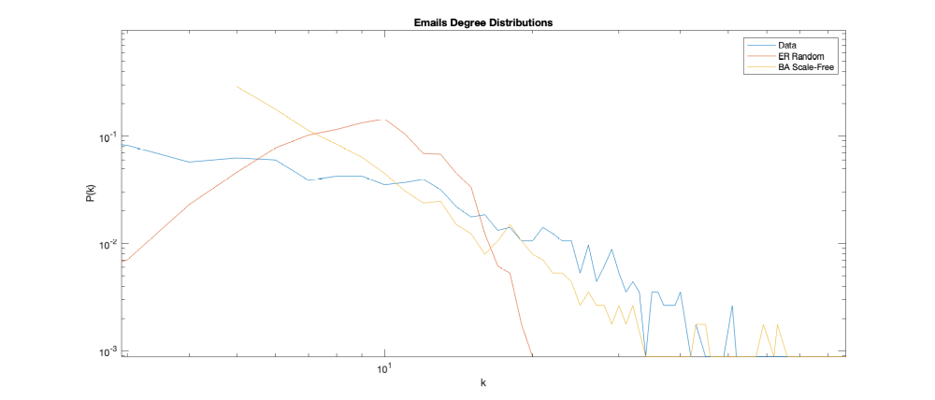
University Emails, ER, BA – Degree distribution in log log scales
Lisa Knuckey

Slide 12
Alta Vista 2003 crawl of the Web graph
Stephen Trempel

Slide 13
This network is a database of networks to aid in the study of sparse matrix problems.
Circle: node (the color darkens (from yellow to red) and the size increases as the degree of the node increases)
Blue line: edges
Stephen Trempel

Slide 14
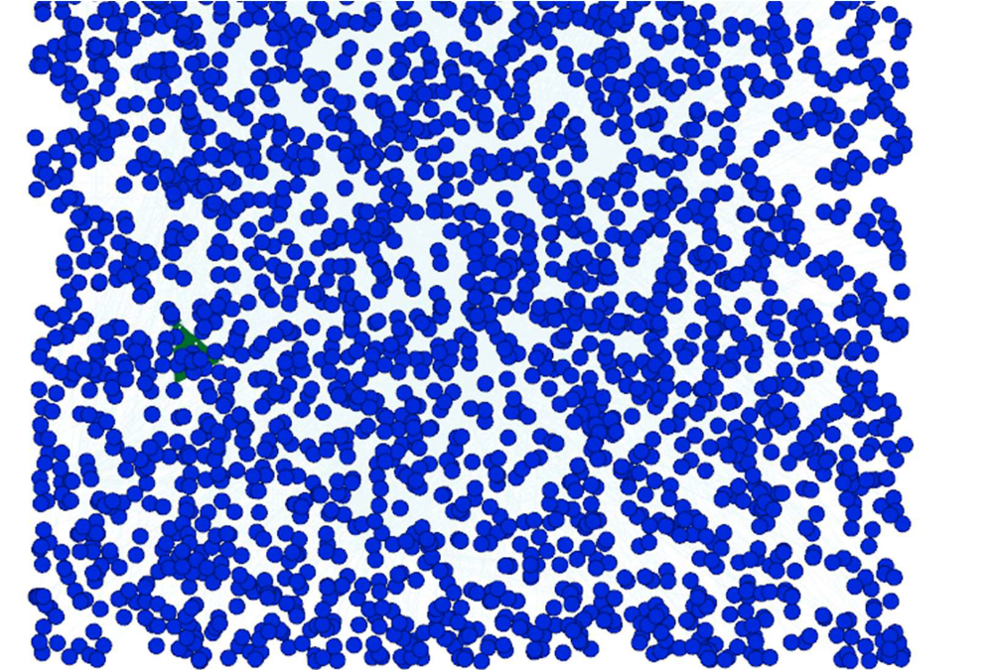
Facebook Social Network with 2.9k nodes shown without edges but with weights
Felix Yu

Slide 15
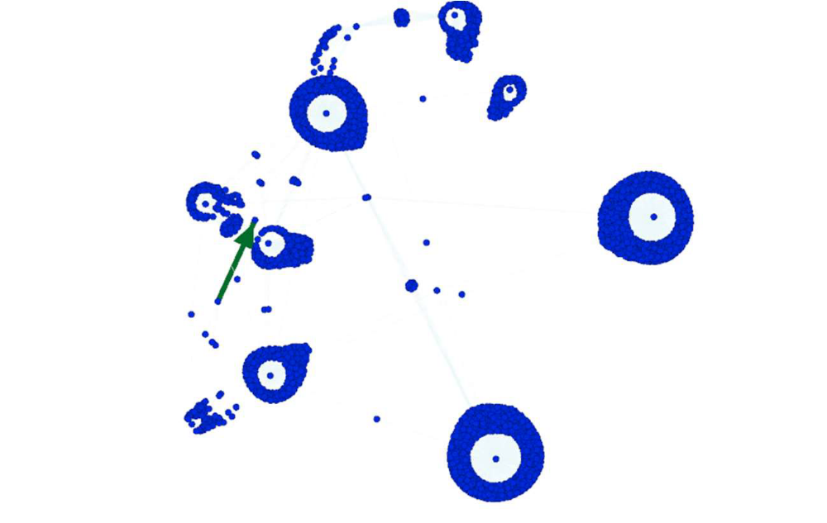
Facebook Social Network with 2.9k nodes – view of clusters
Felix Yu

Slide 16
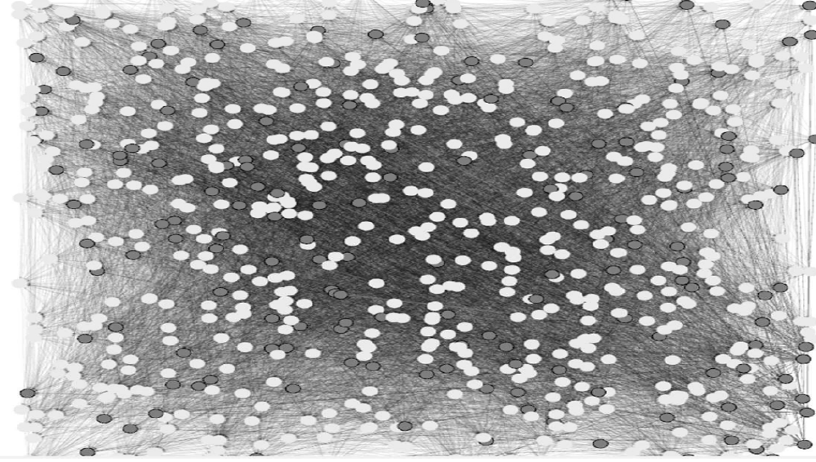
Large network with 16.7k edges – after evolving under force
Felix Yu

