Slide 1

Frontiers of Network Science
Fall 2021
Class 16: Degree Correlations
(Chapter 7 in Textbook)
based on slides by
Albert-László Barabási
and Roberta Sinatra
Boleslaw Szymanski
www.BarabasiLab.com

Slide 2
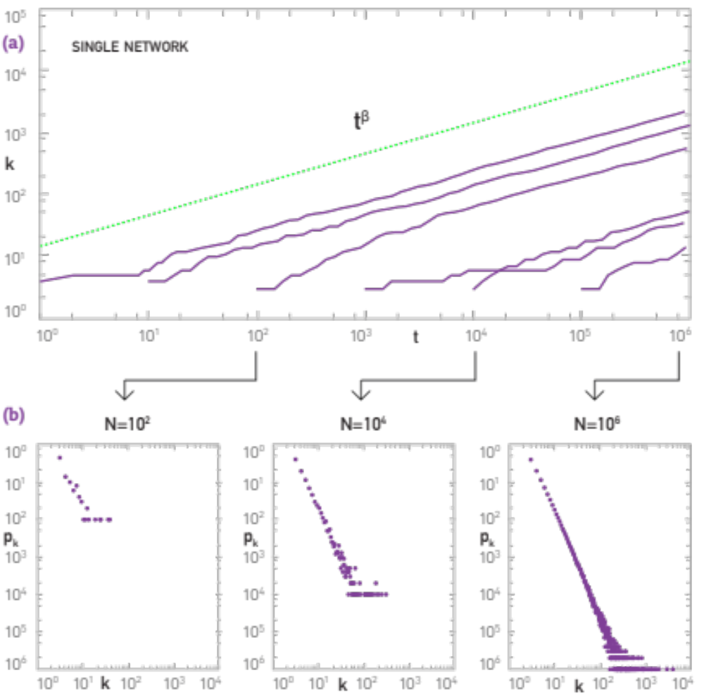
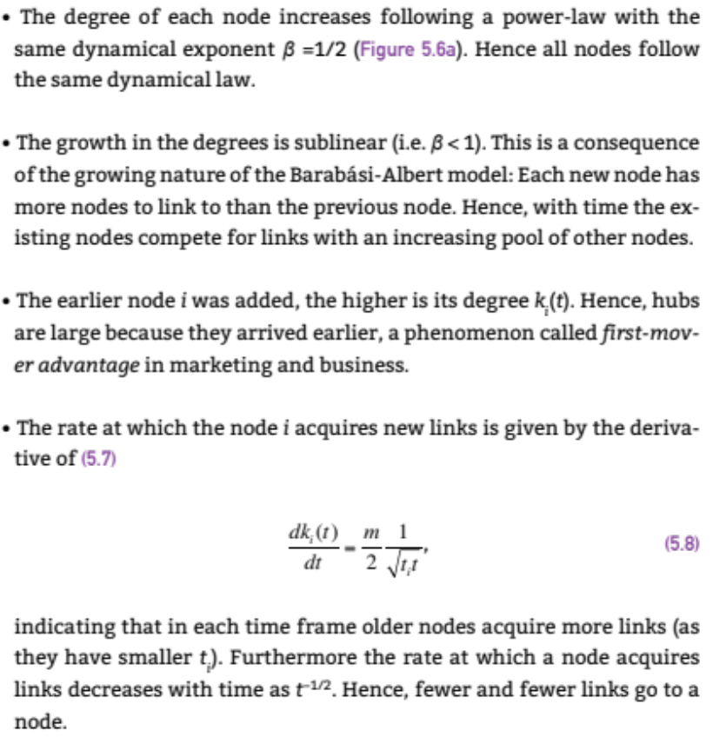
Section 5.3

Slide 3
Section 6
Absence of growth and preferential attachment

Slide 4
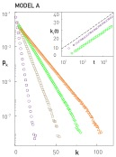
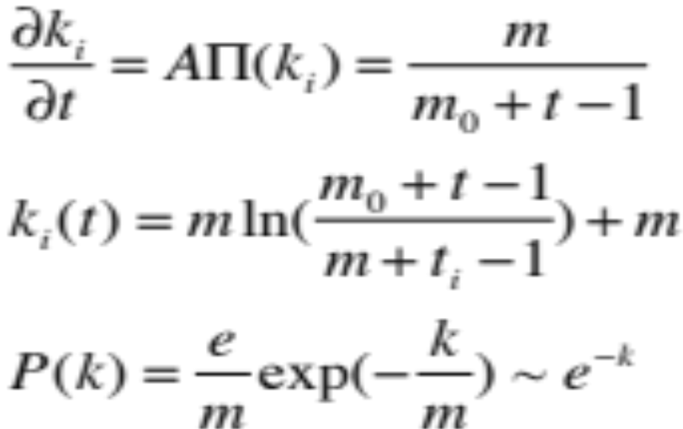
MODEL A
growth preferential attachment
Π(k_{i}) : uniform

Slide 5
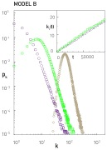
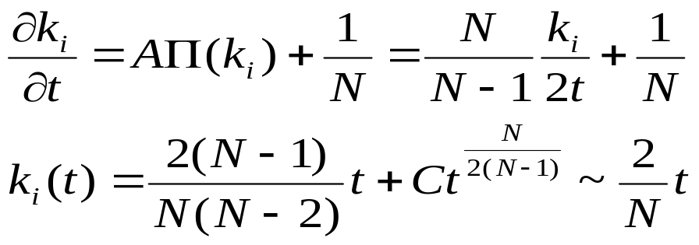
MODEL B
growth preferential attachment
p_{k} : power law (initially) →
→ Gaussian → Fully Connected

Slide 6
Do we need both growth and preferential attachment?
YEP
Network Science: Evolving Network Models

Slide 7
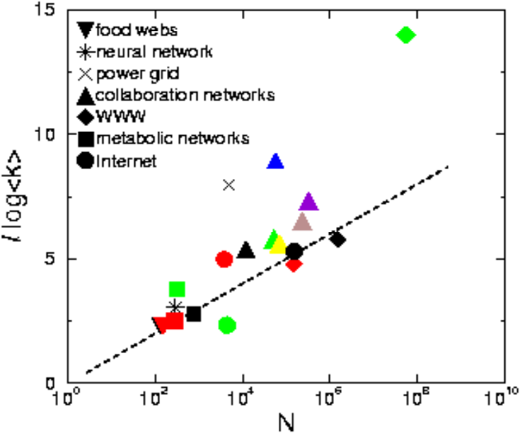
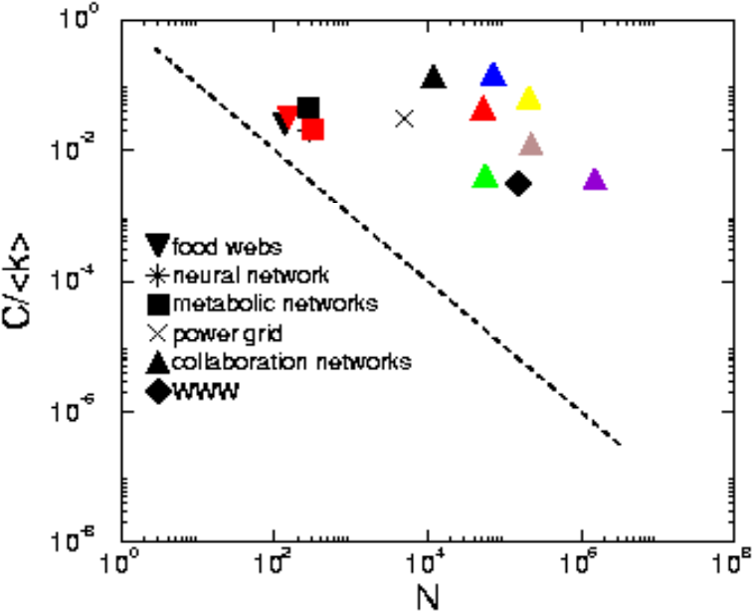








Regular network
EMPIRICAL DATA FOR REAL NETWORKS
Pathlenght
Clustering
Degree Distr.
P(k) ~ k^{-γ}
P(k)=δ(k-k_{d})
Erdos-
Renyi
Watts-
Strogatz
Exponential
Barabasi-Albert
P(k) ~ k^{-γ}
Network Science: Evolving Network Models
Notes:
As a universal feature, they do well in clustering and the path lenghts. However, they all fail in the degree distribution. Hence we need models the fix that problem. As will see, this is not a trivial feature– many properties of real networks are determined primarily by the degree distribution.

Slide 8
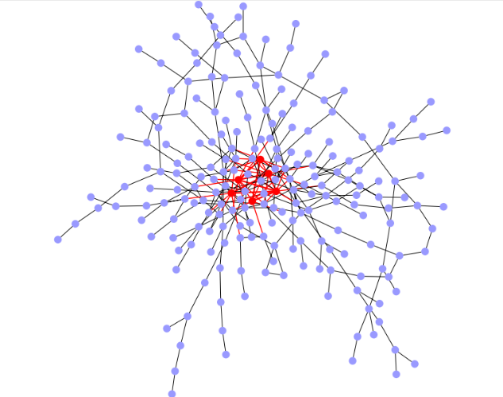
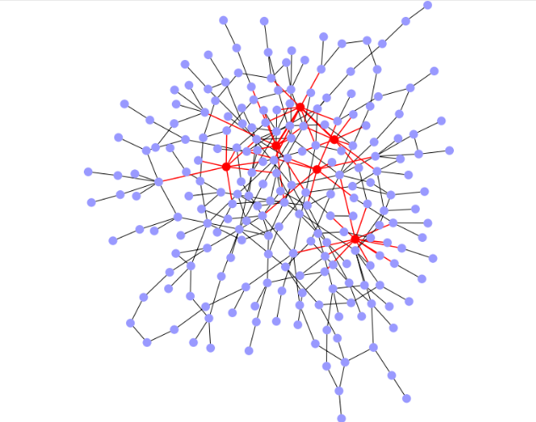
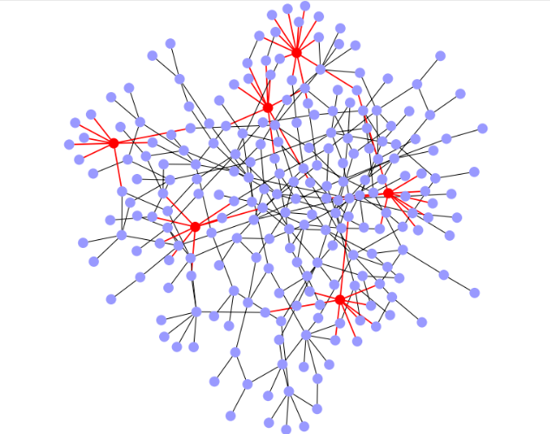
DEGREE CORRELATIONS IN NETWORKS
Assortative:
hubs show a tendency to link to each other.
Neutral:
nodes connect to each other with the expected random probabilities.
Disassortative:
Hubs tend to avoid linking to each other.
Quantifying degree correlations (three approaches):
→ full statistical description (Maslov and Sneppen, Science 2001)
→ degree correlation function (Pastor Satorras and Vespignani, PRL 2001)
→ correlation coefficient (Newman, PRL 2002)
Network Science: Degree Correlations

Slide 9


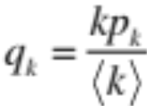

STATISTICAL DESCRIPTION
e_{jk}: probability to find a node with degree j and degree k at the two ends of a randomly selected edge
q_{k}: the probability to have a degree k node at the end of a link.
Where:
Probability to find a node at the end of a link is biased towards the more connected nodes, i.e. q_{k}=Ckp_{k,} where C is a normalization constant . After normalization we find C=1/<k>, or q_{k}=kp_{k}/<k>
If the network has no degree correlations:
Deviations from this prediction are a signature of degree correlation.
M. E. J. Newman, Phys. Rev. Lett. 89, 208701 (2002)
Network Science: Degree Correlations

Slide 10
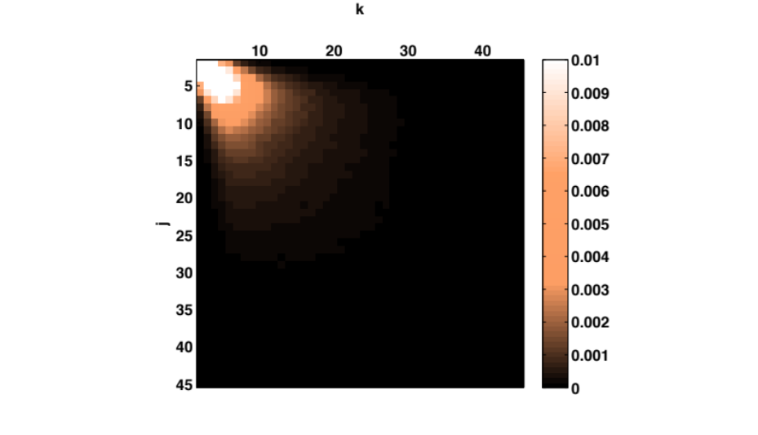
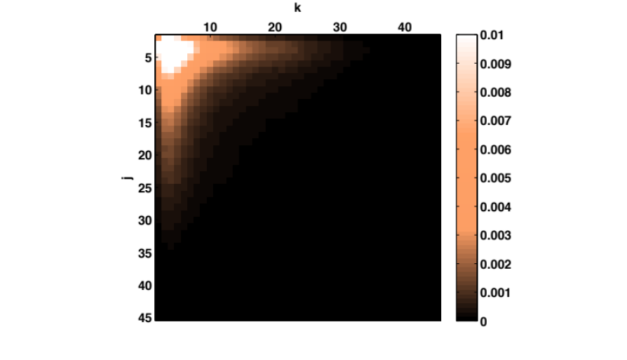

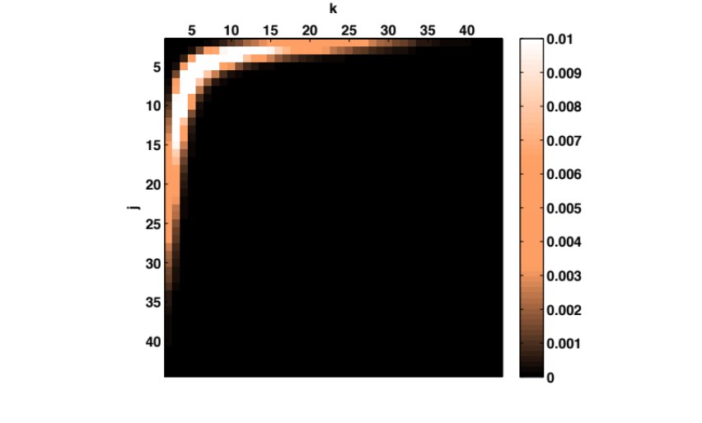
EXAMPLE: e_{jk} FOR A SCALE-FREE NETWORK
Assortative:
More strength in the diagonal, hubs tend to link to each other.
Neutral
Disassortative:
Hubs tend to connect to small nodes.
Each matrix is the average of a 100 independent scale-free networks, generated using the static model with N=10⁴, γ=2.5 and <k>=3.
Network Science: Degree Correlations

Slide 11
EXAMPLE: e_{jk} FOR A SCALE-FREE NETWORK
Assortative:
More strength in the diagonal, hubs tend to link to each other.
Perfectly assortative network:
e_{jk}=q_{k}δ_{jk}
Disassortative:
Hubs tend to connect to small nodes.
Perfectly disassortative network:
Each matrix is the average of a 100 independent scale-free networks, generated using the static model with N=10⁴, γ=2.5 and <k>=3.
Network Science: Degree Correlations

Slide 12

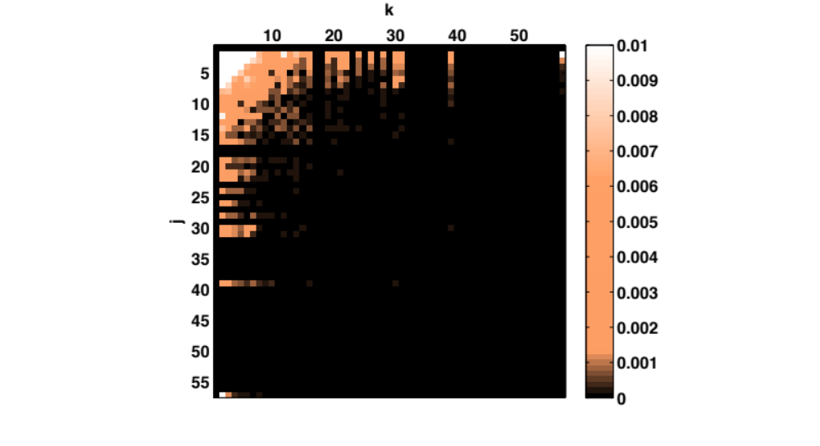


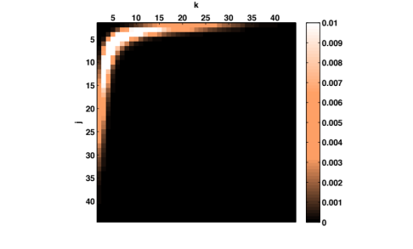
REAL-WORLD EXAMPLES
Astrophysics co-authorship network
Yeast PPI
Assortative:
More strength in the diagonal, hubs tend to link to each other.
Disassortative:
Hubs tend to connect to small nodes.
Network Science: Degree Correlations

Slide 13

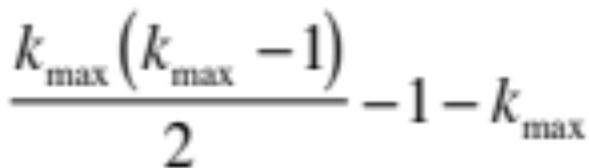
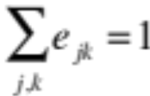
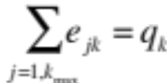
PROBLEM WITH THE FULL STATISTICAL DESCRIPTION
(1) Difficult to extract information from a visual inspection of a matrix.
(2) Based on e_{jk} and hence requires a large number of elements to inspect:
Nr. of independent elements
Undirected network:
k_{max} x k_{max} matrix
Constraints
We need to find a way to reduce the information contained in e_{jk}
M. E. J. Newman, Phys. Rev. Lett. 89, 208701 (2002)
Network Science: Degree Correlations

