Slide 1
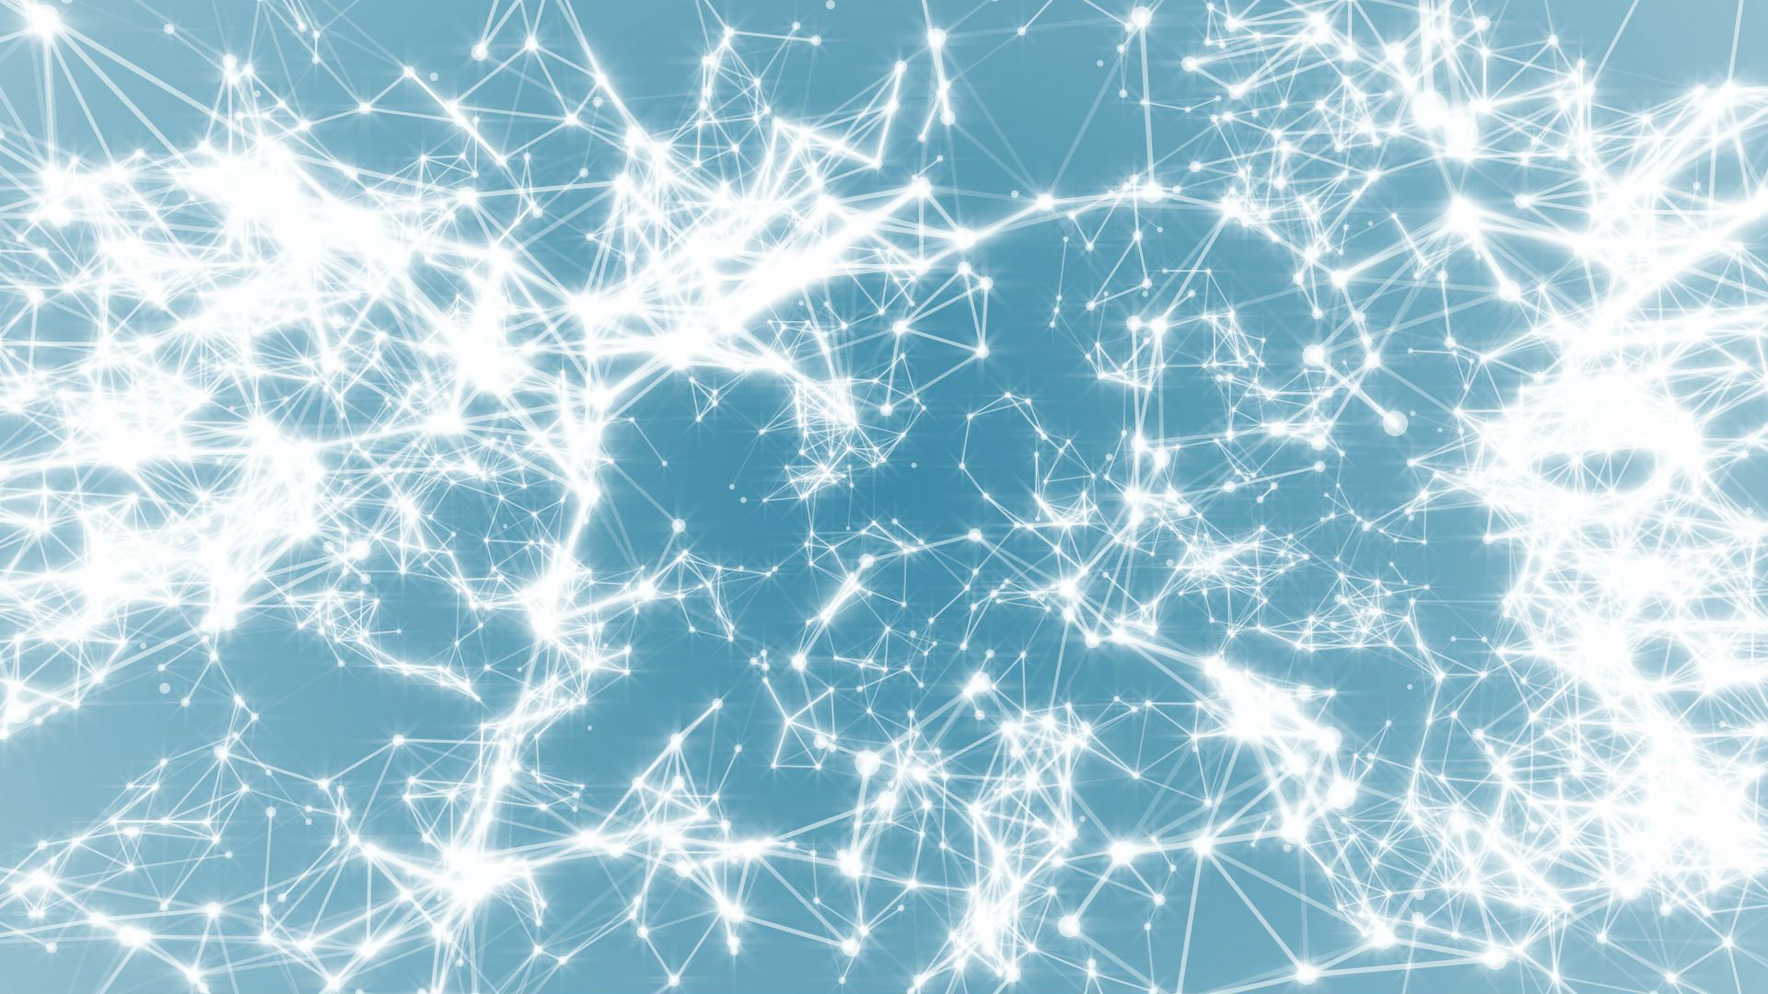
Frontiers of Network Science
Fall 2021
Class 10: Barabasi-Albert Model
(Chapter 5 in Textbook)
Boleslaw Szymanski
based on slides by
Albert-László Barabási
and Roberta Sinatra
www.BarabasiLab.com

Slide 2
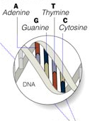

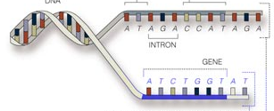
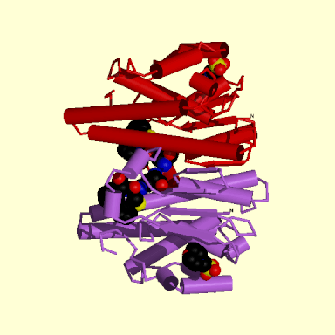
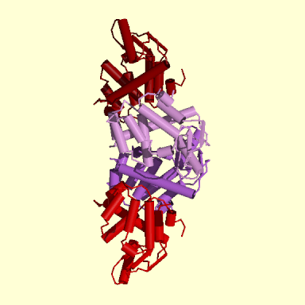
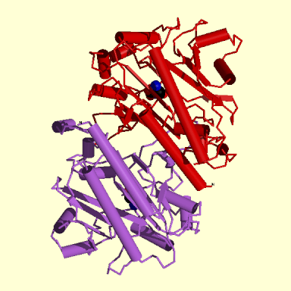
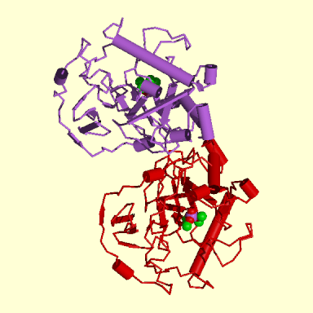
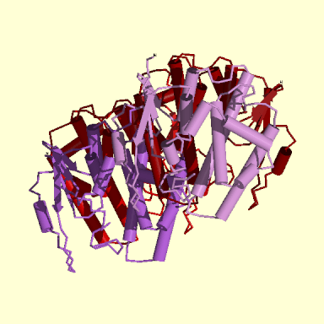
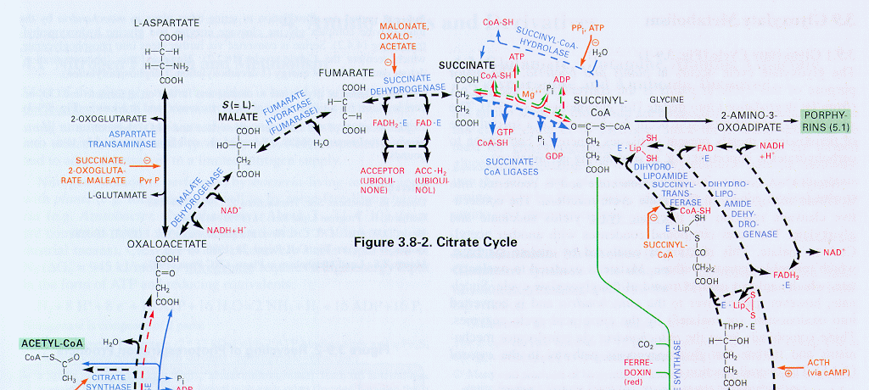
Bio-Map
GENOME
protein-gene interactions
PROTEOME
protein-protein interactions
METABOLISM
Bio-chemical reactions
Citrate Cycle
Network Science: Scale-Free Networks

Slide 3
Citrate Cycle
METABOLISM
Bio-chemical reactions
Network Science: Scale-Free Networks

Slide 4
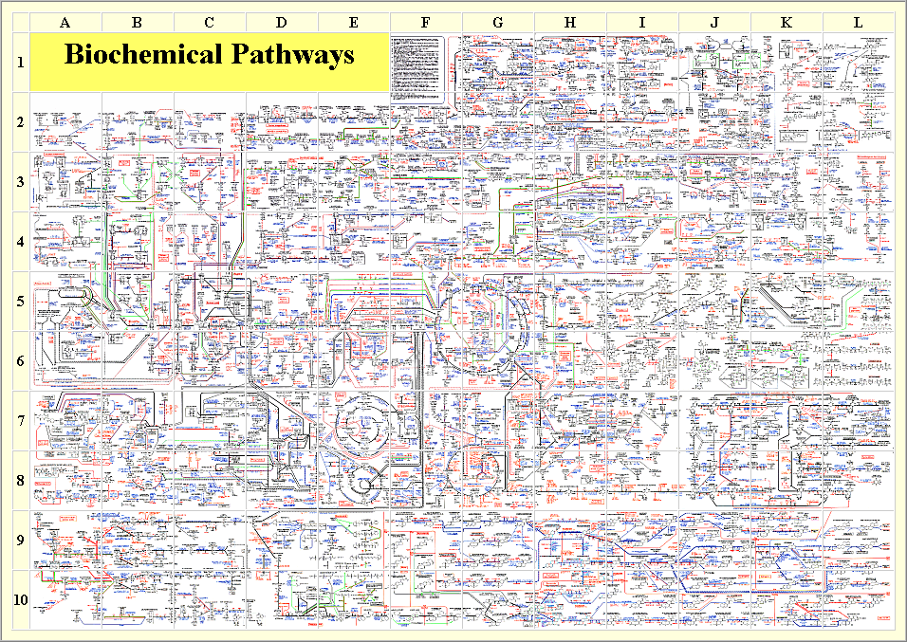
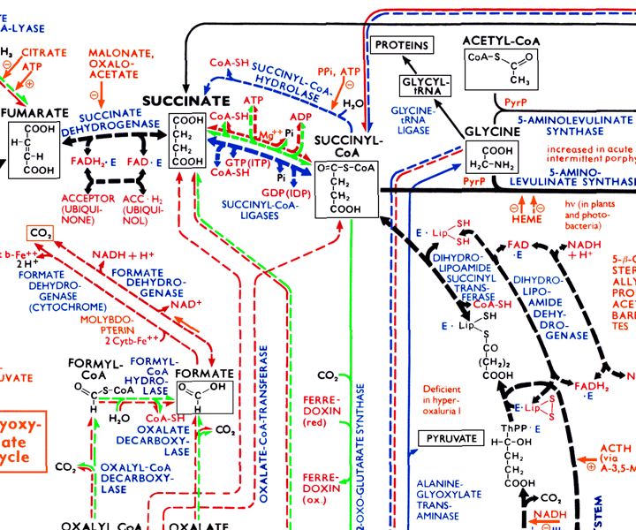
BOEHRING-MENNHEIN

Slide 5
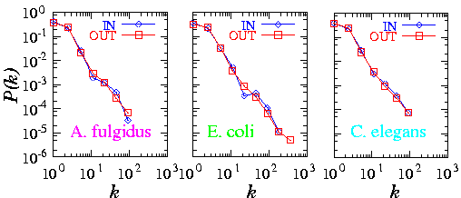
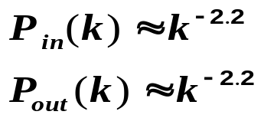
Meta-P(k)
METABOLIC NETWORK
Archaea
Bacteria
Eukaryotes
Organisms from all three domains of life are scale-free!
H. Jeong, B. Tombor, R. Albert, Z.N. Oltvai, and A.L. Barabasi, Nature, 407 651 (2000)
Network Science: Scale-Free Networks

Slide 6
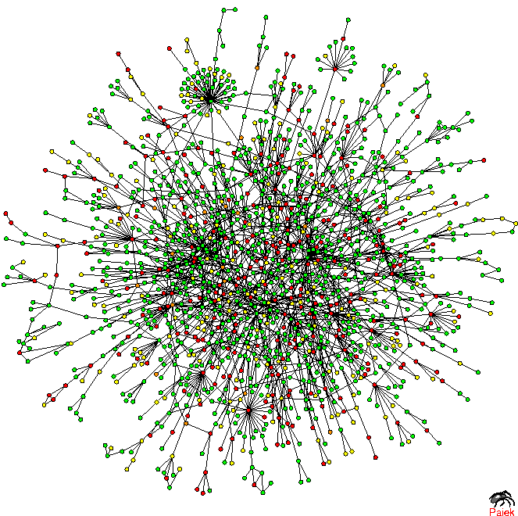
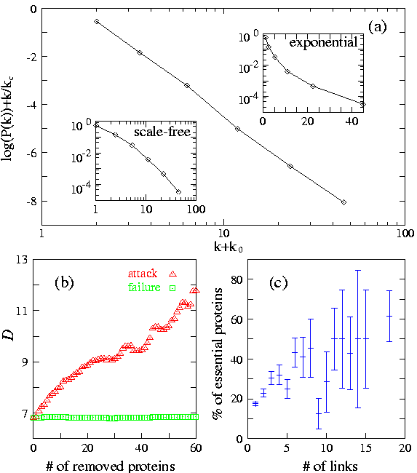
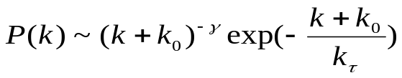
Prot P(k)
TOPOLOGY OF THE PROTEIN NETWORK
Nodes: proteins
Links: physical interactions-binding
H. Jeong, S.P. Mason, A.-L. Barabasi, Z.N. Oltvai, Nature 411, 41-42 (2001)

Slide 7
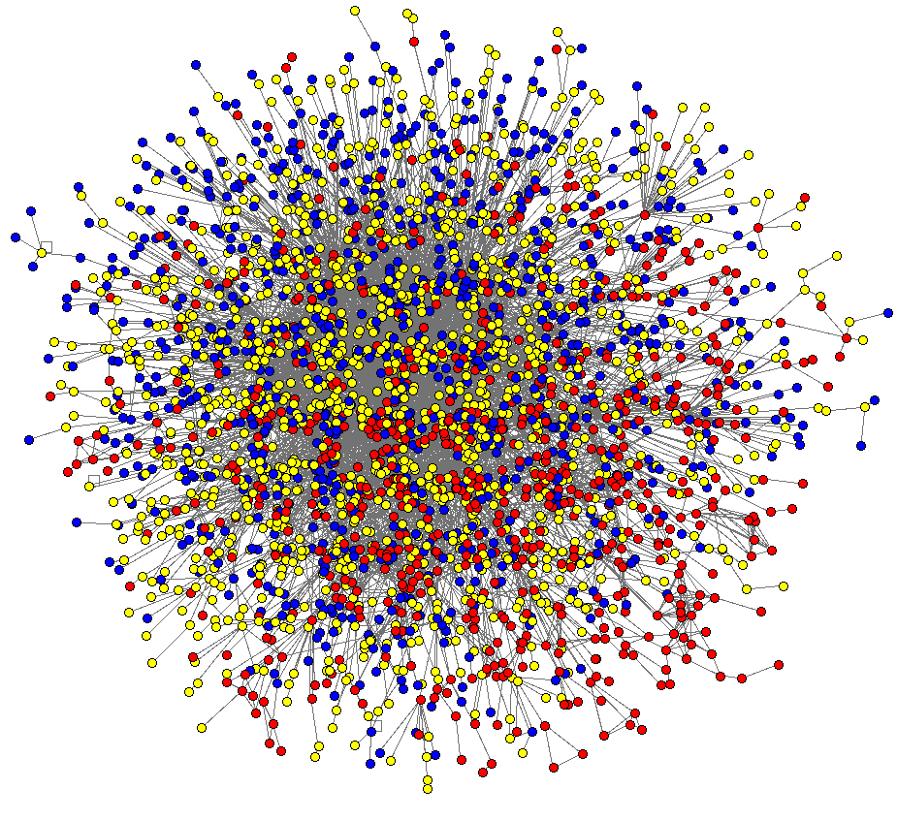
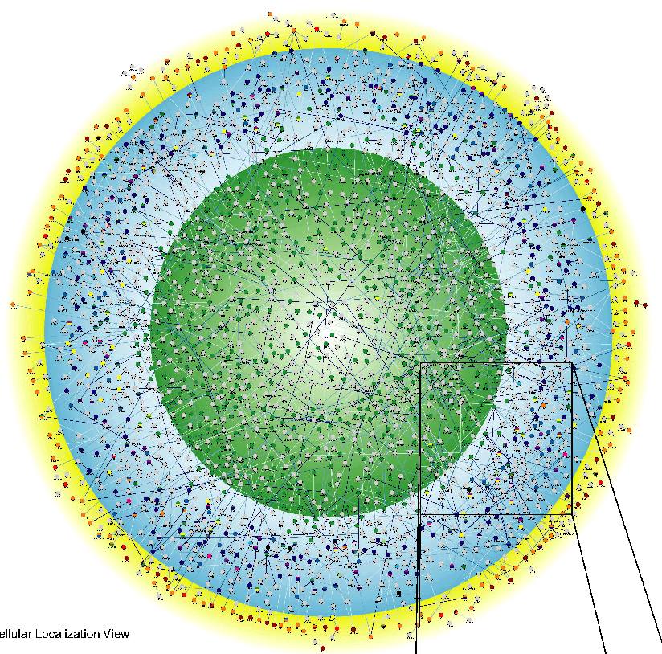
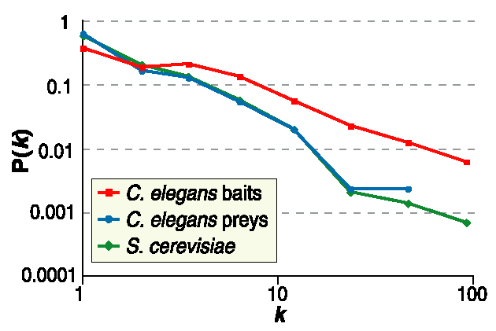
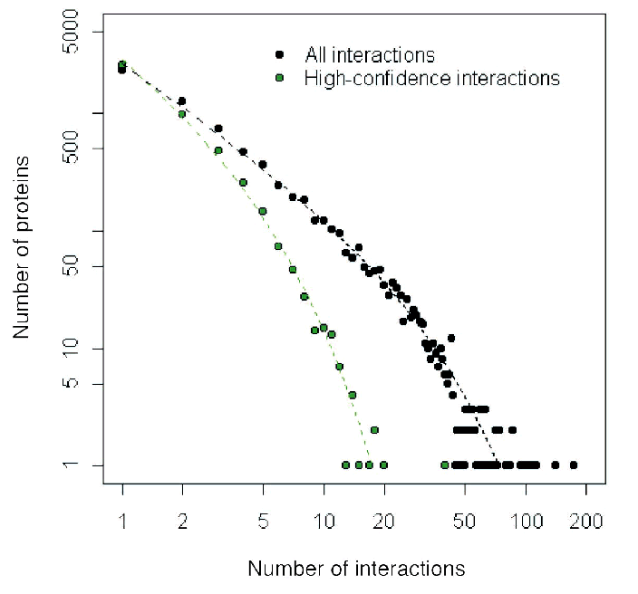
C. Elegans
Drosophila M.
Giot et al. Science 2003
Li et al. Science 2004
Network Science: Scale-Free Networks

Slide 8
Section 2
Growth and preferential attachment

Slide 9
Barabasi-Albert model Definition
The recognition that growth and preferential attachment coexist in real networks has
inspired a minimal model called the Barabási-Albert model (BA model), which
generates scale-free networks [1], defined as follows:
We start with m₀ nodes, the links between which are chosen arbitrarily, as long as each
node has at least one link. The network develops following two steps:
Growth: at each timestep we add a new node with m (≤ m₀) links that connect the
new node to m nodes already in the network.
Preferential attachment: the probability Π(k) that a link of the new node connects to
node i depends on the degree k_{i} as Π(k_{i})=k_{i}∑_{j} k_{j}
Preferential attachment is a probabilistic mechanism: a new node is free to connect to
any node in the network, whether it is a hub or has a single link. However, that if a new
node has a choice between a degree-two and a degree-four node, it is twice as likely that
it connects to the degree-four node.
[1] A.-L.Barabási, R. Albert and H. Jeong, Physica A 272, 173 (1999)
Network Science: Evolving Network Models
Notes:
PREDICTIONS:
(i) The degree exponent $\gamma$ is independent of $m$, a prediction that is in agreement with the numerical results (see Fig. 4).
(ii) As the power-law observed for real networks describes systems of rather different ages and sizes, it is expected that a correct model should provide a time-independent degree distribution. Indeed, Eq.(\ref{cube}) predicts that asymptotically (i.e. in the $t \gg m_0$ limit) the degree distribution of the BA model is independent of time (and, subsequently, independent of the system size $N=m_0+t$), indicating that despite its continuous growth, the network reaches a stationary scale-free state.
Nominal similarities shown in Figure 4 support these predictions.
(iii) Equation (\ref{cube}) indicates that the coefficient of the power-law distribution is proportional to $m^2$. a prediction again confirmed by the numerical simulations shown in Figure \ref{F-BA-BAScaling}.

Slide 10
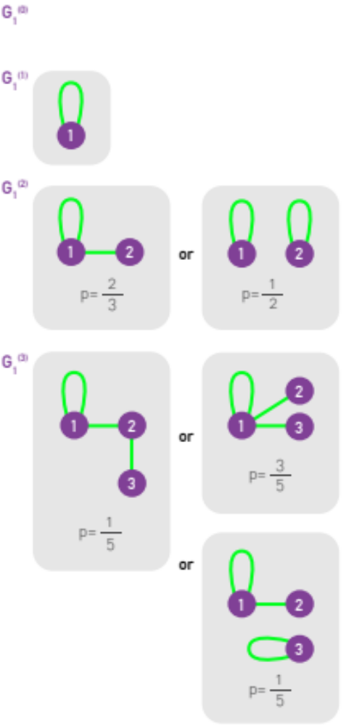
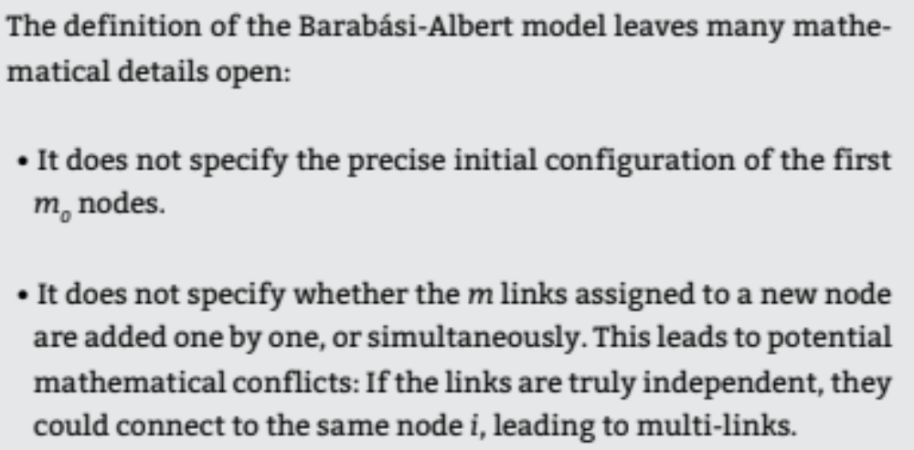

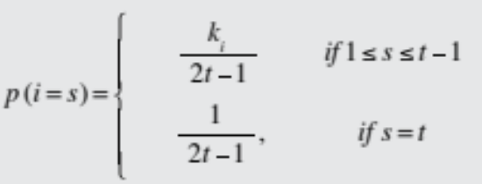
Section 4 Linearized Chord Diagram
Possible evolution
paths with self-loops.
New node is red.
One possible definition with self-loops

Slide 11
Section 4
Degree dynamics

Slide 12
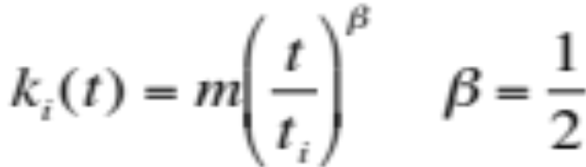
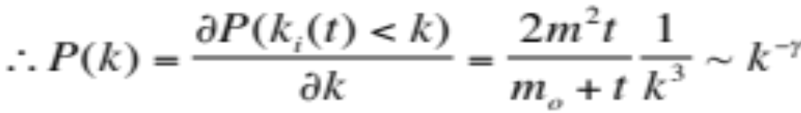
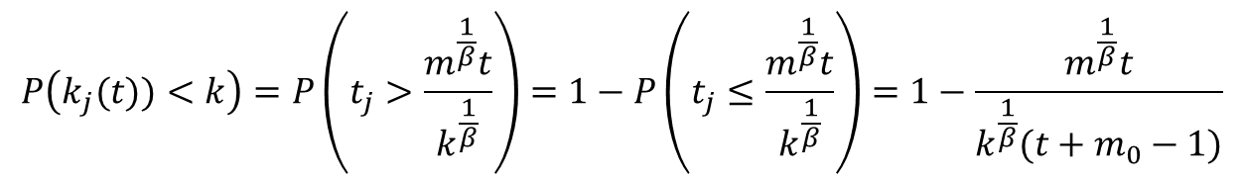
Degree distribution for Barabasi-Albert model
for t ≥ m₀+i and 0 otherwise as system size at t is N=m₀+t-1
We assume the initial m₀ nodes create a fully connected graph.
A random node j arriving at time t is with equal probability 1/N=1/(m₀+t-1) one of the nodes 1, 2,…. N, its degree will grow with the above equation, so
$$P\left(k_{j}(t))<k\right)=P\left(t_{j}>\frac{m^{\frac{1}{β}}t}{k^{\frac{1}{β}}}\right)=1−P\left(t_{j}≤\frac{m^{\frac{1}{β}}t}{k^{\frac{1}{β}}}\right)=1−\frac{m^{\frac{1}{β}}t}{k^{\frac{1}{β}}(t+m_{0}−1)}$$
For the large times t (and so large network sizes) we can replace t-1 with t above, so
γ = 3
A.-L.Barabási, R. Albert and H. Jeong, Physica A 272, 173 (1999)
Network Science: Evolving Network Models
Notes:
PREDICTIONS:
(i) The degree exponent $\gamma$ is independent of $m$, a prediction that is in agreement with the numerical results (see Fig. 4).
(ii) As the power-law observed for real networks describes systems of rather different ages and sizes, it is expected that a correct model should provide a time-independent degree distribution. Indeed, Eq.(\ref{cube}) predicts that asymptotically (i.e. in the $t \gg m_0$ limit) the degree distribution of the BA model is independent of time (and, subsequently, independent of the system size $N=m_0+t$), indicating that despite its continuous growth, the network reaches a stationary scale-free state.
Nominal similarities shown in Figure 4 support these predictions.
(iii) Equation (\ref{cube}) indicates that the coefficient of the power-law distribution is proportional to $m^2$. a prediction again confirmed by the numerical simulations shown in Figure \ref{F-BA-BAScaling}.

Slide 13
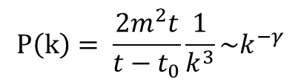
Degree distribution
$$P\left(k\right)= \frac{2m^{2}t}{t−t_{0}}\frac{1}{k^{3}}\sim k^{−γ}$$
γ = 3
(i) The degree exponent is independent of m.
(ii) As the power-law describes systems of rather different ages and sizes, it is expected that a correct model should provide a time-independent degree distribution. Indeed, asymptotically the degree distribution of the BA model is independent of time (and of the system size N)
→ the network reaches a stationary scale-free state.
(iii) The coefficient of the power-law distribution is proportional to m².
A.-L.Barabási, R. Albert and H. Jeong, Physica A 272, 173 (1999)
Network Science: Evolving Network Models
Notes:
PREDICTIONS:
(i) The degree exponent $\gamma$ is independent of $m$, a prediction that is in agreement with the numerical results (see Fig. 4).
(ii) As the power-law observed for real networks describes systems of rather different ages and sizes, it is expected that a correct model should provide a time-independent degree distribution. Indeed, Eq.(\ref{cube}) predicts that asymptotically (i.e. in the $t \gg m_0$ limit) the degree distribution of the BA model is independent of time (and, subsequently, independent of the system size $N=m_0+t$), indicating that despite its continuous growth, the network reaches a stationary scale-free state.
Nominal similarities shown in Figure 4 support these predictions.
(iii) Equation (\ref{cube}) indicates that the coefficient of the power-law distribution is proportional to $m^2$. a prediction again confirmed by the numerical simulations shown in Figure \ref{F-BA-BAScaling}.

Slide 14
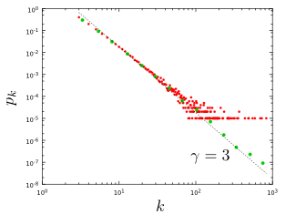
Section 4
Notes:
The degree distribution of a network generated by the Barabási-Albert model. The plot show for a single network of size N=100,000 and m=3 and . It shows both the linearly-binned (red symbols) as well as the log-binned version (green symbols) o. The straight line is added to guide the eye and has slope -3, corresponding to the resulting network’s degree exponent.

Slide 15
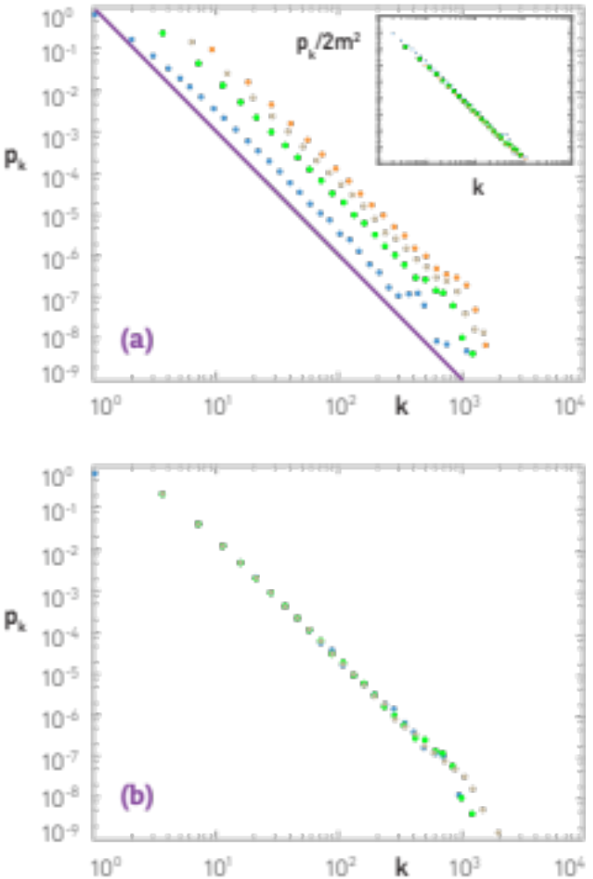
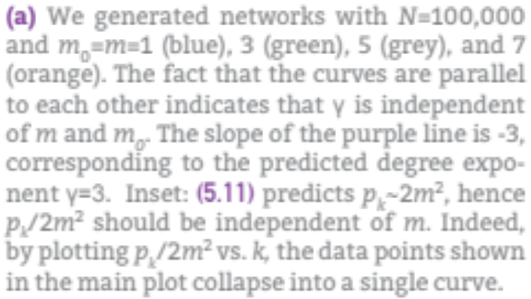

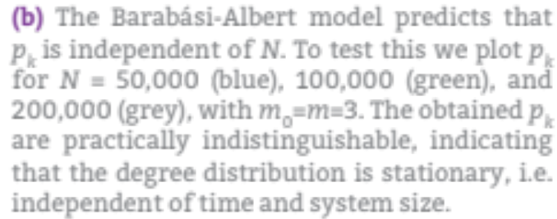
NUMERICAL SIMULATION OF THE BA MODEL

Slide 16
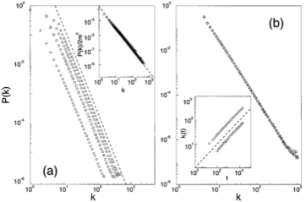

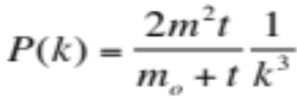



NUMERICAL SIMULATION OF THE BA MODEL
m=1,3,5,7
N=100,000;150,000;200,000
m-dependence
Stationarity:
P(k) independent of N
Insert:
degree dynamics
Network Science: Evolving Network Models

Slide 17
The mean field theory offers the correct scaling, BUT it provides the wrong coefficient of the degree distribution.
So assymptotically it is correct (k→ ∞), but not correct in details (particularly for small k).
To fix it, we need to calculate P(k) exactly, which we will do next using a rate equation based approach.
Network Science: Evolving Network Models

Slide 18

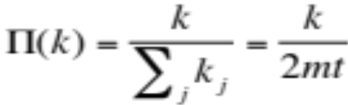



MFT - Degree Distribution: Rate Equation
Number of nodes with degree k at time t.
Since at each timestep we add one node, we have N=t (total number of nodes = number of timesteps)
2m: each node adds m links, but each link contributed to the degree of 2 nodes
Total number of k-nodes
Number of links added to degree k nodes after the arrival of a new node:
Nr. of degree k-1 nodes that acquire a new link, becoming degree k
New node adds m new links to other nodes
Preferential attachment
Nr. of degree k nodes that acquire a new link, becoming degree k+1
# k-nodes at time t+1
# k-nodes at time t
Gain of k-nodes via
k-1→ k
Loss of k-nodes via
k→ k+1
A.-L.Barabási, R. Albert and H. Jeong, Physica A 272, 173 (1999)

Slide 19
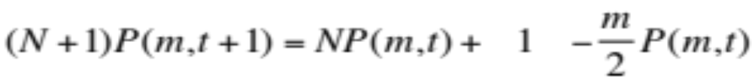
MFT - Degree Distribution: Rate Equation
# k-nodes at time t+1
# k-nodes at time t
Gain of k-nodes via
k-1→ k
Loss of k-nodes via
k→ k+1
We do not have k=0,1,...,m-1 nodes in the network (each node arrives with degree m)
→ We need a separate equation for degree m modes
# m-nodes at time t+1
# m-nodes at time t
Add one
m-degeree node
Loss of an
m-node via
m→ m+1
A.-L.Barabási, R. Albert and H. Jeong, Physica A 272, 173 (1999)
Network Science: Evolving Network Models

Slide 20
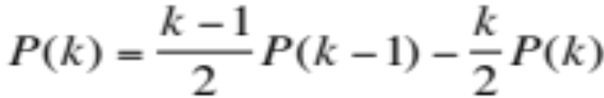
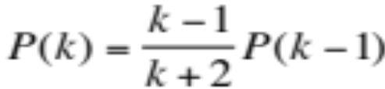
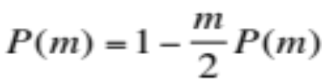
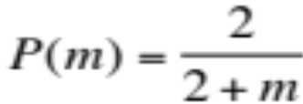
MFT - Degree Distribution: Rate Equation
k>m
We assume that there is a stationary state in the N=t→∞ limit, when P(k,∞)=P(k)
k>m
Network Science: Evolving Network Models

Slide 21
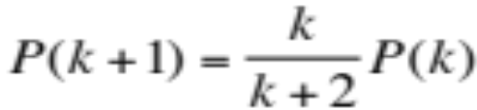
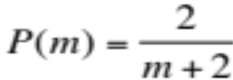
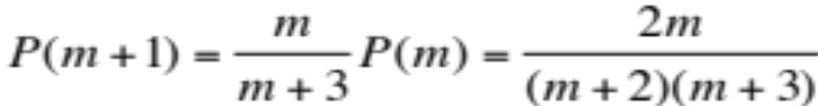
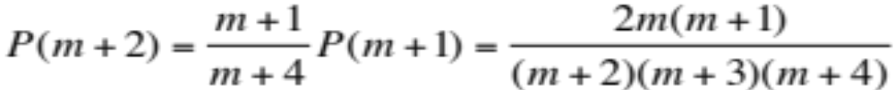
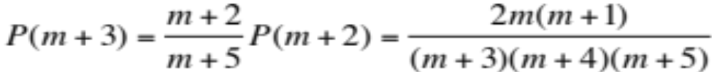
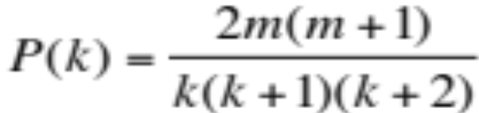

MFT - Degree Distribution: Rate Equation
➔
m+3 → k
...
for large k
Krapivsky, Redner, Leyvraz, PRL 2000
Dorogovtsev, Mendes, Samukhin, PRL 2000
Bollobas et al, Random Struc. Alg. 2001
Network Science: Evolving Network Models

Slide 22
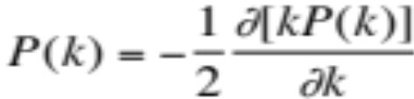
MFT - Degree Distribution: A Pretty Caveat
Start from eq.
Its solution is:
Dorogovtsev and Mendes, 2003
Network Science: Evolving Network Models

Slide 23
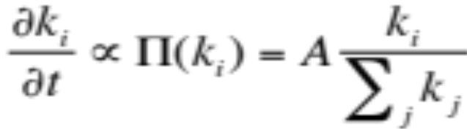
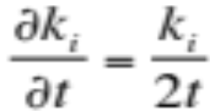
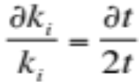
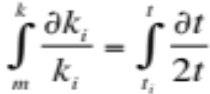



All nodes follow the same growth law
$$A\frac{k_{i}}{\sum_{j}{k_{j}}}=A\frac{k_{i}}{2mt}$$
$$m=\sum_{i}{\frac{∆k_{i}}{dt}}=\sum_{i}{A\frac{k_{i}}{2mt}=A}$$
In limit:
So:
$$\sum_{j}{k_{j}=2m\left(t−1\right)+\frac{m_{0}(m_{0}−1)}{2}}$$
Use:
During a unit time (time step): Δk=m → A=m
β: dynamical exponent
A.-L.Barabási, R. Albert and H. Jeong, Physica A 272, 173 (1999)
Network Science: Evolving Network Models
Notes:
This is an important prediction, as it implies that all nodes follow the same growth law. Hence the difference between the hubs is not in the fact that hubs grow faster, but that they are older. Indeed, the difference between the nodes comes in the intercept of the power-law, controlled by $t_i$, representing the time at which node $i$ joined the network.
If all nodes follow the same growth rate, why do we have hubs and less connected nodes in the network? The reason is that at moment older nodes have a higher degree according to Eq. \ref{connect}--indeed, the smaller $t_i$ is, the higher is the node's degree. As a consequence older nodes acquire more links in an unit time. This is seen by inspective the derivative of Eq. \ref{connect}, which is nothing but the node's growth rate (i.e. the rate at which the node acquires new links)
with predicts two things. First, it tells is that the older the node is (i.e. the smaller $t_i$ is), the larger the growth rate. Second, it also tells us that with time the rate at which the nodes acquire links goes down, thanks to the fact that the new nodes have many more nodes to link to.

Slide 24
Fitness Model
Network Science: Evolving Network Models

Slide 25

Fitness Model: Can Latecomers Make It?
SF model: k(t)~t ^{½} (first mover advantage)
Fitness model: fitness (η ) k(η,t)~t^{β(η)}
β(η) =η/C
Degree (k)
time
Bianconi & Barabási, Physical Review Letters 2001; Europhys. Lett. 2001.

Slide 26


Section 5.3

Slide 27
Section 6
Absence of growth and preferential attachment

Slide 28


MODEL A
growth preferential attachment
Π(k_{i}) : uniform

Slide 29


MODEL B
growth preferential attachment
p_{k} : power law (initially) →
→ Gaussian → Fully Connected

Slide 30
Do we need both growth and preferential attachment?
YEP
Network Science: Evolving Network Models

Slide 31










Regular network
EMPIRICAL DATA FOR REAL NETWORKS
Pathlenght
Clustering
Degree Distr.
P(k) ~ k^{-γ}
P(k)=δ(k-k_{d})
Erdos-
Renyi
Watts-
Strogatz
Exponential
Barabasi-Albert
P(k) ~ k^{-γ}
Network Science: Evolving Network Models
Notes:
As a universal feature, they do well in clustering and the path lenghts. However, they all fail in the degree distribution. Hence we need models the fix that problem. As will see, this is not a trivial feature– many properties of real networks are determined primarily by the degree distribution.

Slide 32
Section 9
The origins of preferential attachment
Notes:
Given the important role preferential attachment plays in the evolution of real networks, we must ask: where does preferential attachment come from? Specifically,
Why does depend on ?
Why is the dependence of linear in k ?
There are two philosophically different takes on these questions. The first approach views preferential attachment as an interplay between random events and some structural network property. These mechanisms do not require global knowledge of the network. Hence we will call them local or random mechanisms. The second approach assumes that the addition of each new node or link is preceeded by a cost-benefit analysis, balancing various needs with the available resources. This assumes familiarity with the whole network and relies on optimization principles, prompting us to call them global or optimized mechanisms. The purpose of this section is to discuss these two approaches.

Slide 33



Section 9 Link selection model
Link selection model -- perhaps the simplest example of a local or random mechanism capable of generating preferential attachment.
Growth: at each time step we add a new node to the network.
Link selection: we select a link at random and connect the new node to one of nodes at the two ends of the selected link.
To show that this simple mechanism generates linear preferential attachment, we write the probability that the node
at the end of a randomly chosen link has degree k as

Slide 34

Section 9 Originators of preferential attachments
Notes:
Given the important role preferential attachment plays in the evolution of real networks, we must ask: where does preferential attachment come from? Specifically,
Why does depend on ?
Why is the dependence of linear in k ?
There are two philosophically different takes on these questions. The first approach views preferential attachment as an interplay between random events and some structural network property. These mechanisms do not require global knowledge of the network. Hence we will call them local or random mechanisms. The second approach assumes that the addition of each new node or link is preceeded by a cost-benefit analysis, balancing various needs with the available resources. This assumes familiarity with the whole network and relies on optimization principles, prompting us to call them global or optimized mechanisms. The purpose of this section is to discuss these two approaches.

Slide 35

Notes:
The discovery of the Barabási-Albert model is recounted in Linked [9], describing a workstop in Porto, Portugal, attended by the first author of the model: “During the summer of 1999 very few people were thinking about networks, and there were no talks on the subject during this workshop. But networks were very much on my mind. I could not help carrying with me on the trip our unresolved questions: Why hubs? Why power-laws? […] Before I left for Europe, Réka Albert and I agreed that she would analyze these networks. On June 14, a week after my departure, I received a long email from her detailing some ongoing activities. At the end of the message there was a sentence added like an afterthought: “I looked at the connectivity distribution too, and in almost all systems (IBM, actors, power grid), the tail of the distribution follows a power law.” Réka’s email suddenly made it clear that the Web was by no means special. I found myself sitting in the conference hall paying no attention to the talks, thinking about the implications of this finding. If two networks as different as the Web and the Hollywood acting community both display power-law degree distribution, then some universal law or mechanism must be responsible. If such a law existed, it could potentially apply to all networks. During the first break between talks I decided to withdraw to the quiet of the seminary where we were housed during the workshop. I did not get far, however. During the fifteen-minute walk back to my room a potential explanation occurred to me, one so simple and straightforward that I doubted it could be right. I immediately returned to the university to fax Réka, asking her to verify the idea using the computer. A few hours later she emailed me the answer. To my great astonishment, the idea worked.” The two images above reproduce the fax sent on June 14, 1999 from Porto, describing the algorithm that we call today the Barabási-Albert model.

