Slide 1
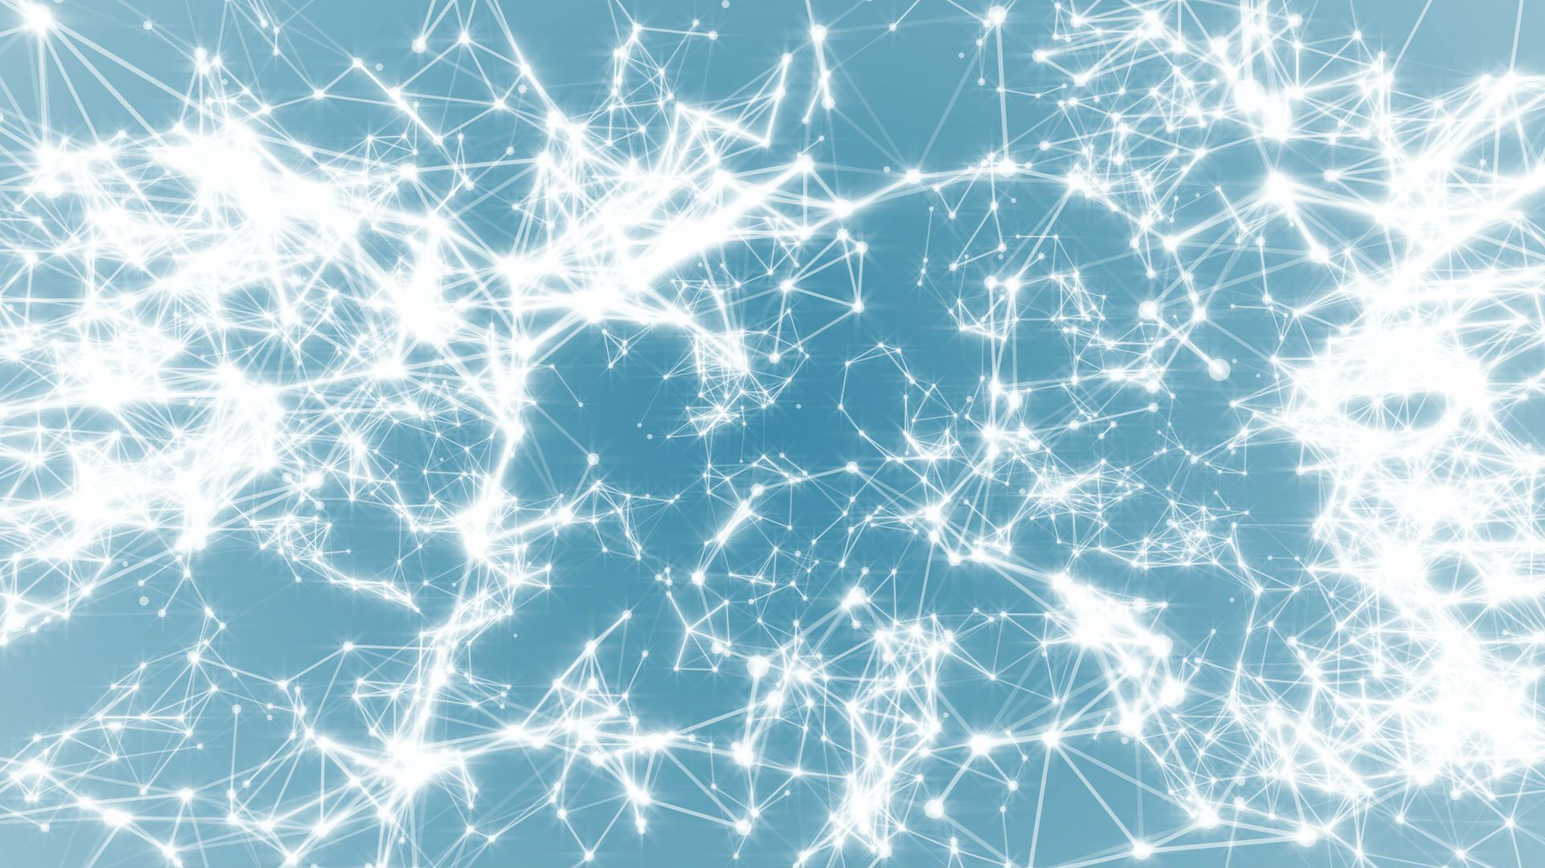
Frontiers of Network Science
Fall 2021
Class 9: Scale Free Networks
(Chapter 4 in Textbook)
Boleslaw Szymanski
based on slides by Albert-László Barabási & Roberta Sinatra

Slide 2
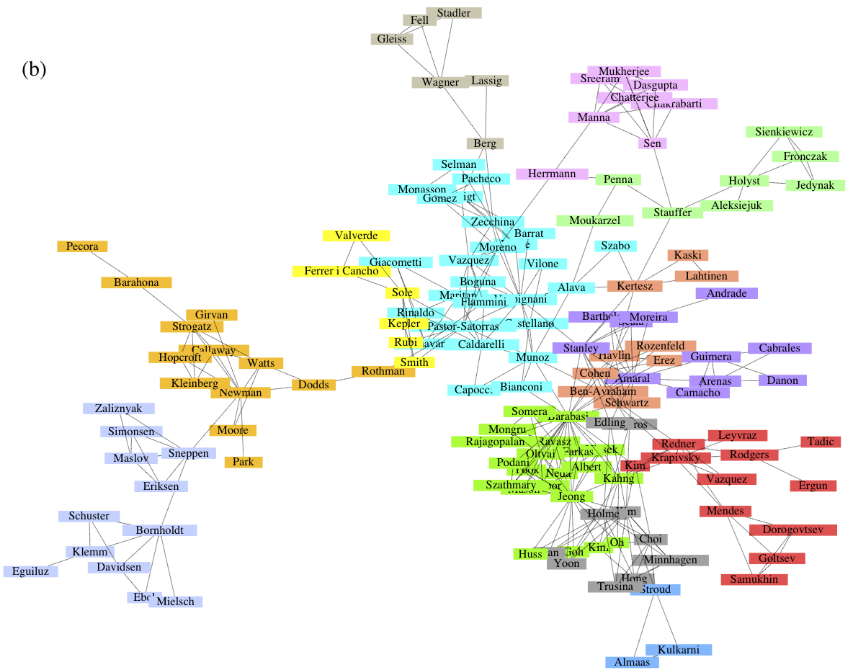
NETWORK DATA: SCIENCE COLLABORATION NETWORKS
Collaboration Network:
Nodes: Scientists
Links: Joint publications
Physical Review:
1893 – 2009.
N=449,673
L=4,707,958
See also Stanford Large Network
database
http://snap.stanford.edu/data/#canets.
Network Science: Small World Networks
Notes:
\bf Data source and mapping:} Several datasets have been studied lately to explore the science collaboration network, The most studied dataset captures the corpus of Physical Review publications, between 1893 and 2009, that can be requested from the American Physical Society. Several datasets are available at the Stanford Large Network database
CITE %\url{http://snap.stanford.edu/data/#canets}.

Slide 3
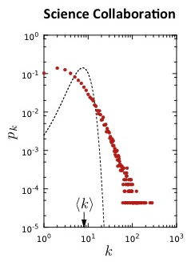
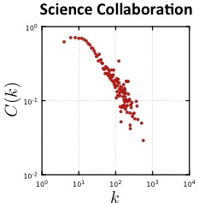
Scale-free
Hierarchical
Network Science: Small World Networks

Slide 4
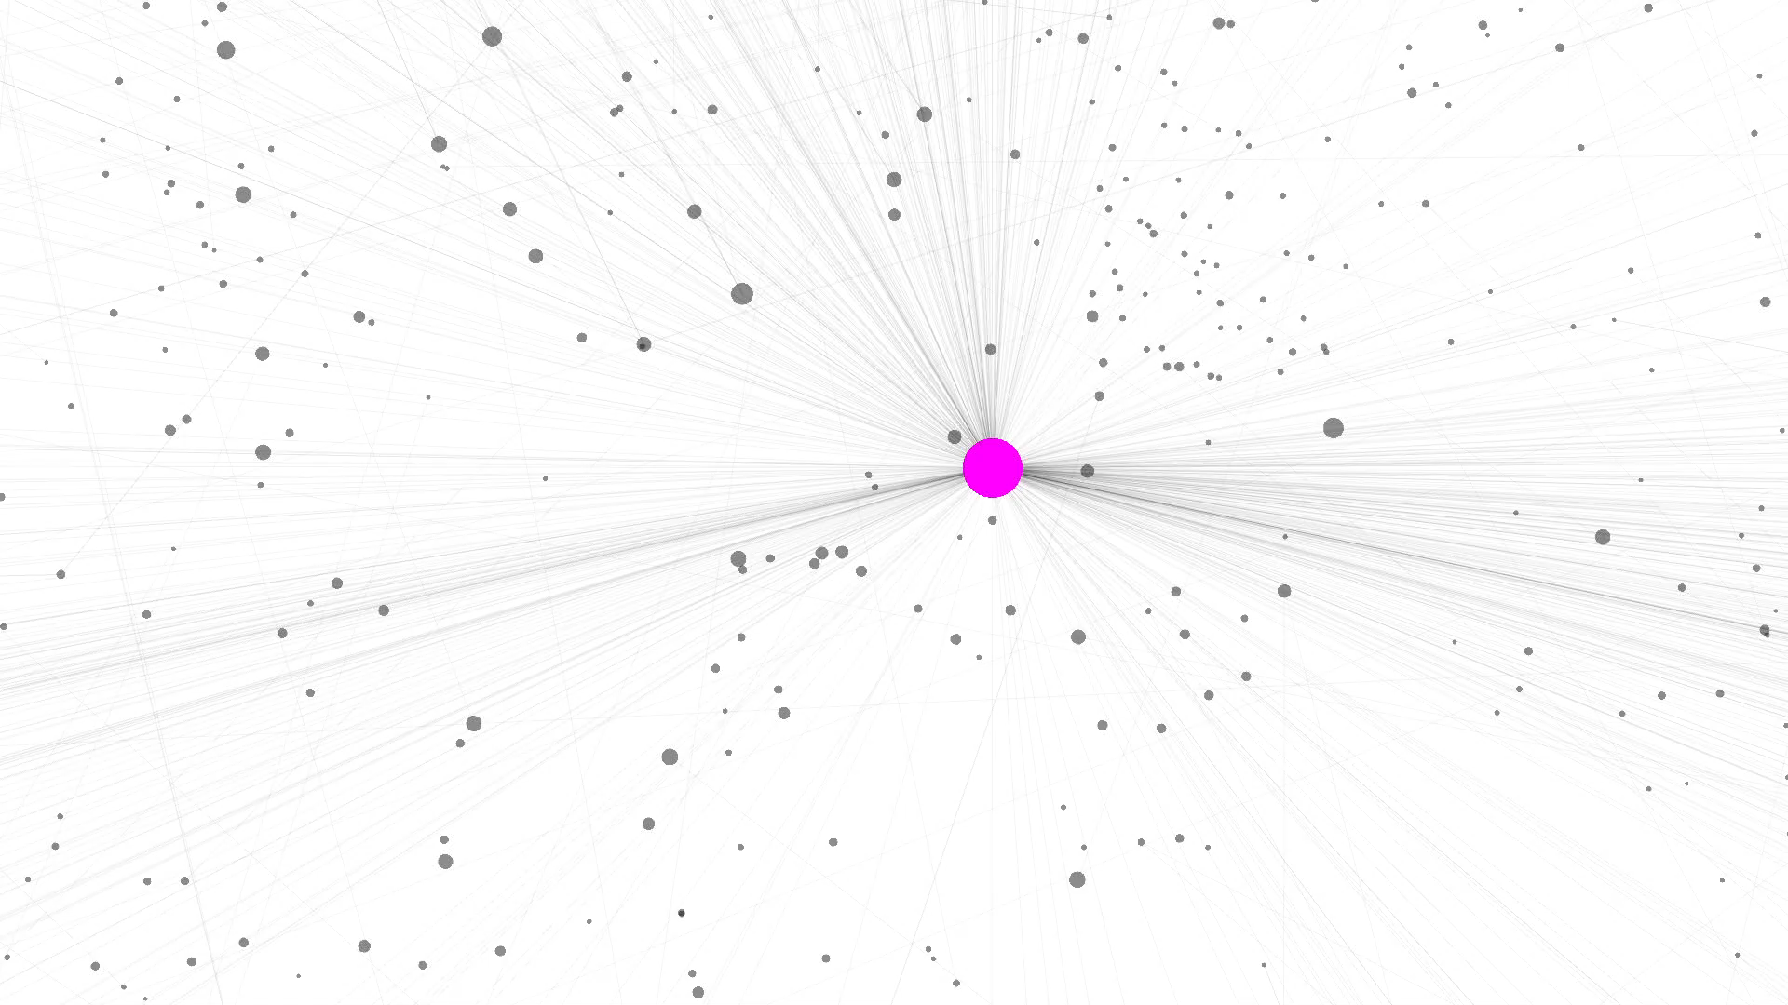
WORLD WIDE WEB
Nodes: WWW documents Links: URL links
Over 3 billion documents
ROBOT: collects all URL’s found in a document and follows them recursively
Network Science: Scale-Free Networks
R. Albert, H. Jeong, A-L Barabasi, Nature, 401 130 (1999).

Slide 5
Section 2
Power laws and scale-free networks
Network Science: Scale-Free Networks

Slide 6
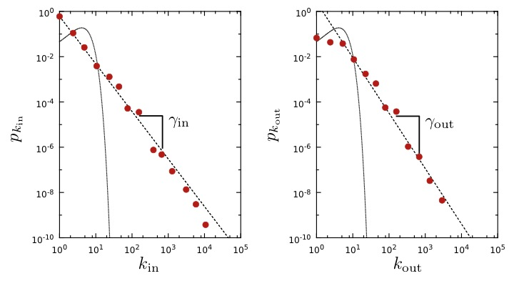
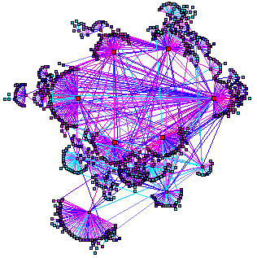
WORLD WIDE WEB
Nodes: WWW documents Links: URL links
Over 3 billion documents
ROBOT: collects all URL’s found in a document and follows them recursively
Expected
R. Albert, H. Jeong, A-L Barabasi, Nature, 401 130 (1999).
Network Science: Scale-Free Networks

Slide 7


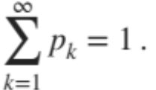
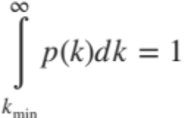
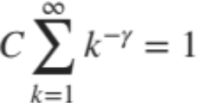
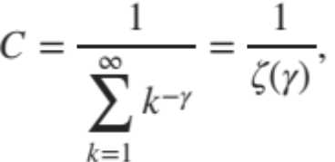
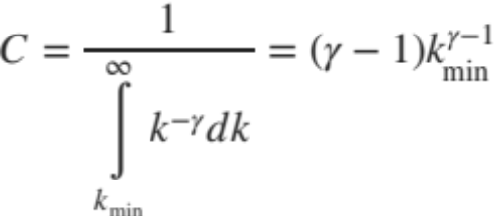
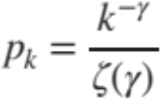



Discrete vs. Continuum formalism
Discrete Formalism
As node degrees are always positive integers, the discrete formalism captures the probability that a node has exactly k links:
Continuum Formalism
In analytical calculations it is often convenient to assume that the degrees can take up any positive real value:
INTERPRETATION:
Network Science: Scale-Free Networks
Notes:
There appears to be little difference between them at the first look. Yet. There is some quite relevant different: the at high degrees the power law curve is always higher than the exponential.

Slide 8
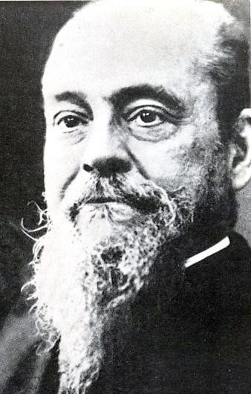
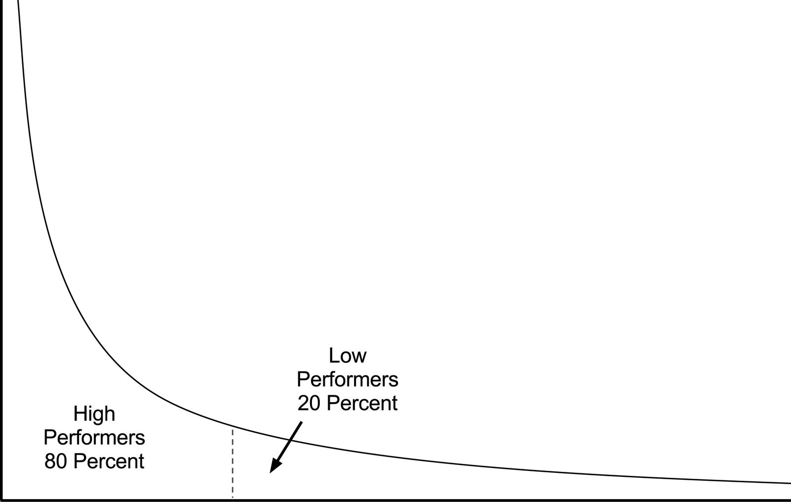
80/20 RULE
Vilfredo Federico Damaso Pareto (1848 – 1923), Italian economist, political scientist and philosopher, who had important contributions to our understanding of income distribution and to the analysis of individuals choices. A number of fundamental principles are named after him, like Pareto efficiency, Pareto distribution (another name for a power-law distribution), the Pareto principle (or 80/20 law).
Notes:
Vilfredo Pareto, a 19th century economist, noticed that in Italy a few wealthy individuals earned most of the money, while the majority of the population earned rather small amounts. He connected this disparity to the observation that incomes follow a power law, representing the first known report of a power law distribution [3]. His finding entered the popular literature as the 80/20 rule: roughly 80 percent of money is earned by only 20 percent of the population. The 80/20 emerges in many areas, like management, stating that 80 percent of profits are produced by only 20 percent of the employees or that 80 percent of decisions are made during 20 percent of meeting time. They are present in networks as well: 80 percent of links on the Web point to only 15 percent of webpages; 80 percent of citations go to only 38 percent of scientists; 80 percent of links in Hollywood are connected to 30 percent of actors [4]. Typically all quantities obeying the 80/20 rule follow a power law distribution. During the 2009 economic crisis power laws have gained a new meaning: the Occupy Wall Street Movement highlighted the fact that in the US 1% of the population earns a disproportionate 15% of the total US income. This 1% effect, a signature of a profound income disparity, is again a natural consequence of the power law nature of the income distribution.

Slide 9
Section 3
Hubs
Network Science: Scale-Free Networks

Slide 10
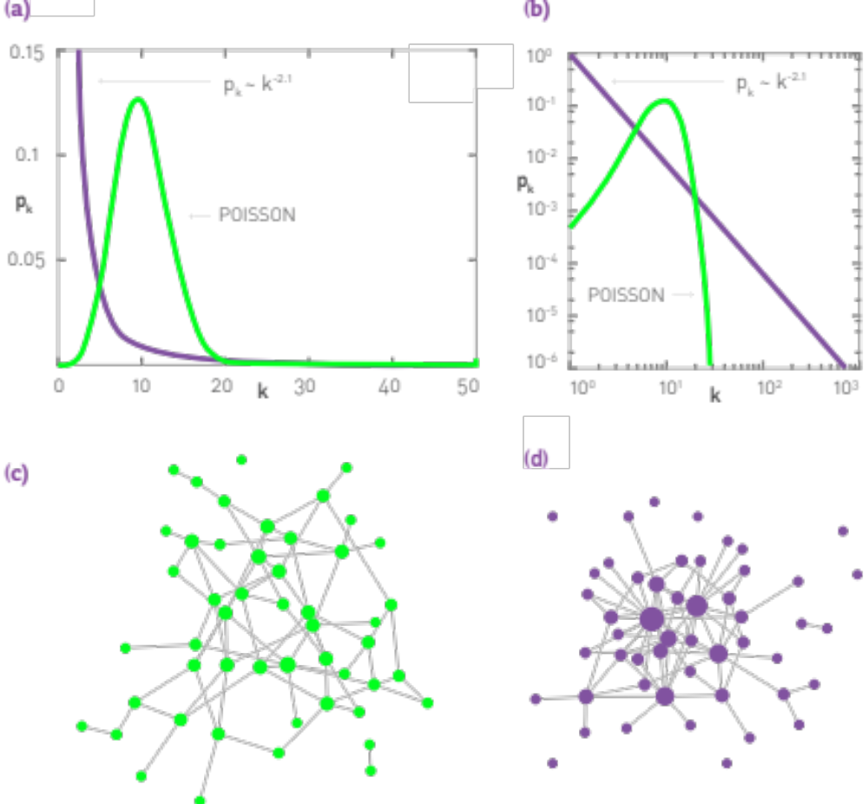
The difference between a power law and an exponential distribution
Network Science: Scale-Free Networks
Notes:
There appears to be little difference between them at the first look. Yet. There is some quite relevant different: the at high degrees the power law curve is always higher than the exponential.

Slide 11



The difference between a power law and an exponential distribution
Let us use the WWW to illustrate the properties of the high-k regime.
The probability to have a node with k~100 is
About in a Poisson distribution
About if p_{k} follows a power law.
Consequently, if the WWW were to be a random network, according to the Poisson prediction we would expect 10⁻¹⁸ k>100 degree nodes, or none.
For a power law degree distribution, we expect about k>100 degree nodes
Network Science: Scale-Free Networks
Notes:
There appears to be little difference between them at the first look. Yet. There is some quite relevant different: the at high degrees the power law curve is always higher than the exponential.

Slide 12
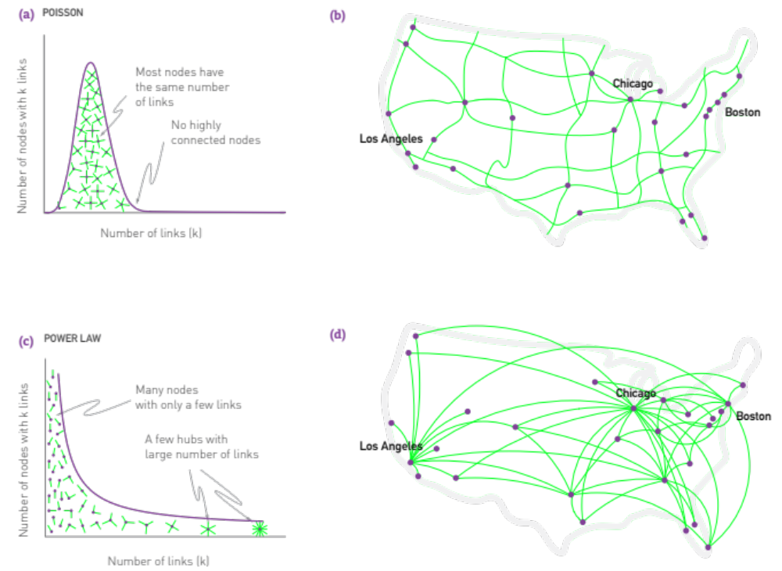
Network Science: Scale-Free Networks
Notes:
There appears to be little difference between them at the first look. Yet. There is some quite relevant different: the at high degrees the power law curve is always higher than the exponential.

Slide 13
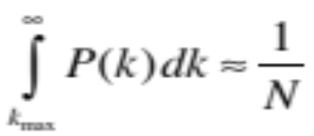
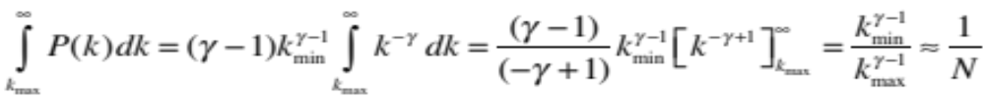
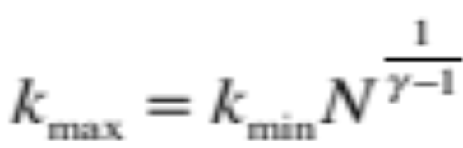
Finite scale-free networks
The size of the biggest hub
All real networks are finite → let us explore its consequences.
→ We have an expected maximum degree, k_{max}
Estimating k_{max}
Why: the probability to have a node larger than k_{max} should not exceed the prob. to have one node, i.e. 1/N fraction of all nodes
Network Science: Scale-Free Networks

Slide 14
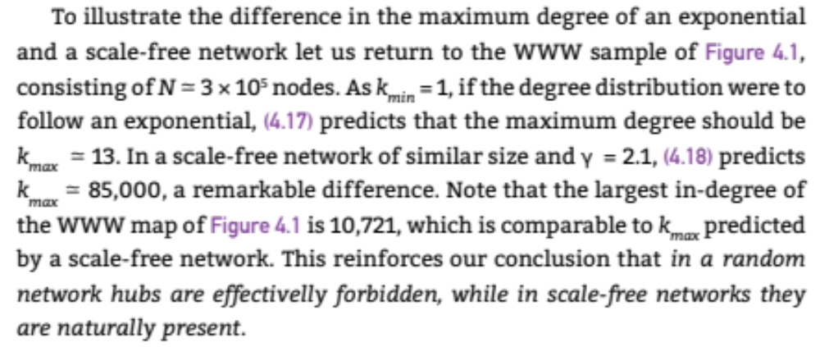
Finite scale-free networks
The size of the biggest hub
Network Science: Scale-Free Networks

Slide 15

Finite scale-free networks
Expected maximum degree, k_{max}
k_{max}, increases with the size of the network
  →the larger a system is, the larger its biggest hub
For γ>2 k_{max} increases slower than N
  the largest hub will contain a decreasing fraction of links as N increases.
For γ=2 k_{max}~N.
  → The size of the biggest hub is O(N)
For γ<2 k_{max} increases faster than N: condensation phenomena
  → the largest hub will grab an increasing fraction of links. Anomaly!
Network Science: Scale-Free Networks

Slide 16
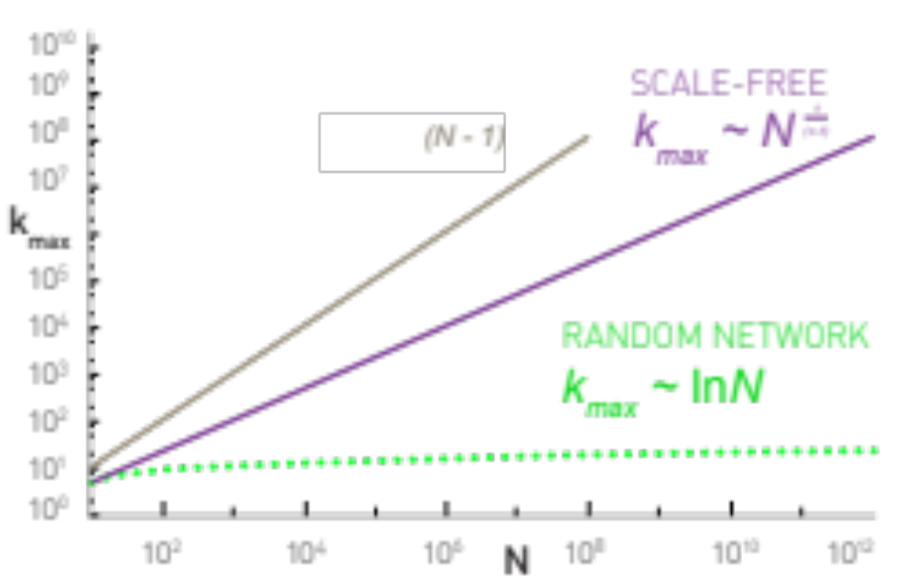
Finite scale-free networks
The size of the largest hub
Network Science: Scale-Free Networks

Slide 17
Section 4
The meaning of scale-free
Network Science: Scale-Free Networks

Slide 18
Scale-free networks: Definition
Definition:
Networks with a power law tail in their degree distribution are called
‘scale-free networks’
Where does the name come from?
Critical Phenomena and scale-invariance
(a detour)
Slides after Dante R. Chialvo
Network Science: Scale-Free Networks
Slides after Dante R. Chialvo

Slide 19
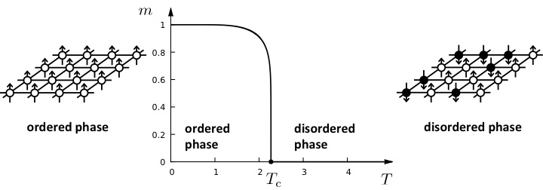

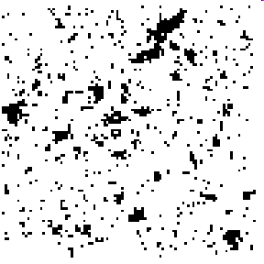
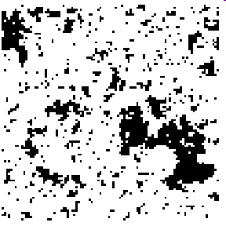
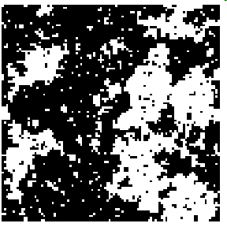
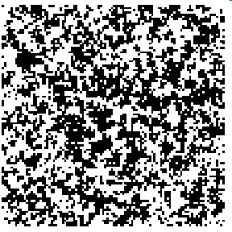
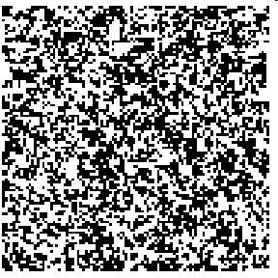

Phase transitions in complex systems I: Magnetism
T = 0.99 T_{c}
T = 0.999 T_{c}
T = T_{c}
T = 1.5 T_{c}
T = 2 T_{c}
ξ
ξ
Network Science: Scale-Free Networks

Slide 20
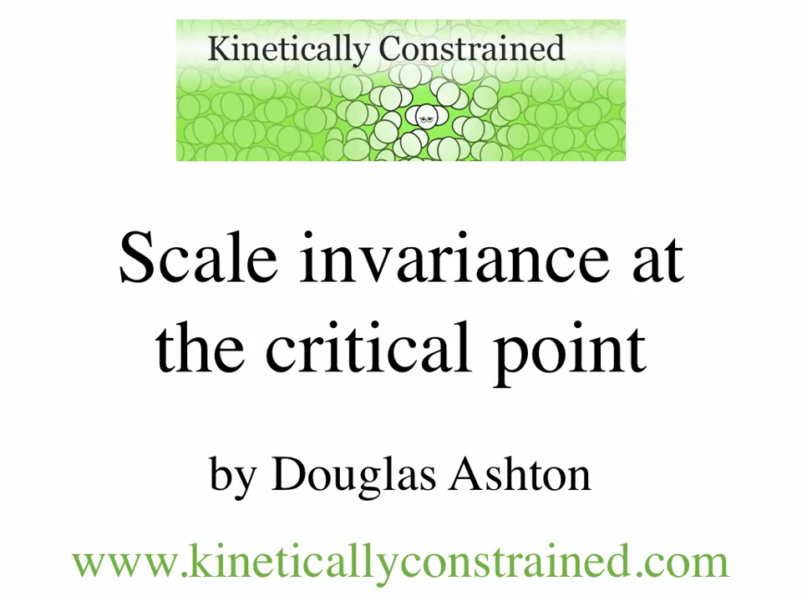
Scale-free behavior in space
At T = Tc:
correlation length diverges
Fluctuations emerge at all scales:
scale-free behavior
Network Science: Scale-Free Property

Slide 21
CRITICAL PHENOMENA
Correlation length diverges at the critical point: the whole system is correlated!
Scale invariance: there is no characteristic scale for the fluctuation (scale-free behavior).
Universality: exponents are independent of the system’s details.
Network Science: Scale-Free Networks
Notes:
Now we see where the ‘scale-free’ name comes from.
But what’s in the name?
We need to learn a bit more to understand that … soon
Before we get there, let us talk about universality.

Slide 22
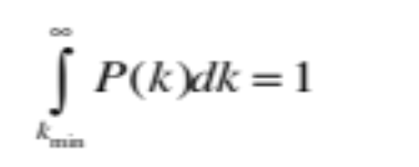
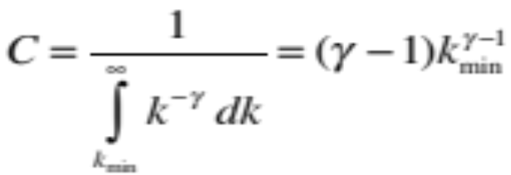
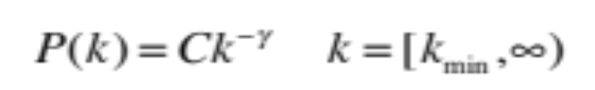

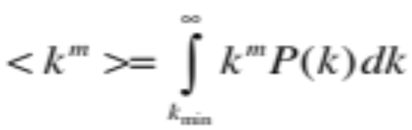
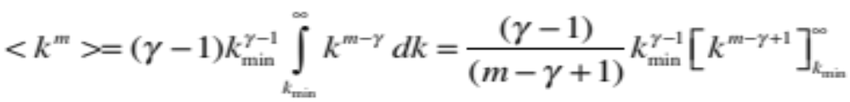
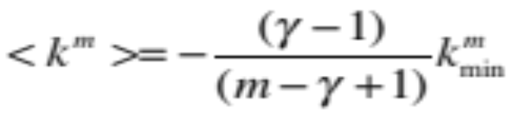
Divergences in scale-free distributions
If m-γ+1<0:
If m-γ+1>0, the integral diverges.
For a fixed γ this means that all moments with m>γ-1 diverge.
Network Science: Scale-Free Networks

Slide 23
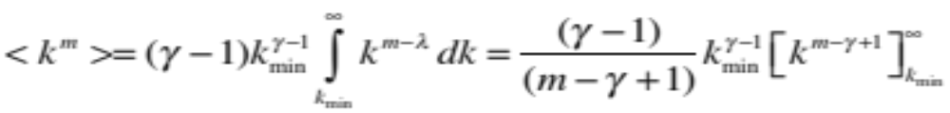
DIVERGENCE OF THE HIGHER MOMENTS
For a fixed γ this means all moments m>γ-1 diverge.
Network | N | L | 〈k〉 | 〈k_{in}²〉 | 〈k_{out}²〉 | 〈k²〉 | γ_{in} | γ_{out} | γ
Internet | 192,244 | 609,066 | 6.34 | - | - | 240.1 | - | - | 3.42*
WWW | 325,729 | 1,497,134 | 4.60 | 1546.0 | 482.4 | - | 2.00 | 2.31 | -
Power Grid | 4,941 | 6,594 | 2.67 | - | - | 10.3 | - | - | Exp.
Mobile-Phone Calls | 36,595 | 91,826 | 2.51 | 12.0 | 11.7 | - | 4.69* | 5.01* | -
Email | 57,194 | 103,731 | 1.81 | 94.7 | 1163.9 | - | 3.43* | 2.03* | -
Science Collaboration | 23,133 | 93,437 | 8.08 | - | - | 178.2 | - | - | 3.35*
Actor Network | 702,388 | 29,397,908 | 83.71 | - | - | 47,353.7 | - | - | 2.12*
Citation Network | 449,673 | 4,689,479 | 10.43 | 971.5 | 198.8 | - | 3.03* | 4.00* | -
E. Coli Metabolism | 1,039 | 5,802 | 5.58 | 535.7 | 396.7 | - | 2.43* | 2.90* | -
Protein Interactions | 2,018 | 2,930 | 2.90 | - | - | 32.3 | - | - | 2.89*-
Many degree exponents are smaller than 3
<k²> diverges in the N→∞ limit!!!
<k> diverges in the N→∞ limit!!!
Network Science: Scale-Free Networks

Slide 24
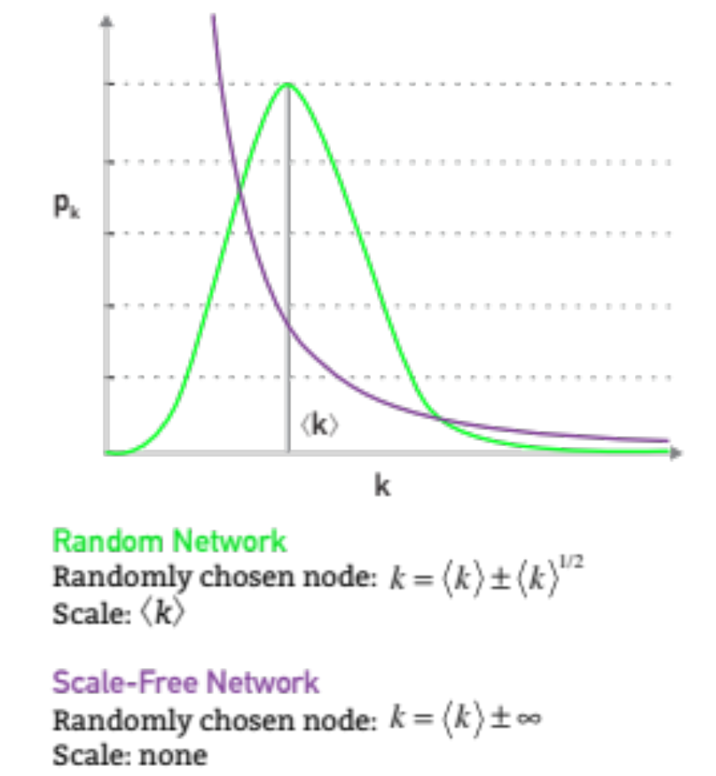
The meaning of scale-free
Network Science: Scale-Free Networks

Slide 25
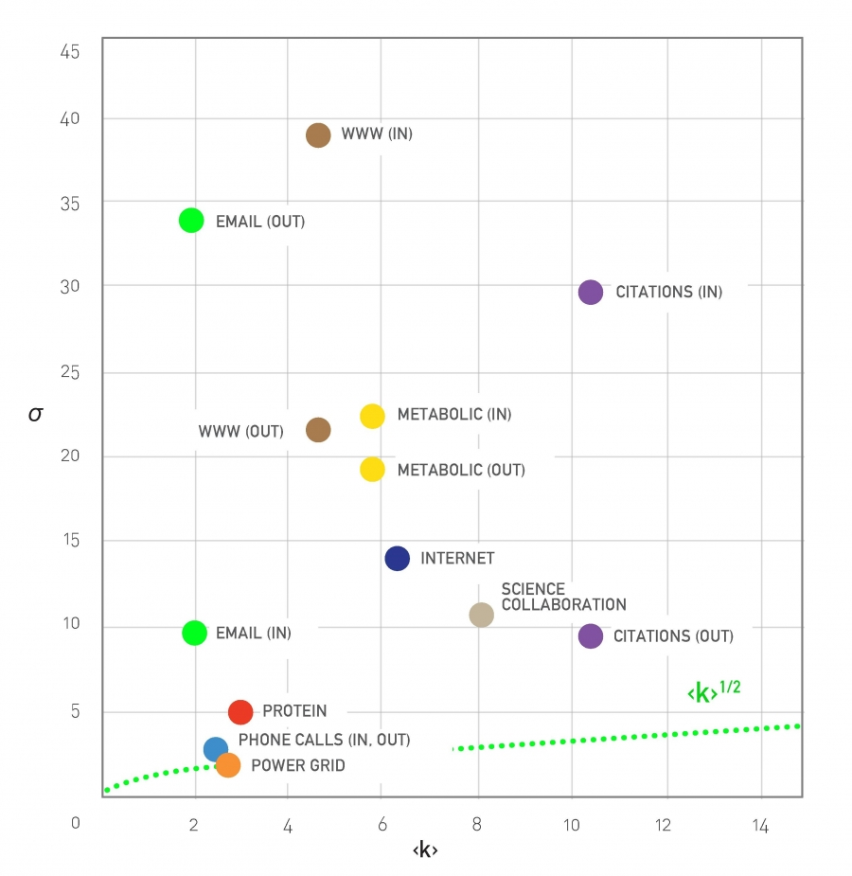
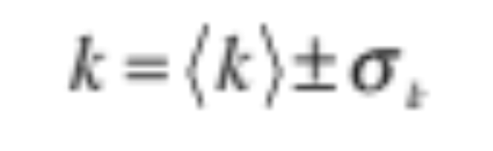
The meaning of scale-free
Network Science: Scale-Free Networks

Slide 26
Section 5
universality
Network Science: Scale-Free Networks

Slide 27
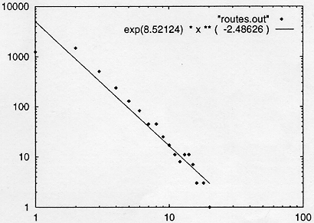
INTERNET BACKBONE
Nodes: computers, routers
Links: physical lines
(Faloutsos, Faloutsos and Faloutsos, 1999)
Network Science: Scale-Free Networks

Slide 28
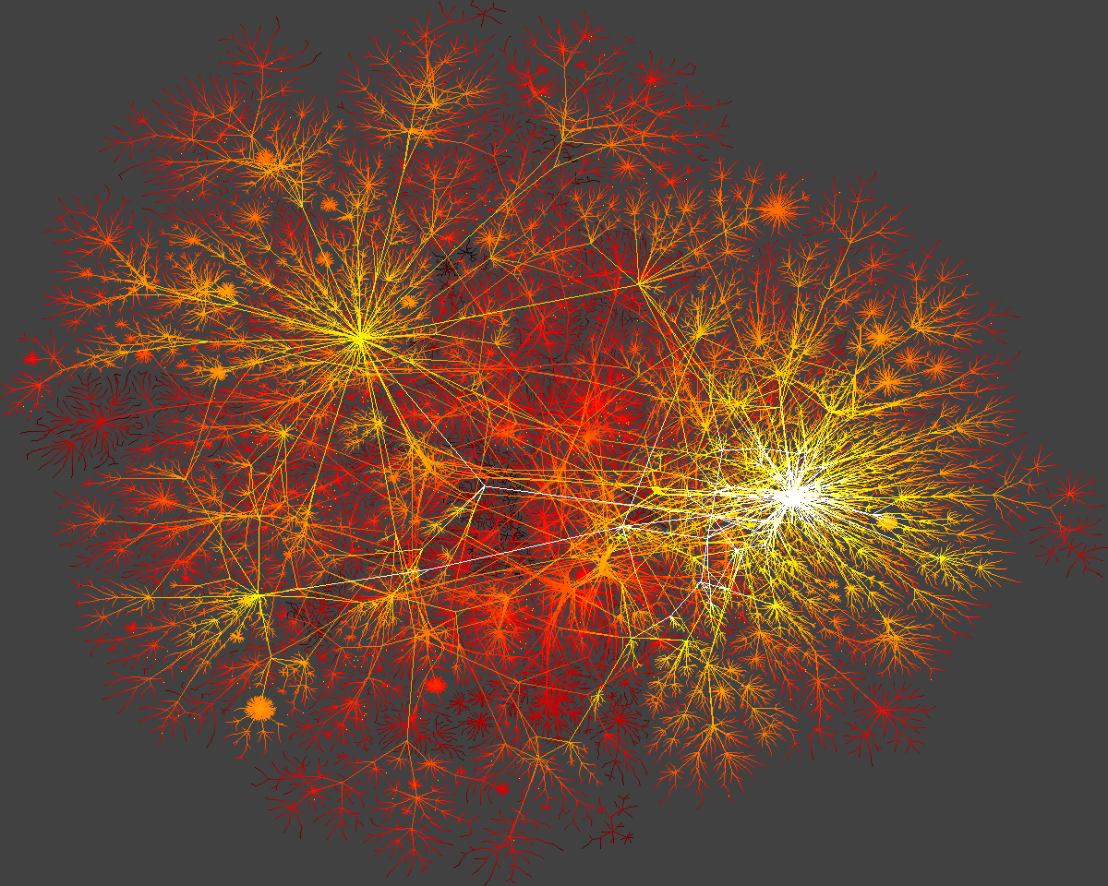
Network Science: Scale-Free Networks

Slide 29
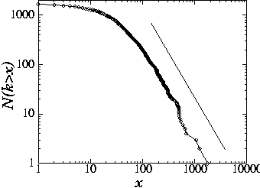
SCIENCE CITATION INDEX
Nodes: papers
Links: citations
25
H.E. Stanley,...
1736 PRL papers (1988)
578...
P(k) ~k^{-γ}
(γ = 3)
(S. Redner, 1998)
Network Science: Scale-Free Networks

Slide 30
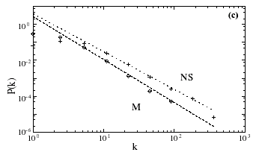
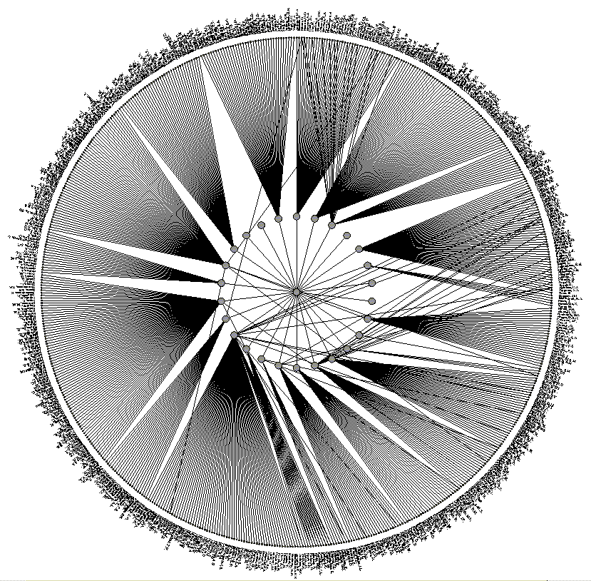
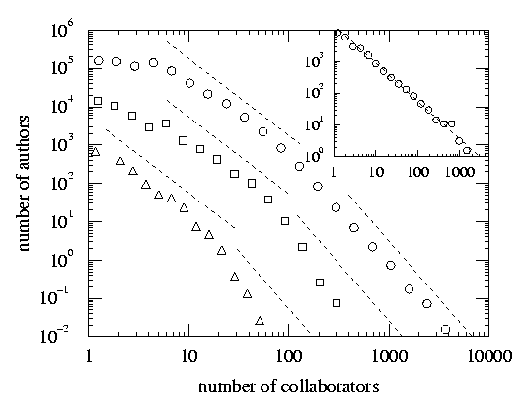
SCIENCE COAUTHORSHIP
Nodes: scientist (authors)
Links: joint publication
M: math
NS: neuroscience
(Newman, 2000, Barabasi et al 2001)
Network Science: Scale-Free Networks

Slide 31
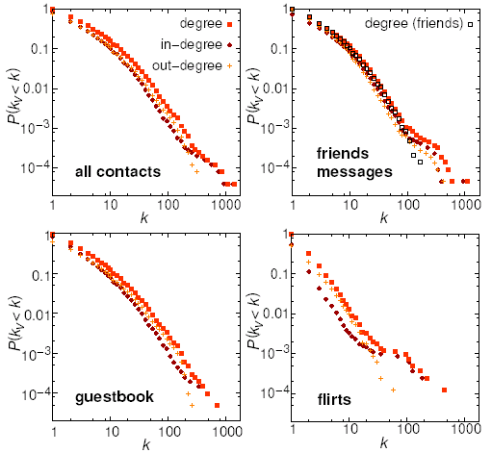
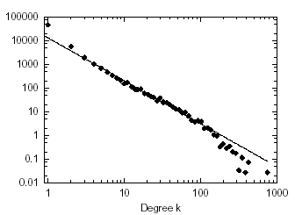
ONLINE COMMUNITIES
Nodes: online user
Links: email contact
Pussokram.com online community;
512 days, 25,000 users.
Kiel University log files
112 days, N=59,912 nodes
Ebel, Mielsch, Bornholdtz, PRE 2002.
Holme, Edling, Liljeros, 2002.
Network Science: Scale-Free Networks

Slide 32
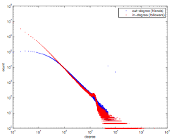
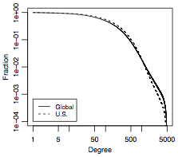
ONLINE COMMUNITIES
Twitter:
Facebook
Jake Hoffman, Yahoo,
Brian Karrer, Lars Backstrom, Cameron Marlowm ²⁰¹¹
Network Science: Scale-Free Networks
Notes:
FACEBOOK: The complementary cumulative distribution function (CCDF). The CCDF at degree k measures the fraction of users who have degree k or greater and in terms of the degree distribution is 􏰂k′ ≥k pk′ . For the U.S., the degree measures the number of friends also from the United States.

