Slide 1
Immunization
By Austin Egri

Slide 2
Outline
Random Immunization
Random Networks
Heterogeneous Networks
How to Halt an Epidemic
Vaccination strategies in Scale-Free Networks
Immunizing the Hubs
Robustness and Immunization
Selective Immunization for Scale-Free Networks
Random Immunization
Selective Immunization
Can Pathogens be Eradicated?

Slide 3
Immunization Strategies
Method specifying how vaccines, treatments, drugs distributed
Ideal: distributed to everyone
Aim to minimize pandemic threat by effective distribution
Pathogen spreading rate: λ
Pathogen critical threshold: λ_{c}
If λ < λ_{c}, the virus naturally dies out
Epidemic threshold vanishes In Scale-free network models
Is this strategy valid?

Slide 4
Random Immunization
Immunization Objectives:
Primary: protect immunized persons from disease
Secondary: reduce speed at which pathogen spreads in population
SIS (Susceptible-Infected Susceptible ) Model
β = rate at which an individual becomes infected
µ = rate at which infected individuals recover
$λ=\frac{β}{μ}$
g Nodes immunized to pathogen, (1-g) nodes susceptible
Degree of susceptible nodes changes from <k> to <k>(1-g)
Spreading rate changes from λ = β/µ to λ’ = λ (1-g)
Notes:
B equivalent to rate of snow fall
Mu equivalent to rate at which plows clear the streets
$τ=\frac{1}{β\left\langle k\right\rangle }$ the characteristic time to reach $\frac{1}{e}$ susceptible individuals (~36%)

Slide 5
Random Immunization
Random Networks
λ’ could fall below epidemic threshold
$gc = 1−\frac{μ}{β}\frac{1}{<k>+1}$
Note how vaccinations lower the rate of spreading and also make it easier for the disease to become eradicated
Notes:
Gc amount of people needed to be immunized dependent (if infection rate rises, then higher immunized rate is needed)
Historically people isolate themselves by various methods
In this case tao becomes negative and the disease is eradicated

Slide 6
Random Immunization
Heterogenous Networks
$g_{c}=1−\frac{μ}{β}\frac{<k>}{<k>^{2}}$ new immunization rate for $λ′$ to fall below the epidemic threshold
In a scale free with $γ<3$, $<k^{2}>→\text{∞}$, so $g_{c}=1$
This implies that virtually every person would have to be immunized
80%-100% in practice (95% for disease such as measles)
Notes:
Gc now dependent more on the hubs (<k^2>) than the average node with low degree

Slide 7
Random Immunization
An example
Digital Virus spreading on email network
Random, undirected
〈k〉=3.26
λ=1 (spreading rate)
Solve for g_{c}=0.76
So 76% of computers would need the anti-virus software
Since email network is actually scale-free, with <k²>=1,271, g_{c}=0.997 for λ=1
This means virtually all computers must have the antiviral software
Impractical in practice

Slide 8
How to Halt an Epidemic
Interventions to control/delay epidemic outbreak
Transmission-Reducing Interventions
Face masks, gloves, hand washing
Contact-Reducing Interventions
Patient quarantine, school closings, mall/movie theater closings
Make network more sparse
Vaccinations
Permanently remove vaccinated nodes from the network

Slide 9
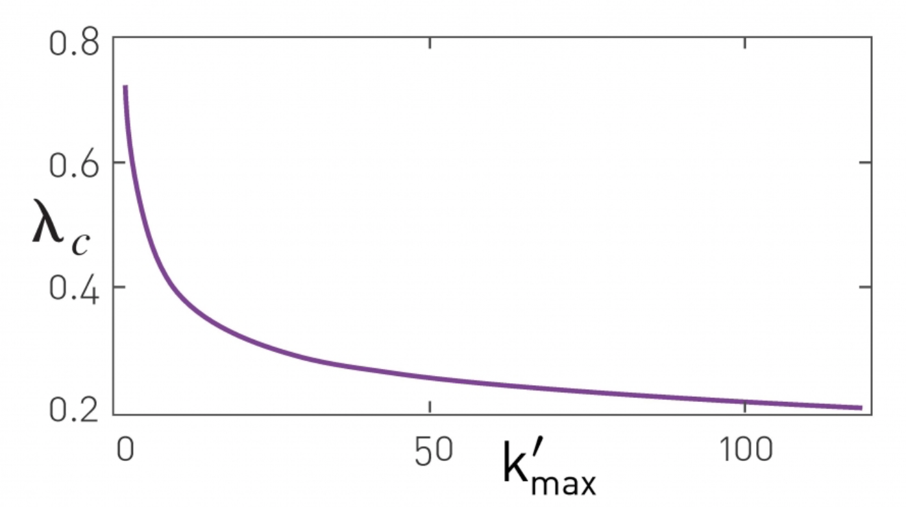
Vaccination Strategies in Scale-Free Networks
Random Immunization is ineffective. How can we minimize the network?
A: Reduce variance <k²> of underlying contact network (Scale-Free Network)

Slide 10
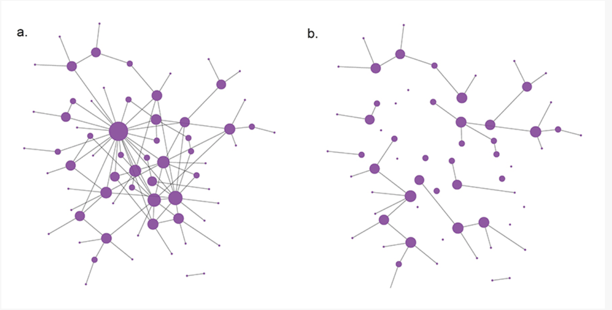
Immunize the Hubs
Immunizing all nodes with degree > $k_{max}^{′}$
The more hubs that are immunized, the larger $λ_{c}$ becomes, thus increasing the chance the disease dies out

Slide 11
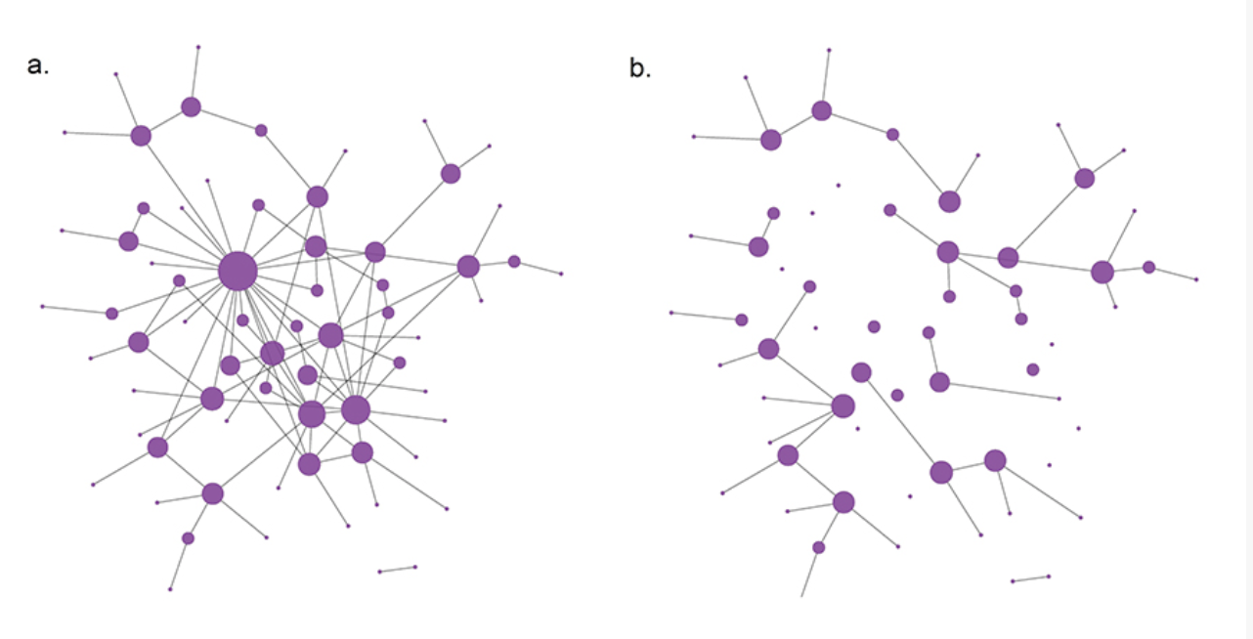
Robustness & Immunization
Scale-free networks are robust to random node/link failures, but removing hubs/nodes with highest connectivity, they fall apart
This problem similar to attack problem on scale-free networks
See network (a)
5 largest hubs removed (b)
Network is shattered
Issue
Hub identification difficult due to minimal network map knowledge
Friendship Paradox:
Average neighbors of a node have higher degree than node itself
Algorithm:
take fraction of infected people
Immunize a single random individual the infected individual had contact with

Slide 12
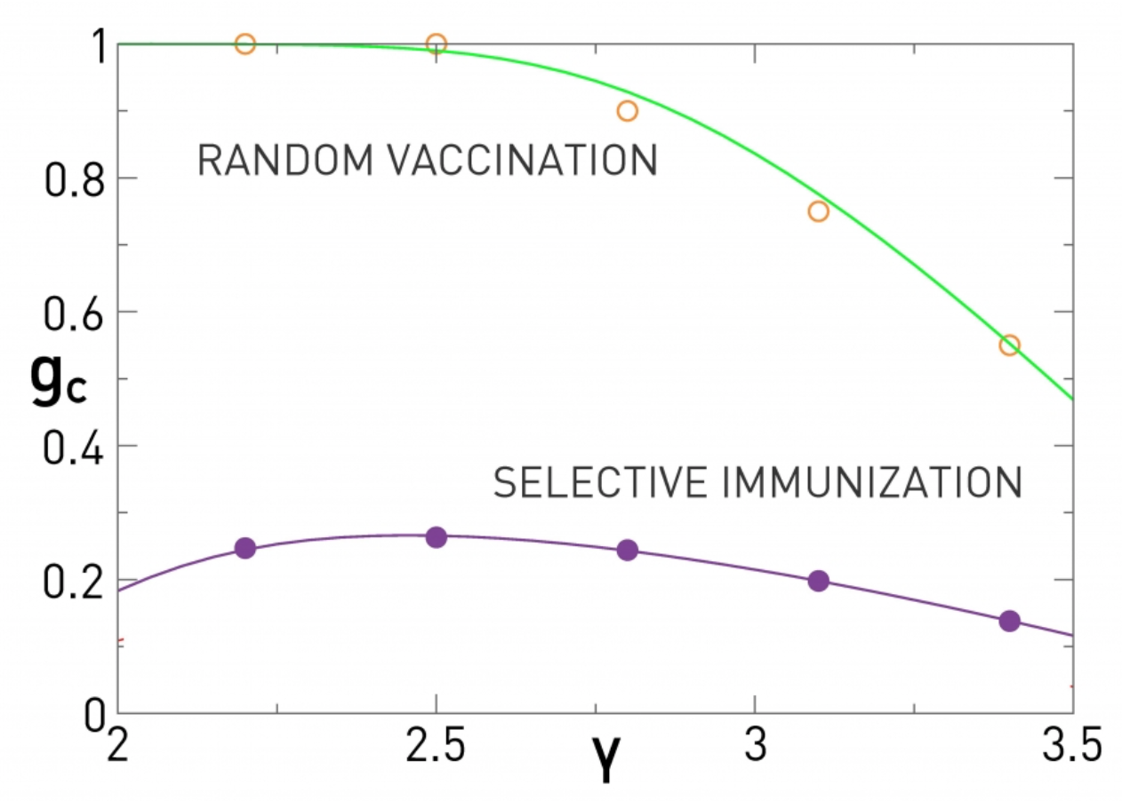
Selective Immunization of Scale-free Networks
$g_{c}$ on the left as a function of the degree exponent $γ$.
Random Immunization
For heterogeneous networks (small $γ$) $g_{c}≅1$, but in high $γ$ networks, immunizing a smaller portion eradicates the disease
Selective Immunization
Using the biased strategy, $g_{c}$is < 30%
Immunize random neighbor of 30% of the nodes, to eradicate disease
MUCH more efficient

Slide 13
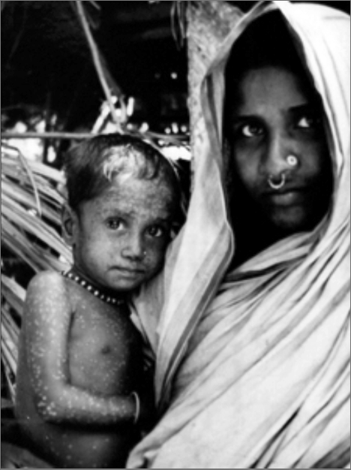
Can Pathogens be Eradicated?
Eradication: the compete elimination of a pathogen from a population
Smallpox started w/ mass vaccination strategy, but was unsuccessful in high population areas
Eventually developed network based vaccination (treat anyone in contact with infected individual), and smallpox became first disease to become officially eradicated
Process:
Select disease with only human carriers
Vaccination exists
Mixed success
Smallpox, rinderpest successful
Hookworm, malaria, yellow fever unsuccessful
Right: Rahima Banu, last smallpox patient (1976)

Slide 14
Conclusion
Immunization increases the difficulty for a disease to spread
Random networks/Scale-free networks with high $γ$ require near total immunization
Effective vaccination and immunization strategy prevents disease outbreak
Eradication occurs when effective strategy combined with effective vaccine works well

Slide 15
References
Barabási, Albert-László, and Márton Pásfai. Network Science. Cambridge University Press, 2016.

Slide 16
