Slide 1
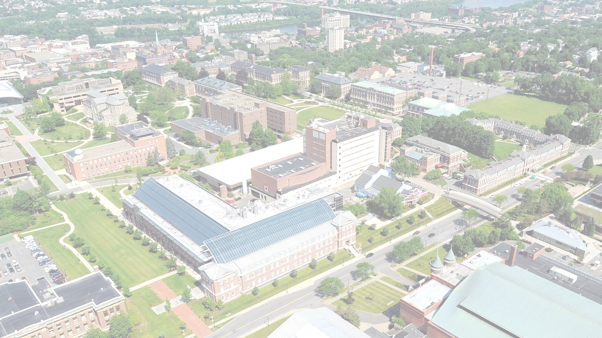


Predicting Viral News Events in Online Media
Xiaoyan Lu, Boleslaw K. Szymanski
NeST Center & SCNARC
Department of Computer Science
Rensselaer Polytechnic Institute, Troy, NY 12180
Reference:
[1] X. Lu, B. Szymanski, "Predicting Viral News Events in Online Media", IEEE Workshop on Parallel and Distributed Processing for Computational Social Systems, 2017.
[2] X. Lu, B. Szymanski, "Scalable prediction of global online media news virality", IEEE Transactions on Computational Social Systems, 2018.

Slide 2


Introduction
The reports in online news media shape the public perception of the emergent events in this world.
  Can we predict the spread of the news about events?
Task 1
Task 2
Task 3
Image source: (left) https://studybreaks.com/2017/02/19/check-your-news-sources/
(right) https://www.brandwatch.com/blog/pr-tracking-using-social-media-monitoring-works/
Notes:
Online media delivers news stories to the public every day. These reports shape people's perception of the ongoing social, political and economical change around them. Although numerous events are reported in the news every hour around the globe, only a few reported events attract enormous attention of the online media - hundreds of news reports suddenly break out after the critical event happens. The burstiness of the reporting behavior in the online media makes the prediction of which events will trigger viral news challenging.

Slide 3
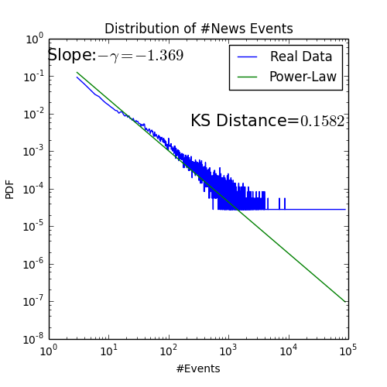
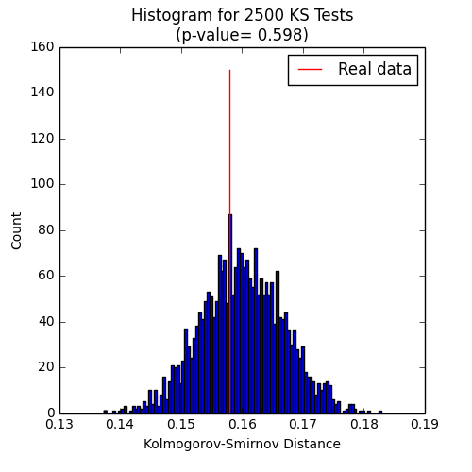
Power-law Distribution of the #Reports per Site
Power-law is a plausible fit to the real data as the p-value is large enough, >10%
Reference: "Power-law distributions in empirical data." by Clauset et al.

Slide 4
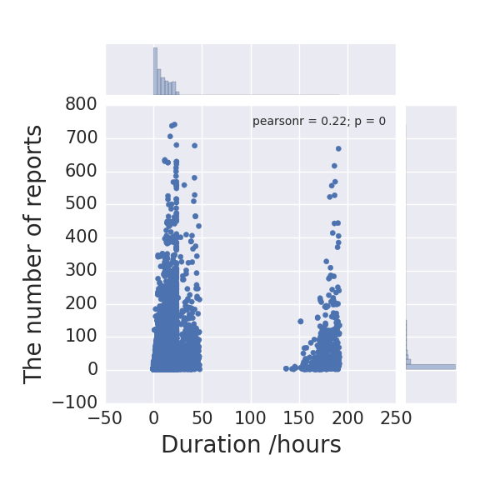
Introduction
The spread of news events exhibits an emergent pattern.
A total of 190,000 events randomly sampled from GDelt dataset.
A few news events are reported massively in a short period.
Can we predict viral news?
Notes:
We calculate the duration of events, computed as the period since its earliest record until the latest. Most news events are reported by the news site within the first 50 hours. This reflects the short life cycle of the production and consumption of the news events. One explanation for this phenomenon is that a news site would prefer not to report an event which is considered out-of-date. In contract to the breaking news, the discussion of long-term topics such as greenhouse effect lasts a very long time, but these events constitute a very small portion of the dataset.

Slide 5
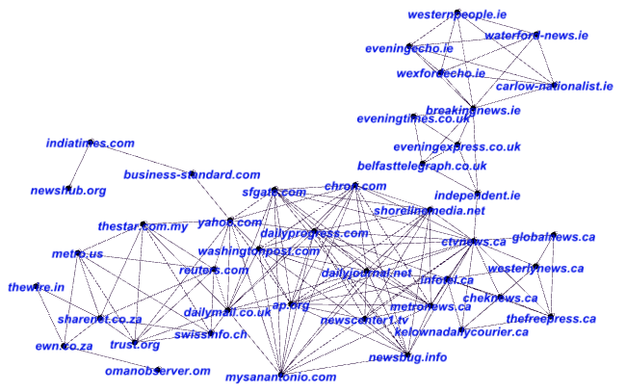

News Events in Online Media
The spread of the news stories exhibits an emergent pattern in online media. Can we predict viral news?
We use survival analysis to model the spread of news events from one online media site to its neighbors.
The instantaneous rate of the infection from node u to node v in a graph:
Notes:
Why survival analysis?
The delay of infection
Model news reports as information propagation process

Slide 6
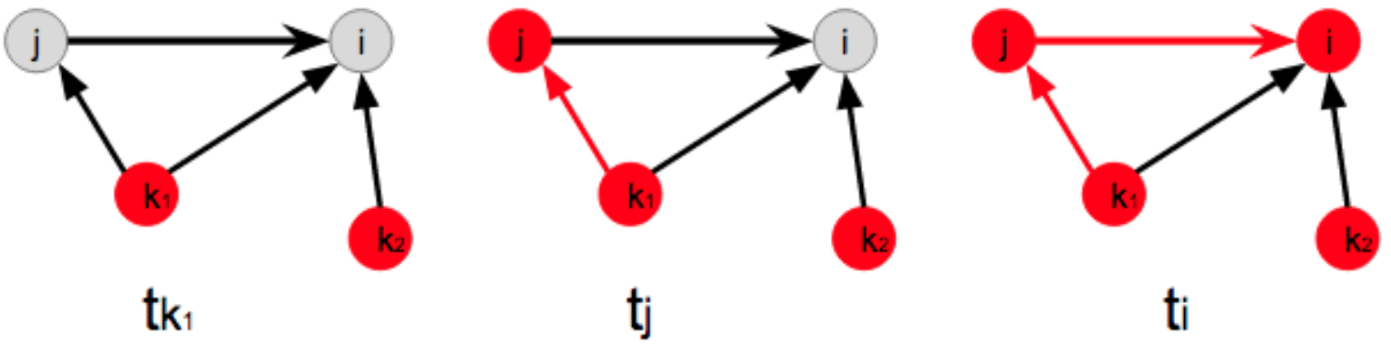
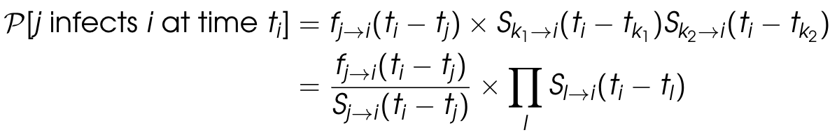
Survival Analysis
The stochastic propagation model [Kempe 2003]:
  Infection delay through every link is independent.
  Once a node has been infected, it won’t be infected again.
According to the survival analysis [Infopath 2013]
where the survival function S(τ) denotes the probability
that NO infection happens within the period of time τ.
(Hazard Function)

Slide 7
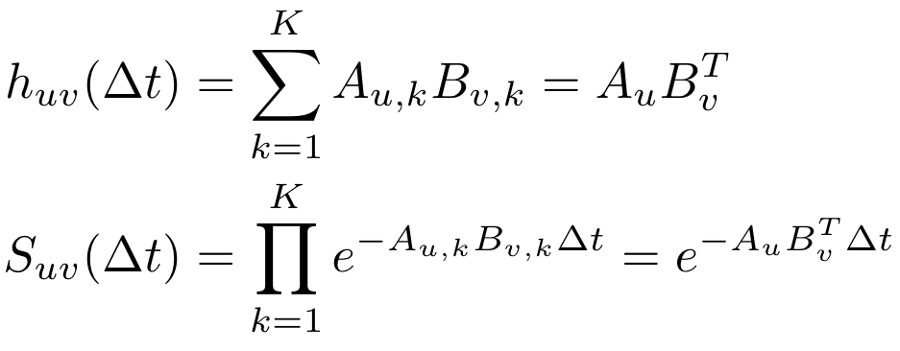
Nodes vs. Edges
Instead of modeling the links, we focus on the nodes. The number of latent variable becomes linear in the number of nodes.
Topic Model:
where Auk is the influence of node
u on topic k; Bvk is the selectivity of
node v on topic k.
A common choice for the survival
time distribution S_{uv} is the
exponentially decaying. The minimum
infection delay across the K topics
follows the exponential distribution with intensity h_{uv}
Influence Vector
Selectivity Vector

Slide 8
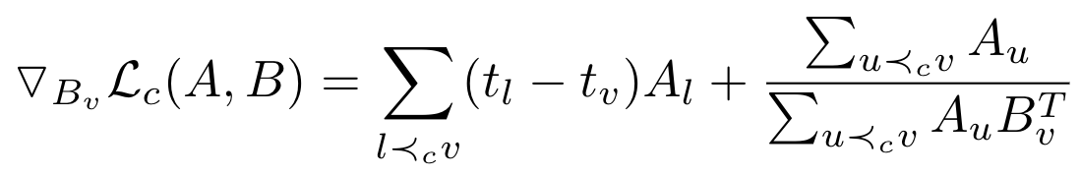
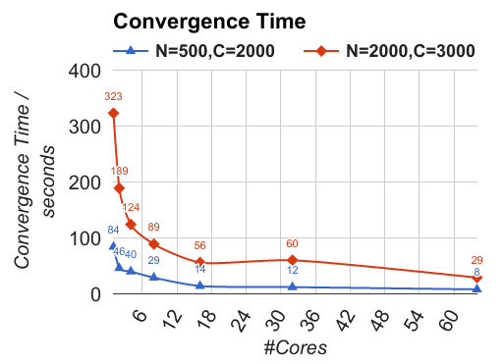
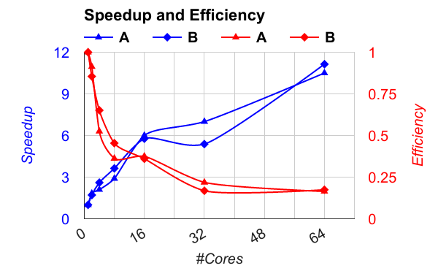
Parallelized Model Training on Shared Memory Machines
Every processor accepts an individual cascade and does gradient descent in parallel.
Atomic Compare-And-Swap (CAS) operations to update the components of the influence and selectivity vector of the same node.

Slide 9
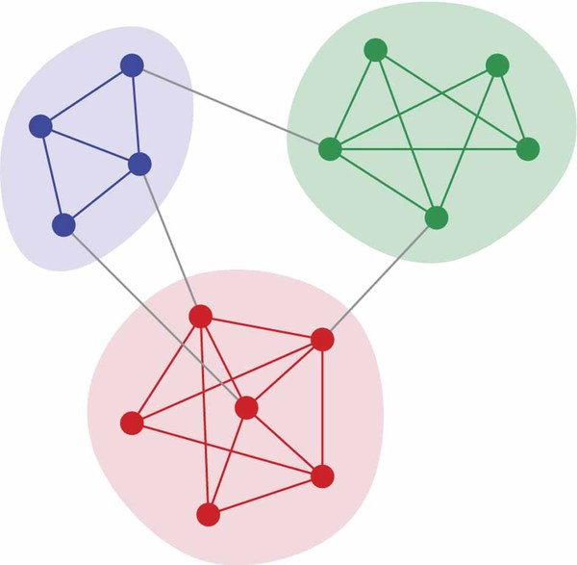
Parallelized Model Training on Distributed Memory Machines
A cascade involves the nodes distributed in different processors.
#inter-core messages can be quadratic in the size of a cascade

Slide 10
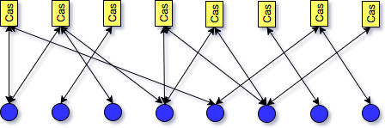
Parallelized Model Training on Distributed Memory Machines
On distributed memory machines, a cascade layer is proposed to reduce the inter-core communication caused by node-node connection in the survival analysis.
The response time of a node to a cascade follows exponential distribution with rate parameter Au Mc where Mc is the influence vector of a cascade.
The training algorithm propagates parameters between the cascade layer and node layer. A node (blue) is connected to all the cascades (yellow) in which it involves.

Slide 11


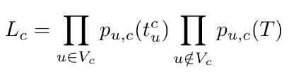






Response Times Drawn from Expo Distribution
Given an information cascade where the i-th node has response time , the likelihood of observing a cascade is
where the negative nodes can be approximated by drawing a set of samples, i.e. in .
The probability density function is the exponential distribution
where the is the sigmoid function with a scaling parameter w and represents the inner product in vector space.

Slide 12
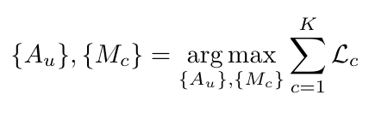
Maximum Likelihood Estimation
We maximize the likelihood which factorizes into the product of the likelihoods of K cascades
  The input of the model is the response times of the nodes to every cascade. This is a practical setting when the underlying network topology is incomplete or hidden during the information propagation process.
  The parameter space does not have any restriction thanks to the adoption of the sigmoid function.

Slide 13





Stochastic Gradient Ascent Algorithm
The partial derivative of this objective function over a particular becomes
which is a weighted sum of the terms in the form of .
  Given the value of t, depends only on and
  The SGA updates can operate on a bipartite graph where node u and cascade c are connected if

Slide 14
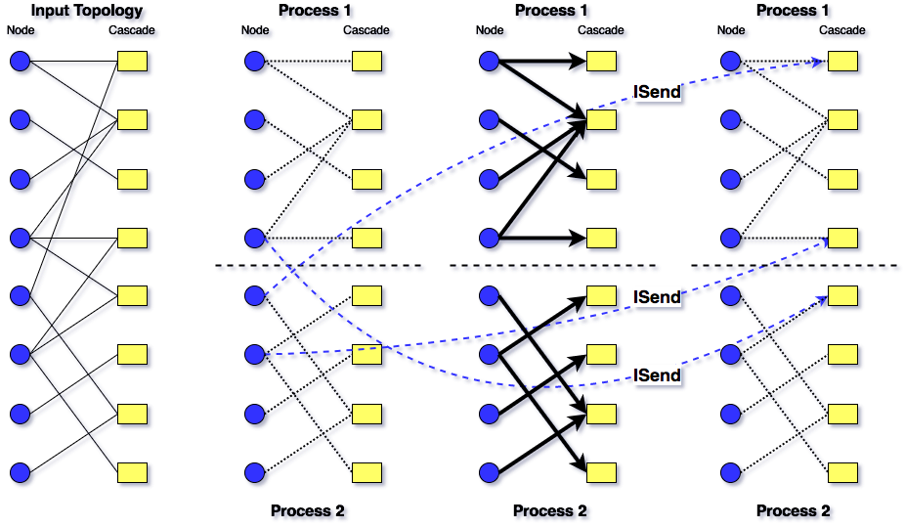
Parallelization Scheme for Distributed Memory Machines
Asynchronous communication occurs between different processors while each processor does internal computations.

Slide 15
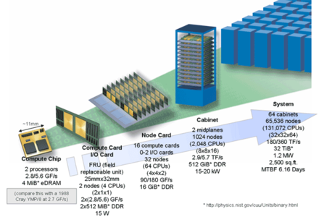

AMOS Supercomputer @ Rensselaer
Advanced Multiprocessing Optimized System (AMOS) is named after Amos Eaton, natural scientist, educator, and co-founder of the Rensselaer school.
Ranked No. 1 among supercomputers at private American academic institutions and No. 3 among supercomputers at American academic institutions.
The system is 5-rack, 5K nodes, 80K cores IBM Blue Gene/Q with additional equipment.
Each node consists of a 16-core, 1.6 GHz A2 processor, with 16 GB of DDR3 memory.

Slide 16
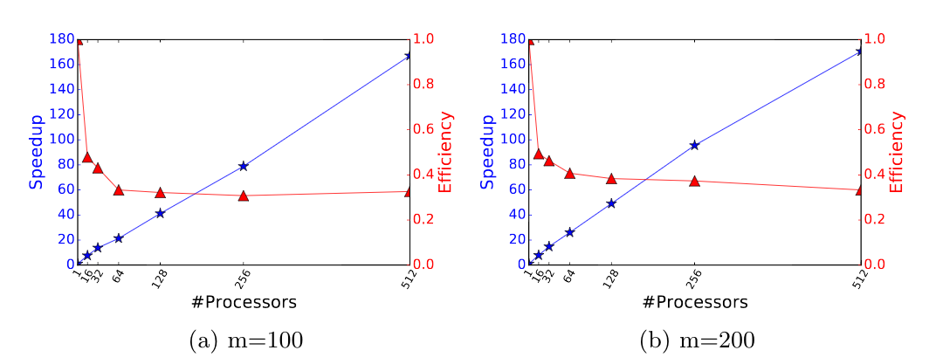
Speedup and Efficiency on AMOS Supercomputer
Every node of the AMOS system uses 16 cores.
Each core has an independent local memory for the embeddings associated with its own nodes/cascades and a ghost memory for the embeddings associated with remote nodes/cascades.

Slide 17
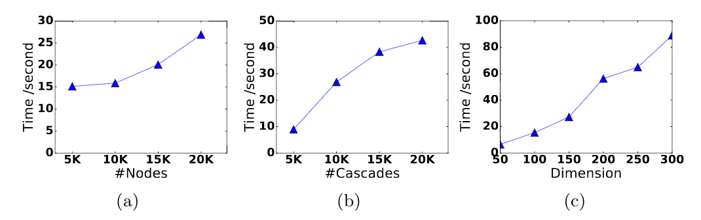
Algorithm Scalability
The execution time of one SGA iteration in relation to the dimension m, the number of nodes and the number of cascades.

Slide 18
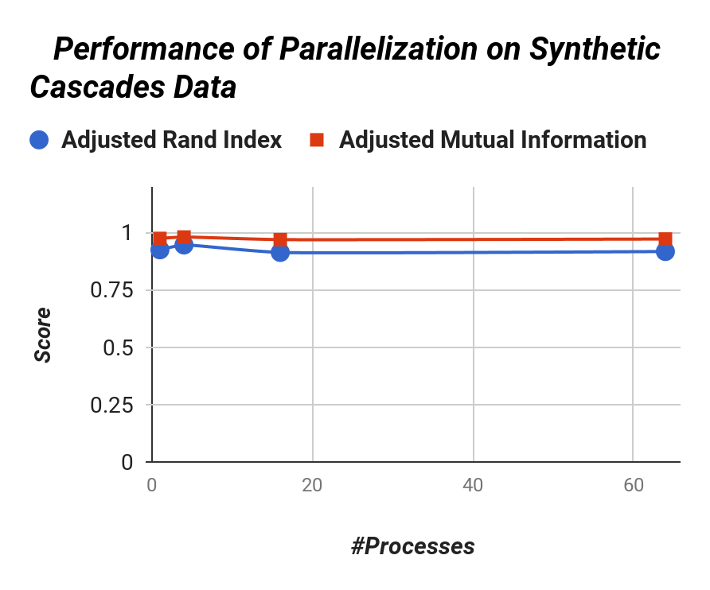
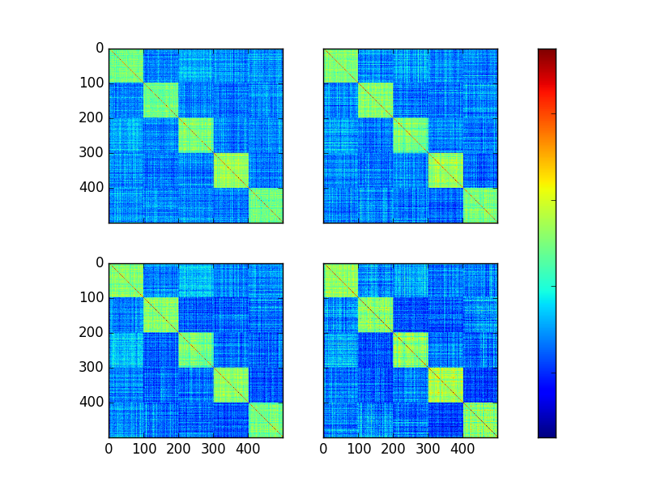
Parallelization Performance on Community Detection
The parallelization scheme preserves the quality of the resulting node embeddings.
Distance Matrix of the First 500 Nodes
#Processors=1
#Processors=4
#Processors=16
#Processors=64
5K cascades simulated on a Stochastic Blockmodel (SBM) network with 10K nodes. We evaluate the quality of the community discovered by K-means algorithm based on the vector representation of nodes.

Slide 19
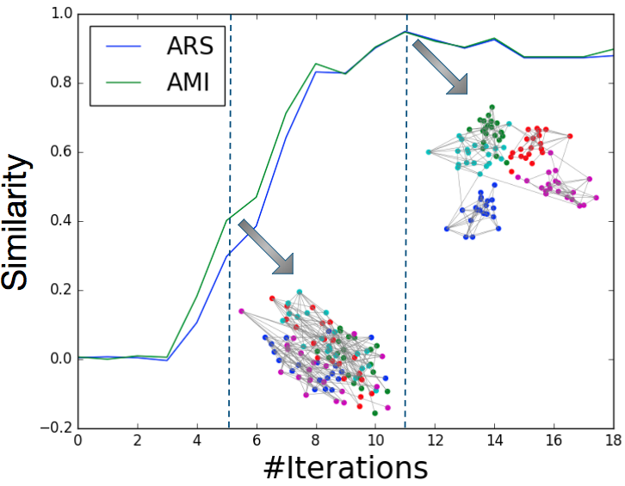
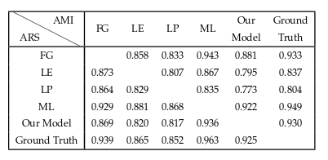
Parallelization Performance on Community Detection
The alignment between the node clustering of our model and ground truth increases as the training algorithm proceeds.
The network topology is visualized by multidimensional scaling (MDS).
The pairwise similarities between the output of the state-of-the-art community detection algorithms, the node clustering of our model and the ground truth.
FG: fast greedy algorithm
LE: leading eigenvector method
LP: label propagation algorithm
ML: multilevel algorithm
ARS: adjusted rand score
AMI: adjusted mutual information

Slide 20
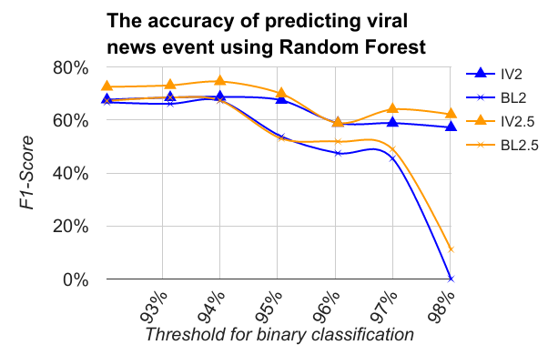
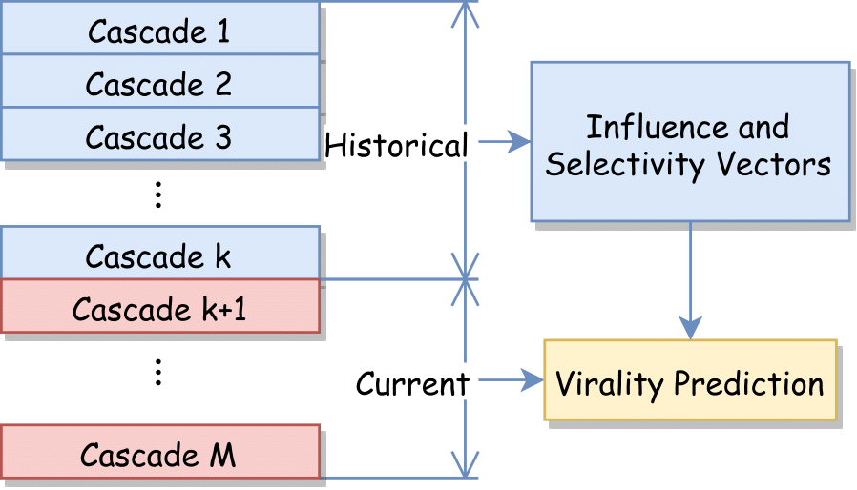
Virality Prediction of Online News Cascades
Task: Predict the final number of news sites reporting an emergent news event.
  The summation of the influence vectors of the early adopters in the first 2 or 2.5 hours is used as the input. (IV2, IV2.5)
  A baseline model uses features including number of early adopters, time intervals etc. as input. (BL2, BL2.5)
#News Sites = 5634
#News Events = 41452
(K=35000)

Slide 21
Virality Prediction of Online News Cascades
Since we are only interested in predicting the most viral events reported in the news, the threshold ranges from 90% to 99% in our experiments.
A high threshold would result in two very imbalanced sets of samples, which makes the prediction challenging.
The prediction models take the news sites reporting an event in the first hours, i.e. the early adopters, as input.
Community structures can provide the critical signals to forecast the viral information cascades at the early stage.

Slide 22
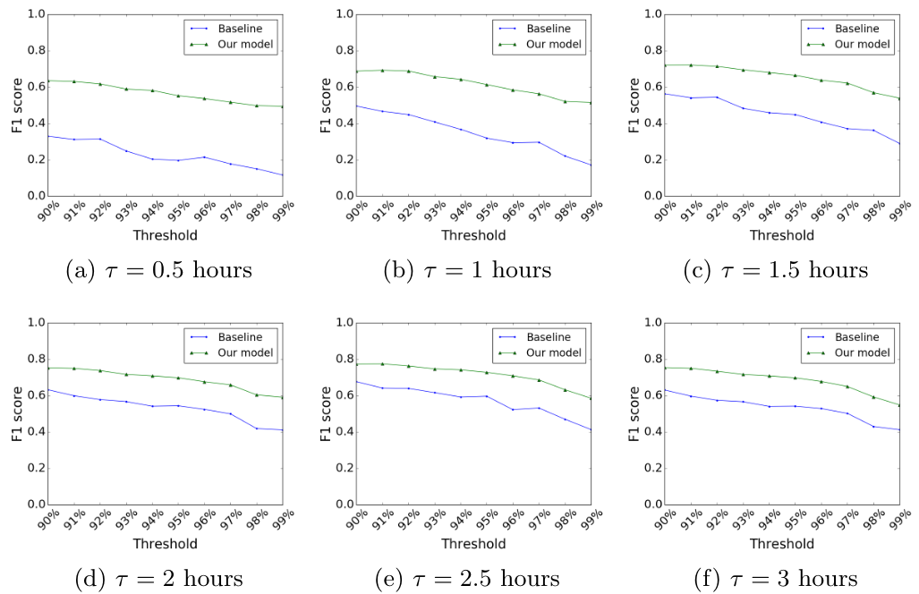
Virality Prediction of Online News Cascades

Slide 23
Conclusions
Most news events are reported by the news sites from the same region.
Cascades of news rarely cross the language boundaries, but if they do they become large.
The high divergence of the early adopters of a news event predicts the rapid growth of future reports.
Our algorithm can efficiently predict the viral news events in the first 1-3 hours ( ~20% improvement over the baseline approach).

Slide 24
Thanks

