Slide 1
Frontiers of Network Science
Fall 2018
Class 18: Robustness Part I
(Chapter 8 in Textbook)
based on slides by
Albert-László Barabási
and Roberta Sinatra
Boleslaw Szymanski
www.BarabasiLab.com

Slide 2
MALLOY-REED CRITERIA: THE EXISTENCE OF A GIANT COMPONENT
A giant cluster exists if each node is connected to at least two other nodes.
The average degree of a node i linked to the GC, must be 2, i.e.
Bayes’ theorem
P(k_{m}|i <-> j): joint probability that a node has degree k_{m} and is connected to nodes i and j.
For a randomly connected network (does NOT mean random network!) with P(k):
i can choose between N-1 nodes to link to, each with probability 1/(N-1). I can try k_{i} times.
κ>2: a giant cluster exists
κ<2: many disconnected clusters
Network Science: Robustness Cascades
Malloy, Reed, Random Structures and Algorithms (1995); Cohen et al., Phys. Rev. Lett. 85, 4626 (2000).
Notes:
A : For a graph having degree distribution P(k) to have a giant component, a node that is reached by following a link from the giant component must have at least one other link on average to allow the component to exist. For this to occur, the average degree must be at least 2 (one incoming and one outgoing link) given that the node i is connected to j:
B:

Slide 3
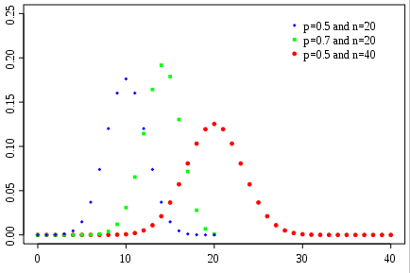
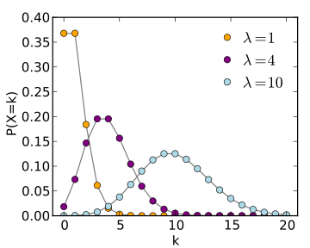
Apply the Malloy-Reed Criteria to an Erdos-Renyi Network
Discrete Formulation
-binomial distribution-
Continuum Formulation
-Poisson distribution-
Probability Distribution Function
(PDF)
Network Science: Robustness Cascades

Slide 4
Apply the Malloy-Reed Criteria to an Erdos-Renyi Network
A giant cluster exists if each node is connected to at least two other nodes.
κ>2: a giant cluster exists;
κ<2: many disconnected clusters;
Malloy-Reed; Cohen et al., Phys. Rev. Lett. 85, 4626 (2000).
Network Science: Robustness Cascades

Slide 5
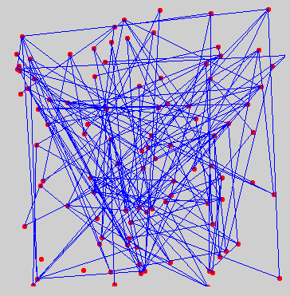
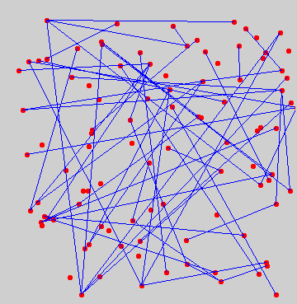
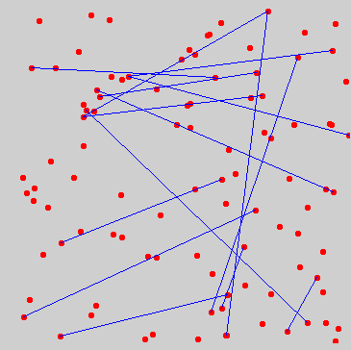
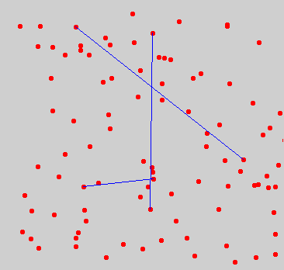
RANDOM NETWORK: DAMAGE IS MODELED AS AN INVERSE OERCOLATION PROCESS
f = fraction of removed nodes
S
Component
structure
Graph
f=0
f_{c} =(1-1/N)/<k>
f=1/<k>
<k>=N-1
k_{c} : <k>=1
<k>->0
(Inverse percolation phase transition)
Network Science: Robustness Cascades

Slide 6
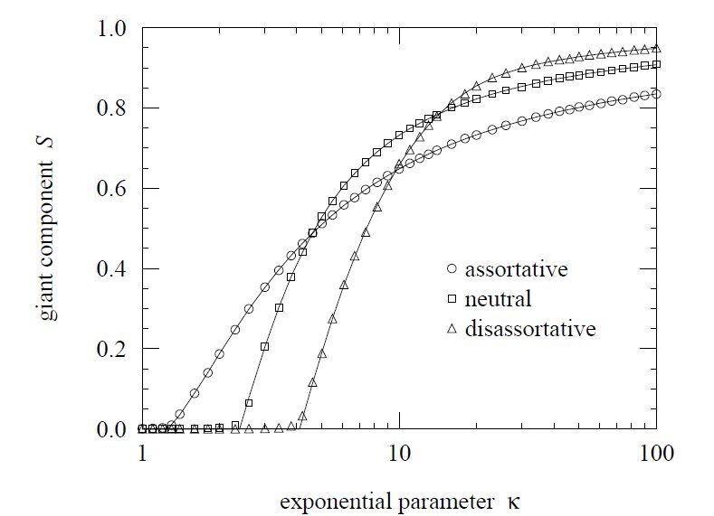
FINAL REMARKS: EFFECT OF ASSORTATIVE MIXING: PERCOLATION
M. E. J. Newman, Phys. Rev. Lett. 89, 208701 (2002)
Network Science: Degree Correlations

Slide 7
BREAKDOWN THRESHOLD FOR ARBITRARY P(k)
Problem: What are the consequences of removing a fraction f of all nodes?
At what threshold f_{c} will the network fall apart (no giant component)?
Random node removal changes
the degree of individual nodes [k → k’ ≤k]
the degree distribution [P(k) → P’(k’)]
A node with degree k will loose some links and become a node with degree k’ with probability:
The prob. that we had a k degree node was P(k), so the probability that we will have a new node with degree k’ :
Remove k-k’ links, each with probability f
Leave k’ links untouched, each with probability 1-f
Let us asume that we know <k> and <k²> for the original degree distribution P(k)
→ calculate <k’> , <k’²> for the new degree distribution P’(k’).
Cohen et al., Phys. Rev. Lett. 85, 4626 (2000).
Network Science: Robustness Cascades

Slide 8
BREAKDOWN THRESHOLD FOR ARBITRARY P(K)
Degree distribution after we removed f fraction of nodes.
The sum is done over the triangle shown in the right, so we can replace it with
k=[k’, ∞)
k’
Cohen et al., Phys. Rev. Lett. 85, 4626 (2000).
Network Science: Robustness Cascades

Slide 9
BREAKDOWN THRESHOLD FOR ARBITRARY P(K)
Degree distribution after we removed f fraction of nodes.
The sum is done over the triangle shown in the right, i.e. we can replace it with
k=[k’, ∞)
k’
Cohen et al., Phys. Rev. Lett. 85, 4626 (2000).
Network Science: Robustness Cascades

Slide 10
BREAKDOWN THRESHOLD FOR ARBITRARY P(K)
Robustness: we remove a fraction f of the nodes.
At what threshold f_{c} will the network fall apart (no giant component)?
Random node removal changes
the degree of individuals nodes [k → k’ ≤k)
the degree distribution [P(k) → P’(k’)]
κ>2: a giant cluster exists
κ<2: many disconnected clusters
S
Breakdown threshold:
f<f_{c}: the network is still connected (there is a giant cluster)
f>f_{c}: the network becomes disconnected (giant cluster vanishes)
f_{c}
f
Cohen et al., Phys. Rev. Lett. 85, 4626 (2000).
Network Science: Robustness Cascades

Slide 11
ROBUSTNESS OF SCALE-FREE NETWORKS
Scale-free networks do not appear to break apart under random failures.
Reason: the hubs.
The likelihood of removing a hub is small.
1
S
0
f
1
Albert, Jeong, Barabási, Nature 406 378 (2000)
Network Science: Robustness Cascades

Slide 12
ROBUSTNESS OF SCALE-FREE NETWORKS
Scale-free networks do not appear to break apart under random failures. Why is that?
Network Science: Robustness Cascades

Slide 13
ROBUSTNESS OF SCALE-FREE NETWORKS
γ>3: κ is finite, so the network will break apart at a finite f_{c} that depens on K_{min}
γ<3: κ diverges in the N→ ∞ limit, so f_{c} → 1 !!!
for an infinite system one needs to remove all the nodes to break the system.
For a finite system, there is a finite but large f_{c} that scales with the system size as:
Internet: Router level map, N=228,263; γ=2.1±0.1; κ=28 → f_{c}=0.962
AS level map, N= 11,164; γ=2.1±0.1; κ=264 → f_{c}=0.996
Network Science: Robustness Cascades

Slide 14
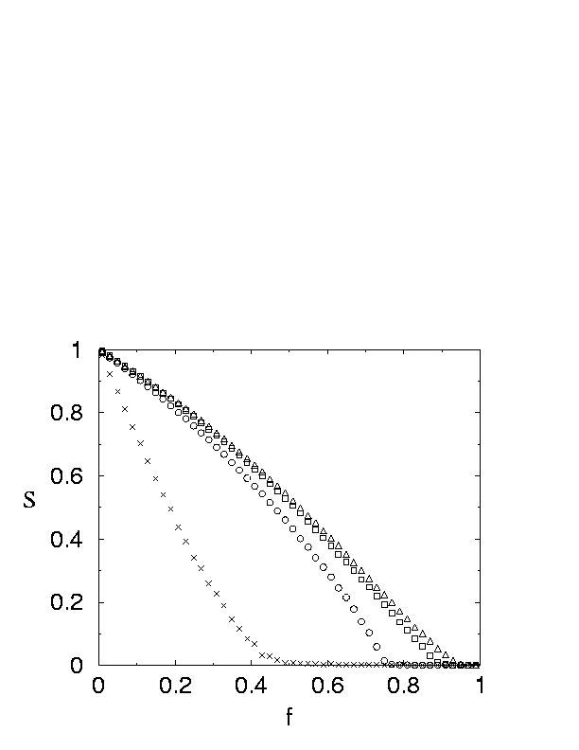
NUMERICAL EVIDENCE
Scale-free random graph with
Cohen et al., Phys. Rev. Lett. 85, 4626 (2000).
Infinite scale-free networks with do not break down under
random node failures.
Network Science: Robustness Cascades

Slide 15
SIZE OF THE GIANT COMPONENT DURING RANDOM DAMAGE –WITHOUT PROOF-
S: size of the giant component, f fraction of randomly removed nodes, not damage for f<f_{c}
γ>4: S≈f-f_{c} (similar to that of a random graph)
3>γ>4: S≈(f-f_{c})^{1/(γ-3)}
γ<3: f_{c} =0 and S≈f^{1+1/(3-γ)}
R. Cohen, D. ben-Avraham, S. Havlin,
Percolation critical exponents in scale-free networks Phys. Rev. E 66, 036113 (2002);
See also: Dorogovtsev S, Lectures on Complex Networks, Oxford, pg44
Network Science: Robustness Cascades

Slide 16
Achilles’ Heel of scale-free networks
1
Attacks
Failures
S
γ ≤ 3 : f_{c}=1
(R. Cohen et al PRL, 2000)
0
f_{c}
1
f
Albert, Jeong, Barabási, Nature 406 378 (2000)
Network Science: Robustness Cascades

Slide 17
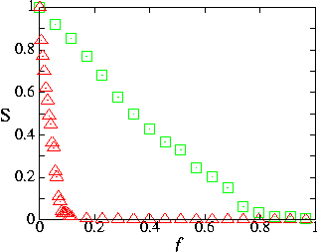
INTERNET’S ROBUSTNESS TO RANDOM FAILURES
failure
attack
Internet
R. Albert, H. Jeong, A.L. Barabasi, Nature 406 378 (2000)
Internet: Router level map, N=228,263; γ=2.1±0.1; κ=28 → f_{c}=0.962
AS level map, N= 11,164; γ=2.1±0.1; κ=264 → f_{c}=0.996
Internet parameters: Pastor-Satorras & Vespignani, Evolution and Structure of the Internet: Table 4.1 & 4.4
Network Science: Robustness Cascades

Slide 18
Attack threshold for arbitrary P(k)
Attack problem: we remove a fraction f of the hubs.
At what threshold f_{c} will the network fall apart (no giant component)?
Hub removal changes
the maximum degree of the network [K_{max} → K’_{max} ≤K_{max})
the degree distribution [P(k) → P’(k’)]
A node with degree k will loose some links because some of its neighbors will vanish.
Claim: once we correct for the changes in K_{max} and P(k),we are back to the robustness problem.
That is, attack is nothing but a robusiness of the network with a new K_{max} and P(k).
Cohen et al., Phys. Rev. Lett. 85, 4626 (2000).
Network Science: Robustness Cascades

Slide 19
Attack threshold for arbitrary P(k)
Attack problem: we remove a fraction f of the hubs.
the maximum degree of the network [K_{max} → K’_{max} ≤K_{max}) `
If we remove an f fraction of hubs, the maximum degree changes:
As K’_{max} ≤K_{max}
we can ignore
the K_{max} term
← The new maximum degree after removing f fraction of the hubs.
Cohen et al., Phys. Rev. Lett. 85, 4626 (2000).
Network Science: Robustness Cascades

Slide 20
Attack threshold for arbitrary P(k)
Attack problem: we remove a fraction f of the hubs.
the degree distribution changes [P(k) → P’(k’)]
A node with degree k will loose some links because some of its neighbors will vanish.
Let us calculate the fraction of links removed ‘randomly’ , f’, as a consequence of we removing f fraction of hubs.
as K’_{max} ≤K_{max}
For γ→2, f’→1, which means that even the removal of a tiny fraction of hubs will destroy the network. The reason is that for γ=2 hubs dominate the network
Cohen et al., Phys. Rev. Lett. 85, 4626 (2000).
Network Science: Robustness Cascades

