Slide 1

Frontiers of Network Science
Fall 2018
Class 14: Degree Correlations I
(Chapter 7 in Textbook)
based on slides by
Albert-László Barabási
and Roberta Sinatra
Boleslaw Szymanski
www.BarabasiLab.com

Slide 2
EXTENDED MODEL: Small-k cutoff
P(k) ~ (k+κ(p,q,m))^{-γ(p,q,m)} γ ∈ [1,∞)
Extended Model
prob. p : internal links
prob. q : link deletion
prob. 1-p-q : add node
→Predicts a small-k cutoff
a correct model should predict all aspects of the degree distribution, not only the degree exponent.
Degree exponent is a continuous function of p,q, m
p=0.937
m=1
κ = 31.68
γ = 3.07
Actor network
Network Science: Evolving Network Models
Notes:
It also

Slide 3
NONLINEAR PREFERENTIAL ATTACHMENT: MORE MODELS
Non-linear preferential attachment:
→ P(k) does not follow a power law for α≠1
⇒ α<1 : stretch-exponential
⇒ α>1 : no-scaling (α>2 : “gelation”)
P. Krapivsky, S. Redner, F. Leyvraz, Phys. Rev. Lett. 85, 4629 (2000)
Network Science: Evolving Network Models

Slide 4
INITIAL ATTRACTIVENESS
BA model: k=0 nodes cannot aquire links, as Π(k=0)=0
(the probability that a new node will attach to it is zero)
A - initial attractiveness
Initial attractiveness shifts the degree exponent:
Note: the parameter A can be measured from real data, being the rate at which k=0 nodes acquire links, i.e. Π(k=0)=A
Dorogovtsev, Mendes, Samukhin, Phys. Rev. Lett. 85, 4633 (2000)
Network Science: Evolving Network Models

Slide 5
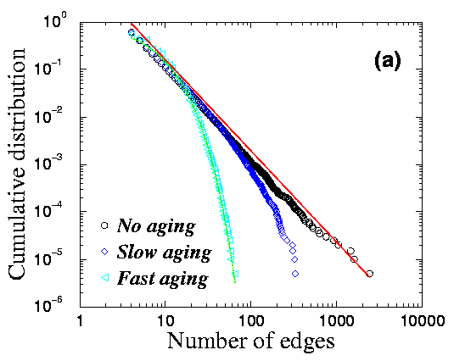
GROWTH CONSTRAINTS AND AGING CAUSE CUTOFFS
Finite lifetime to acquire new edges
L. A. N. Amaral et al., PNAS 97, 11149 (2000)
Gradual aging:
S. N. Dorogovtsev and J. F. F. Mendes, Phys. Rev. E 62, 1842 (2000)
Network Science: Evolving Network Models

Slide 6


THE LAST PROBLEM: HIGH, SYSTEM-SIZE INDEPENDENT C(N)
Pathlenght
Clustering
Degree Distr.
P(k) ~ k^{-γ}
Regular network
P(k)=δ(k-k_{d})
Erdos-
Renyi
Watts-
Strogatz
Exponential
Barabasi-Albert
P(k) ~ k^{-γ}
Network Science: Evolving Network Models
Notes:
As we can see, the BA model gets approximatelly right the small world effect, the degree distribution. When it comes to the clustering coefficient, the bad news is that it still decreases with the system size. The good news, is that it decreases slower that the ER prediction. Most important, however, the real difference is this: the model is really a modeling platform, that can be adjusted to the properties of real networks– we will see that in fact it can generate a finite, system size independnet clustering coefficient, if our main goal is to do just that.

Slide 7
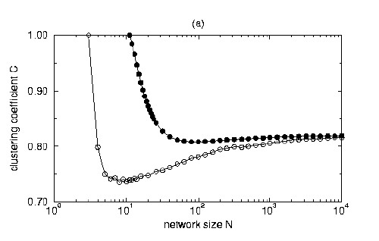
A MODEL WITH HIGH CLUSTERING COEFFICIENT
Each node of the network can be either active or inactive.
There are m active nodes in the network in any moment.
Start with m active, completely connected nodes.
Each timestep add a new node (active) that connects to m active nodes.
Deactivate one active node with probability:
C→ C* when N→∞
K. Klemm and V. Eguiluz, Phys. Rev. E 65, 036123 (2002)
Network Science: Evolving Network Models

Slide 8
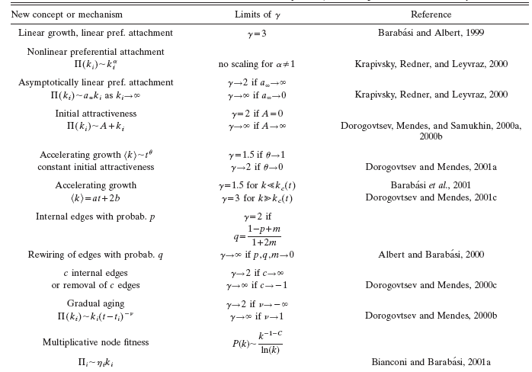
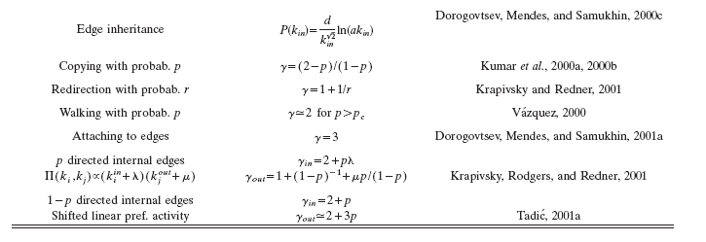

Slide 9
Section 11: Summary
The network grows, but the degree distribution is stationary.

Slide 10
Section 11: Summary
The network grows, but the degree distribution is stationary.

Slide 11
Section 11: Summary

Slide 12
LESSONS LEARNED: evolving network models
There is no universal exponent characterizing all networks.
Growth and preferential attachment are responsible for the emergence of the scale-free property.
The origins of the preferential attachment is system-dependent.
Modeling real networks:
      identify the microscopic processes that take place in the system
      measure their frequency from real data
      develop dynamical models that capture these
      processes.
5. If the model is correct, it should correctly predict not only the degree exponent, but both small and large k-cutoffs.
Network Science: Evolving Network Models

Slide 13
LESSONS LEARNED: evolving network models
Philosophical change in network modeling:
ER, WS models are static models – the role of the network modeler it to cleverly place the links between a fixed number of nodes to that the network topology mimic the networks seen in real systems.
BA and evolving network models are dynamical models: they aim to reproduce how the network was built and evolved.
Thus their goal is to capture the network dynamics, not the structure.
→ as a byproduct, you get the topology correctly
Network Science: Evolving Network Models

Slide 14
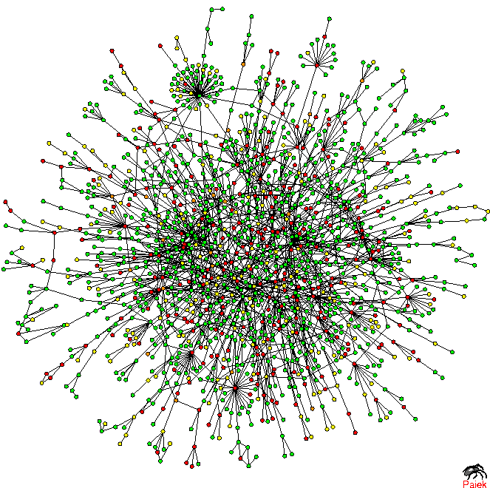
Prot P(k)
TOPOLOGY OF THE PROTEIN NETWORK
Nodes: proteins
Links: physical interactions (binding)
Puzzling pattern:
Hubs tend to link to small degree nodes.
Why is this puzzling?
In a random network, the probability that a node with degree k links to a node with degree k’ is:
k≅50, k’=13, N=1,458, L=1746
Yet, we see many links between degree 2 and 1 links, and no links between the hubs.
H. Jeong, S.P. Mason, A.-L. Barabasi, Z.N. Oltvai, Nature 411, 41-42 (2001)
Network Science: Degree Correlations

