Slide 1

Frontiers of Network Science
Fall 2018
Class 10: Barabasi-Albert Model I
(Chapter 5 in Textbook)
Boleslaw Szymanski
based on slides by
Albert-László Barabási
and Roberta Sinatra
www.BarabasiLab.com

Slide 2
Section 2
Growth and preferential attachment

Slide 3
Section 4 Linearized Chord Diagram
Possible evolution
paths with self-loops.
New node is red.
One possible definition with self-loops

Slide 4
Section 4
Degree dynamics

Slide 5
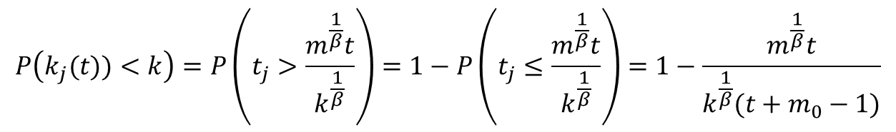
Degree distribution
for t ≥ m₀+i and 0 otherwise as system size at t is N=m₀+t-1
A random node j at time t then is with equal probability 1/N=1/(m₀+t-1) onr of the nodes 1, 2,…. N ( we assume the initial m₀ nodes create a fully connected graph), its degree will grow with the above equation, so
$$P\left(k_{j}(t))<k\right)=P\left(t_{j}>\frac{m^{\frac{1}{β}}t}{k^{\frac{1}{β}}}\right)=1−P\left(t_{j}≤\frac{m^{\frac{1}{β}}t}{k^{\frac{1}{β}}}\right)=1−\frac{m^{\frac{1}{β}}t}{k^{\frac{1}{β}}(t+m_{0}−1)}$$
For the large times t (and so large network sizes) we can replace t-1 with t above, so
γ = 3
A.-L.Barabási, R. Albert and H. Jeong, Physica A 272, 173 (1999)
Network Science: Evolving Network Models
Notes:
PREDICTIONS:
(i) The degree exponent $\gamma$ is independent of $m$, a prediction that is in agreement with the numerical results (see Fig. 4).
(ii) As the power-law observed for real networks describes systems of rather different ages and sizes, it is expected that a correct model should provide a time-independent degree distribution. Indeed, Eq.(\ref{cube}) predicts that asymptotically (i.e. in the $t \gg m_0$ limit) the degree distribution of the BA model is independent of time (and, subsequently, independent of the system size $N=m_0+t$), indicating that despite its continuous growth, the network reaches a stationary scale-free state.
Nominal similarities shown in Figure 4 support these predictions.
(iii) Equation (\ref{cube}) indicates that the coefficient of the power-law distribution is proportional to $m^2$. a prediction again confirmed by the numerical simulations shown in Figure \ref{F-BA-BAScaling}.

Slide 6
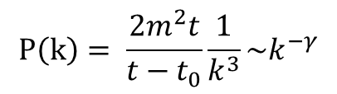
Degree distribution
$$P\left(k\right)= \frac{2m^{2}t}{t−t_{0}}\frac{1}{k^{3}}\sim k^{−γ}$$
γ = 3
(i) The degree exponent is independent of m.
(ii) As the power-law describes systems of rather different ages and sizes, it is expected that a correct model should provide a time-independent degree distribution. Indeed, asymptotically the degree distribution of the BA model is independent of time (and of the system size N)
→ the network reaches a stationary scale-free state.
(iii) The coefficient of the power-law distribution is proportional to m².
A.-L.Barabási, R. Albert and H. Jeong, Physica A 272, 173 (1999)
Network Science: Evolving Network Models
Notes:
PREDICTIONS:
(i) The degree exponent $\gamma$ is independent of $m$, a prediction that is in agreement with the numerical results (see Fig. 4).
(ii) As the power-law observed for real networks describes systems of rather different ages and sizes, it is expected that a correct model should provide a time-independent degree distribution. Indeed, Eq.(\ref{cube}) predicts that asymptotically (i.e. in the $t \gg m_0$ limit) the degree distribution of the BA model is independent of time (and, subsequently, independent of the system size $N=m_0+t$), indicating that despite its continuous growth, the network reaches a stationary scale-free state.
Nominal similarities shown in Figure 4 support these predictions.
(iii) Equation (\ref{cube}) indicates that the coefficient of the power-law distribution is proportional to $m^2$. a prediction again confirmed by the numerical simulations shown in Figure \ref{F-BA-BAScaling}.

Slide 7
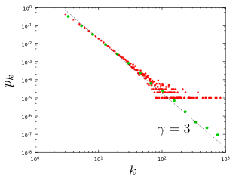
Section 4
Notes:
The degree distribution of a network generated by the Barabási-Albert model. The plot show for a single network of size N=100,000 and m=3 and . It shows both the linearly-binned (red symbols) as well as the log-binned version (green symbols) o. The straight line is added to guide the eye and has slope -3, corresponding to the resulting network’s degree exponent.

Slide 8
NUMERICAL SIMULATION OF THE BA MODEL

Slide 9
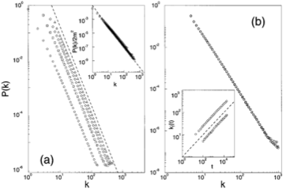

NUMERICAL SIMULATION OF THE BA MODEL
m=1,3,5,7
N=100,000;150,000;200,000
m-dependence
Stationarity:
P(k) independent of N
Insert:
degree dynamics
Network Science: Evolving Network Models

Slide 10
The mean field theory offers the correct scaling, BUT it provides the wrong coefficient of the degree distribution.
So assymptotically it is correct (k→ ∞), but not correct in details (particularly for small k).
To fix it, we need to calculate P(k) exactly, which we will do next using a rate equation based approach.
Network Science: Evolving Network Models

Slide 11
MFT - Degree Distribution: Rate Equation
Number of nodes with degree k at time t.
Since at each timestep we add one node, we have N=t (total number of nodes = number of timesteps)
2m: each node adds m links, but each link contributed to the degree of 2 nodes
Total number of k-nodes
Number of links added to degree k nodes after the arrival of a new node:
Nr. of degree k-1 nodes that acquire a new link, becoming degree k
New node adds m new links to other nodes
Preferential attachment
Nr. of degree k nodes that acquire a new link, becoming degree k+1
# k-nodes at time t+1
# k-nodes at time t
Gain of k-nodes via
k-1→ k
Loss of k-nodes via
k→ k+1
A.-L.Barabási, R. Albert and H. Jeong, Physica A 272, 173 (1999)

Slide 12
MFT - Degree Distribution: Rate Equation
# k-nodes at time t+1
# k-nodes at time t
Gain of k-nodes via
k-1→ k
Loss of k-nodes via
k→ k+1
We do not have k=0,1,...,m-1 nodes in the network (each node arrives with degree m)
→ We need a separate equation for degree m modes
# m-nodes at time t+1
# m-nodes at time t
Add one
m-degeree node
Loss of an
m-node via
m→ m+1
A.-L.Barabási, R. Albert and H. Jeong, Physica A 272, 173 (1999)
Network Science: Evolving Network Models

Slide 13
MFT - Degree Distribution: Rate Equation
k>m
We assume that there is a stationary state in the N=t→∞ limit, when P(k,∞)=P(k)
k>m
Network Science: Evolving Network Models

Slide 14
MFT - Degree Distribution: Rate Equation
➔
m+3 → k
...
for large k
Krapivsky, Redner, Leyvraz, PRL 2000
Dorogovtsev, Mendes, Samukhin, PRL 2000
Bollobas et al, Random Struc. Alg. 2001
Network Science: Evolving Network Models

Slide 15
MFT - Degree Distribution: A Pretty Caveat
Start from eq.
Its solution is:
Dorogovtsev and Mendes, 2003
Network Science: Evolving Network Models

Slide 16
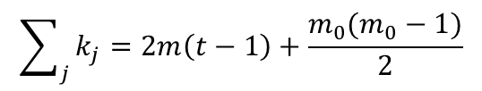
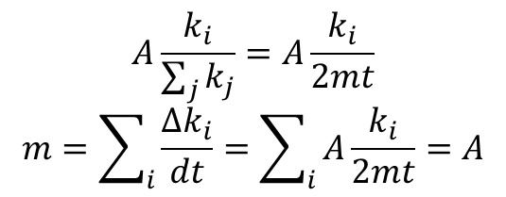
All nodes follow the same growth law
$$A\frac{k_{i}}{\sum_{j}{k_{j}}}=A\frac{k_{i}}{2mt}$$
$$m=\sum_{i}{\frac{∆k_{i}}{dt}}=\sum_{i}{A\frac{k_{i}}{2mt}=A}$$
In limit:
So:
$$\sum_{j}{k_{j}=2m\left(t−1\right)+\frac{m_{0}(m_{0}−1)}{2}}$$
Use:
During a unit time (time step): Δk=m → A=m
β: dynamical exponent
A.-L.Barabási, R. Albert and H. Jeong, Physica A 272, 173 (1999)
Network Science: Evolving Network Models
Notes:
This is an important prediction, as it implies that all nodes follow the same growth law. Hence the difference between the hubs is not in the fact that hubs grow faster, but that they are older. Indeed, the difference between the nodes comes in the intercept of the power-law, controlled by $t_i$, representing the time at which node $i$ joined the network.
If all nodes follow the same growth rate, why do we have hubs and less connected nodes in the network? The reason is that at moment older nodes have a higher degree according to Eq. \ref{connect}--indeed, the smaller $t_i$ is, the higher is the node's degree. As a consequence older nodes acquire more links in an unit time. This is seen by inspective the derivative of Eq. \ref{connect}, which is nothing but the node's growth rate (i.e. the rate at which the node acquires new links)
with predicts two things. First, it tells is that the older the node is (i.e. the smaller $t_i$ is), the larger the growth rate. Second, it also tells us that with time the rate at which the nodes acquire links goes down, thanks to the fact that the new nodes have many more nodes to link to.

