Slide 1
Frontiers of Network Science
Fall 2018
Class 9: Introduction to graph databases
Using Neo4j for network analysis and visualization
Boleslaw Szymanski

Slide 2
Main Topics
CLASS PLAN
Overview of graph databases
Installing and using Neo4j
Neo4j hands-on labs

Slide 3
Graph Databases
GRAPH DATABASES OVERVIEW
Use graph structures for semantic queries with nodes, edges, and properties to represent and store data
Use the Property Graph Model:
Connected entities (nodes) can hold any number of attributes (key-value-pairs) and can be tagged with labels representing their different roles in your domain
Relationships provide directed, named connections between two node-entities. A relationship always has a direction, a type, a start node, and an end node.
Well suited for semi-structured and highly connected data
Require a new query language

Slide 4
Relational vs. Graph Databases
GRAPH DATABASES COMPARISON WITH RELATIONAL
Relational
Store highly structured data in tables with predetermined columns of certain types and many rows of the same type of information
Require developers and applications to strictly structure the data used in their applications
References to other rows and tables are indicated by referring to their (primary-)key attributes via foreign-key columns
In case of many-to-many relationships, you have to introduce a JOIN table (or junction table) that holds foreign keys of both participating tables which further increases join operation costs
Graph
Relationships are first-class citizens of the graph data model
Each node (entity or attribute) directly and physically contains a list of relationship-records that represent its relationships to other nodes
The ability to pre-materialize relationships into database structures provides performances of several orders of magnitude advantage

Slide 5
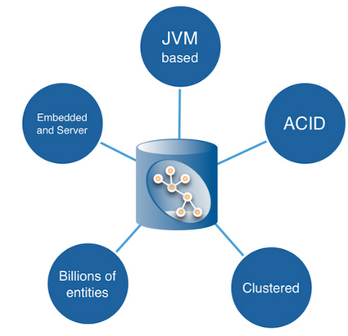
Neo4j Graph Database
GRAPH DATABASES NEO4J
NoSQL Graph Database
Implemented in Java and Scala
Open source
Free and open-source Community edition and Enterprise editions which provide all of the functionality of the Community edition in addition to scalable clustering, fail-over, high-availability, live backups, and comprehensive monitoring.
Full database characteristics including ACID transaction compliance, cluster support, and runtime failover
Constant time traversals for relationships in the graph both in depth and in breadth

Slide 6
Cypher Query Language
GRAPH DATABASES NEO4J GRAPH QUERY LANGUAGE
SQL-inspired language for describing patterns in graphs visually using an ASCII-art syntax
Declarative – allows us to state what we want to select, insert, update or delete from our graph data without requiring us to describe exactly how to do it
Contains clauses for searching for patterns, writing, updating, and deleting data
Queries are built up using various clauses. Clauses are chained together, and the they feed intermediate result sets between each other
Cypher query gets compiled to an execution plan that can run and produce the desired result
Statistical information about the database is kept up to date to optimize the execution plan
Indexes on Node or Relationships properties are supported to improve the performance of the application

Slide 7
Neo4j API
GRAPH DATABASES NEO4J API
REST API
Designed with discoverability in mind (discover URIs where possible)
Stateless interactions store no client context on the server between requests
Supports streaming results, with better performance and lower memory overhead
HTTP API
Transactional Cypher HTTP endpoint
POST to a HTTP URL to send queries, and to receive responses from Neo4j
Drivers
The preferred way to access a Neo4j server from an application
Use the Bolt protocol and have uniform design and use
Available in four languages: C# .NET, Java, JavaScript, and Python
Additional community drivers for: Spring, Ruby, PHP, R, Go, Erlang / Elixir, C/C++, Clojure, Perl, Haskell
API is defined independently of any programming language
Procedures
Allow Neo4j to be extended by writing custom code which can be invoked directly from Cypher
Written in Java and compiled into jar files
To call a stored procedure, use a Cypher CALL clause

Slide 8
Neo4j Resources
GRAPH DATABASES NEO4J RESOURCES
Neo4j Web site: https://neo4j.com/
Neo4j installation manual: https://neo4j.com/docs/operations-manual/current/deployment/single-instance/
Cypher Refcard https://neo4j.com/docs/cypher-refcard/current/
Coursera course “Graph Analytics for Big Data” from the University of California, San Diego (https://www.coursera.org/learn/big-data-graph-analytics) has a lesson “Graph Analytics With Neo4j”
Webber, Jim. "A programmatic introduction to Neo4j." Proceedings of the 3rd annual conference on Systems, programming, and applications: software for humanity. ACM, 2012.
Robinson, Ian, James Webber, and Emil Eifrem. Graph databases. Sebastopol, CA: O'Reilly, 2015
Bruggen, Rik. Learning Neo4j. Birmingham, UK: Packt Pub, 2014

Slide 9
Main Topics
CLASS PLAN
Overview of graph databases
Installing and using Neo4j
Neo4j hands-on labs

Slide 10
Neo4j Installation
NEO4J INSTALLATION
Neo4j runs on Linux, Windows, and OS X
A Java 8 runtime is required
For Community Edition there are desktop installers for OS X and Windows
Several ways to install on Linux, depending on the Linux distro (see the “Neo4j Resources” slide)
Check the /etc/neo4j/neo4j.conf configuration file: # HTTP Connector dbms.connector.http.type=HTTP dbms.connector.http.enabled=true # To accept non-local HTTP connections, uncomment this line dbms.connector.http.address=0.0.0.0:7474
File locations depend on the operating system, as described here: https://neo4j.com/docs/operations-manual/current/deployment/file-locations/
Make sure you start the Neo4j server (e.g., “./bin/neo4j start” or “service neo4j start” on Linux)

Slide 11
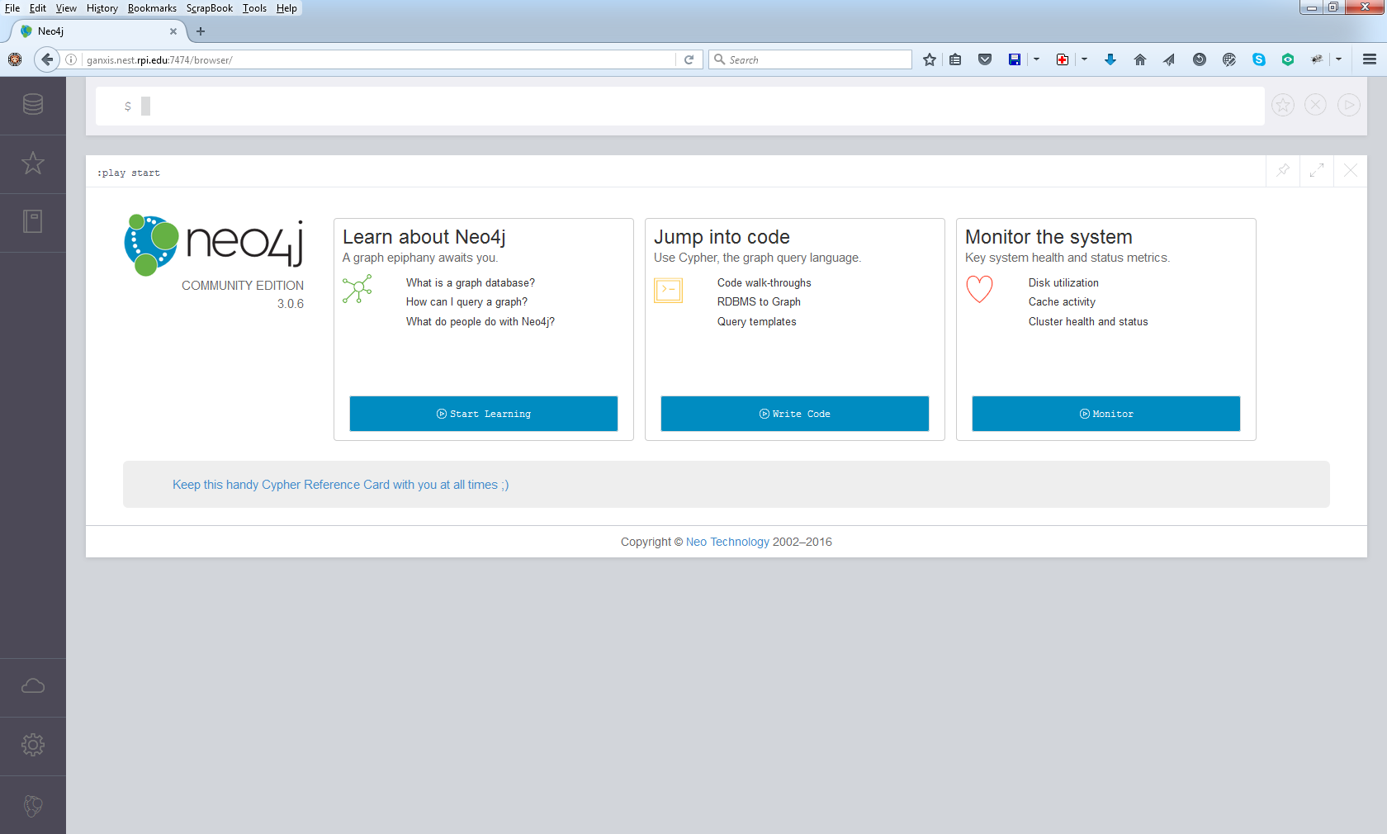
Neo4j Browser
NEO4J BROWSER
Open the URL http://localhost:7474 (replace “localhost” with your server name, and 7474 with the port name as set in neo4j.conf)
Enter the username/ password (if not set, Neo4j browser will prompt you to select the username and password)
Start working with Neo4j by entering Cypher queries and observing their results
Save frequently used Queries to Favorites

Slide 12
The Structure of a Cypher Query
NEO4J CYPHER
Nodes are surrounded with parentheses which look like circles, e.g. (a)
A relationship is basically an arrow --> between two nodes with additional information placed in square brackets inside of the arrow
A query is comprised of several distinct clauses, like:
MATCH: The graph pattern to match. This is the most common way to get data from the graph.
WHERE: Not a clause in its own right, but rather part of MATCH, OPTIONAL MATCH and WITH. Adds constraints to a pattern, or filters the intermediate result passing through WITH.
RETURN: What to return.
MATCH (john {name: 'John'})-[:friend]->()-[:friend]->(fof) RETURN john.name, fof.name
http://www.peikids.org/what-we-do/ourmission/attachment/paint-hands/

Slide 13
Writing Cypher Queries
NEO4J CYPHER
Node labels, relationship types and property names are case-sensitive in Cypher
CREATE creates nodes with labels and properties or more complex structures
MERGE matches existing or creates new nodes and patterns. This is especially useful together with uniqueness constraints.
DELETE deletes nodes, relationships, or paths. Nodes can only be deleted when they have no other relationships still existing
DETACH DELETE deletes nodes and all their relationships
SET sets values to properties and add labels on nodes
REMOVE removes properties and labels on nodes
ORDER BY is a sub-clause that specifies that the output should be sorted and how
http://www.peikids.org/what-we-do/ourmission/attachment/paint-hands/

Slide 14
Importing and Exporting Data
NEO4J IMPORT AND EXPORT
Loading data from CSV is the most straightforward way of importing data into Neo4j
For fast batch import of huge datasets, use the neo4j-import tool
Lots of other tools for different data formats and database sizes
More on importing data at https://neo4j.com/developer/guide-importing-data-and-etl/
Export data using Neo4j browser or neo4j-shell-tools

Slide 15
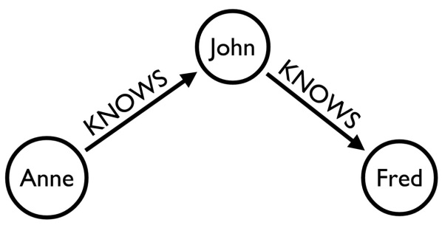
Loading Data from CSV
NEO4J CSV IMPORT
Understand your graph model
CSV files
people.csv 1,"John" 10,"Jane" 234,"Fred" 4893,"Mark" 234943,"Anne"
friendships.csv 1,234 10,4893 234,1 4893,234943 234943,234 234943,1
Run the following Cypher queries:
CREATE CONSTRAINT ON (p:Person) ASSERT p.userId IS UNIQUE;
LOAD CSV FROM "file:///people.csv" AS csvLine MERGE (p:Person {userId: toInteger(csvLine[0]), name: csvLine[1]});
USING PERIODIC COMMIT LOAD CSV FROM "file:///friendships.csv " AS csvLine MATCH (p1:Person {userId: toInteger(csvLine [0])}), (p2:Person {userId: toInteger(csvLine [1])}) CREATE (p1)-[:KNOWS]->(p2);
CREATE INDEX ON :Person(name);
Check the results:
MATCH (:Person {name:"Anne"})-[:KNOWS*2..2]-(p2) RETURN p2.name, count(*) as freq ORDER BY freq DESC;
(p1:Person {userId:10,name:"Anne"})-[:KNOWS]->(p2:Person {userId:123,name:"John"})
https://dzone.com/articles/how-neo4j-data-import-minimal
Notes:
https://dzone.com/articles/how-neo4j-data-import-minimal
All second degree friends of “Anne” and on how many ways they can be reached

Slide 16
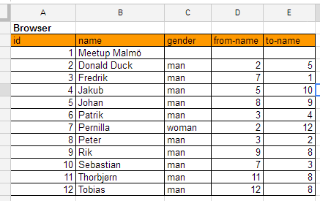
Loading Data from a Spreadsheet
NEO4J SPREADSHEET IMPORT
Lay out your data in a spreadsheet
Use formulas to generate the required Cypher statements
Collect Cypher queries and run them
Check the results:
MATCH (p1:Person)-[:ATTENDS]-(e:Event{name:"Meetup Malmö"})-[:ATTENDS]-(p2:Person) WHERE (p1)-[:FRIENDS_WITH]-(p2) RETURN p1, p2, e;
Based on a blog post by Rik Van Bruggen (https://neo4j.com/blog/importing-data-into-neo4j-the-spreadsheet-way/)
Notes:
https://neo4j.com/blog/importing-data-into-neo4j-the-spreadsheet-way/
All people attending the event at Malmö who have at least one friend also attending this event.

Slide 17
Loading Data from a GraphML file
NEO4J GRAPHML IMPORT
Use neo4j-shell-tools from https://github.com/jexp/neo4j-shell-tools
Populate the database from a GraphML file
import-graphml -i /usr/share/neo4j/import/airlines.graphml -r HAS_DIRECT_FLIGHTS_TO -b 20000 -c -t
Check the results:
MATCH (a)--()
WITH a.tooltip as airport, count(*) as flights
RETURN airport, flights ORDER BY flights DESC LIMIT 10

Slide 18
Loading Data from an Arbitrary Format
NEO4J IMPORT FROM OTHER FORMATS
Write a simple piece of code to convert your file into a set of two CSV files
Load data from the CSV file into a Neo4j database
CREATE CONSTRAINT ON (p:Person) ASSERT p.userId IS UNIQUE;
LOAD CSV WITH HEADERS FROM "file:///Wiki-Vote-nodes.csv" AS csvLine MERGE (p:Person {userId: toInt(csvLine.NodeID)});
USING PERIODIC COMMIT LOAD CSV WITH HEADERS FROM "file:///Wiki-Vote-edges.csv" AS csvLine MATCH (p1:Person {userId: toInt(csvLine.EdgeFrom)}), (p2:Person {userId: toInt(csvLine.EdgeTo)}) CREATE (p1)-[:VOTED_ON]->(p2);
CREATE INDEX ON :Person(name);
Check the results:
MATCH (p:Person)-[r]-() WITH p as persons, count(distinct r) as degree RETURN degree, count(persons) ORDER BY degree ASC
from sys import argv def read_edge_list(filename): nodeset= set([]) edgelist = [] with open(filename, 'r') as file_handle: for line in file_handle: if line[0] != '#': data = line.split() node_from = data[0] node_to = data[1] nodeset.add(node_from) nodeset.add(node_to) edgelist.append([node_from, node_to]) return nodeset, edgelist def write_csv_nodes(nodes, file_nodes): with open(file_nodes, 'w') as file_handle: file_handle.write("NodeID\n") for node in nodes: file_handle.write('{0}\n'.format(node)) def write_csv_edges(edges, file_nodes): with open(file_nodes, 'w') as file_handle: file_handle.write("EdgeFrom,EdgeTo\n") for edge in edges: file_handle.write('{0},{1}\n'.format(edge[0], edge[1])) script, input_file, output_file_nodes, output_file_edges = argv nodes, edges = read_edge_list(input_file) write_csv_nodes(nodes, output_file_nodes) write_csv_edges(edges, output_file_edges)
Wikipedia vote network from http://snap.stanford.edu/data/wiki-Vote.html
Notes:
from sys import argv def read_edge_list(filename): nodeset= set([]) edgelist = [] with open(filename, 'r') as file_handle: for line in file_handle: if line[0] != '#': data = line.split() node_from = data[0] node_to = data[1] nodeset.add(node_from) nodeset.add(node_to) edgelist.append([node_from, node_to]) return nodeset, edgelist def write_csv_nodes(nodes, file_nodes): with open(file_nodes, 'w') as file_handle: file_handle.write("NodeID\n") for node in nodes: file_handle.write('{0}\n'.format(node)) def write_csv_edges(edges, file_nodes): with open(file_nodes, 'w') as file_handle: file_handle.write("EdgeFrom,EdgeTo\n") for edge in edges: file_handle.write('{0},{1}\n'.format(edge[0], edge[1])) script, input_file, output_file_nodes, output_file_edges = argv nodes, edges = read_edge_list(input_file) write_csv_nodes(nodes, output_file_nodes) write_csv_edges(edges, output_file_edges)
This is a degree histogram of a graph.

Slide 19
Exporting Data From Neo4j
NEO4J EXPORT
Click the download icon on the table view of the Cypher query results
Use neo4j-shell-tools to export results of a Cypher query to a CSV or GraphML file
Access the graph data with Neo4j API and save it in the desired format

Slide 20
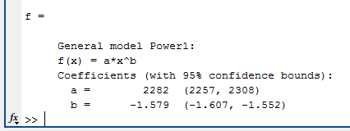
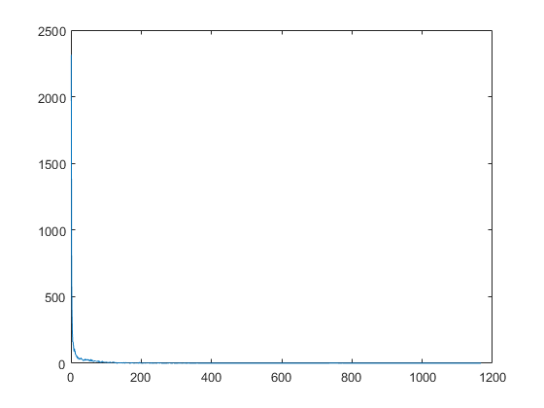
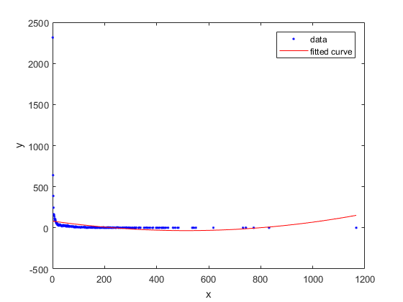
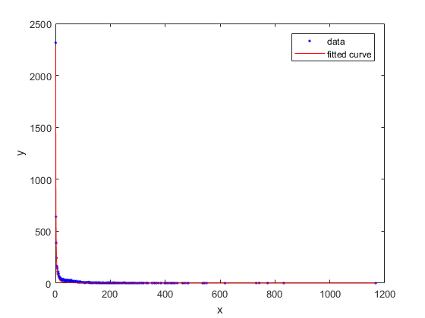
Analyzing Graph Data with MATLAB
NEO4J USING EXPORTED DATA IN OTHER TOOLS
Load CSV data exported from Neo4j into MATLAB
Use MATLAB to perform additional analysis and to draw plots
Export analysis results and plots for publication
filename = 'filename.csv';
M = csvread(filename,1,0);
x = M(:,1);
y = M(:,2);
plot(x,y)
f=fit(x,y,'poly2')
plot(f,x,y)
f=fit(x,y,'power1')
plot(f,x,y)

Slide 21
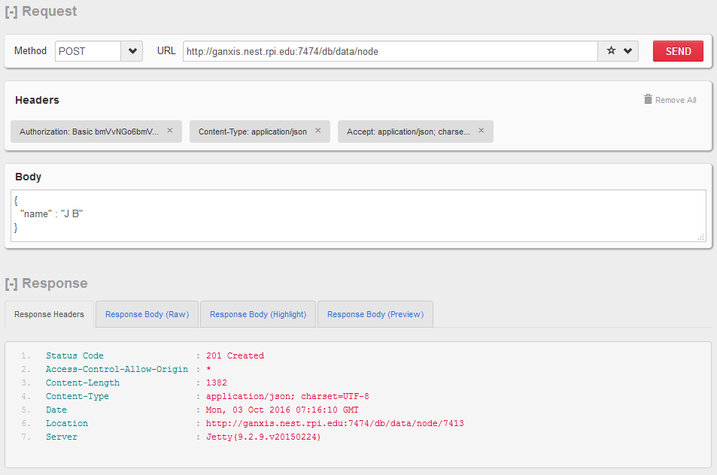
Accessing Neo4j Data using REST API
NEO4J REST API
Service root is the starting point to discover the REST API
GET http://localhost:7474/db/data/
Accept: application/json; charset=UTF-8
Create node with properties
POST http://localhost:7474/db/data/node
Accept: application/json; charset=UTF-8
Content-Type: application/json
{ "foo" : "bar" }
Create relationship
POST http://localhost:7474/db/data/node/66/relationships
Accept: application/json; charset=UTF-8
Content-Type: application/json
{ "to" : "http://localhost:7474/db/data/node/67", "type" : "FRIENDS_WITH" }

Slide 22
Using Transactional Cypher HTTP Endpoint
NEO4J HTTP ENDPOINT
Allows you to execute a series of Cypher statements within the scope of a transaction
The transaction may be kept open across multiple HTTP requests, until the client chooses to commit or roll back
Each HTTP request can include a list of statements
Requests should include an Authorization header, with a value of Basic <payload>, where "payload" is a base64 encoded string of "username:password"
import requests from requests.exceptions import ConnectionError import json NEO4J_SERVER = 'http://ganxis.nest.rpi.edu:7474' NEO4J_COMMIT_ENDPOINT = '/db/data/transaction/commit' NEO4J_CREDENTIALS = 'bmVvNGo6bmVvNGo=' def execute_neo4j_cypher(url, credentials, query, parameters): result = None query_text = json.dumps(dict(statements = [dict(statement = query, parameters = parameters)])) headers = {'Accept' : 'application/json', 'Content-type' : 'application/json', 'Authorization:' : 'Basic ' + credentials} try: resp = requests.post(url, headers = headers, data = query_text) result = resp.json() except ConnectionError as exception: print exception # Log error if len(result['errors']) > 0: print '@@@ ERROR! Error executing Cypher query' # Log error print '@@@ ', query, '<-', parameters print '@@@ ' + str(result) return result query = 'MERGE (p: Person {id:{userid}, name:{name}}) ON CREATE SET p.created = timestamp() ON MATCH SET p.matched = timestamp() RETURN p' parameters = dict() parameters['userid'] = 17 parameters['name'] = 'J J' execute_neo4j_cypher(NEO4J_SERVER + NEO4J_COMMIT_ENDPOINT, NEO4J_CREDENTIALS, query, parameters)

Slide 23
Using Drivers to Access Neo4j
NEO4J DRIVER API
Binary Bolt protocol (starting with Neo4j 3.0)
Binary protocol is enabled in Neo4j by default and can be used in any language driver that supports it
Native Java driver officially supported by Neo4j
Drivers implement all low level connection and communication tasks
import org.neo4j.driver.v1.*;
public class Neo4j
{
public static void javaDriverDemo() {
Driver driver = GraphDatabase.driver("bolt://ganxis.nest.rpi.edu", "neo4j", "neo4j"));
Session session = driver.session();
StatementResult result = session.run("MATCH (a)-[]-(b)-[]-(c)-[]-(a) WHERE a.id < b.id AND b.id < c.id RETURN DISTINCT a,b,c");
int counter = 0;
while (result.hasNext())
{
counter++;
Record record = result.next();
System.out.println(record.get("a").get("id") + " \t" + record.get("b").get("id") + " \t" + record.get("c").get("id"));
}
System.out.println("Count: " + counter);
session.close();
driver.close();
}
public static void main(String [] args)
{
javaDriverDemo();
}
}

Slide 24
Using Core Java API
NEO4J CORE JAVA API
Native Java API performs database operations directly with Neo4j core
import java.io.*;
import java.util.*;
import org.neo4j.graphdb.*
public class Neo4j
{
public enum NodeLabels implements Label { NODE; }
public enum EdgeLabels implements RelationshipType{ CONNECTED; }
public static void javaNativeDemo(int nodes, double p) {
Node node1, node2; Random randomgen = new Random();
GraphDatabaseFactory dbFactory = new GraphDatabaseFactory();
GraphDatabaseService db = dbFactory.newEmbeddedDatabase(new File("TestNeo4jDB"));
try (Transaction tx = db.beginTx()) {
for (int i = 1; i <= nodes; i++) {
Node node = db.createNode(NodeLabels.NODE);
node.setProperty("id", i);
}
for (int i = 1; i <= nodes; i++)
for (int j = i + 1; j <= nodes; j++) {
if (randomgen.nextDouble() < p) {
node1 = db.findNode(NodeLabels.NODE, "id", i);
node2 = db.findNode(NodeLabels.NODE, "id", j);
Relationship relationship = node1.createRelationshipTo(node2,EdgeLabels.CONNECTED);
relationship = node2.createRelationshipTo(node1,EdgeLabels.CONNECTED);
}
}
tx.success();
}
db.shutdown();
}
public static void main(String [] args) {
javaNativeDemo(100, 0.2); }
}

Slide 25
Main Topics
CLASS PLAN
Overview of graph databases
Installing and using Neo4j
Neo4j hands-on labs

Slide 26
Neo4j Exercises Grading: 1st 3pts, 2nd 3pts, 3rd 4 pts, due 10/9/18 before midnight
Neo4j Hands-on Labs
Exercise 1
Learn how to use Neo4j interface
Import a network file for the German school class from 1880-81 (see Gephi slides)
Visualize the graph
Exercise 2
Learn the basics of Cypher
Compute simple network measures for the graph imported in Exercise 1: number of nodes, of edges, average degree
Compute additional network measures for the same graph using more advanced Cypher queries: diameter, eccentricity and radius
Exercise 3
Access Neo4j graph database using an API
Generate ER random graph with the same number of nodes and the same average degree as the graph imported in Exercise 1.
Generate a Barabási–Albert graph with the same number of nodes as graph imported in Exercise 1 and with (a) k_{min} = 2 and (b) k_{min} = 3. Report number of edges for both created files.
Export ER graph.

