Slide 1

Frontiers of Network Science
Fall 2018
Class 2: Introduction Part II
(Chapter 1 in Textbook)
Boleslaw Szymanski
based on slides by Albert-László Barabási & Roberta Sinatra

Slide 2
Section 8
SCIENTIFIC IMPACT
Network Science: Introduction
Notes:
Nowhere is the impact of network thinking more evident than in the scientific community. The most prominent scientific journals, from Nature and Science to Cell and PNAS, have devoted special issues, reviews, or editorials address- ing the impact of networks on various topics from biology to social sciences. During the past decade, each year several dozen international conferences, workshops, summer and winter schools have focused exclusively on network sci- ence. A successful network science meeting series, called NetSci, attracts the field’s practitioners since 2005. Several general-interest books, making the bestseller lists in many countries, have brought network science to the public. Most major universities offer network science courses, attracting a diverse student body.

Slide 3
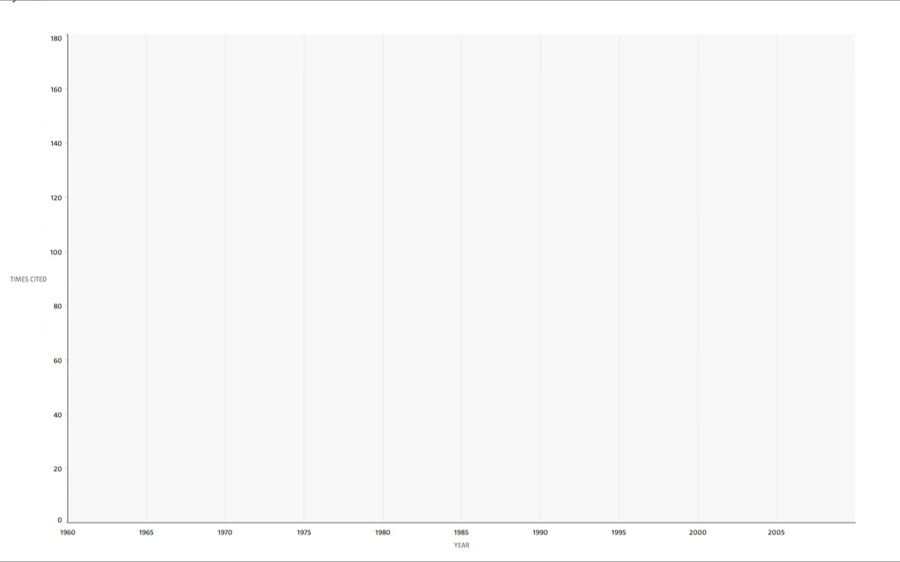
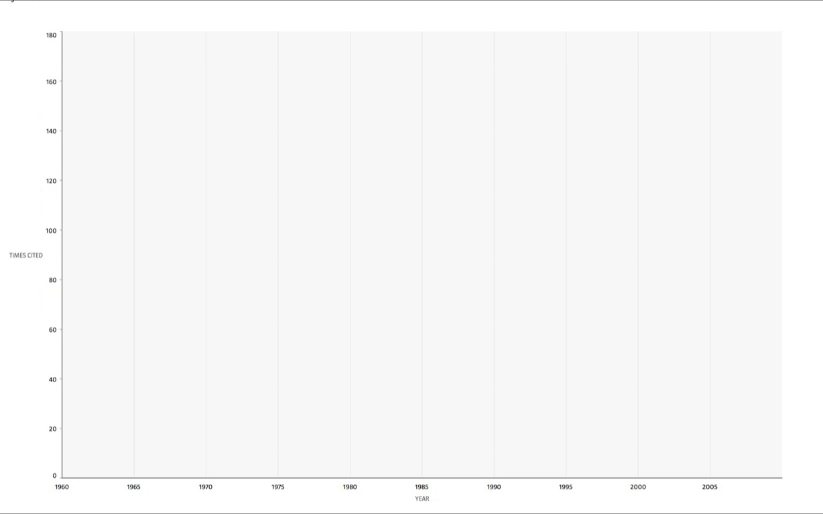
NETWORK SCIENCE The science of the 21st century
NETWORK SCIENCE The science of the 21st century

Slide 4
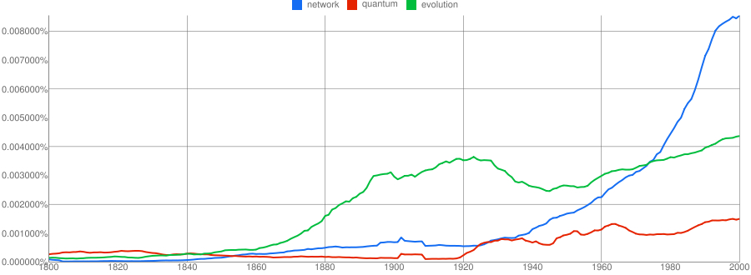
Thex
NGRAMS Networks Awareness
Network Science: Introduction
Notes:
While the emergence of the scientific interest in networks was rather sudden, the enthusiasm for the field was responding to the emergence of a wider social awareness of the importance of networks. This is illustrated in Image 1.16, where we show the usage frequency of the words that represent two important scientific revolutions of the past two centuries: evolution, capturing the most common term to refer to Darwin’s theory of evolution, and quantum, the most frequently used term when one refers to quantum mechanics. The use of evolution increases only after the 1859 publication of Darwin’s On the Origins of Species. The word quantum, first used in 1902, is virtually absent until the 1920s, when quantum mechanics gains prominence. The use of the word network has increased dramatically following the 1980s. While the word has many uses (as do evolution and quantum), its dramatic rise captures the extraordinary awareness of networks in the society at large. Indeed, evolution and quantum mechanics are just as important as core scientific fields, as they are as enabling platforms: the current revolution in genetics is built on evolutionary theory, and quantum mechanics offers a platform for a wide range of advances in contemporary science, from chemistry to wireless communications. In a similar fashion, network science is an enabling science, offering new tools and perspective for a wide range of scientific fields from social networking to drug design. Given the wide importance and impact of networks, we need to develop the tools to study and quantify them. The rest of this book is devoted to this worthy subject.
Image 1.16
The rise of networks.
The frequency of the use of the words evolution and quantum represents the major scientific advances of the 19th and 20th century, namely Dar- win’s theory of evolution and quantum mechanics. The plot indicates the exploding awareness of networks in the last decades of the 20th century, preparing a fertile ground for the emergence of network science. The plots were generated by using the ngram platform of Google: http://books. google.com/ngrams.

Slide 5
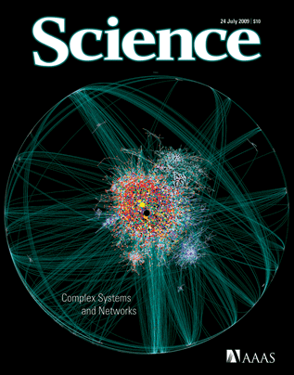
Complex systems and networks.
Science:
Special Issue for the 10 year anniversary of Barabasi & Albert 1999 paper.
Network Science: Introduction
Notes:
Complex systems and networks.
Special issue of Science magazine
on Complex Systems and Networks, published on July 24, 2009, marking the 10th anniversary of the 1999 discovery of scale-free networks [3].

Slide 6
Original papers:
1998: Watts-Strogatz paper in the most cited Nature publication from 1998; highlighted by ISI as one of the ten most cited papers in physics in the decade after its publication.
1999: Barabasi and Albert paper is the most cited Science paper in 1999; highlighted by ISI as one of the ten most cited papers in physics in the decade after its publication.
2001: Pastor -Satorras and Vespignani is one of the two most cited papers among the papers published in 2001 by Physical Review Letters.
2002: Girvan-Newman is the most cited paper in 2002 Proceedings of the National Academy of Sciences.
Network Science: Introduction

Slide 7
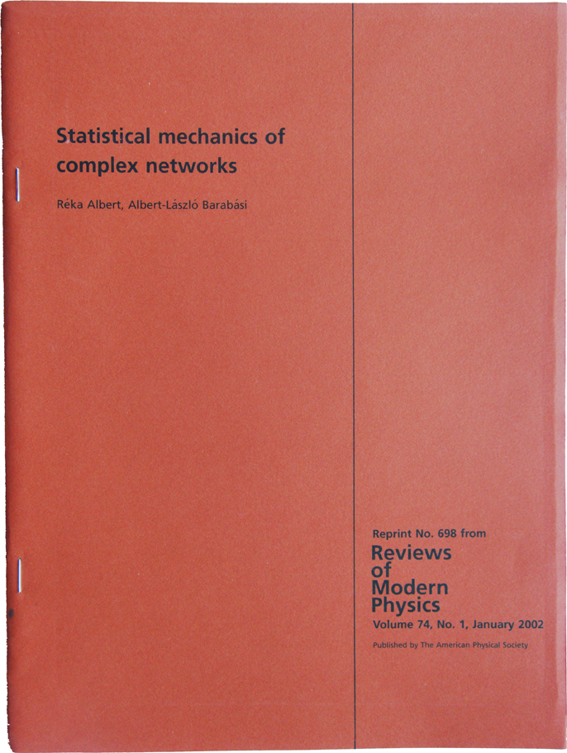

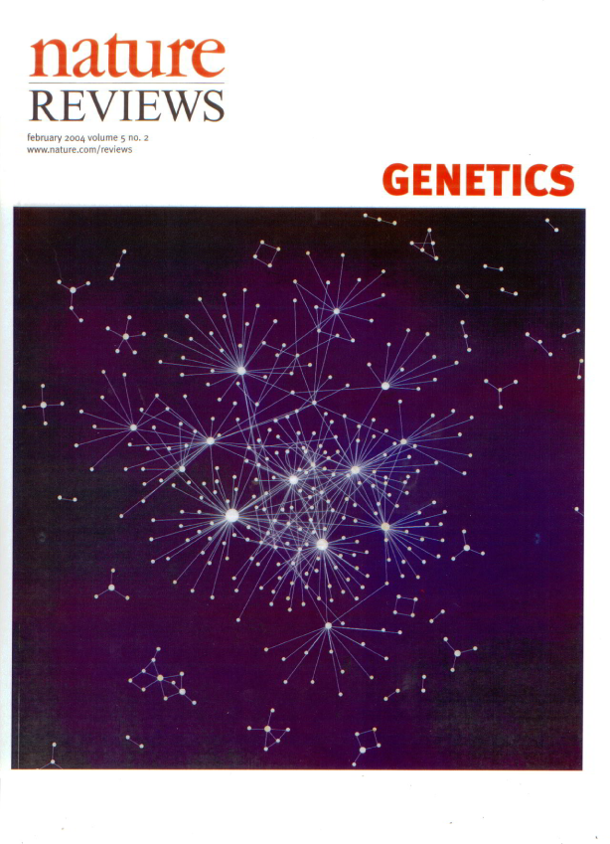
REVIEWS:
The first review of network science by Albert and Barabasi, 2001) is the second most cited paper published in Reviews of Modern Physics, the highest impact factor physics journal, published since 1929. The most cited is Chandrasekhar’s 1944 review on solar processes, but it will be surpassed by the end of 2012 by Albert et al.
Update Sept. 2016: Now far surpassed, 17006 to 8545.
The SIAM review of Newman on network science is the most cited paper of any SIAM journal.
BIOLOGY: “Network Biology”, by Barabasi and Oltvai (2004) , is the second most cited paper in the history of Nature Reviews Genetics, the top review journal in genetics.
Network Science: Introduction

Slide 8
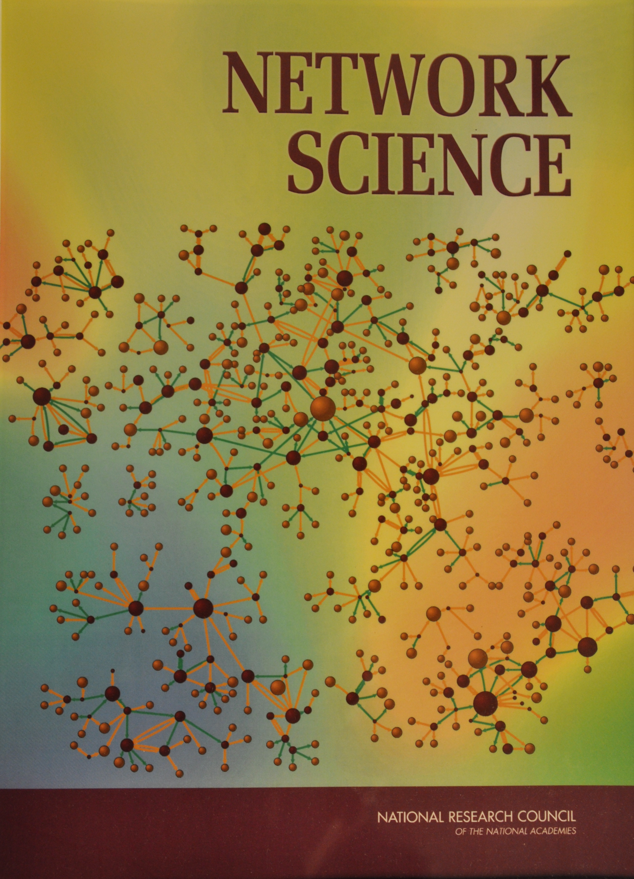

National Research Council
Network Science: Introduction
Notes:
Given this extraordinary response by the scientific com- munity, network science was examined by the Nation- al Research Council (NRC), the arm of the US National Academies in charge of offering policy recommendation to the US government. NRC has assembled two panels, resulting in two publications [31], defining the field of network science (Image 1.13). They not only document the emergence of a new research field, but highlight the field’s vital importance to national competitiveness and security. Following these reports, the National Science Foundation (NSF) in the US established a network science directorate and a series of network science centers were established by the Army Research Labs.

Slide 9
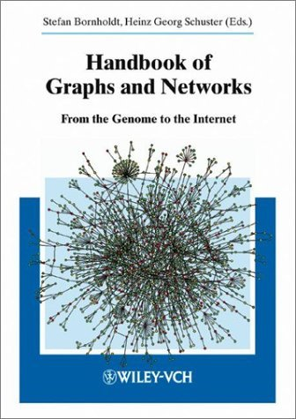
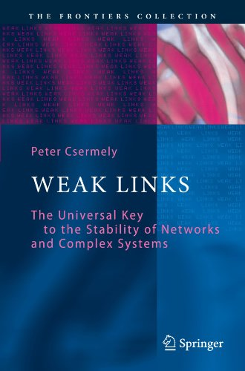
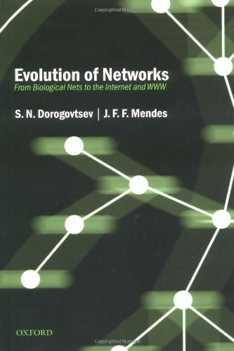
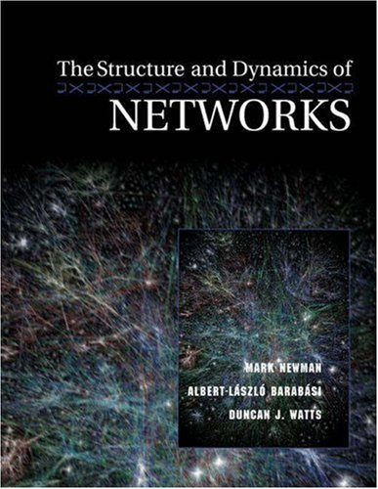

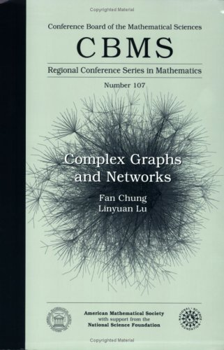
BOOKS
Handbook of Graphs and Networks: From the Genome to the Internet (Wiley-VCH, 2003).
S. N. Dorogovtsev and J. F. F. Mendes, Evolution of Networks: From Biological Nets to the Internet and WWW (Oxford University Press, 2003).
S. Goldsmith, W. D. Eggers, Governing by Network: The New Shape of the Public Sector (Brookings Institution Press, 2004).
P. Csermely, Weak Links: The Universal Key to the Stability of Networks and Complex Systems (The Frontiers Collection) (Springer, 2006), rst edn.
M. Newman, A.-L. Barabasi, D. J. Watts, The Structure and Dynamics of Networks: (Princeton Studies in Complexity) (Princeton
University Press, 2006), rst edn.
L. L. F. Chung, Complex Graphs and Networks (CBMS Regional Conference Series in Mathematics) (American Mathematical Society, 2006).
Network Science: Introduction
Notes:
I am a scientist, which means that I believe that natural phenomena can be CLICK
understood, quantified, predicted, and eventually
controlled.
No one would find any of these goals questionable.
What, however, if I now replace Natural Phenomena with humans. So lets read it together:
Humans can be understood, quantified, predicted, controlled.

Slide 10
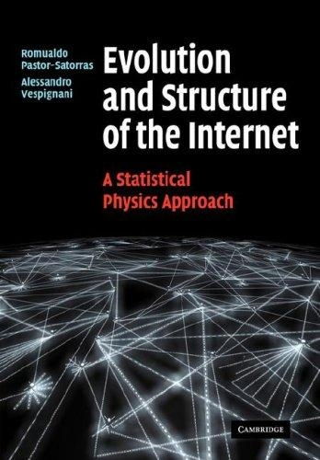

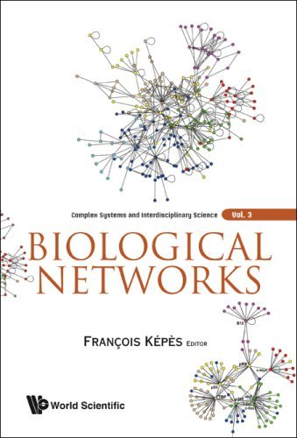

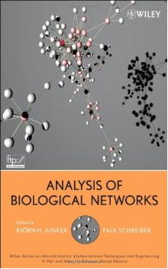
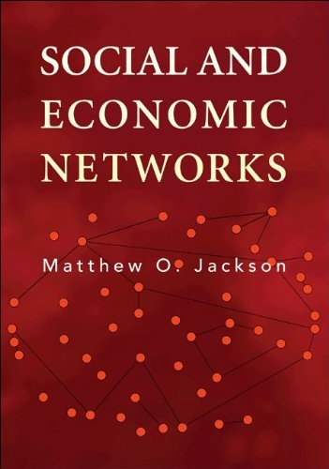
BOOKS
R. Pastor-Satorras, A. Vespignani, Evolution and Structure of the Internet: A Statistical Physics Approach (Cambridge University Press, 2007), rst edn.
F. Kopos, Biological Networks (Complex Systems and Interdisciplinary Science) (World Scientic Publishing Company, 2007), rst edn.
B. H. Junker, F. Schreiber, Analysis of Biological Networks (Wiley Series in Bioinformatics) (Wiley-Interscience, 2008).
T. G. Lewis, Network Science: Theory and Applications (Wiley, 2009).
E. Ben Naim, H. Frauenfelder, Z.Torotzai, Complex Networks (Lecture Notes in Physics) (Springer, 2010), rst edn.
M. O. Jackson, Social and Economic Networks (Princeton University Press, 2010).
Network Science: Introduction
Notes:
I am a scientist, which means that I believe that natural phenomena can be CLICK
understood, quantified, predicted, and eventually
controlled.
No one would find any of these goals questionable.
What, however, if I now replace Natural Phenomena with humans. So lets read it together:
Humans can be understood, quantified, predicted, controlled.

Slide 11
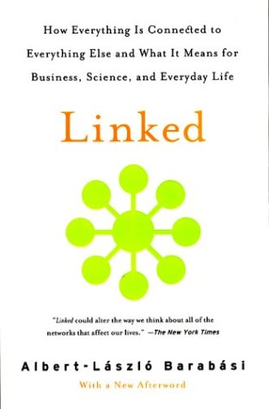
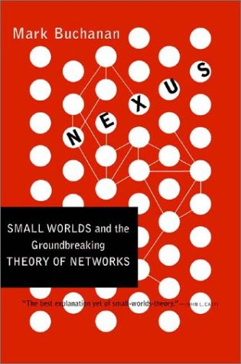
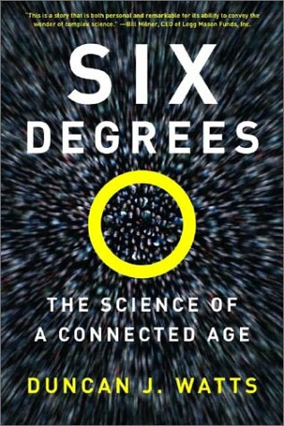
GENERAL AUDIENCE
Network Science: Introduction
Notes:
General Audience
The results of network science have excited the public as well. This was fueled partly by the success of several gener- al audience books, like Linked: The New Science of Networks by Albert-László Barabási, Nexus by Mark Buchanan, and Six Degrees by Duncan Watts, each being translated in many of languages. Newer books, like Connected by Nicholas Christakis and James Fowler, were also exceptionally successful (Image 1.15).

Slide 12

DOCUMENTARY
Network Science: Introduction
Notes:
An award-winning documentary, Connected, by Australian filmmaker Annamaria Talas, has brought the field to our TV screen, being broadcasted all over the world and winning several prestigious prizes (Image 1.14).
Networks have inspired artists as well, leading to a wide range of network science research inspired art project, and even an annual symposium series that brings together, on a yearly basis, artists and scientists [32]. Fueled by successful movies like The Social Network, and a series of novels and short stories, from science fiction to novels exploiting the network paradigm, today networks have permeated popular culture.

Slide 13
Section 9
SUMMARY
Network Science: Introduction
Notes:
Nowhere is the impact of network thinking more evident than in the scientific community. The most prominent scientific journals, from Nature and Science to Cell and PNAS, have devoted special issues, reviews, or editorials address- ing the impact of networks on various topics from biology to social sciences. During the past decade, each year several dozen international conferences, workshops, summer and winter schools have focused exclusively on network sci- ence. A successful network science meeting series, called NetSci, attracts the field’s practitioners since 2005. Several general-interest books, making the bestseller lists in many countries, have brought network science to the public. Most major universities offer network science courses, attracting a diverse student body.

Slide 14
Thex
NGRAMS Networks Awareness
Network Science: Introduction
Notes:
While the emergence of the scientific interest in networks was rather sudden, the enthusiasm for the field was responding to the emergence of a wider social awareness of the importance of networks. This is illustrated in Image 1.16, where we show the usage frequency of the words that represent two important scientific revolutions of the past two centuries: evolution, capturing the most common term to refer to Darwin’s theory of evolution, and quantum, the most frequently used term when one refers to quantum mechanics. The use of evolution increases only after the 1859 publication of Darwin’s On the Origins of Species. The word quantum, first used in 1902, is virtually absent until the 1920s, when quantum mechanics gains prominence. The use of the word network has increased dramatically following the 1980s. While the word has many uses (as do evolution and quantum), its dramatic rise captures the extraordinary awareness of networks in the society at large. Indeed, evolution and quantum mechanics are just as important as core scientific fields, as they are as enabling platforms: the current revolution in genetics is built on evolutionary theory, and quantum mechanics offers a platform for a wide range of advances in contemporary science, from chemistry to wireless communications. In a similar fashion, network science is an enabling science, offering new tools and perspective for a wide range of scientific fields from social networking to drug design. Given the wide importance and impact of networks, we need to develop the tools to study and quantify them. The rest of this book is devoted to this worthy subject.
Image 1.16
The rise of networks.
The frequency of the use of the words evolution and quantum represents the major scientific advances of the 19th and 20th century, namely Dar- win’s theory of evolution and quantum mechanics. The plot indicates the exploding awareness of networks in the last decades of the 20th century, preparing a fertile ground for the emergence of network science. The plots were generated by using the ngram platform of Google: http://books. google.com/ngrams.

Slide 15
Thex
MOST IMPORTANT Networks Really Matter
If you were to understand the spread of diseases, can you do it without networks?
If you were to understand the WWW structure, searchability, etc, hopeless without invoking the Web’s topology.
If you want to understand human diseases, it is hopeless without considering the wiring diagram of the cell.
Network Science: Introduction

Slide 16
Complex systems and networks.
Science:
Special Issue for the 10 year anniversary of Barabasi & Albert 1999 paper.
Network Science: Introduction
Notes:
Complex systems and networks.
Special issue of Science magazine
on Complex Systems and Networks, published on July 24, 2009, marking the 10th anniversary of the 1999 discovery of scale-free networks [3].

Slide 17
Class
CLASS INFORMATION
Network Science: Introduction
Notes:
Nowhere is the impact of network thinking more evident than in the scientific community. The most prominent scientific journals, from Nature and Science to Cell and PNAS, have devoted special issues, reviews, or editorials address- ing the impact of networks on various topics from biology to social sciences. During the past decade, each year several dozen international conferences, workshops, summer and winter schools have focused exclusively on network sci- ence. A successful network science meeting series, called NetSci, attracts the field’s practitioners since 2005. Several general-interest books, making the bestseller lists in many countries, have brought network science to the public. Most major universities offer network science courses, attracting a diverse student body.

Slide 18
Classes
Classes: 12:00 pm - 1:40pm
Always at the SoS Building J-ROWL 2C25
*unless a different location is announced (during classes, via email)

Slide 19
What to achieve
You are expected to come to lectures and participate in in-class discussion (10% of score)
1 project, counting for 50% of score
1 written assignment for undergraduates
1 presentation for graduates
counting for 40% of score
Check the syllabus on the course website!
www.cs.rpi.edu/~szymansk/fns.18

Slide 20
How to achieve it
Make sure you read chapters before the class
Make sure you bring your laptop for the “project prep classes”
Respect the deadlines for the assignments (no extensions granted)
Instructions for the presentations will be given during the class

Slide 21
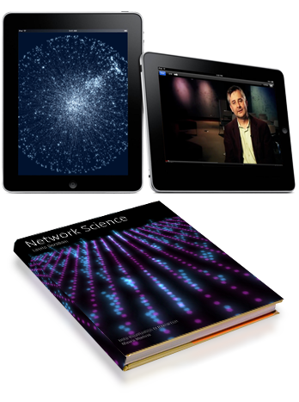
Network Science an interactive textbook
barabasi.com/NetworkScienceBook/
facebook.com/NetworkScienceBook

Slide 22

barabasilab.com/NetworkScienceBook/ facebook.com/NetworkScienceBook

