Slide 1
Seven Habits of Highly Effective Proposal Writers
Slota slotag@rpi.edu
(Slides adapted from Jim Hendler)
Thesis proposal (I propose you admit me to candidacy)
Thesis Defense (I propose you give me my degree)
Fellowship Proposal (I propose you give me some research $)
Grant Proposal (I propose you give me some research $$$)
Grant Report (I propose you give me more $$ next time)
And many others…*
* You’re on your own for marriage proposals and the like…
Slota's marriage proposal: "Alright, let's do that [expletive] nonsense."

Slide 2
WARNING WARNING WARNING
The following slides contain Slota’s opinions. His opinions are often wrong, nonsensical, and/or erroneous.
As with everything in life, the information contained in the following presentation should not be treated as absolute fact, but it should be observed with a cautious and critical eye.

Slide 3
Slota’s Proposal Experience
PhD proposal, defense, academic job applications
Blue Water Graduate Fellowship, NCSA
Science Policy Fellowship, SIAM
2x finalist for named DOE lab post docs (PNNL, LBNL)
DOE SciDAC FASTMath4, FASTMath5
Sandia National Labs internal projects x2
NSF CAREER Award
NSF MRI Award for RPI’s AiMOS
IBM FCRC Projects x2
A dozen or so smaller awards
And many many many more that were unfunded.

Slide 4
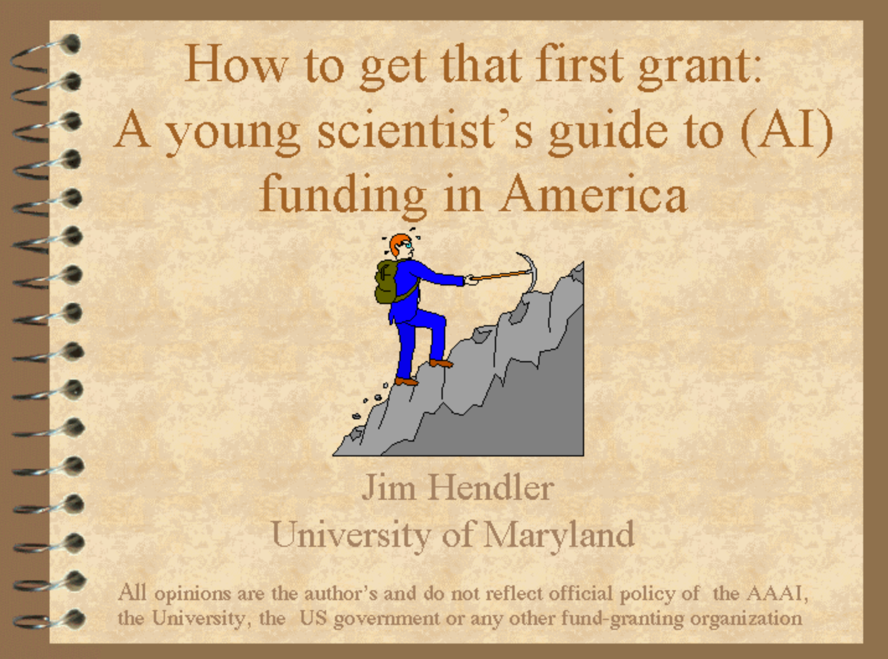
Slides today will include some from
A talk on proposals from Hendler 1999
  http://www.cs.rpi.edu/~hendler/funding-talk/index.htm
  His most downloaded presentation ever
  Updated periodically, but very minor changes
This will include the most relevant slides – those are the ones that look like this:
With a few “Slota Specials” in the mix

Slide 5
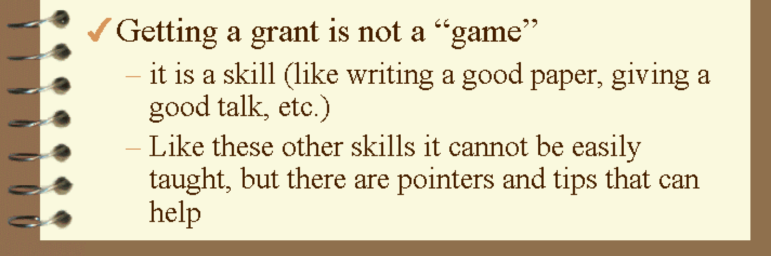
Before we start:
And like any skill, practice is important!
But also there are some “rules” to performing
Note: We will specifically focus on proposals related to research in this talk, but the same ideas can be more broadly applied.

Slide 6
RULE 1: A good proposal tells a story…
Goldilocks jumped off quickly and went over to the middle-sized chair. But this chair was far too soft, and when she tried the porridge from the middle-sized bowl it was too cold. So she went over to the little chair and picked up the smallest spoon and tried some of the porridge from the tiny bowl
Mother Bear said in a quiet gentle voice. "Somebody has been sitting in my chair. Then little Bear said in small squeaky baby voice. "Somebody has been sitting in my chair and has broken it!"
Then Father Bear looked at his bowl of porridge and saw the spoon in it and he said in his great big growly voice,
He squeaked so loudly that Goldilocks woke up with a start. She jumped out of bed, and away she ran, down the stairs and out into the forest. And the three bears never saw her again.
One morning, their breakfast porridge was too hot to eat, so they decided to go for a walk in the forest. While they were out, a little girl called Goldilocks came through the trees and found their house. She knocked on the door and, as there was no answer, she pushed it open and went inside.
…
Compare this

Slide 7
RULE 1: … in a coherent (ordered) way
Once upon a time there were three bears who lived in a house in the forest. There was a great big father bear, a middle-sized mother bear and a tiny baby bear.
One morning, their breakfast porridge was too hot to eat, so they decided to go for a walk in the forest. While they were out, a little girl called Goldilocks came through the trees and found their house. She knocked on the door and, as there was no answer, she pushed it open and went inside.
In front of her was a table with three chairs, one large chair, one middle-sized chair and one small chair. On the table were three bowls of porridge, one large bowl, one middle-sized bowl and one small bowl – and three spoons.
Goldilocks was hungry and the porridge looked good, so she sat in the great big chair, picked up the large spoon and tried some of the porridge from the big bowl. But the chair was very big and very hard, the spoon was heavy and the porridge too hot.
Goldilocks jumped off quickly and went over to the middle-sized chair. But this chair was far too soft, and when she tried the porridge from the middle-sized bowl it was too cold. So she went over to the little chair and picked up the smallest spoon and tried some of the porridge from the tiny bowl.
…
To this

Slide 8
Rule 2: The story you MUST tell…
The Question you are trying to answer
(Good questions are harder to formulate than good answers)
The proposed work
Current work

Slide 9
Rule 2: …and it’s key points
What you have not done already, and will NOT do in this proposed work. (Broad 'reach' goals)
What you have not done already, but propose to do. (Must be achievable in required time frame)
What you have done already. (Must provide evidence for yellow box)

Slide 10
Rule 2: …and it’s key points
What you have not done already, and will NOT do in this proposed work. (Broad 'reach' goals)
What you have not done already, but propose to do. (Must be achievable in required time frame)
HOW IT WILL BE EVALUATED !!
What you have done already. (Must provide evidence for yellow box)

Slide 11

Story time with Slota
I was a finalist for a ‘named’ DOE lab post doc.
I proposed work that was impactful, realistic, and achievable in the given timeframe of the fellowship.
This work would have produced several high quality publications and would have led to future funding opportunities (and it eventually did do both).
Feedback: Your proposed work would produce several high quality publications and is realistic and achievable in the given timeframe. Other applicants promised the frickin’ moon, so we’re going to have to go with one of them.

Slide 12

Story Time with Slota (part 2)
Takeaways:
  You are not being evaluated in a vacuum. Committees will always be evaluating your proposal in the context of the few/dozens/hundreds of other submissions.
  Including ‘reach’ goals is important. Other writers will be promising the frickin’ moon, so it can hurt to be too reserved about the impacts of your work. (Though, you still need to be reasonably honest and realistic.)
    - I.e., where to draw the line between yellow/red boxes?
  Feedback and evaluations are often random and seemingly nonsensical. Getting funding amounts to nothing more than a numbers game, sometimes^{(most of the time)}.

Slide 13
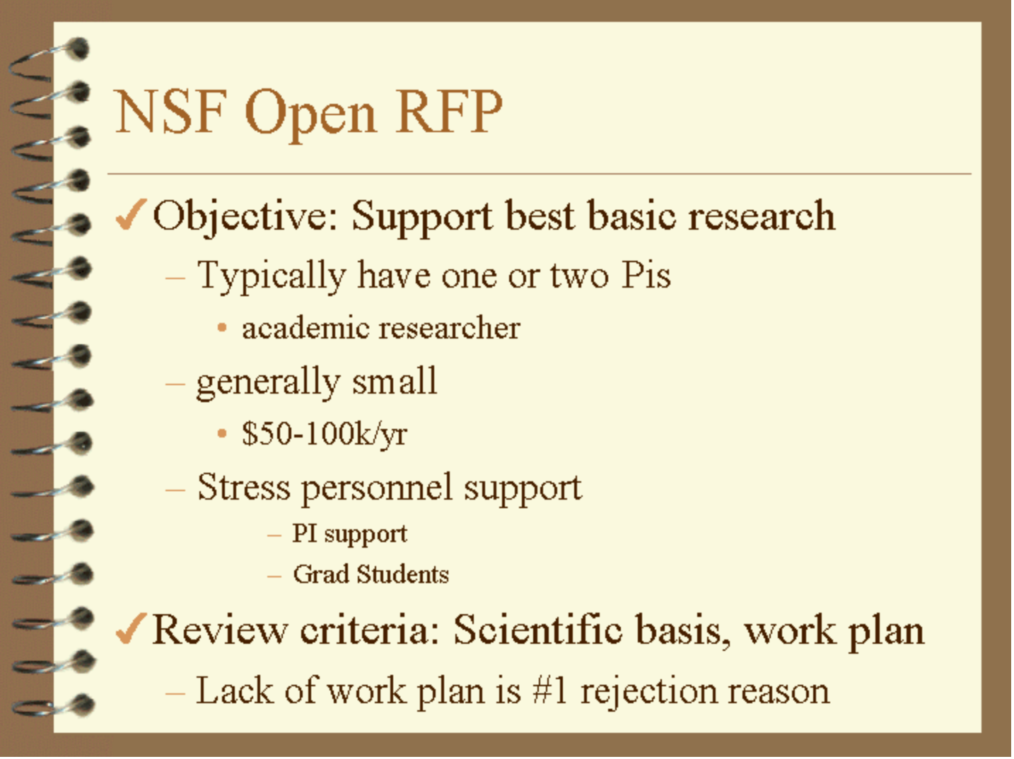
Rule 3: You must include a work plan/schedule of some kind

Slide 14
3a: Evaluation
Your claims must be clear
You need to evaluate what you are claiming.
Demonstrate that you can do everything!
Here’s one example…
See A Letter from the Editor: Avoiding Rejection. IEEE Intell. Syst. 20(5): 2-4 (2005)
A well designed research plan and schedule provides important evidence to reviewers that you have put considerable thought into your proposed work.

Slide 15
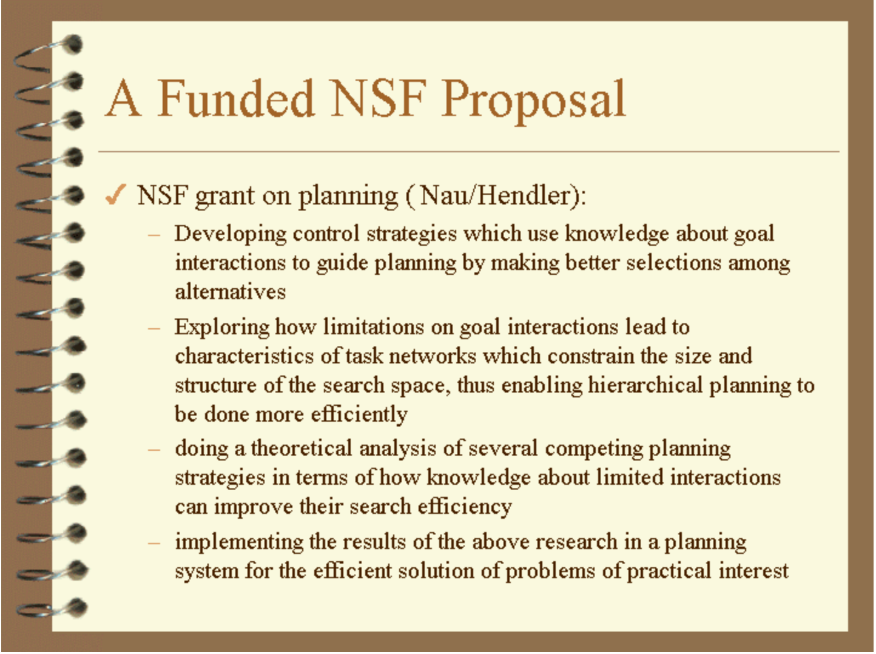
Rule 4: Know your audience
Compare this

Slide 16
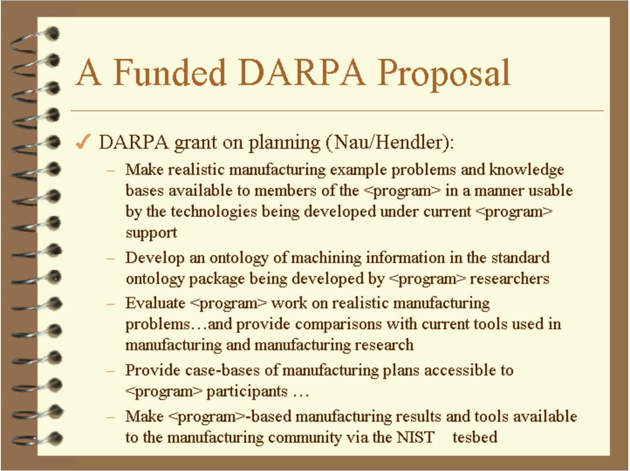
Rule 4: Know your audience
To this

Slide 17
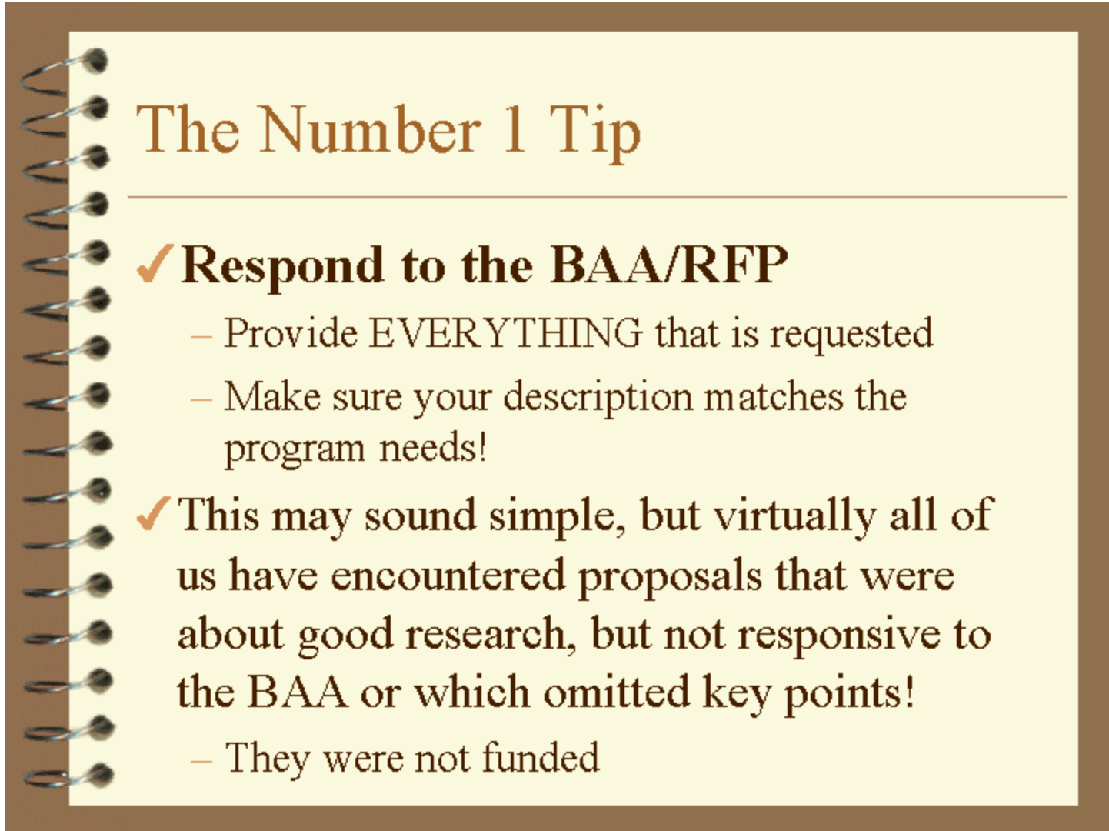
Rule 5: Learn (and follow) the rules of the proposal
This is the number 1 response when Hendler asked people about what to know about submitting grant proposals in 1999, 2005, 2010, 2015, and 2017.

Slide 18
Rule 5: Learn (and follow) the rules of the proposal
Note this is also true of thesis proposals and theses:
There are required elements
vary a bit between CS subfields
ask your advisor
get a copy of successful examples from your peers
This is the number 1 response when I asked people about what to know about submitting grant proposals in 1999, 2005, 2010, 2015, and 2017.

Slide 19
5a: Get started early
There is often a ‘formal process’ that inherently takes time to complete.
Fellowships: You’ll need letters from professors who ignore their emails.
NSF/DOE/etc. RFPs: There’s a number of accompanying documents required just beyond the proposal itself. You’ll also need outside help getting accurate numbers for things like a budget.
  E.g., budget, budget justification, bio, data management plan, equipment needs, etc.
  Most organizations have departments that can help. Contact them sooner rather than later.

Slide 20
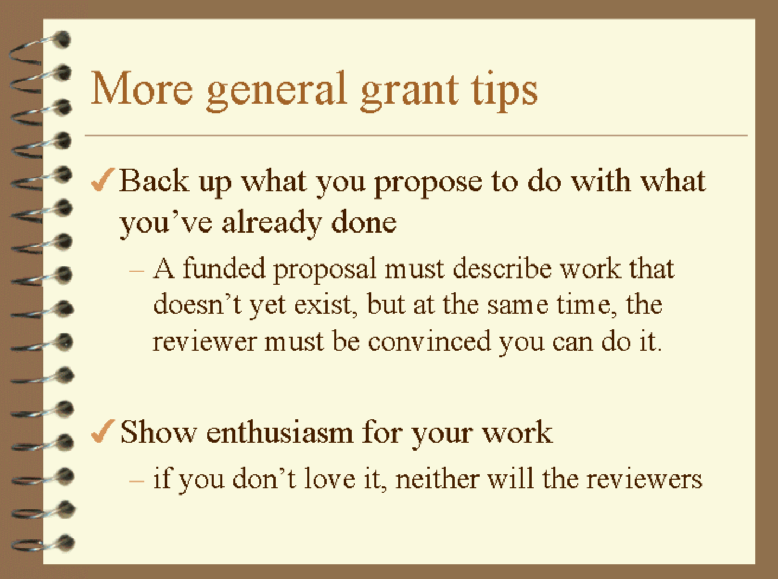
Rule 6: “Sell” it
(or professors on your committee)

Slide 21
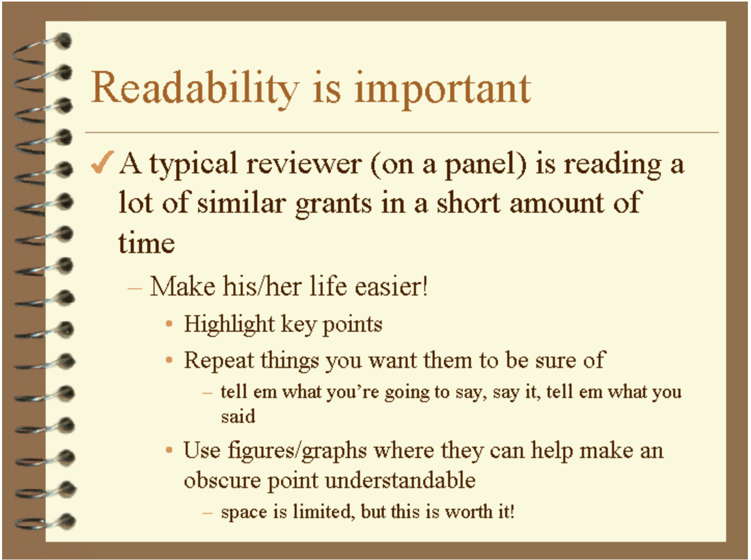
Rule 7: Writing counts!!!!!!!!!
Members of your committee are busy professors – your thesis proposal/thesis is a “book” – how much time do they have to read carefully?
(your advisor will (probably) read it carefully!)

Slide 22
7a: Please learn how to write well
"I can't define good writing, but I know it when I see it." - Justice Potter Stewart
"The Elements of Style" - classic and cheap book
Learn appropriate grammar, punctuation rules, etc.
Get to the point, avoid unnecessary text
Be as clear as possible when getting to the point, dense writing does not make you appear smarter
Vary sentence structure, length, wording – this has a large impact on making your writing 'interesting'

Slide 23
7b: Make it pretty
Despite claims or ideals otherwise, superficiality is pervasive throughout research and the sciences.
Generally: A ‘good’ proposal needs to also ‘look good’.
You will be implicitly evaluated on how your writing looks, not just its content. ‘Emotional impact’ matters.
DO: Spend the time on formatting, nice figures, good paragraph structure, etc. This goes a long way. Not every reviewer will read every word, but they will look at every page. Give them something nice to look at.
DO NOT: Submit huge blocks of nonstop text. This is fatiguing and boring for the reviewers to read.
  (I understand the irony inherent in these slides)

Slide 24
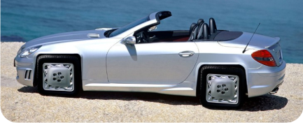
But wait, there’s more
There are other criteria
Novelty is necessary but not sufficient
Difficulty is necessary but not sufficient
Utility is necessary but not sufficient

Slide 25
Reviewing the rules
Rule 1: Tell a coherent story
Rule 2: Remember the three boxes (including what is beyond the current work) and esp. how it will be evaluated
Rule 3: A time frame/work plan/schedule is crucial
  3a: Evaluation needs to fit claim
Rule 4: Know your audience
Rule 5: Follow the rules of the proposal (and these rules too)
Rule 6: You must convince people it is important
Rule 7: Writing Counts!

Slide 26
But wait, there’s even more!
Read as many successful proposals as you can.
  You can ask people/your advisor/etc. for their proposals.
  Don’t be afraid to ask for help or for someone to read what you have. Don’t be offended if they say no.
Your goal is to evoke a positive emotion in the reviewer.
  Write well, have pretty pictures, format things nicely, and actually have a coherent research plan.
  Assume the reviewer will skim. Put important stuff first, use bolding and clever formatting to highlight the main ideas.
  Reviewers get offended if you don’t include their papers in your references. Good luck with that.
Be prepared for failure.
  You WILL fail more than you succeed. Try not to take it personally and learn from these failures.
  Expect some degree of randomness from your reviewers.
  However: Some reviewers are, in fact, idiots. That’s life.
Notes:
z

Slide 27
One final word: Networking
A lot of funding opportunities will exist that don’t require you to be a sole PI. (arguably most)
  E.g., all of my DOE+Sandia+IBM funding.
Networking is the primary means you’ll have to access these opportunities.
  Talk to people at conferences. Ask questions.
  Do good and interesting work. Be someone worth knowing.
  Make genuine friends with your colleagues (if possible).
Side benefit: most research job applications require recommendation letters. Promotions can require a dozen or more. The people you ask to write these need to know you and your accomplishments well.
Sider benefitter: Many worthwhile non-research positions are only obtainable through networking connections.

Slide 28

rpi
~slotag

