Slide 1
The Graduate Student Experience
Colleen Smith (she/her), Dean of Graduate Student Experience
Student Success | Student Life

Slide 2
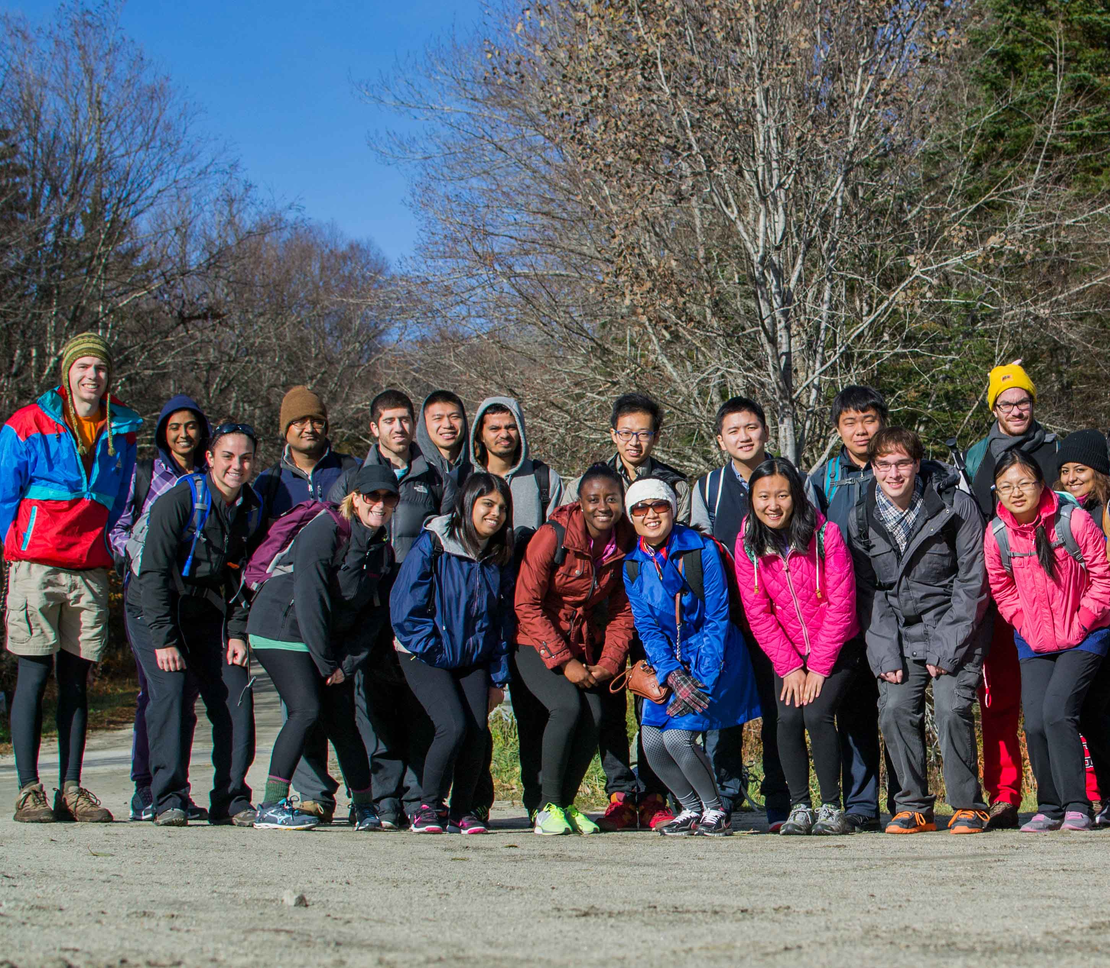
WELCOME TO RENSSELAER!
  About Graduate Experience
  The Iceberg Illusion
  Navigating Graduate School
    Professional Development
    Personal Development

Slide 3
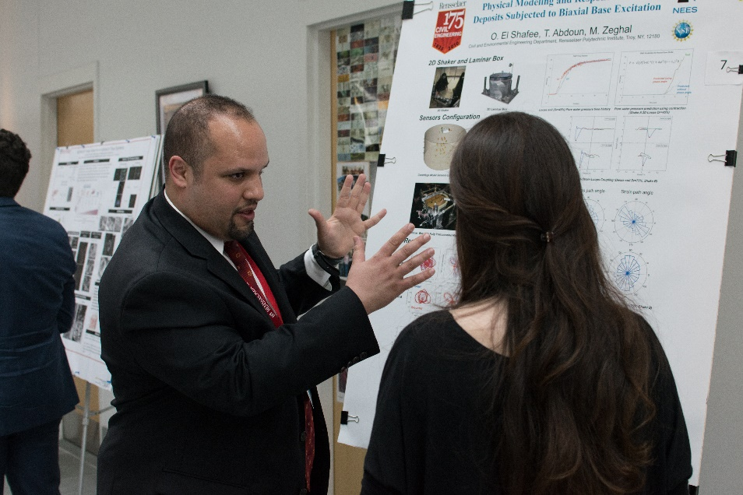
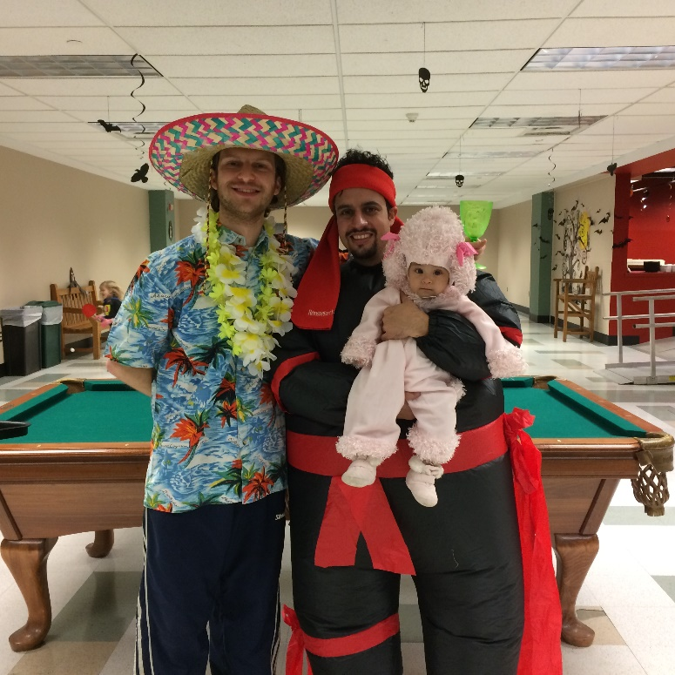
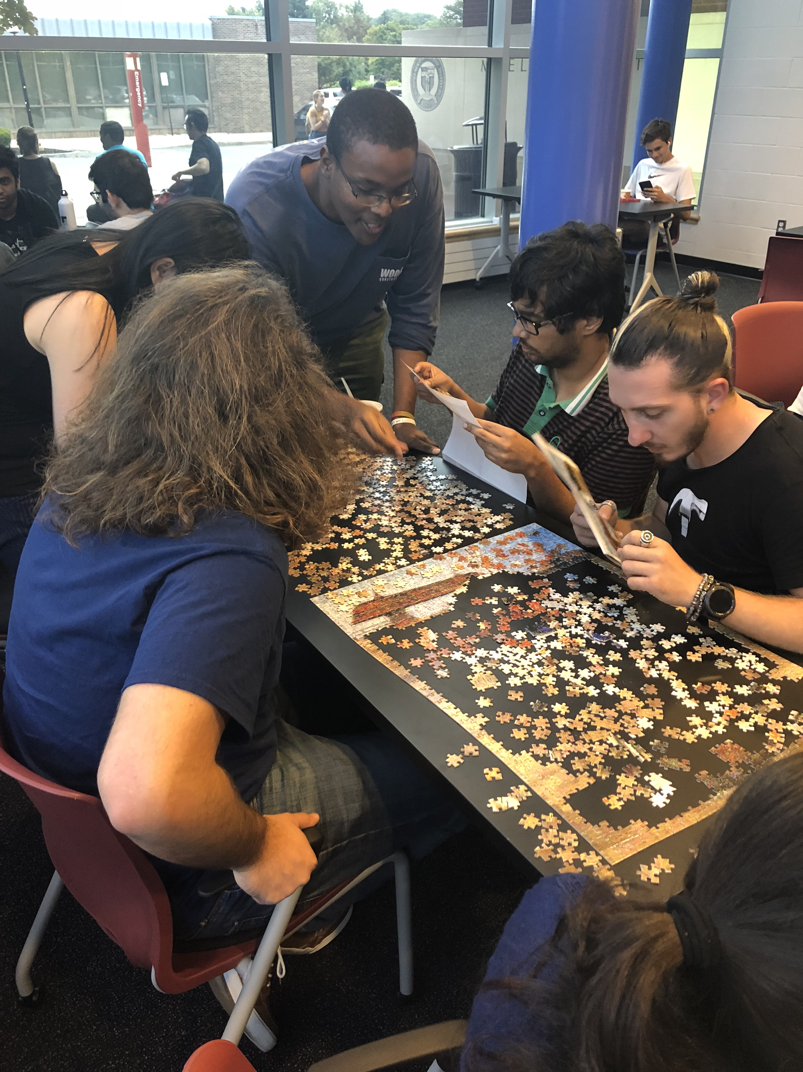
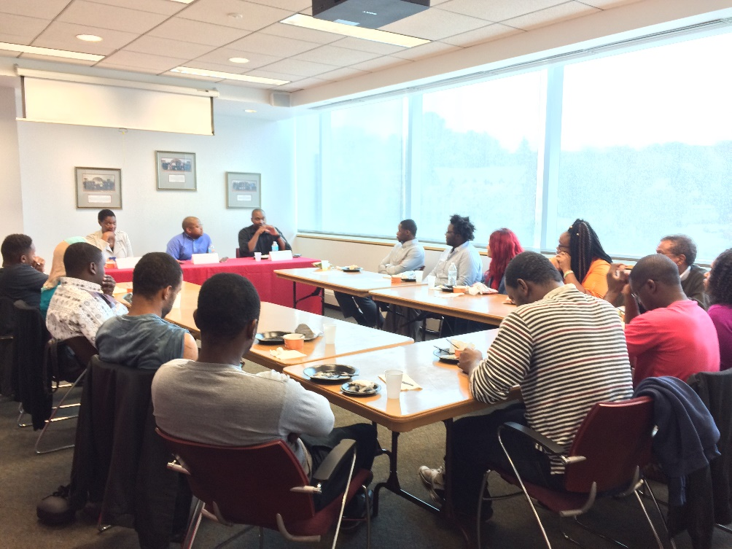
GRADUATE EXPERIENCE
The Graduate Experience Office, in collaboration with campus partners, promotes academic, personal, and professional development programs and initiatives that provide opportunities for graduate student involvement and engagement with other students, staff, and faculty.
Notes:
Advocate for graduate student concerns and issues with campus community
Partner with graduate student groups and other departments to provide programming and engagement activities
Serve as a liaison between Student Life, Office of Graduate Education, and Graduate Programs to provide support for graduate students
Meet with graduate students in need of intervention and referral support

Slide 4
WHY MEET WITH GRAD EXPERIENCE DEAN?
Some examples of why graduate students have met with dean of graduate experience:
Ph.D. to master’s transition
Advisor issues/concerns
Advisor selection/finding new advisor
Conflict with faculty or peers
Sense of belonging/imposter syndrome
Mental health concerns
Unclear policies
Uncertainty about future
Concern about fellow grad student
Below 3.0 GPA
Academic concerns/EWS academic notifications
Financial concerns
Grad student organization support
Program planning – professional and personal development
Navigating RPI

Slide 5
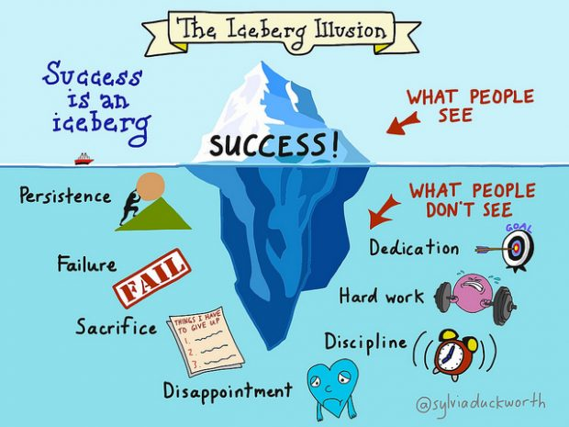
WHAT PEOPLE THINK
GRAD SCHOOL IS LIKE
WHAT GRAD SCHOOL
IS REALLY LIKE

Slide 6
Four takeaways for navigating grad school:
1. Be proactive.
2. Take care of yourself.
3. Build a support group.
4. Ask for help.

Slide 7
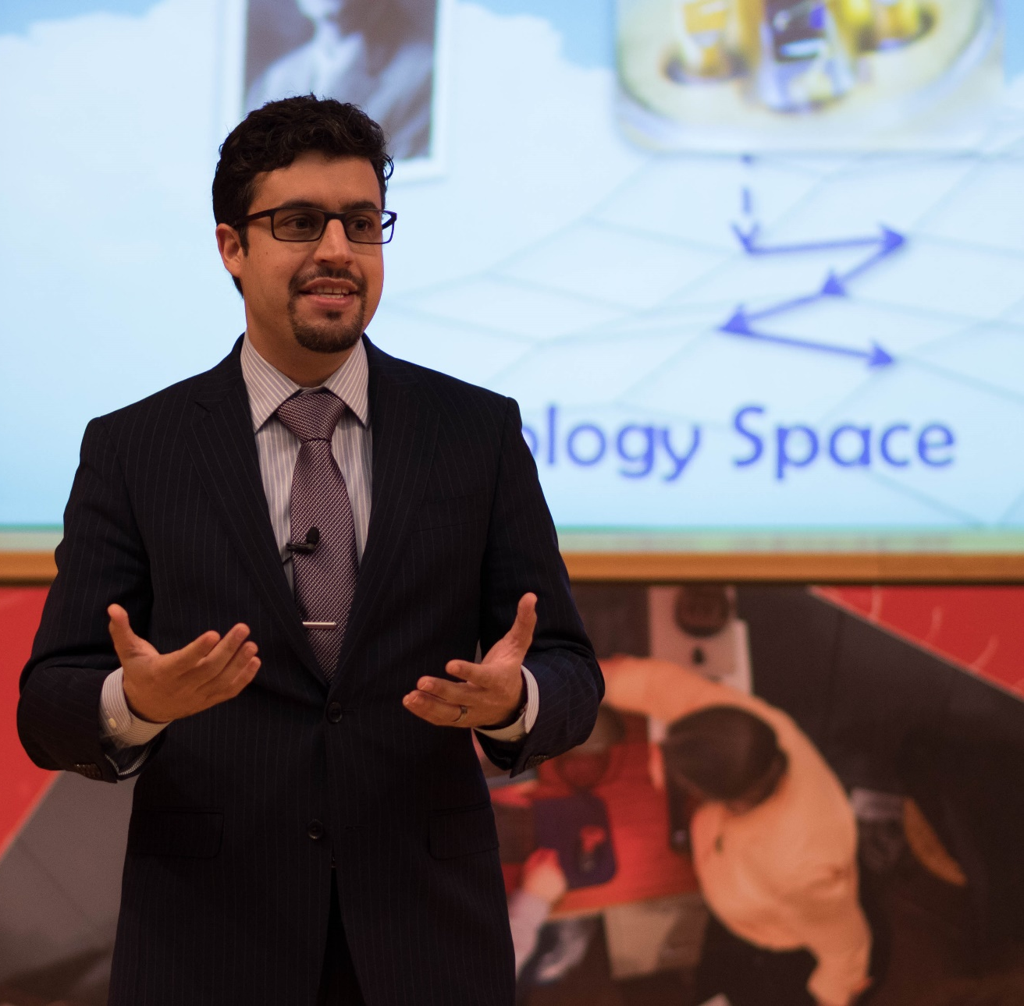
BE PROACTIVE
Take initiative – what do you want out of graduate school? Why are you here?
Read catalog, student handbook, grad supplement, grad program handbook
Know your program requirements and timelines, track your progress
Attend Career Center programs and workshops, create Handshake profile
Go to events, join organization(s)
Professional development opportunities
Notes:
Take initiative – what do you want out of graduate school? Why are you here?
Know your program requirements and timelines
Track your progress
Professional development opportunities
Professional Leadership Series
Graduate Research Symposium – May
Expand your network
Career Center Resources Create Handshake profile

Slide 8
PROFESSIONAL DEVELOPMENT OPPORTUNITIES
  More information here.
  Professional Leadership Series
  Lunch and Learn Series
  Teaching and Learning Collaboratory
  Severino Center for Technological Entrepreneurship
  Graduate Research Symposium and Three Minute Thesis
  Center for Global Communication + Design
  Center for Career and Professional Development (CCPD)
  Beyond Platforms – career development for master’s and PhD students

Slide 9
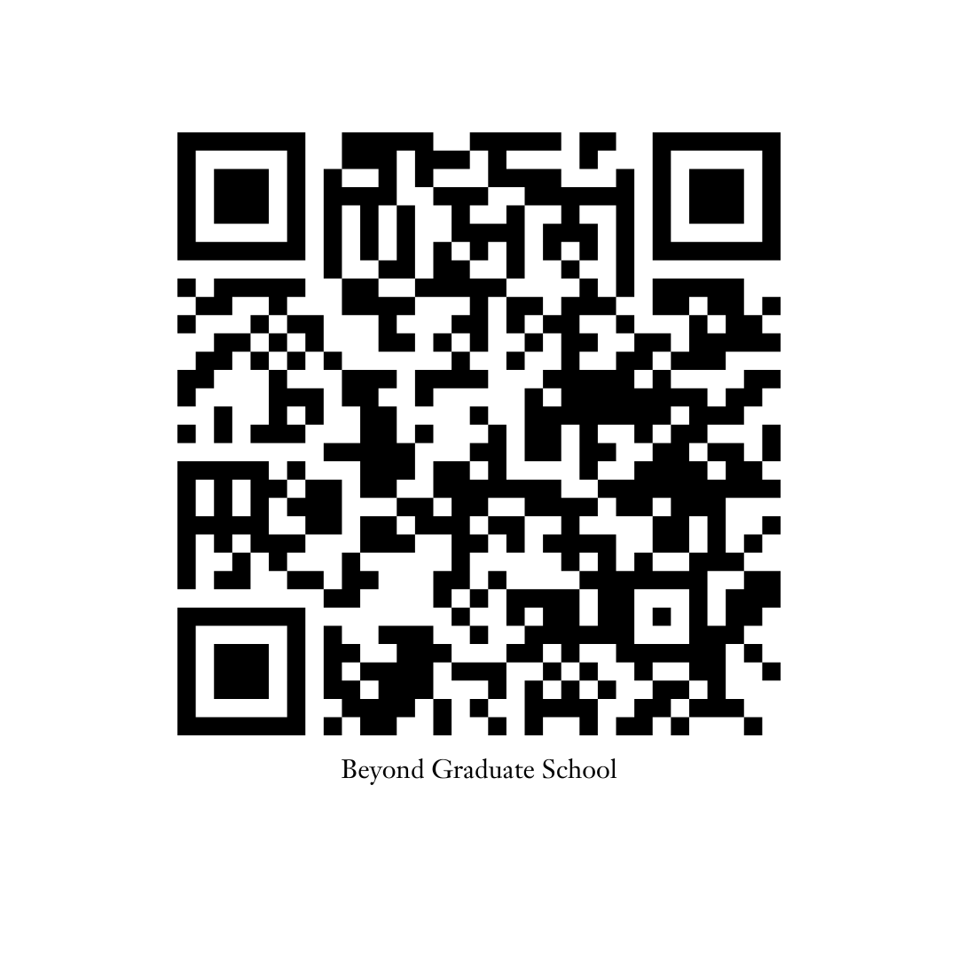
BEYOND CAREER PLATFORMS – IT’S NEVER TOO EARLY
Beyond Graduate School
Self-paced courses with videos and workbooks
Live monthly webinars and annual conferences to help you stay up-to-date on industry trends
A unique video library featuring master’s degree holders who now work in exciting career pathways.
Bookmark: https://institutions.beyondgradschool.com/ for easy access!

Slide 10

BEYOND CAREER PLATFORMS – IT’S NEVER TOO EARLY
Beyond the Professoriate
A massive video library featuring PhDs who work in exciting career pathways
Self-paced courses with videos and workbooks about career exploration and job application materials
Regular virtual workshops and conferences
Bookmark: https://institutions.beyondprof.com/ for easy access!

Slide 11

TAKE CARE OF YOURSELF
Sleep, eat, exercise, breath
Find organization method(s) or technique(s) that work for you, then stick to them
Take breaks, do something you enjoy
Carve out time for family and friends – isolation in graduate school is real
Explore the area (Troy, the Capital Region, and the Hudson Valley)
Make mental health a priority
Notes:
Check in with yourself and others

Slide 12

MENTAL HEALTH RESOURCES
Health and Counseling Center
BHS (Username: Rensselaer)
Campus Recreation, Fitness, and Wellness
RPI Food Pantry
Student Success Labs (self-paced)
Mental Health Posters
Notes:
To supplement our services, Rensselaer has partnered with BHS to offer additional urgent, and crisis care services to students, 24/7. As an extension of the RPI Counseling Center, continuity of care is confidential and seamless between RPI counselors and BHS.
Call (518) 276-8888 to speak with a licensed clinical professional from the BHS program 24 hours a day, 365 days a year. Students can also access BHS resources and live chat features online at: https://portal.bhsonline.com (Username: Rensselaer)

Slide 13
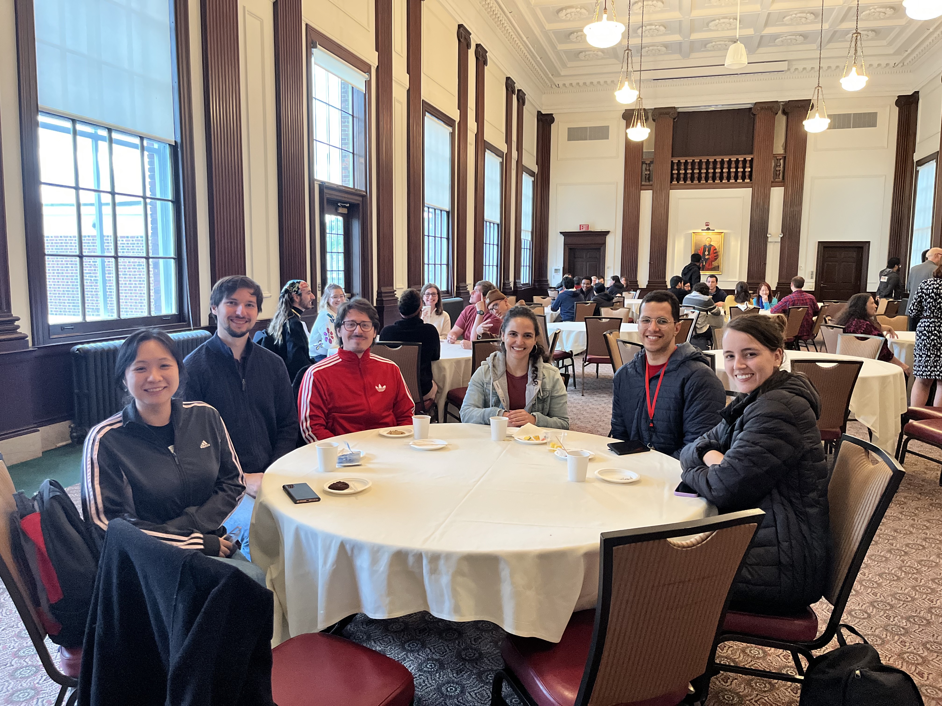
BUILD A SUPPORT GROUP
Communicate, communicate, communicate
Know who is in your corner
Familiarize yourself with graduate program staff and faculty
Don’t compare yourself. Avoid conflict, competition, and jealousy with peers and others
Collaborate with your peers, support your peers, celebrate their accomplishments
Learn from others

Slide 14
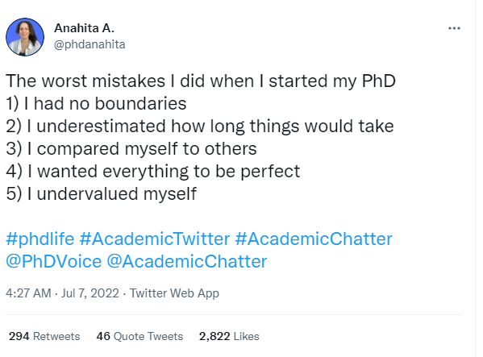
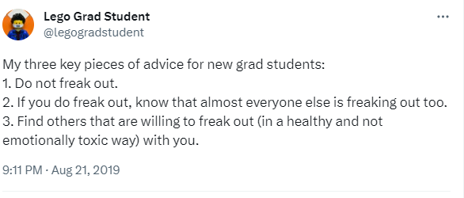
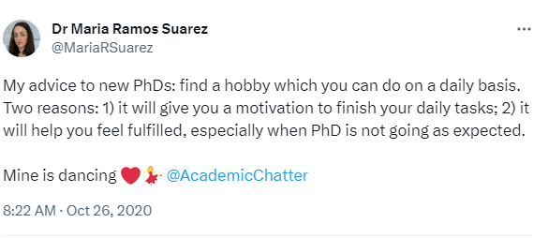
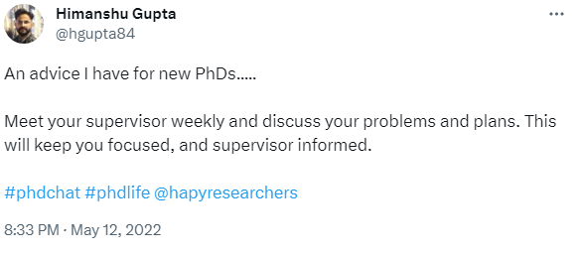
ADVICE TO NEW GRADUATE STUDENTS

Slide 15
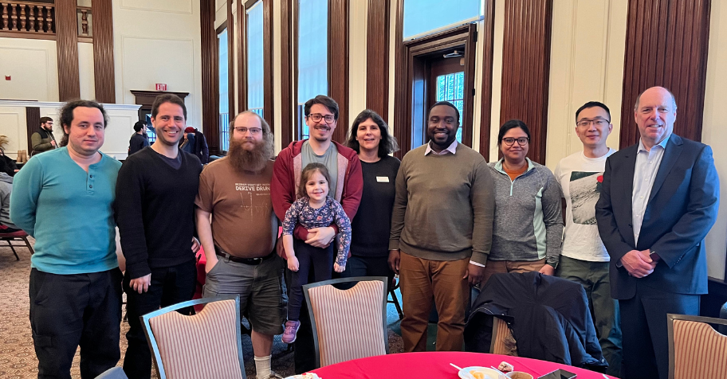
ASK FOR HELP (AND ASK QUESTIONS)
  Hidden Curriculum in Grad School
  Be your own advocate
  You are not the only one who does not know the answer
  Academic jargon, department and disciplinary norms, Rensselaer acronyms
  Milestones, paperwork and processes
  Obstacles and uncertainty

Slide 16
CAMPUS RESOURCES
Graduate Program Faculty & Staff Grad Program Director Grad Program Administrator Office of Graduate Education Graduate Experience Office Health & Counseling ISSS – International Services CCPD – Career Center Off-Campus Commons Dean of Students Bursar Payroll Financial Aid | Graduate Student Council Student Organizations Public Safety Building/department councils/organizations Archer Center for Student Alumni Engagement Parking and Transportation Champlin’s Office Help Desk Union, Campus Rec, and Student Activities Severino Center Comm + D - “Writing” Center

Slide 17
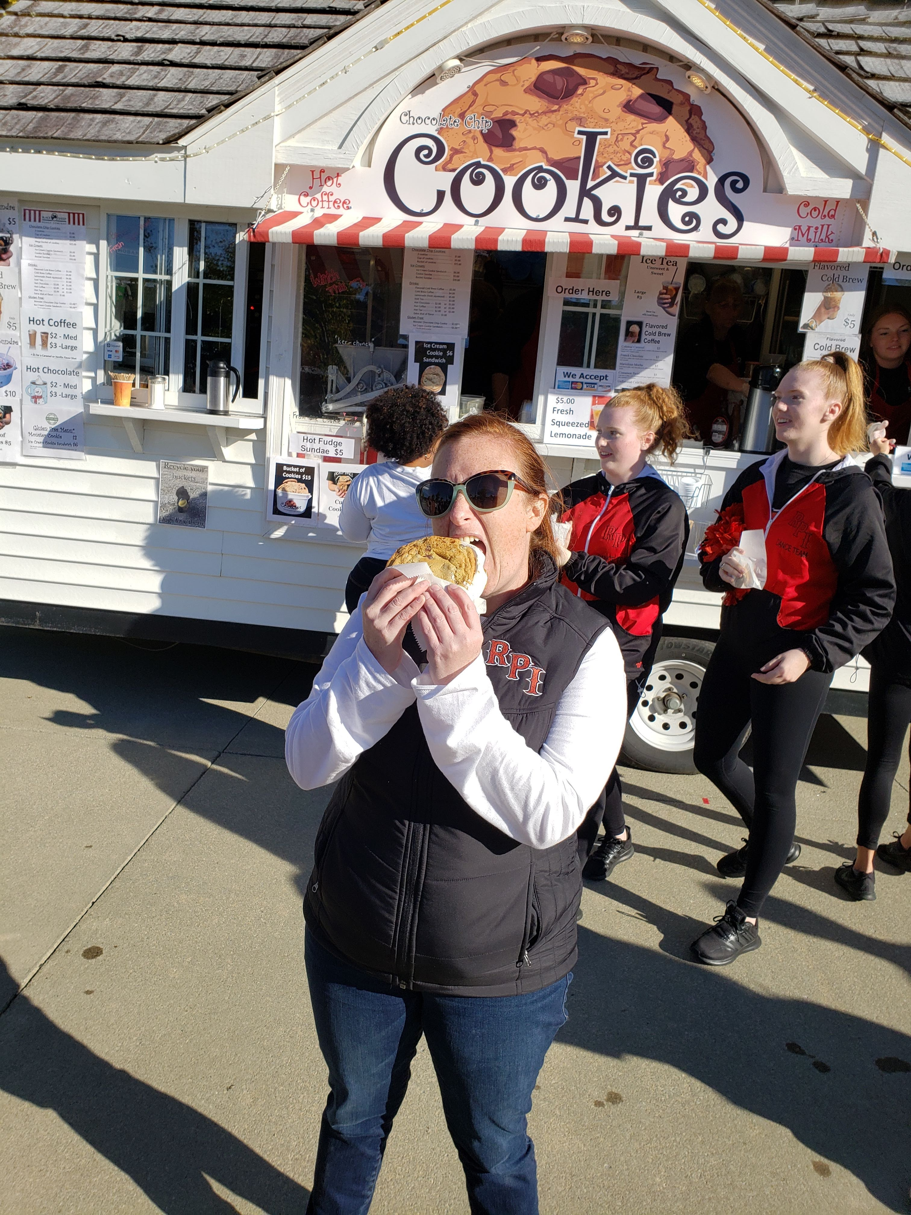
DEAN OF GRAD EXPERIENCE CONTACT INFO
Colleen Smith
4600 Academy Hall
518-276-8802
smithc15@rpi.edu
Webex: smithc15
https://linktr.ee/RPIGradLife
Read the RPI Grad Experience Newsletter ☺

