Slide 1
Introduction to External Funding Support
Office of Graduate Education Elizabeth “Betty” Madigan madige@rpi.edu

Slide 2




Objectives:
Understanding how they work & benefits
Application Process/ Drafting Statements
Resources
Finding Programs/Eligibility

Slide 3

























Understanding Funding – Overview
Universities (internal)
EXTERNAL
Industry
Out of Pocket
Government
Foundations
International

Slide 4
Funding Terms
Time:
One Year
Multiple Years
Service Requirement:
NONE
Summer
Year/year
Stage of Career:
Early
Research
Writing
Benefits:
Stipend
Tuition

Slide 5


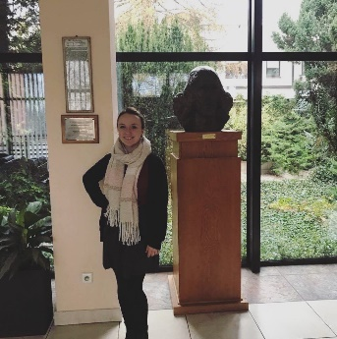



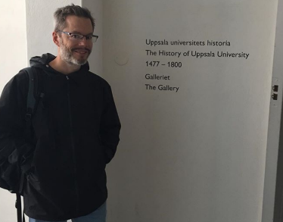


Funding Terms - LOCATION

Slide 6

Common to all Fellowships
Deadlines are 6 months to a year before funding begins

Slide 7

NSF GRFP
Eligibility
National Science Foundation Graduate Research Program
(NSF GRFP)
Disciplines: Science and engineering fields supported by NSF (see website)
Award: 3 years of support during a 5-year fellowship period, with a $37,000 annual stipend, opportunities for internships (GRIP), research abroad (GROW), and supercomputer access (XSEDE)
Citizenship: US Citizen, US National, or Permanent Resident
Academic Profile: Graduating senior entering a graduate program or current graduate student in either the first or second year. You may apply once in undergrad and once in grad school.
Due October to November. (Deadline depends on discipline; see website.)

Slide 8


Science, Mathematics, & Research for Transformation Awards
https://www.smartscholarship.org/smart
Disciplines: 21 STEM disciplines
Award: $30,000 - $46,000 stipend; tuition; health and book allowance, paid summer internships at DoD labs, employment placement after graduation (one year of employment required for every year of funding)
Citizenship: US Citizen, Australia, Canada, New Zealand, or United Kingdom
Academic Profile: undergraduate or graduate student able to participate in summer internships at Department of Defense (DoD) laboratories and willing to accept post-graduate employment with the DoD as a civilian research scientist
Due December
National Defense Science & Engineering Graduate Fellowships
http://ndseg.sysplus.com/
Disciplines: fifteen disciplines in engineering and science (such as cognitive, computer, mathematical, or life sciences)
Award: $40,800 stipend; tuition and fees; up to $1,400 annually for health insurance; 3 year fellowship; opportunities for summer internships at DoD labs or test centers
Citizenship: US Citizen or US National
Academic Profile: graduating senior entering a PhD program or in the first year of PhD program
Due November

Slide 9



International Students
Amelia Earhart Fellowship
www.zonta.org/global-impact/education/amelia-earhart-fellowship
Disciplines: Aerospace
Award: $10,000: This is a scholarship – TA or RA position may still be necessary to cover tuition.
Citizenship: U.S. Citizen, international student
Academic Profile: PhD student, woman, must have at least one year of graduate school complete
Due November
Link Modeling, Simulation and Training Dissertation Fellowships
www.linksim.org
Disciplines: Modeling, Simulation and Training
Award: $35,000 stipend; 1 year renewable
Citizenship: US Citizen, international student
Academic Profile: PhD Student: dissertation year(s)
Due January
Schlumberger Foundation Faculty for the Future
www.facultyforthefuture.net
Disciplines: STEM
Award: $50,000, renewable through completion of studies
Citizenship: international women from developing nations only that intend to return to home country
Academic Profile: PhD student or PhD
Due November
IBM PhD Fellowship Program
https://www.research.ibm.com/university/awards/fellowships.html
Disciplines: AI/ cognitive computing, cloud/open source, data science, Internet of Things, quantum computing, security/cyber security
Award: $40,000, IBM mentorship
Citizenship: US Citizen, international student (except from embargoed countries)
Academic Profile: graduate student working on dissertation; faculty must submit proposal on behalf of student, OGE must be contacted
Due August nomination

Slide 10






Information sessions and workshops
Information Session:
Information Session:
Spring Summer
Information Session:
Nov 6, Noon
Shelnutt Gallery, Rens. Union
Writers Retreat:
Summer

Slide 11
Application Components
APPLICATION COMPONENTS
Register
Transcripts
Curriculum Vitae
Letters of Recommendation (3)
Research Statement or Essay Prompts
Personal Statement

Slide 12
Resources for finding programs:
https://graduate.rpi.edu/funding-and-fellowships/nationally-competitive-fellowships
Lists of programs
Links to filterable fellowship databases
Ask your academic advisor
Schedule a consultation with Betty (madige@rpi.edu)

Slide 13

Content Decisions
You will make many decisions
while writing your statements:
Is there a main theme to my statements – other than “give me money?”
How much detail or background do you include?
Should I use creative writing techniques?
Do I use the same statement for multiple programs?
How technical should my terms/acronyms be?
Who should I write about? People that inspired me? My advisor? Others?

Slide 14


Write Compelling Research Statements
The hour glass approach:
Start out with broad ideas, narrow into specific ideas/procedures, move back out to broad application.
Global or universal idea
Knowledge Gap **
Hypothesis
Method
Expected Results
Local/immediate Impact
Broader/Global Applicability

Slide 15
Personal Statement: Why am I the PERSON to complete this mission?
List across the top the characteristics sought by the specific program you are applying to. Recall stories of how you demonstrated those attributes in different settings. “Show don’t tell.”
 | skills | Interpret/ present | lead | overcome persevere | collaborate | serve
Home
School
Work
Other

Slide 16
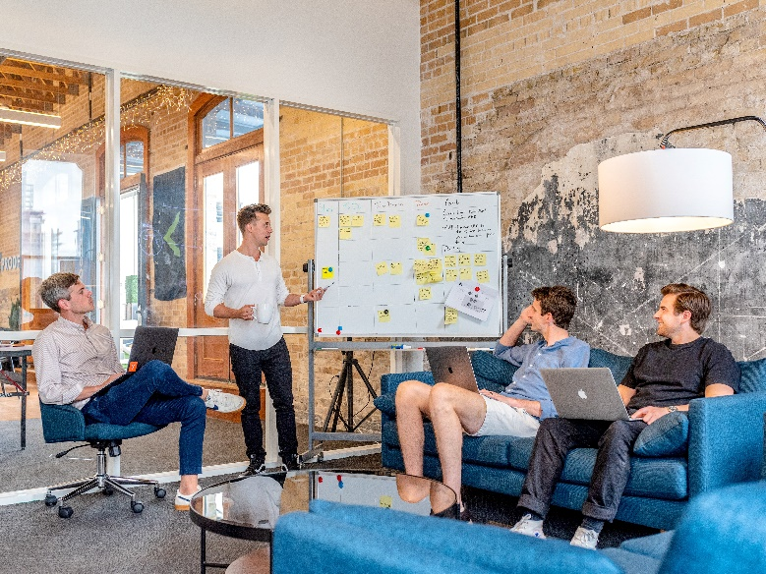

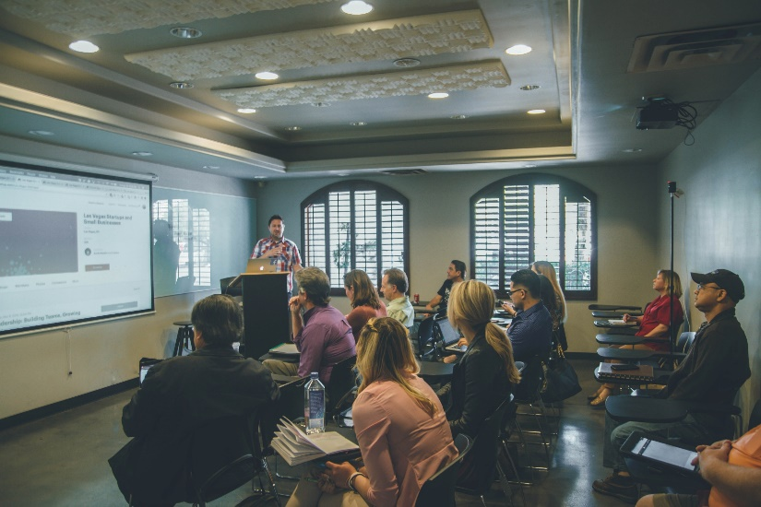



Write Compelling Personal Statements
Use strong verbs in your documents.
learned
Lead
Collaborate
Coordinate
studied
Analyze
Categorize
Compare
Apply
Transform
Create
researched

Slide 17



Editing Tips and Tricks
Consider the application reviewer’s perspective:
They are likely reviewing 20-30 applications.
Re-reading = 40 - 60 papers!

Slide 18
Editing Tips and Tricks
Be the subject! Be intentional. USE ACTIVE VOICE.
Avoid presenting yourself as receiver:
“my program taught me”
“this experience made me”
“The award was given to me”
“Dr. Shah accepted/inspired me”
Present yourself as intentional actor:
“I capitalized on this experience”
“I applied these concepts in”
“I accepted the award”
“I aspire to emulate the work ethic, technical skills, etc (be specific) exemplified by Dr. Shah.”
SUBJECT > VERB > OBJECT

Slide 19

Editing Tips and Tricks
Adverbs
EVERY WORD MATTERS
Adjectives
Every word is worth a lot of money!
BE CONCISE.
Avoid using these and similar phrases that clutter your statements.
Prepositions
“such as”
“specifically”
“for example”
“thus”
“however”

Slide 20
Say what something IS.
Original
This was illustrated by the finding that although the system did, eventually,
have the desired effect of making energy consumption more salient in the work of the officers, consequentially improving practice, it was evident that the effect was contingent on the system being enacted as a relational mediator, allowing collective sense making of the information it generated***
Edit
Officers became invested in and implemented the energy consumption system when it was introduced as a tool for collaborative sensemaking of the information it generated.
Avoid words like ‘illustrated,” “evidenced.” “showed.” Just state the finding.

Slide 21
Say what something IS.
Original
Most studies taking a practice approach to technology base their theoretical framework on the work of Wanda Orlikowski (2000). From the perspective developed by Orlikowski (2000) social and organization structures (e.g., rules and resources guiding the management of energy) are not embodied in technology, neither are they determined by managerial imperatives or policies, but emerge from being enacted in practice by the people performing their work in everyday situations(Brown and Duguid 1991; Orr 1996).***
Edit
Individual workers responding in everyday situations more readily adopt management of energy practices than when promoted by managerial imperatives/policies or the technological innovation itself. (Brown….).
Do not use valuable words in YOUR statement describing other researchers or advisors’ processes. Simply state their finding and cite it.
Reduced the word count from 75 to 26.

Slide 22
Say what something is POSITIVELY.
Original
The moderator considered it important not to give the impression of blaming colleagues but to create a positive feeling surrounding the possibility for improvement by demonstrating the potential in their own work.***
Edit
The moderator engaged participants by focusing them on the potential for positive change in their own work.
Paint a picture of what you want them to see in their mind. Do not paint an image and then tell them to erase it. Don’t waste words on something that isn’t.
Hint: remove words and prefixes like:
“not” “didn’t” “un-” “non-”
This significantly reduces word count.

Slide 23
Combine sentences that use the same word into one sentence or select an alternate word. Avoid using the same word more than once in a sentence or paragraph.
Original
Data collection was based on semi-structured interviews with 12 bridge officers working on 6 different ships, supplemented by observation of work carried out by the officers (maneuvering, navigation, maintenance). The interviews and observations took place between February and April 2018.***
Edit
Semi-structured interviews with 12 bridge officers from 6 different ships, supplemented by observation of various tasks (maneuvering, navigation, maintenance), were carried out between February and April 2018.
Combine if a sentence is a description of or modifying something in another sentence.
Reduced the word count from 41 to 28.

Slide 24
Avoid using “and” 3 or more times in a sentence.
Original
Ships have numerous energy consumers (for propulsion, accommodation, cargo handling), they operate under highly variable conditions (weather, sea, routes, maintenance and loading) and they differ fundamentally in terms of design (size, speed, complexity and type of cargoes carried).***
Above is an excellent example of using lists for groups and sequences of activities.

Slide 25
PRACTICE EXERCISE 1
Original
One reason making the dearth of information a particularly challenging problem is the complexity of ship energy consumption.***
Suggested Edit
The complexity of ship energy consumption presents a challenge to collecting data.
Reduced words, increased clarity.

Slide 26
PRACTICE EXERCISE 2
Original
Numerous factors thus influence the fuel consumption of a ship, which often varies significantly during and between voyages. This complexity, including the lack of knowledge on the ship and route specificity of energy consumption, makes it particularly difficult for crews to learn and develop optimal work practices***
Suggested Edit
Ship consumption of fuel varies significantly during and between voyages. The complex and numerous variables affecting routes hinder crews from developing and learning optimal practices.
Reduced words, increased clarity.

Slide 27
PRACTICE EXERCISE 3
Original Abstract
Too many words
Too many words
The paper offers an analysis of how an energy-monitoring system was implemented and eventually adopted by the crew members in a shipping company. It illustrates how the social process of enacting the system as a collaborative technology- in-practice, enabling a significant reduction in energy consumption, was contingent on the negotiation of meaning and mutual learning among crew members in their community of practice . The case study contributes to the literature on the relation between information technology, organization and energy efficiency by investigating the socially situated nature of technology implementation and work practice change. The findings’ implications for the role of information technology in improving energy efficiency in shipping are discussed.***
redundant
What other community would they being do this in?
Too many words

Slide 28
PRACTICE EXERCISE 3
Potential Abstract
This analysis of strategies for implementing an energy-monitoring system compares policy or management driven practice to introduction by collaborative technology-in-practice. A shipping company achieves significant reduction of energy usage when crew members are able to negotiate the meaning of and engage in mutual learning associated with the new technology in their work environment. Implications for the relationship between information technology, organization, and energy efficiency are discussed.

Slide 29
Key Writing Guidelines
Make explicit connections between the funder’s goals, your abilities, and your project.
Create a unique statement for each funding program. Address reviewers according to their level of knowledge in your field. (jargons, acronyms)
Print these two pages for writing & editing checklist
Personal Statement: Illustrate you are the PERSON to accomplish a funder’s mission
Personal statement and C.V. should contain different information
Avoid:
Thanking your advisor
negative statements about a school or business
“feelings” or journal type statements “PASSION”

Slide 30
Key Editing Concepts
Read it out loud.
State others results and cite. Reduce clutter: “it can be demonstrated” “showed” “illustrated” “thus” “specifically” (Faculty names clutter your application!)
VERBS:
Use strong action verbs: avoid “worked” “researched” “studied”
Use less than 3 verbs (or ands) per sentence unless in list form
Use subject > verb > object format “Who did What”
Verb should be close to the subject performing the action
Avoid repeating words and phrases
State what it is: remove “not” “un” “non” “didn’t”
Check for singular plural agreement (He runs, they run)

Slide 31
Final Comments:
Do NOT edit while writing your first draft: get the ideas down THEN edit and refine later
Create Multiple Drafts: it is common for successful fellows to have 10+ versions of their statements
Ask people inside and outside of your discipline for feedback: You may also email your statements to madige@rpi.edu at least a week before the deadline
After you submit: CELEBRATE! You have worked hard to get to this point and developed skills along the way.

Slide 32

Questions

