Slide 1
Universal Intelligence
Mohammad Mohammadi Amiri
DEPARTMENT OF COMPUTER SCIENCE

Slide 2
Research Profile
Converging diverse perspectives into a unified and accessible intelligence
Large Language Models (LLMs)
Data Valuation
Federated Learning

Slide 3
LLMs
Efficiency
Data-Centric
Influence
Function
Data
Selection
Fine Tuning
Inference
Model Compression
Model Merging
KV-Caching

Slide 4
LLMs (Efficiency – Fine Tuning)
Data
Pretrained model
Adapted model
Task

Slide 5
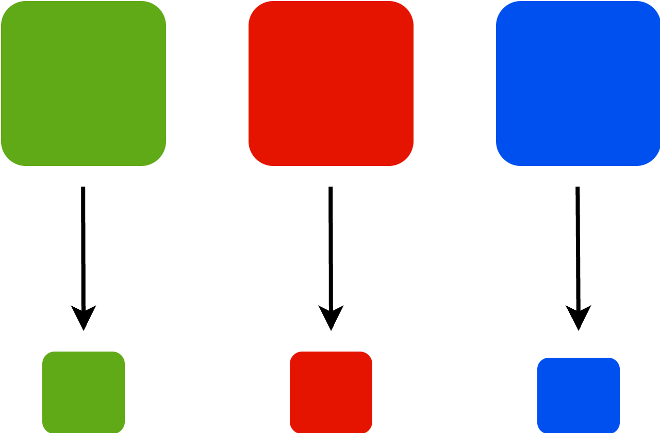
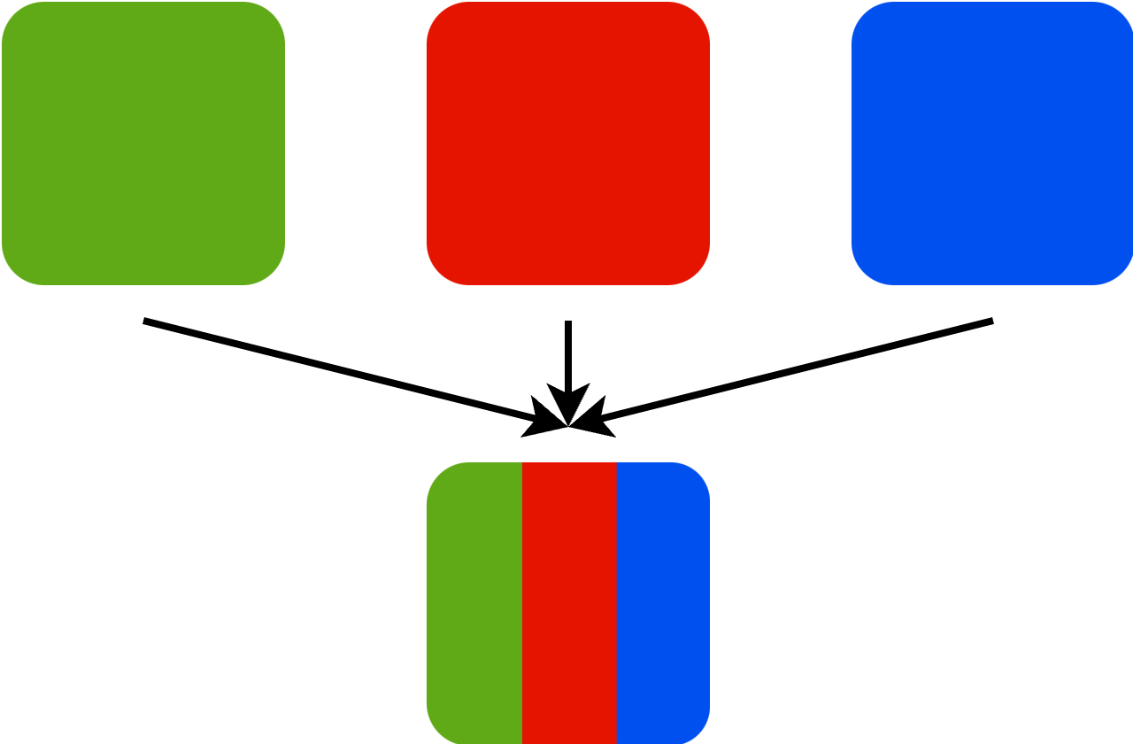
LLMs (Efficiency – Inference)
Model Compression
Model Merging

Slide 6
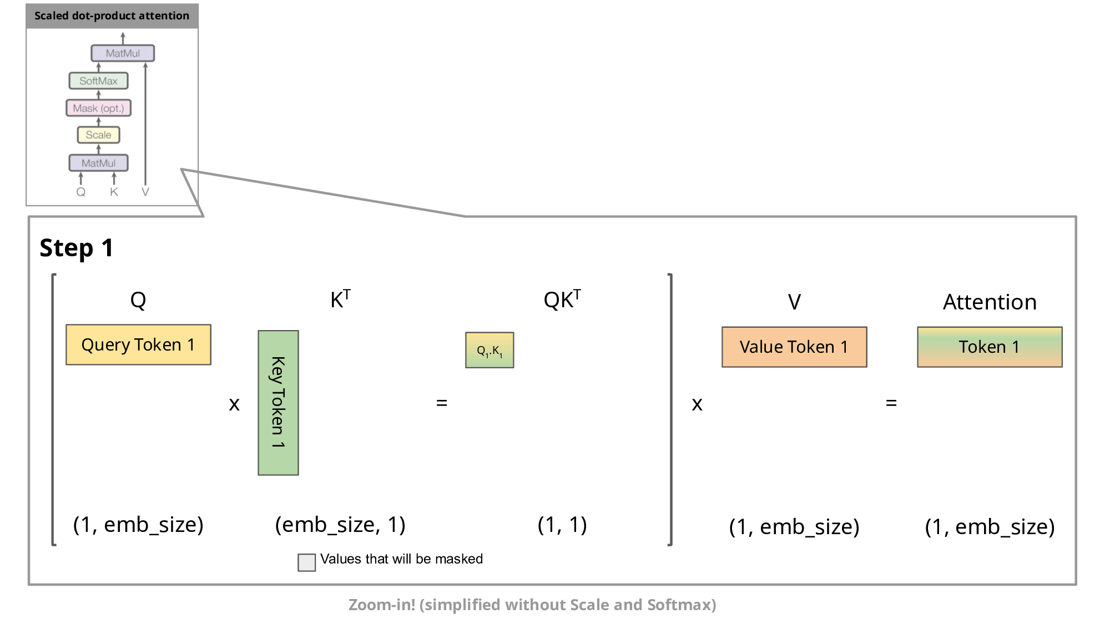
LLMs (Efficiency – Inference)
KV-Caching

Slide 7
LLMs (Data-Centric)
Influence function: Quantifying data impact on model predictions
Data selection: Prioritizing data subsets for efficient LLM training

Slide 8
Data Valuation
Pharma
Company
Hospital
$

Slide 9
Data Valuation
Estimating relevant and diverse statistics

Slide 10
Federated Learning
Malignant ( ) vs. Benign ( )
Server
Hospital
Hospital
Hospital

Slide 11

Connect
Notes:
A fancy well-known approach

